Slide 1
Title
Author

Slide 2
What is this?
  Simulation of mobile, autonomous robots
  and how they can coordinate
  even if they can’t communicate
  and don’t remember anything.
Why is this interesting?
  Theory of computation: can we do it?
  Mobile geometry
  Practical considerations: do more with less
  It’s fun!

Slide 3
Contents
The mobile robots problem
Previous work
Motivation
The Camfora simulator
Discussion

Slide 4
Autonomous humans
Think of a person, trying to go somewhere, they have to do these things:
  See/hear/touch surroundings
  Understand what they’re seeing/hearing
  Think and decide what to do
  Act on the decision

Slide 5
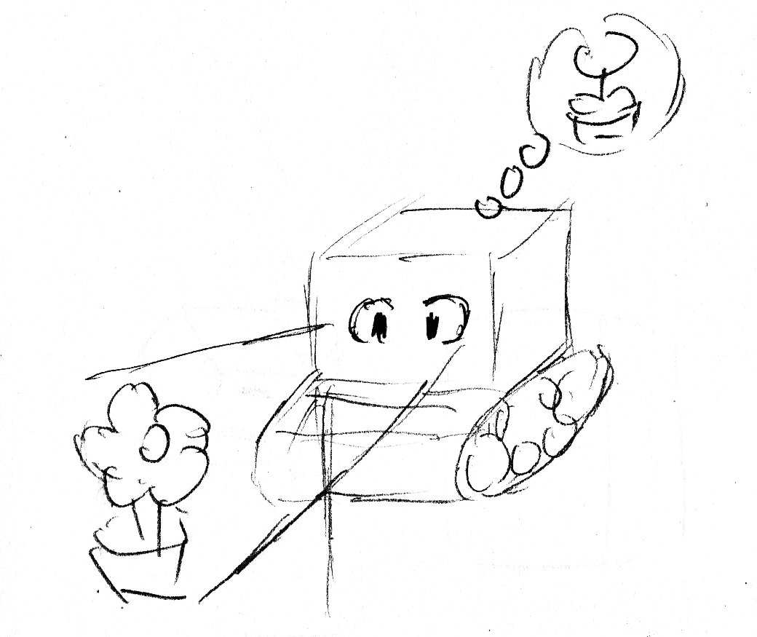
Autonomous robot
An autonomous robot also has to be able to do these things:
  Sensing: like camera, lidar, compass, gyro, GPS…
  Recognition: understand it’s a car, it’s a person
  Computation
  Output: adjust power, steering, signals

Slide 6
Mobile robot model
In our theoretical model, it’s simplified:
  LOOK: get information from surroundings
  (understanding is assumed to be perfect)
  COMPUTE: decide a goal to move to
  MOVE to the decided point

Slide 7
Mobile robot model
In this model they run in stages
Additionally,
  Robots are sizeless
  And oblivious (have no memory)
COMPUTE
LOOK
MOVE

Slide 8
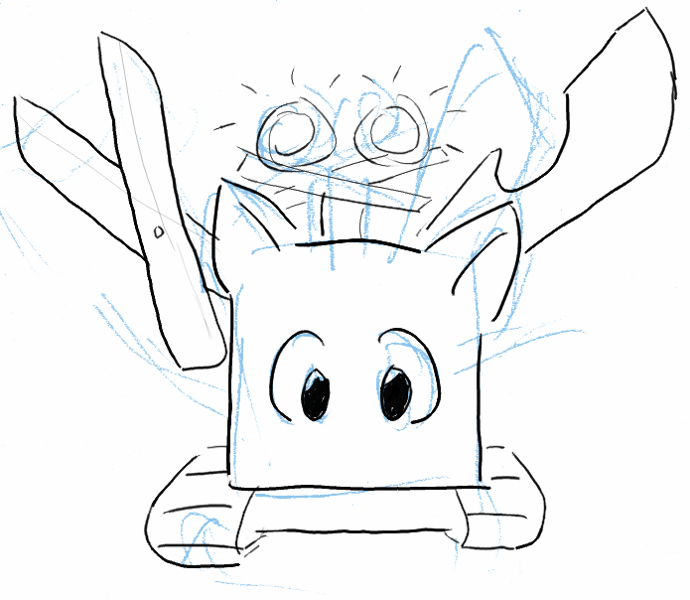
Variations - capabilities
Different conditions the robots are under
Including how much resources they have
  Coordinate systems: (dis)agreement on distance, orientation
  Vision: range, obstruction, multiplicity detection
  Memory: oblivious, constant, limited, unlimited
  Movement: rigid, minimal/maximal distance
  Communications: lights / no lights
  Power: unlimited/limited
  and so on...

Slide 9
Variations – disturbances
Faults
Add/remove
Self-stablization

Slide 10
Variations – time
Robots also run on a schedule
Usually thought as controlled by a central “scheduler”
(something about wi-fi High Performance Browser Networking Ilya Grigorik )

Slide 11
Contents
The mobile robots problem
Previous work
Motivation
The Camfora simulator
Discussion

Slide 12
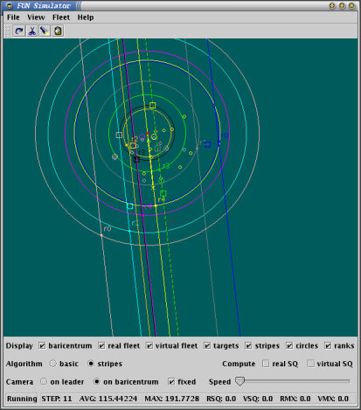
CORDA simulator

Slide 13
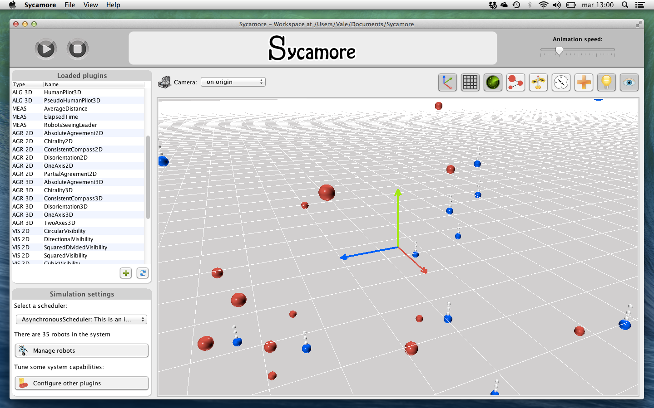
Sycamore

Slide 14
Contents
The mobile robots problem
Previous work
Motivation
The Camfora simulator
Discussion

Slide 15
Motivation
Sycamore is great, but…
  You need to download Java to run it, and also need the JDK to build on it
  It isn’t interactive
Want something that
  Easier to run and develop
  Is interactive
  Is extensible

Slide 16
Motivation (cont.)
Rich Internet Application (fat client)
Wants something that
  Fast to download
  Smooth animations
  (running outside the browser would be nice, too)

Slide 17
Contents
The mobile robots problem
Previous work
Motivation
The Camfora simulator
Discussion

Slide 18
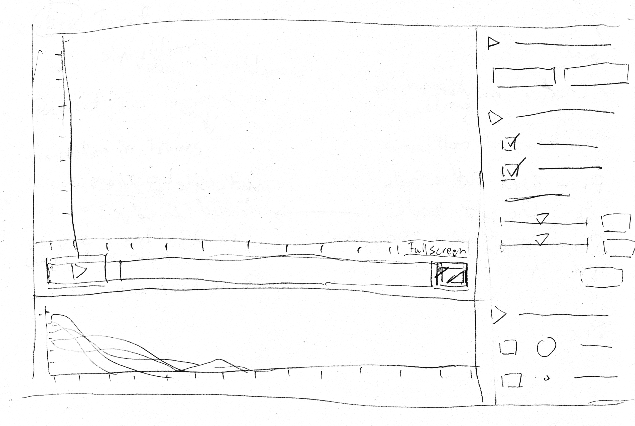
Design: UI
Embed in web page, or take full window
Use sidebar for commands

Slide 19
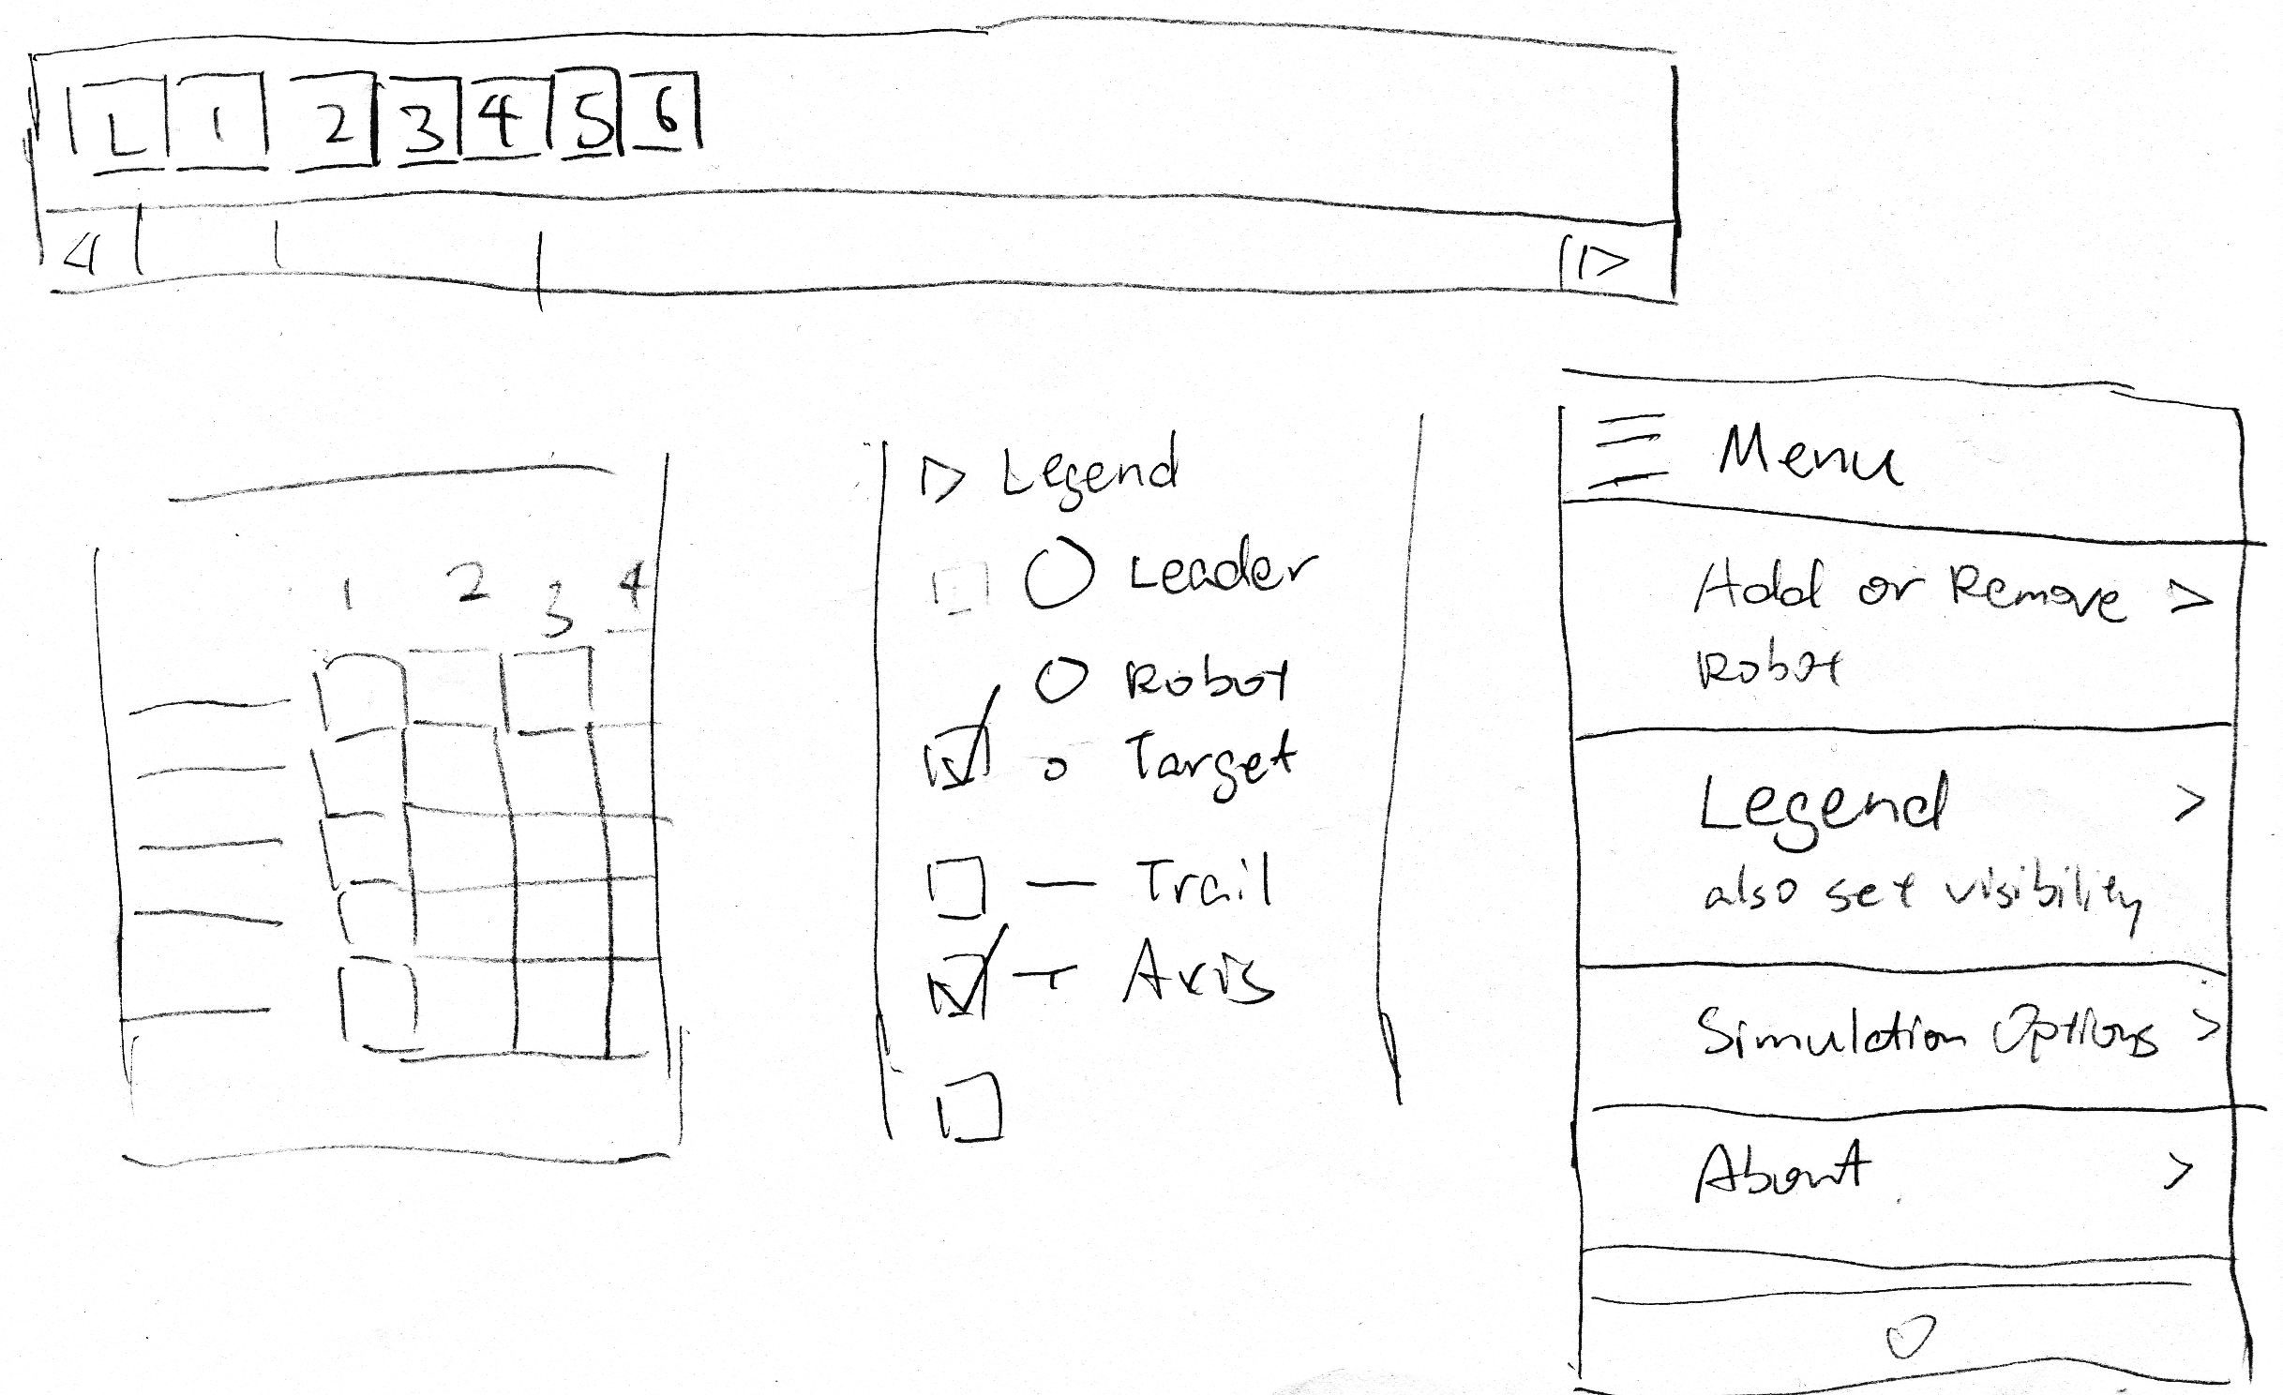
Design: UI
Sidebar collapses on mobile
Exploration of command palette

Slide 20
Design: Visualization
Visualizing movement:
  Axes, trails
Goals
Algorithm specific visualization: to be implemented separately.

Slide 21
Implementation
Using JavaScript
Dependencies:
  D3 : visualization library, lots of useful tools
  Glmatrix: vector mathematics without creating lots of temporary objects
  Rollup: compile JavaScript-of-tonight modules into JavaScript-of-today
Using ES6 modules, rest is ES5
Tries to avoid temporary objects every frame (not always successful)

Slide 22
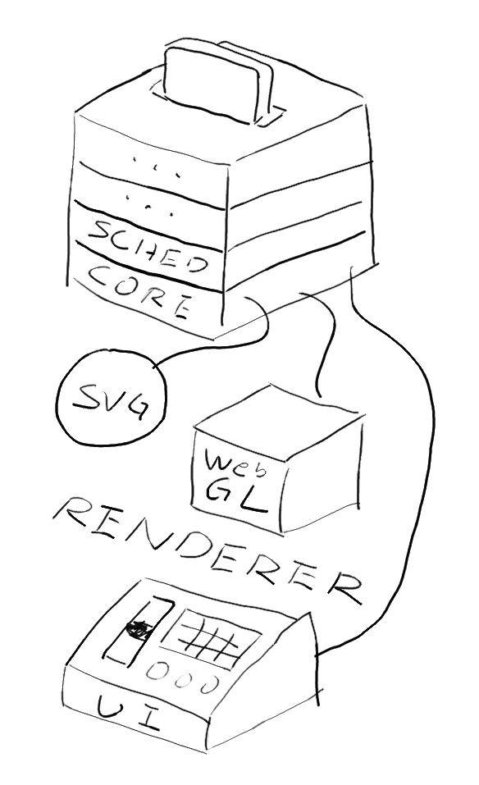
Implementation – Architecture
Model (simulation)
View (renderer & UI)
  Currently: Scalable Vector Graphics
  Decoupled renderer:
  SVG, HTML+CSS, OpenGL…
  Or running without graphics
Controller (environment & API)
  Drives simulation
  Allows running fast or slowly

Slide 23
Implementation – Event loop
Basic event loop:
  Handle events
  Update game world
  Render visuals (and audio)
  Repeat

Slide 24
Inside the update function
Update simulation time
Calculate new positions
Check state changes
Do LOOK and COMPUTE
  Plugins as filters on LOOK result
Render and update UI

Slide 25
Implementation – Event loop
In browsers you’re living in somebody else’s event loop.
So it’s important for performance not to write to the DOM during layout
  (avoid write-read hazard)
Using RequestAnimationFrame instead of SetInterval / setTimeout for more efficient animation

Slide 26
Demo

Slide 27
Contents
The mobile robots problem
Previous work
Motivation
The Camfora simulator
Discussion

Slide 28
Discussion
Turns out avoiding Java doesn’t entirely avoid problems arising with complexity
  Once it gets complex, browser no longer suitable as Integrated Development Environment
  Still depend on libraries, build-tools
JavaScript modules and packages is confusing

Slide 29
Future Work

Slide 30
References
Gervasi, V. and Prencipe, G., 2004. Coordination without communication: the case of the flocking problem. Discrete Applied Mathematics, 144(3), pp.324-344.
Gervasi, V. and Prencipe, G., 2003, October. Robotic cops: The intruder problem. In Systems, Man and Cybernetics, 2003. IEEE International Conference on (Vol. 3, pp. 2284-2289). IEEE.
VOLPI, V., 2013. Sycamore-2D/3D Mobile Robots simulation environment.

Slide 31
Slides:
http://kakuradystatic.nfshost.com/files/2016/camforajs/
Code:
https://github.com/Kakurady/camforajs
Best wishes on your exams!

