Slide 1

JAVA 8
At First Glance
https://www.slideshare.net/vanhuong794/java-8-presentation
VISION Team - 2015

Slide 2
Agenda
New Features in Java language
Lambda Expression
Functional Interface
Interface’s default and Static Methods
Method References
New Features in Java libraries
Stream API
Date/Time API
https://www.slideshare.net/vanhuong794/java-8-presentation

Slide 3
Lambda Expression
Example 1:
Comparator<Person> byAge = new Comparator<Person>(){ public int compare(Person p1, Person p2){
return p1.getAge().compareTo(p2.getAge());
}
};
Example 2:
JButton testButton = new JButton("Test Button"); testButton.addActionListener(new ActionListener(){ @Override public void actionPerformed(ActionEvent ae){
System.out.println(“Hello Anonymous inner class");
}
});
https://www.slideshare.net/vanhuong794/java-8-presentation

Slide 4
Lambda Expression
Example 1:
Comparator<Person> byAge = new Comparator<Person>(){ public int compare(Person p1, Person p2){
return p1.getAge().compareTo(p2.getAge());
}
};
Example 1: with lambda
Comparator<Person> byAge =
(Person p1, Person p2) -> p1.getAge().compareTo(p2.getAge());
https://www.slideshare.net/vanhuong794/java-8-presentation

Slide 5
Lambda Expression
Example 2:
JButton testButton = new JButton("Test Button"); testButton.addActionListener(new ActionListener(){ @Override public void actionPerformed(ActionEvent ae){
System.out.println(“Hello Anonymous inner class");
}
});
Example 2: with lambda
testButton.addActionListener(e -> System.out.println(“Hello Lambda"));
https://www.slideshare.net/vanhuong794/java-8-presentation

Slide 6
Lambda Expression
Lambda Syntax
https://www.slideshare.net/vanhuong794/java-8-presentation

Slide 7
Lambda Expression
Arrow
(Person p1, Person p2) -> p1.getAge().compareTo(p2.getAge());
Lambda parameters
Lambda body
The basic syntax of a lambda is either
(parameters) -> expression
or
(parameters) -> { statements; }
https://www.slideshare.net/vanhuong794/java-8-presentation

Slide 8
Lambda Expression
Lambda does not have:
Name
Return type
Throws clause
Type parameters
https://www.slideshare.net/vanhuong794/java-8-presentation

Slide 9
Lambda Expression
Examples:
(String s) -> s.length()
(Person p) -> p.getAge() > 20 3. () -> 92
(int x, int y) -> x + y
(int x, int y) -> { System.out.println(“Result:”); System.out.println(x + y);
}
https://www.slideshare.net/vanhuong794/java-8-presentation

Slide 10
Lambda Expression
Where should we use Lambda?
https://www.slideshare.net/vanhuong794/java-8-presentation

Slide 11
Lambda Expression
Runnable:
// Anonymous class
Runnable r1 = new Runnable(){ @Override
public void run(){
System.out.println("Hello world one!");
}
};
// Lambda Runnable
Runnable r2 = () -> System.out.println("Hello world two!");
https://www.slideshare.net/vanhuong794/java-8-presentation

Slide 12
Lambda Expression
Iterator:
List<String> features = Arrays.asList("Lambdas", "Default Method", "Stream API", "Date and Time API");
//Prior to Java 8 :
for (String feature : features) { System.out.println(feature);
}
//In Java 8:
Consumer<String> con = n -> System.out.println(n)
features.forEach(con);
https://www.slideshare.net/vanhuong794/java-8-presentation

Slide 13
Demonstration
https://www.slideshare.net/vanhuong794/java-8-presentation

Slide 14
tional Interface
What is functional interface?
https://www.slideshare.net/vanhuong794/java-8-presentation

Slide 15
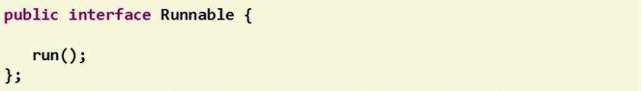
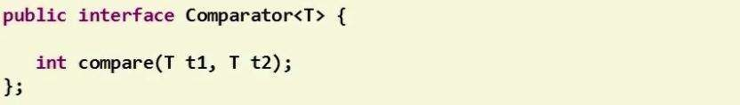
_{F}Add t_{u}ext h_{n}ere.._{c}.
tional Interface
New term of Java 8
A functional interface is an interface with only one abstract method.
https://www.slideshare.net/vanhuong794/java-8-presentation

Slide 16
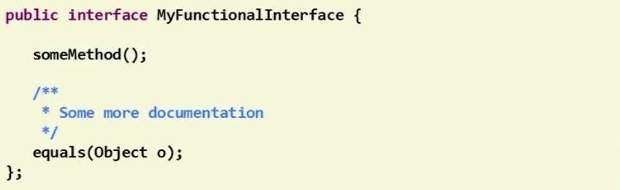
_{F}Add t_{u}ext h_{n}ere.._{c}.
tional Interface
Methods from the Object class don’t count.
https://www.slideshare.net/vanhuong794/java-8-presentation

Slide 17
_{F}Add t_{u}ext h_{n}ere.._{c}.
tional Interface
Annotation in Functional Interface
https://www.slideshare.net/vanhuong794/java-8-presentation

Slide 18
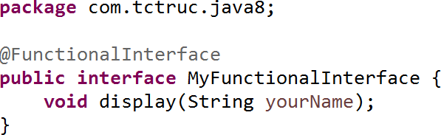
_{F}Add t_{u}ext h_{n}ere.._{c}.
tional Interface
A functional interface can be annotated.
It’s optional.
https://www.slideshare.net/vanhuong794/java-8-presentation

Slide 19
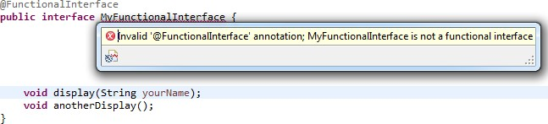
_{F}Add t_{u}ext h_{n}ere.._{c}.
tional Interface
Show compile error when define more than one abstract method.
https://www.slideshare.net/vanhuong794/java-8-presentation

Slide 20
_{F}Add t_{u}ext h_{n}ere.._{c}.
tional Interface
Functional Interfaces Toolbox
https://www.slideshare.net/vanhuong794/java-8-presentation

Slide 21
_{F}Add t_{u}ext h_{n}ere.._{c}.
tional Interface
Brand new java.util.function package.
Rich set of function interfaces.
4 categories:
Supplier
Consumer
Predicate
Function
https://www.slideshare.net/vanhuong794/java-8-presentation

Slide 22
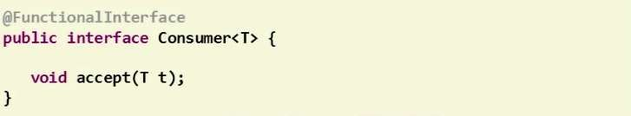
C^{Add te}o^{xt he}n^{re...}sumer Interface
Accept an object and return nothing.
Can be implemented by lambda expression.
https://www.slideshare.net/vanhuong794/java-8-presentation

Slide 23
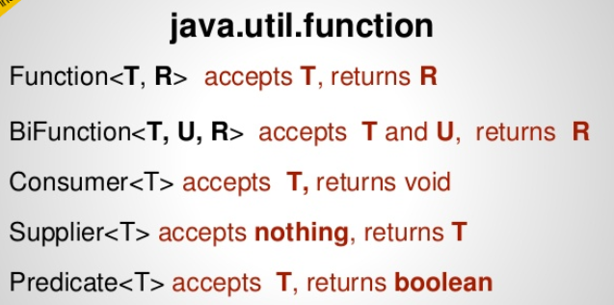
https://www.slideshare.net/LivePersonDev/functional-programming-with-java-8

Slide 24
Pogledati primjere
https://www.javabrahman.com/java-8/java-8-java-util-function-consumer-tutorial-with-examples/

Slide 25
Demonstration
https://www.slideshare.net/vanhuong794/java-8-presentation

Slide 26
_{I}Ad_{n}d t_{t}ex_{e}t he_{r}re_{f}.._{a}.
ce Default and Static Methods
Interface Default and Static Methods
https://www.slideshare.net/vanhuong794/java-8-presentation

Slide 27
Interface Default and Static Methods
Extends interface declarations with two new concepts:
Default methods
Static methods
Advantages:
- No longer need to provide your own companion utility classes. Instead, you can place static methods in the appropriate interfaces
java.util.Collections
static <T> Collection<T>
java.util.Collection
synchronizedCollection(Collection<T
- Adding methods to an interface without breaking the existing
implementation
https://www.slideshare.net/vanhuong794/java-8-presentation

Slide 28
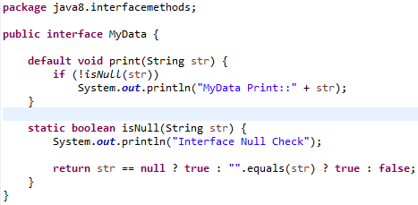
Interface Default and Static Methods
Syntax
[modifier] default | static returnType nameOfMethod (Parameter List) {
// method body
}
https://www.slideshare.net/vanhuong794/java-8-presentation

Slide 29
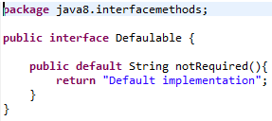

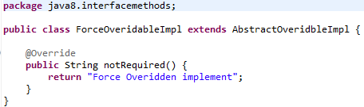
Default methods
Classes implement interface that contains a default method
Not override the default method and will inherit the default method
Override the default method similar to other methods we override in subclass
Redeclare default method as abstract, which force subclass to override it
https://www.slideshare.net/vanhuong794/java-8-presentation

Slide 30
Default methods
Solve the conflict when the same method declare in interface or
class
Method of Superclasses, if a superclass provides a concrete method.
If a superinterface provides a default method, and another interface supplies a method with the same name and parameter types (default or not), then you must overriding that method.
https://www.slideshare.net/vanhuong794/java-8-presentation

Slide 31
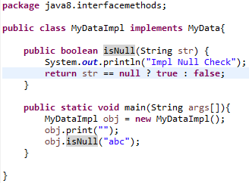
Static methods
Similar to default methods except that we can’t override
them in the implementation classes
https://www.slideshare.net/vanhuong794/java-8-presentation

Slide 32
Demonstration
https://www.slideshare.net/vanhuong794/java-8-presentation

Slide 33
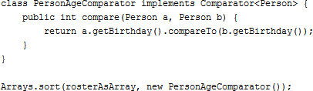
Method References
Method reference is an important feature related to lambda expressions. In order to that a method reference requires a target type context that consists of a compatible functional interface
https://www.slideshare.net/vanhuong794/java-8-presentation

Slide 34
Method References
There are four kinds of method references:
Reference to a static method
Reference to an instance method of a particular object
Reference to an instance method of an arbitrary object of a particular type
Reference to a constructor
https://www.slideshare.net/vanhuong794/java-8-presentation

Slide 35
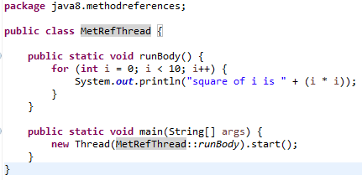
Method References
Reference to a static method
The syntax: ContainingClass::staticMethodName
https://www.slideshare.net/vanhuong794/java-8-presentation

Slide 36
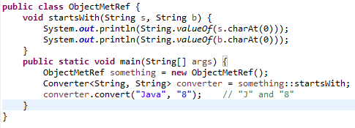
Method References
Reference to an instance method of a particular object The syntax: containingObject::instanceMethodName
https://www.slideshare.net/vanhuong794/java-8-presentation

Slide 37
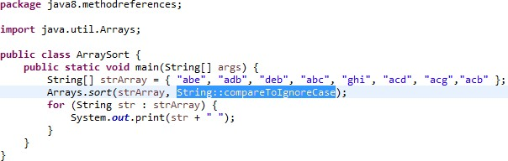
Method References
Reference to an instance method of an arbitrary object of a
particular type
The syntax: ContainingType::methodName
https://www.slideshare.net/vanhuong794/java-8-presentation

Slide 38
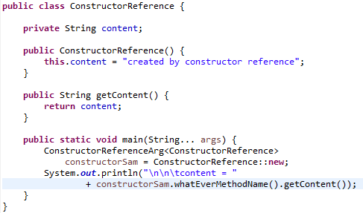

Method References
Reference to a constructor The syntax: ClassName::new
https://www.slideshare.net/vanhuong794/java-8-presentation

Slide 39
Method References
Method references as Lambdas Expressions
Syntax | Example | As Lambda
ClassName::new | String::new | () -> new String()
Class::staticMethodName | String::valueOf | (s) -> String.valueOf(s)
object::instanceMethodName | x::toString | () -> "hello".toString()
Class::instanceMethodName | String::toString | (s) -> s.toString()
https://www.slideshare.net/vanhuong794/java-8-presentation

Slide 40
_{S}Add t_{t}ext_{r}he_{e}re..._{am}
What is a Stream?
https://www.slideshare.net/vanhuong794/java-8-presentation

Slide 41
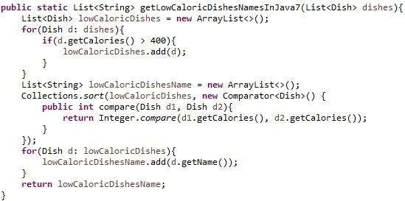
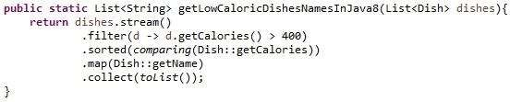
_{S}Add t_{t}ext_{r}he_{e}re..._{am}
Old Java:
Java 8:
https://www.slideshare.net/vanhuong794/java-8-presentation

Slide 42
_{S}Add t_{t}ext_{r}he_{e}re..._{am}
❏ Not store data
❏ Designed for processing data
❏ Not reusable
❏ Can easily be outputted as arrays or lists
https://www.slideshare.net/vanhuong794/java-8-presentation

Slide 43
S^{Add t}t^{ext}r^{he}e^{re...}am - How to use
Build a stream
Filter
Sort
Transform stream
Collect result
https://www.slideshare.net/vanhuong794/java-8-presentation

Slide 44
S^{Add t}t^{ext}r^{he}e^{re...}am - build streams
Build streams from collections
List<Dish> dishes = new ArrayList<Dish>();
....(add some Dishes)....
Stream<Dish> stream = dishes.stream();
https://www.slideshare.net/vanhuong794/java-8-presentation

Slide 45
S^{Add t}t^{ext}r^{he}e^{re...}am - build streams
Build streams from arrays
Integer[] integers =
{1, 2, 3, 4, 5, 6, 7, 8, 9};
Stream<Integer> stream = Stream.of(integers);
https://www.slideshare.net/vanhuong794/java-8-presentation

Slide 46
S^{Add t}t^{ext}r^{he}e^{re...}am - Operations
Intermediate operations (return Stream)
filter()
map()
sorted()
….
https://www.slideshare.net/vanhuong794/java-8-presentation

Slide 47
S^{Add t}t^{ext}r^{he}e^{re...}am - filter()
// get even numbers
Stream<Integer> evenNumbers = stream
.filter(i -> i%2 == 0);
// Now evenNumbers have {2, 4, 6, 8}
https://www.slideshare.net/vanhuong794/java-8-presentation

Slide 48
S^{Add t}t^{ext}r^{he}e^{re...}am - Operations
Terminal operations
forEach()
collect()
match()
….
https://www.slideshare.net/vanhuong794/java-8-presentation

Slide 49
S^{Add t}t^{ext}r^{he}e^{re...}am - forEach()
// get even numbers evenNumbers.forEach(i -> System.out.println(i));
/* | Console | output
* | 2
* | 4
* | 6
* | 8
*/
https://www.slideshare.net/vanhuong794/java-8-presentation

Slide 50
Stream - Converting to collections
Add text here...
Converting stream to list
List<Integer> numbers = evenNumbers.collect(Collectors.toList());
Converting stream to array
Integer[] numbers = evenNumbers.toArray(Integer[]::new);
https://www.slideshare.net/vanhuong794/java-8-presentation

Slide 51
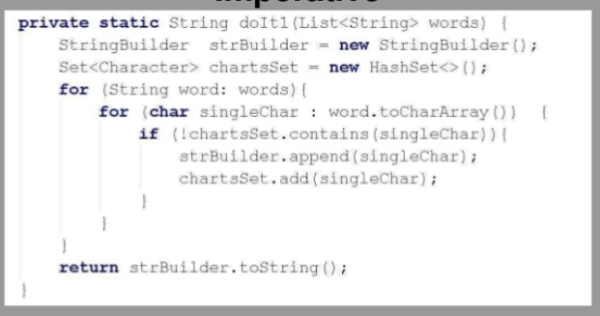
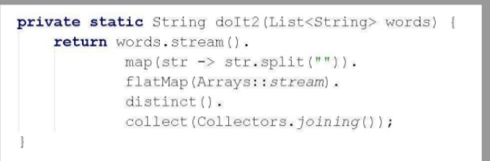

Slide 52
Demonstration
https://www.slideshare.net/vanhuong794/java-8-presentation

Slide 53
_{D}Add te_{a}xt h_{t}ere_{e}...
/ Time
What’s new in Date/Time?
https://www.slideshare.net/vanhuong794/java-8-presentation

Slide 54
_{D}Add te_{a}xt h_{t}ere_{e}...
/ Time
Why do we need a new Date/Time API?
Objects are not immutable
Naming
Months are zero-based
https://www.slideshare.net/vanhuong794/java-8-presentation

Slide 55
_{D}Add te_{a}xt h_{t}ere_{e}...
/ Time
LocalDate
A LocalDate is a date, with a year, month, and day of the month
LocalDate today = LocalDate.now();
LocalDate christmas2015 = LocalDate.of(2015, 12, 25);
LocalDate christmas2015 = LocalDate.of(2015, Month.DECEMBER, 25);
https://www.slideshare.net/vanhuong794/java-8-presentation

Slide 56
_{D}Add te_{a}xt h_{t}ere_{e}...
/ Time
Java 7:
Calendar c = Calendar.getInstance(); c.add(Calendar.DATE, 1);
Date dt = c.getTime();
Java 8:
LocalDate tomorrow = LocalDate.now().plusDay(1);
https://www.slideshare.net/vanhuong794/java-8-presentation

Slide 57
_{D}Add te_{a}xt h_{t}ere_{e}...
/ Time
Temporal adjuster
LocalDate nextPayDay = LocalDate.now()
.with(TemporalAdjusters.lastDayOfMonth());
https://www.slideshare.net/vanhuong794/java-8-presentation

Slide 58
_{D}Add te_{a}xt h_{t}ere_{e}...
/ Time
Create your own adjuster
TemporalAdjuster NEXT_WORKDAY = w -> {
LocalDate result = (LocalDate) w;
do {
result = result.plusDays(1);
} while (result.getDayOfWeek().getValue() >= 6);
return result;
};
LocalDate backToWork = today.with(NEXT_WORKDAY);
https://www.slideshare.net/vanhuong794/java-8-presentation

