Slide 1






DATA SCIENCE & MACHINE LEARNING TRACK
Predicting Medical Insurance Costs
Using patient data to explain and predict what drives a person's medical insurance charges.
Kalkidan Tekle
Bezawit Alemayehu
Makda Yirgaye
Sarasiah Munene Kanelo
Onnelie Mathendele
Bereket Tadesse
GROUP LEADER
INFNOVA Academy • Summer Boot Camp 2026 • Graduation Day
Notes:
Introduce all six team members, name the track (Data Science & ML), and give the one-sentence problem statement: we're using patient data to explain and predict medical insurance charges.

Slide 2
THE DATA
A clean, real-world medical cost dataset
Dataset at a glance
Summary statistics
Rows: 1,338 individuals
 | Age | BMI | Charges ($)
Mean | 41.0 | 30.4 | 26,948
Median | 42.0 | 30.6 | 22,391
Std. dev. | 13.5 | 6.0 | 12,996
Min | 18 | 16.0 | 8,783
Max | 64 | 47.3 | 63,770
Source: Cleaned medical insurance cost dataset (insurance_medical_cost_cleaned.csv)
Target variable: charges — annual medical insurance cost ($)
Predictors: age, sex, BMI, children, smoker, region (one-hot)
Smokers in data: 20.8% of individuals
Charges are right-skewed (skewness ≈ 1.37) — most people pay moderate premiums, but a smoker-driven tail pushes some costs far higher.
2
Notes:
Describe the dataset: 1,338 patient records, target is charges, predictors include age/sex/bmi/children/smoker/region. Point out the right-skew in charges caused by smokers.

Slide 3
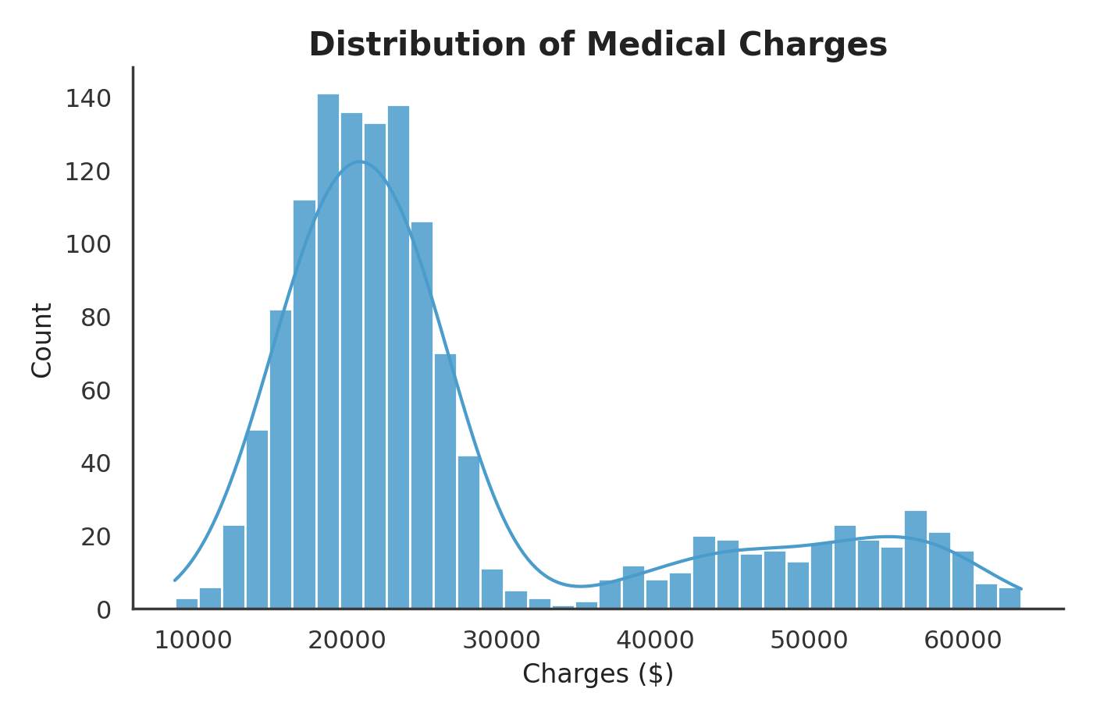
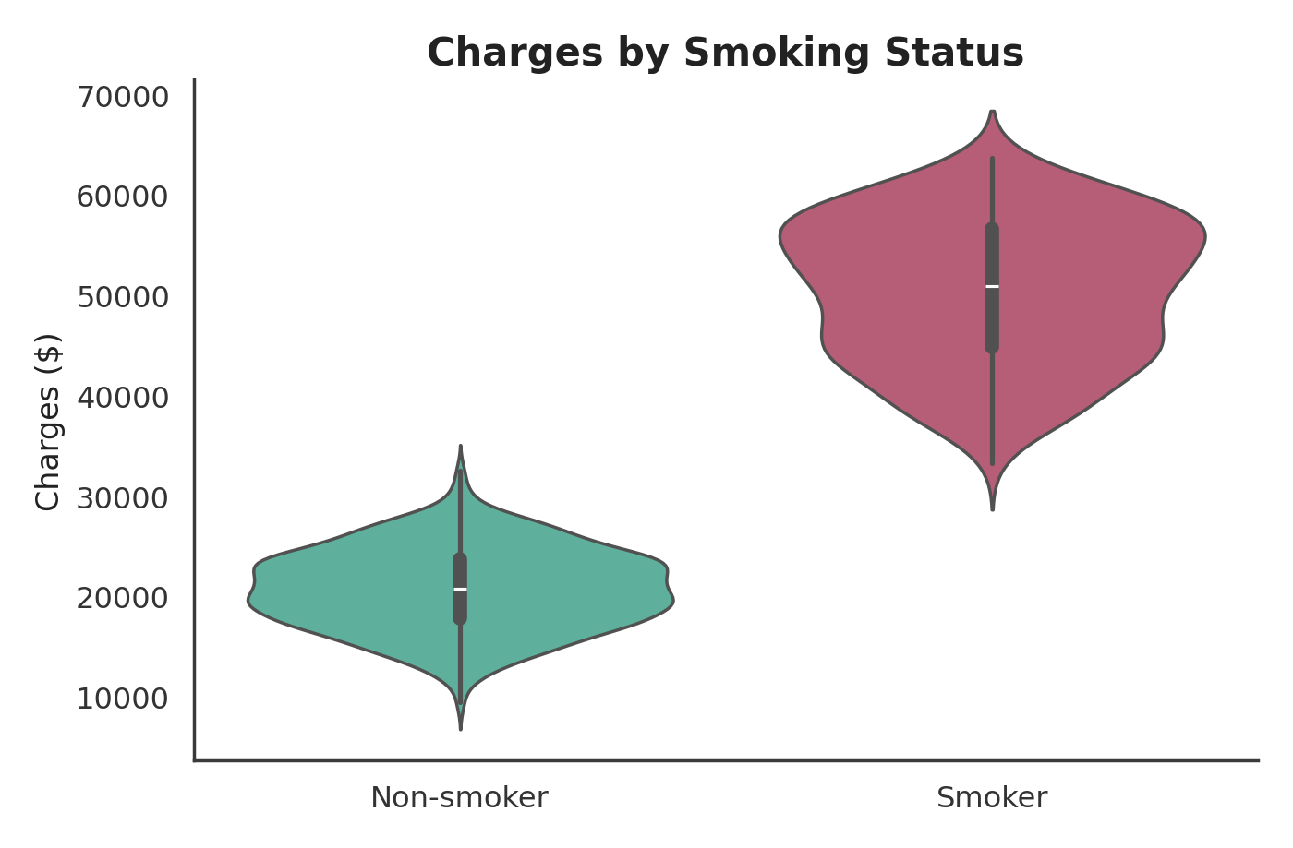
VISUALIZATION
Charges are bimodal — smoking splits the population
Insight: non-smokers average $20,780, smokers average $50,466 — over 2x higher.
3
Notes:
Show the histogram with density curve for charges (clearly bimodal) next to the violin plot split by smoking status. Smoking status explains the two humps in the distribution.

Slide 4
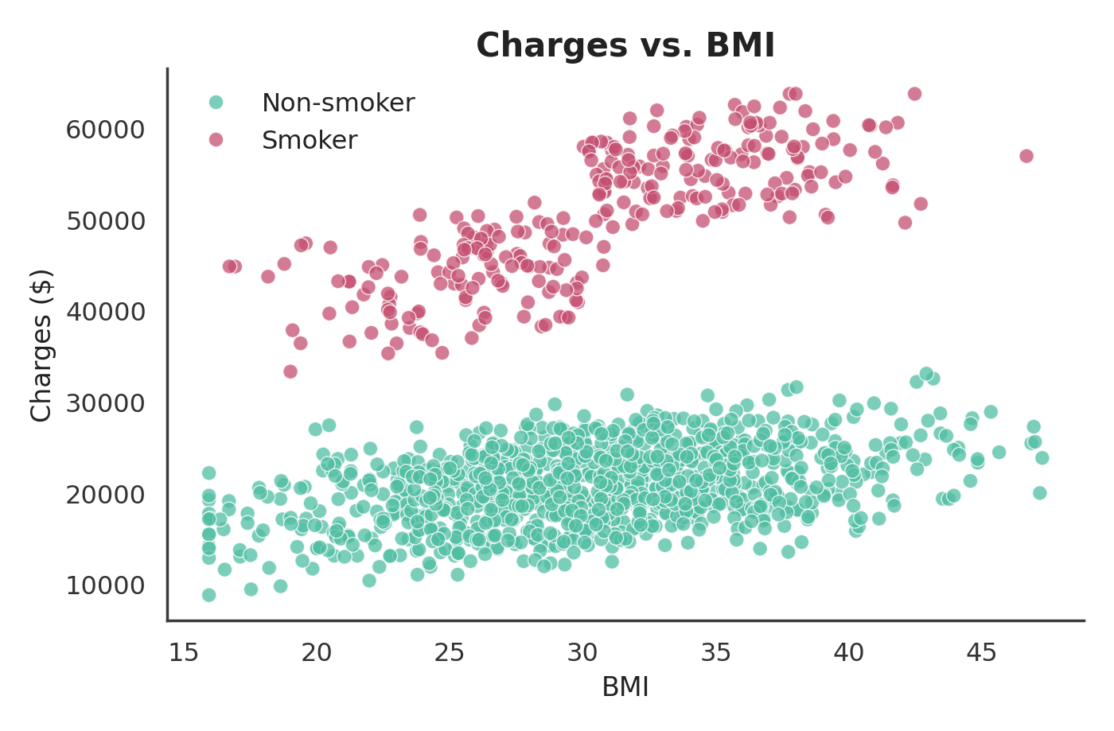
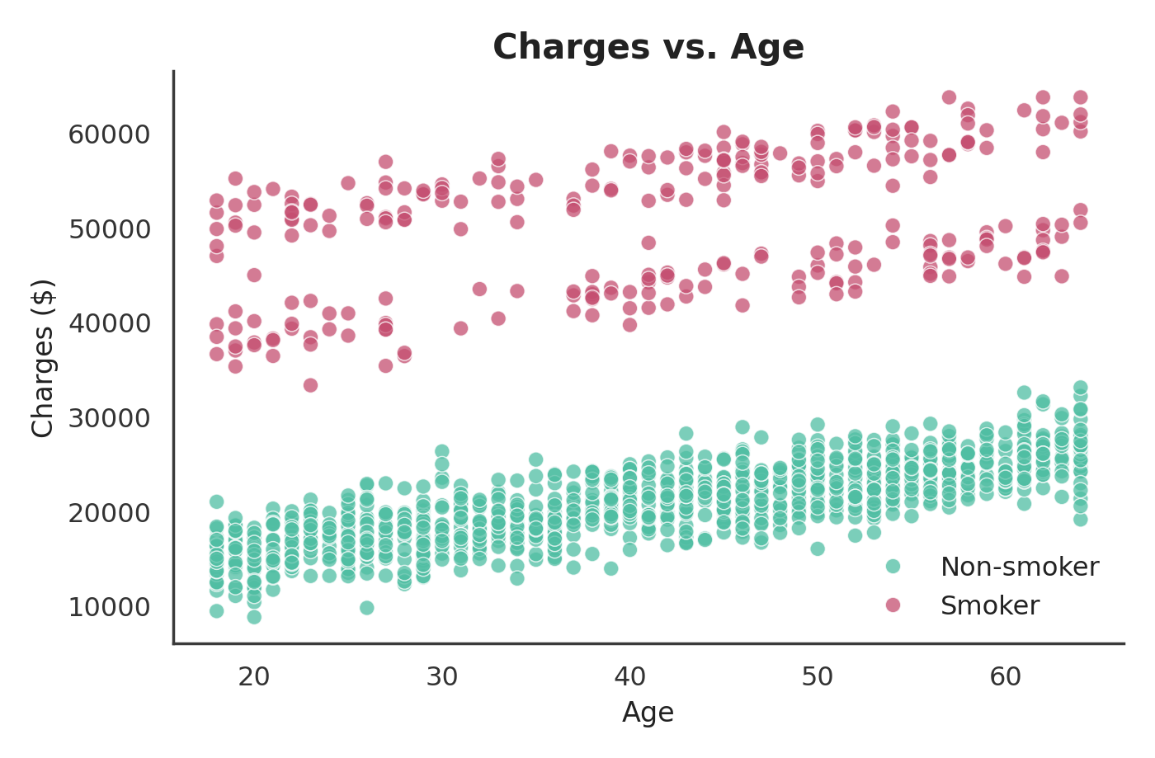
VISUALIZATION
BMI and age both raise cost — smoking amplifies it
Insight: correlation with charges — age: 0.26, BMI: 0.21, smoker: 0.93 (by far the strongest).
4
Notes:
Two scatter plots colored by smoker status. Both age and BMI trend upward with charges, but the smoker/non-smoker split is the dominant pattern in both.

Slide 5
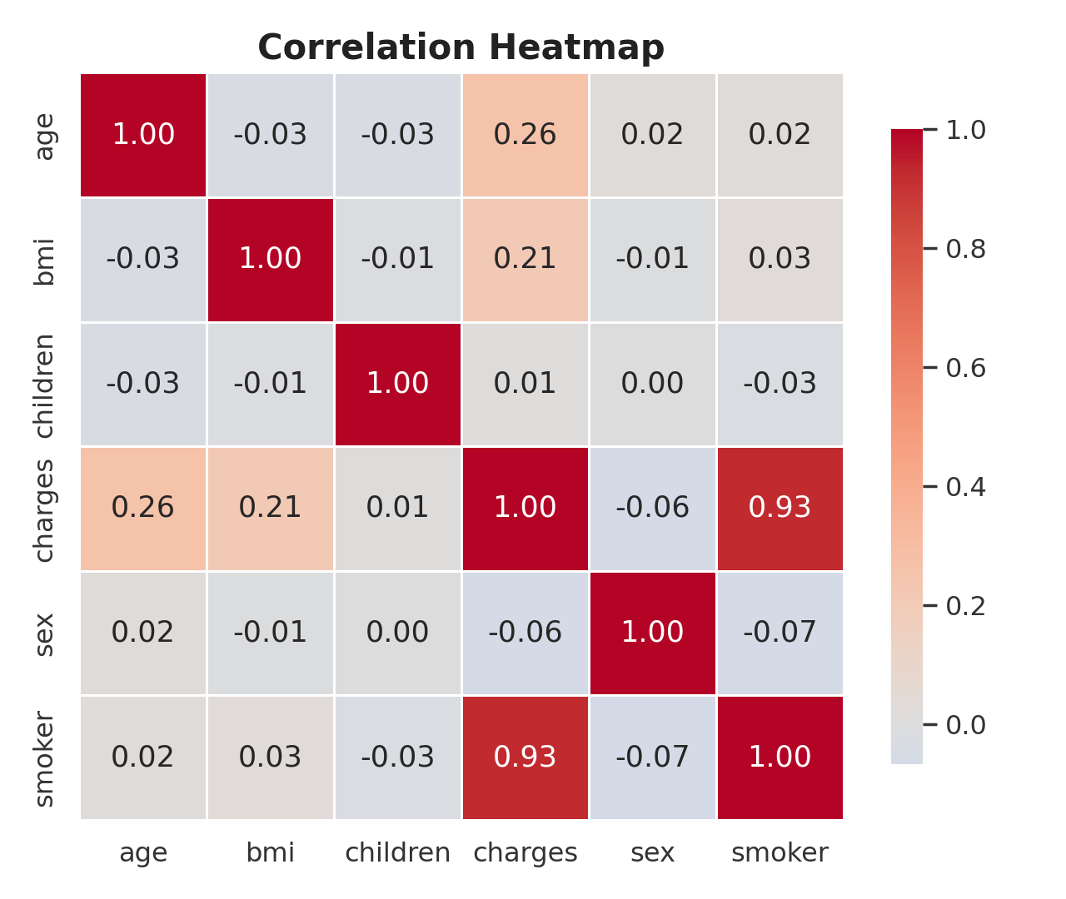
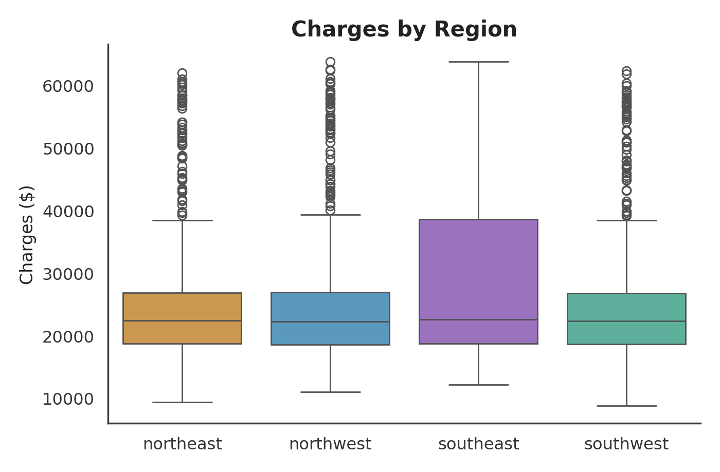
VISUALIZATION
Smoking dominates the correlation structure
Insight: region has almost no effect on charges — the boxplots for all four regions overlap heavily.
5
Notes:
Correlation heatmap shows smoker (0.93) far outweighs age (0.26) and BMI (0.21). Region boxplot shows charges are flat across all four regions.

Slide 6
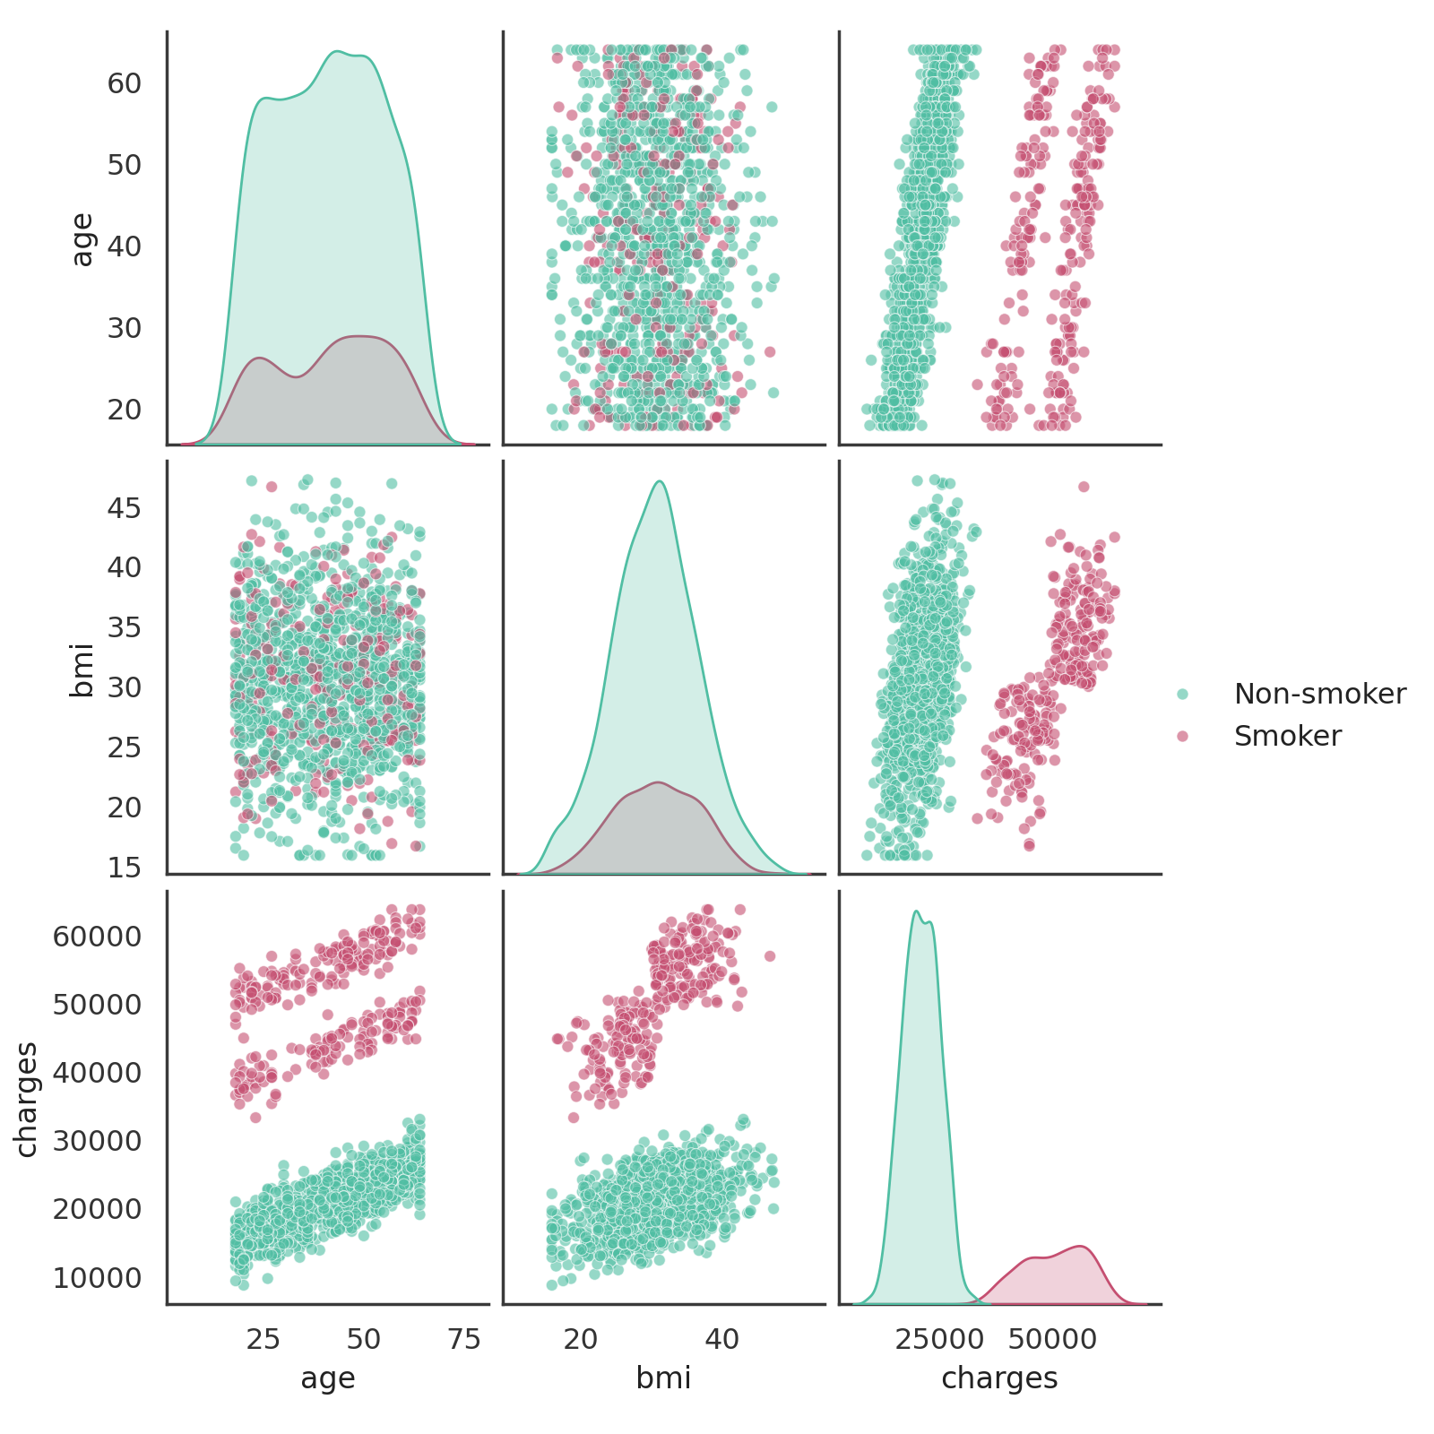
VISUALIZATION
Putting it together: age, BMI, and charges by smoker status
Insight: the smoker group (rose) forms a visibly separate band from non-smokers (teal) across every pairing.
6
Notes:
The pairplot combines all previous insights in one view - notice how cleanly the two smoker groups separate, especially in the BMI-vs-charges and age-vs-charges panels.

Slide 7
PREDICTION MODEL
Two models, two questions
MODEL 1 — REGRESSION
MODEL 2 — CLASSIFICATION
Linear Regression vs. Random Forest
Logistic Regression
Question: Given a person's details, what will their exact medical charge be?
Question: Given a person's details and charges, are they a smoker or not?
How it works: Linear Regression fits a straight-line weight to each feature (e.g. +$29,328 if smoker). Random Forest instead grows many decision trees on random subsets of the data and averages their predictions, capturing non-linear effects the straight line misses.
How it works: Logistic Regression estimates the probability of "smoker" vs. "non-smoker" by fitting an S-shaped curve to the features, then classifies using a 0.5 probability cutoff — turning the regression problem into a yes/no decision.
Model selection: we trained Linear Regression and Random Forest on the same 80/20 train-test split and compared them side by side on held-out data — Random Forest scored higher on every metric, so we chose it as our final regression model (see Results, next).
7
Notes:
Explain both models at a high level: why we compared Linear Regression and Random Forest for predicting exact charges, and why logistic regression to classify smoker status (this is what gives us accuracy/precision/recall).

Slide 8
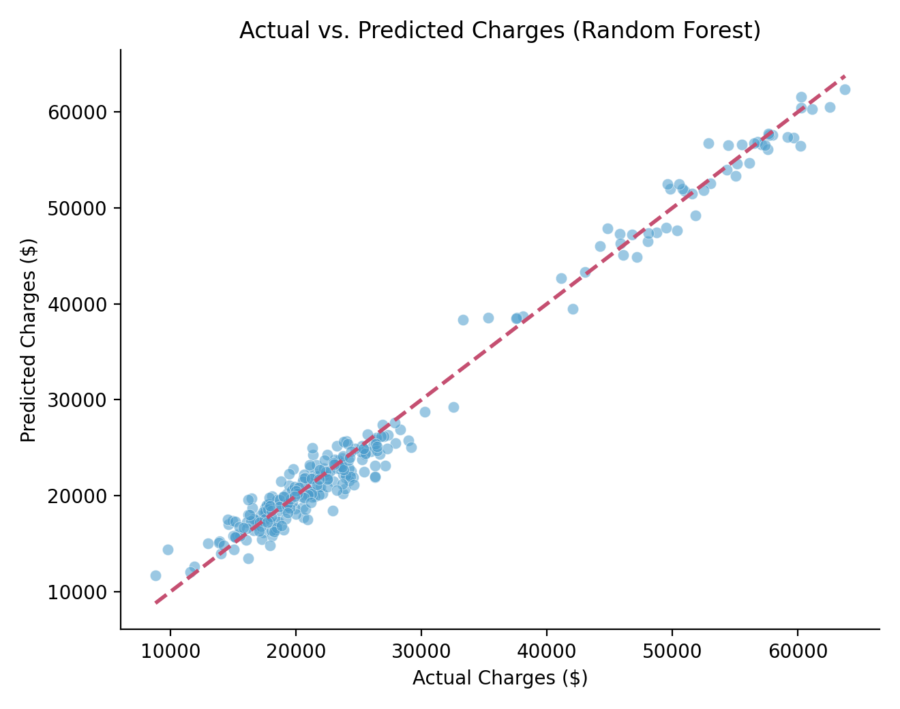
RESULTS & DISCUSSION
Regression: predicting the exact charge
Metric | Linear Reg. | Random Forest
R² (variance explained) | 0.965 | 0.983
MAE (avg. $ error) | $1,861 | $1,328
RMSE | $2,437 | $1,685
Random Forest wins: it explains 98% of the variance in charges, with predictions typically within $1,328 of the true cost.
Discussion: smoker status alone accounts for 87% of the Random Forest's feature importance — age and BMI matter, but smoking dominates. With more time, we'd tune hyperparameters and try gradient boosting to close the remaining error gap.
8
Notes:
Walk through R2, MAE, RMSE for both models, explain why Random Forest performs better, and mention smoker status dominates feature importance.

Slide 9
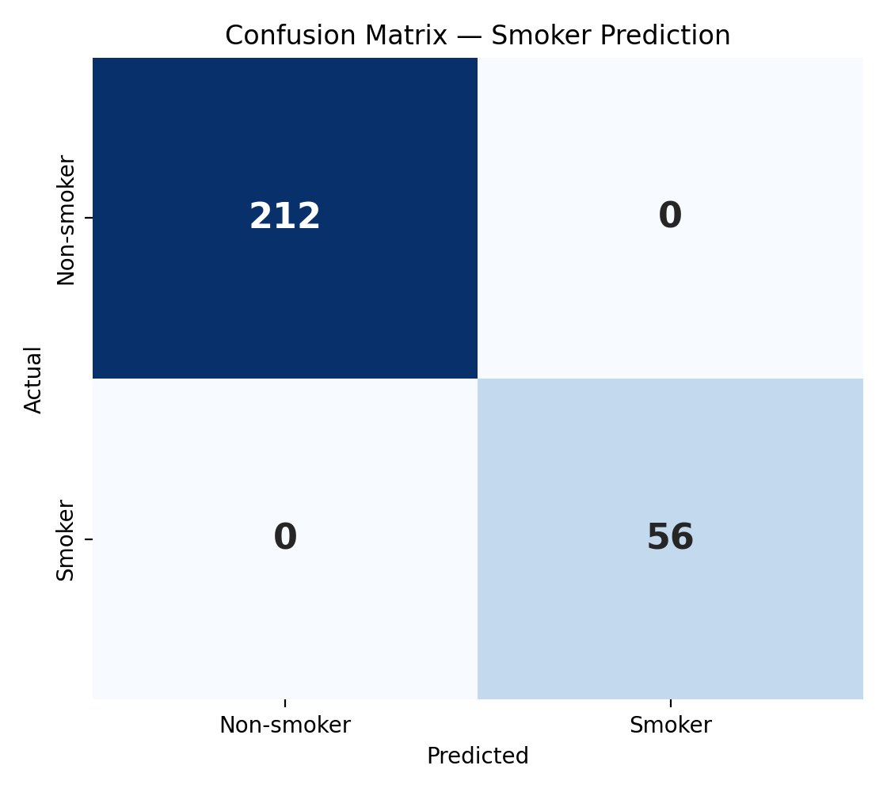
RESULTS & DISCUSSION
Classification: predicting smoker status
100.0%
100.0%
Accuracy
Precision
100.0%
100.0%
Recall
F1 score
Discussion: charges is such a strong signal for smoking (correlation 0.93) that the classifier separates the two groups almost perfectly on this dataset — a real deployment would need to predict smoker status without already knowing the charges, which is a harder, more realistic version of this task.
9
Notes:
Present accuracy/precision/recall/F1 (all near-perfect), show the confusion matrix, and be upfront in discussion that this is expected given how strongly correlated charges and smoking are - flag it as a limitation for real-world deployment.

Slide 10
Thank You
Questions? We'd love to hear them.
Bezawit Alemayehu • Makda Yirgaye • Kalkidan Tekle • Sarasiah Munene Kanelo • Onnelie Mathendele • Bereket Tadesse
Notes:
Thank the audience and open the floor for questions.

Slide 11
APPENDIX (BACKUP SLIDE)
The code behind the two models
REGRESSION — CHARGES (scikit-learn)
CLASSIFICATION — SMOKER STATUS (scikit-learn)
X = df[['age','sex','bmi','children','smoker',
'region_northwest','region_southeast','region_southwest']]
y = df['charges']
X_train, X_test, y_train, y_test = train_test_split(
X, y, test_size=0.2, random_state=42)
lin = LinearRegression().fit(X_train, y_train)
rf = RandomForestRegressor(n_estimators=300, max_depth=6,
random_state=42).fit(X_train, y_train)
r2_score(y_test, rf.predict(X_test)) # -> 0.983
mean_absolute_error(y_test, rf.predict(X_test)) # -> $1,328
Xc = df[['age','sex','bmi','children','charges',
'region_northwest','region_southeast','region_southwest']]
yc = df['smoker']
Xc_train, Xc_test, yc_train, yc_test = train_test_split(
Xc, yc, test_size=0.2, random_state=42, stratify=yc)
clf = LogisticRegression(max_iter=1000).fit(Xc_train, yc_train)
pred = clf.predict(Xc_test)
accuracy_score(yc_test, pred) # -> 1.00
precision_score(yc_test, pred) # -> 1.00
recall_score(yc_test, pred) # -> 1.00
Backup slide — kept out of the timed 5-minute flow, ready to show only if asked how the models were built.
Notes:
Backup only — skip during the timed run-through. Show this if a judge asks to see the actual model-training code.

