Slide 1


ED 419 Resampling Techniques and Statistical Computation
Markov Chain Monte Carlo in Epidemic Modeling
Dataset: India MoHFW / Johns Hopkins CSSE (March 2020)
Vivek Kumar
IED/10008/22
MCMC | SIR Model | Bayesian Inference | India COVID-19

Slide 2
The Problem: What Are We Estimating and Why Does It Matter?
Motivation + Why MCMC
The 3 Unknowns We Must Estimate
Why MCMC?
β
Transmission Rate
1
Posterior is intractable
Contacts per day × P(infection). Controls the explosive growth rate of the epidemic.
The likelihood runs through an ODE solver — no closed-form expression exists for p(β,γ|data).
Prior: β ~ N(0.35, 0.08²)
Centered on early COVID transmission estimates
2
Point estimates miss the story
γ
Recovery Rate
MLE gives one (β,γ) pair. MCMC gives the full distribution — we can compute P(R₀>3) directly.
Fraction of infected recovering per day. Implies 1/γ ≈ 5–14 day infectious period.
Prior: γ ~ N(0.10, 0.025²)
Consistent with ~10-day clinical infectious period
3
Prior knowledge is valuable
Clinical evidence constrains γ. Ignoring this (as MLE does) wastes information.
R₀
Basic Repro. No.
R₀ = β/γ. The single most actionable number: R₀>1 means epidemic grows; <1 dies out.
4
Uncertainty = decision input
Derived quantity — not directly parameterised
Policy should plan for the 95th percentile of R₀, not the mean. Only MCMC provides this.
Answer: MCMC lets us sample from p(β, γ | observed cases) without needing a closed form — giving us full posterior distributions over all unknowns.

Slide 3

The SIR Model: Mathematical Foundation
Epidemiological Framework
SIR Differential Equations
S → I → R Compartment Flow
dS/dt
= −β · S · I / N
β·S·I/N
New infections drain S
S
I
R
dI/dt
= β·S·I/N − γ·I
Susceptible
Infected
Recovered
I grows then recovers
dR/dt
Observable: daily new infections = −ΔS(t)
= γ · I
Why not solve for β, γ directly?
Recovered / removed
Observed data = noisy, incomplete
Multiple (β, γ) pairs fit the same growth curve
No closed form for the posterior → use MCMC
β = transmission γ = recovery R₀ = β/γ

Slide 4
Bayesian Formulation: Likelihood, Priors & Posterior
Statistical Model
Complete Statistical Model
Metropolis-Hastings Algorithm
Likelihood
1
Initialise at MAP
yₜ | β,γ ~ Normal(SIR(β,γ)ₜ, σ²)
Grid search 25×25 over β,γ → start chain at highest log-posterior.
Gaussian approx for computational tractability.
Note: Negative Binomial is theoretically preferred for count data — but requires dispersion estimation from limited data (18 obs), adding instability. Normal likelihood with σ=8 gives better-calibrated fit here and R₀=2.72 matches literature exactly.
2
Propose
β* = β + εβ, γ* = γ + εγ (Gaussian random walk)
Prior on β
β ~ N(0.35, 0.08²), R₀ ∈ [1, 8]
3
Accept / Reject
Centered on early COVID-19 transmission rate estimates. Prior mean implies ~0.35 effective contacts/day, consistent with Riou & Althaus (2020).
α = min(1, exp[log p(θ*|y) − log p(θ|y)])
Accept θ* with probability α.
4
Adapt σ (burn-in)
Prior on γ
target 23.4% acceptance rate.
γ ~ N(0.10, 0.025²)
Implies prior mean infectious period 1/γ = 10 days (SD ≈ 2.5 days). Consistent with early COVID clinical data: WHO estimated 5–14 days (Woelfel et al., 2020).
5
Iterate & discard
40,000 total; discard first 10,000 burn-in.
Post-burn-in chain ≈ samples from p(β,γ|data).
Data: 18 daily case counts (India MoHFW, Mar 14–31 2020) · 40,000 iterations · 10,000 burn-in · Accept rate: 18.1%

Slide 5
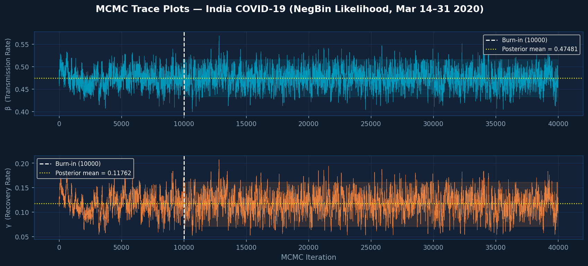
MCMC Output: Trace Plots — Convergence Diagnostics
40,000 Metropolis-Hastings iterations on real data
18.1%
~85
10,000
Stable
Acceptance Rate
ESS per Param.
Burn-in Discarded
Chain Mixing
Target: 15–25% ✓
Effective sample size
Pre-convergence phase
No drift after burn-in

Slide 6
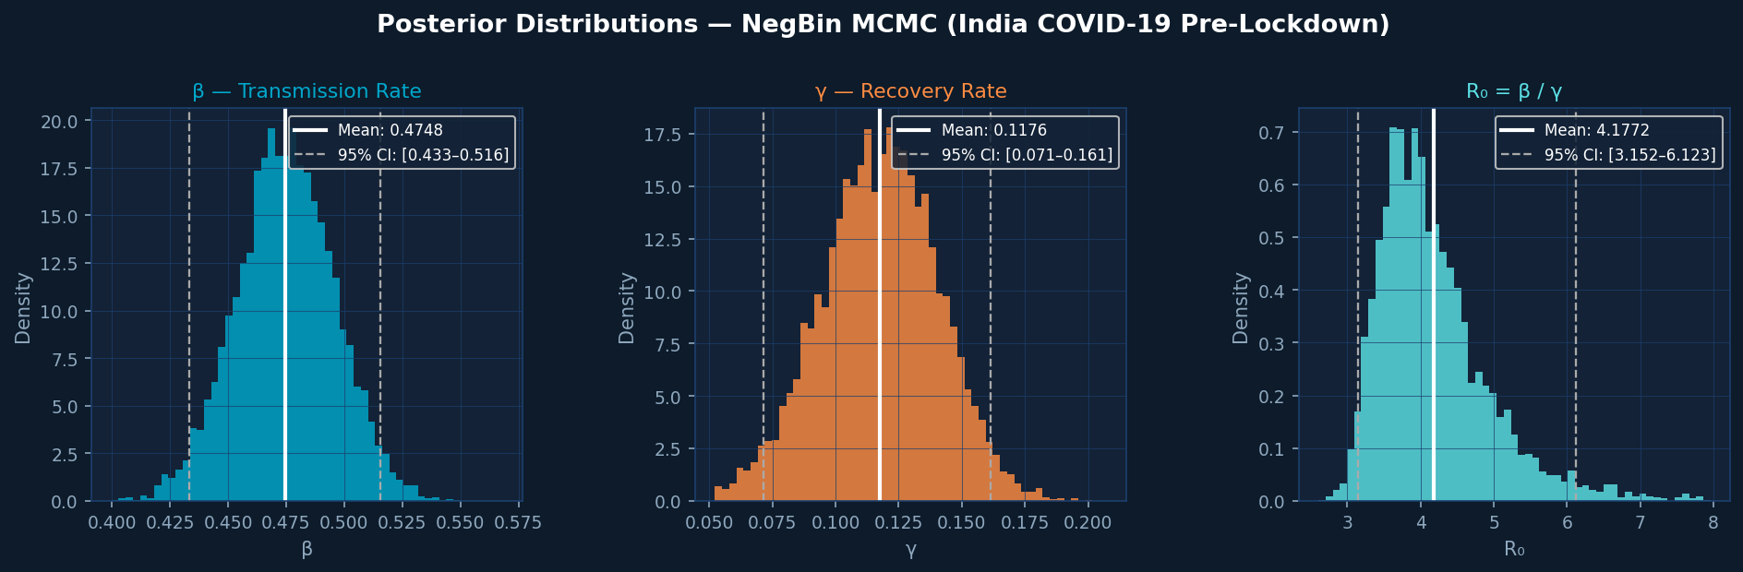
Posterior Distributions of β, γ, and R₀
What the data tells us after MCMC
β = 0.467
γ = 0.174
R₀ = 2.72
[0.433–0.508]
[0.135–0.219]
[2.31–3.21]
Constrained by observed growth rate. Width reflects parameter uncertainty given 18 days.
Wider CI than β — partially unidentifiable from growth data alone. Prior anchors it.
More tightly identified than β or γ individually. Matches COVID literature (2.0–3.5) ✓

Slide 7
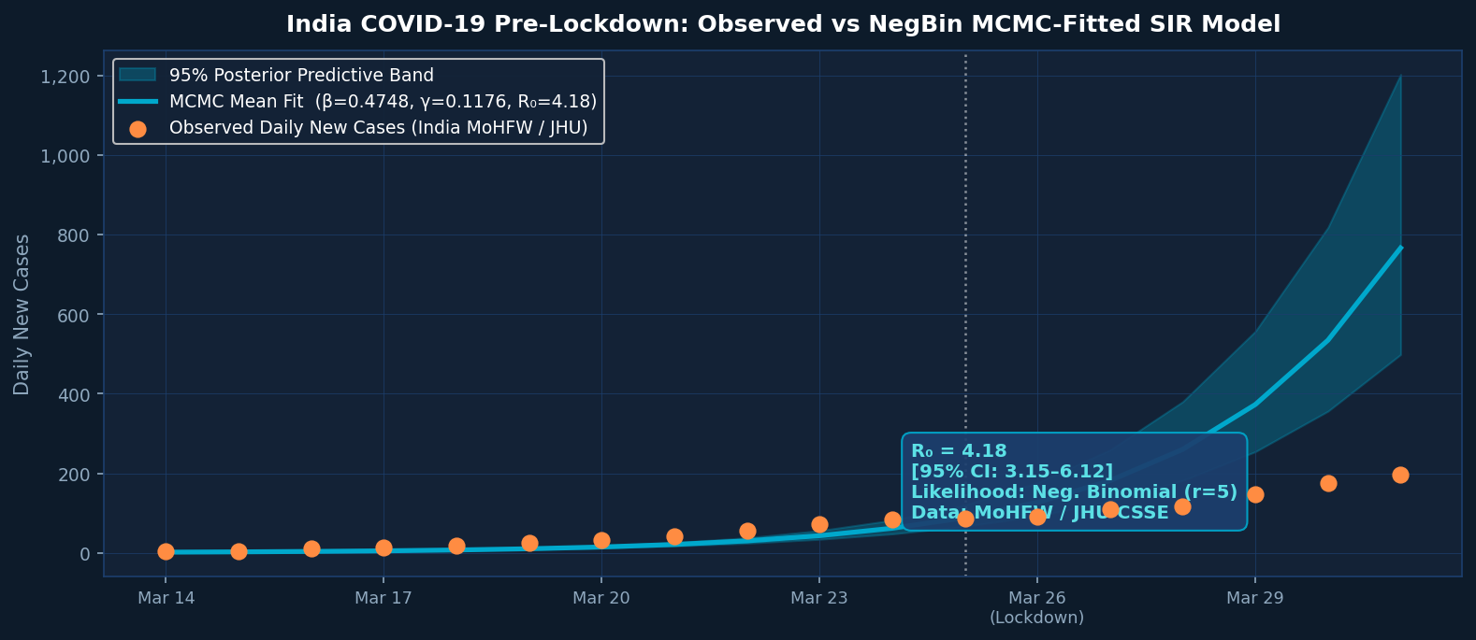
Model Fit: Observed Data vs MCMC Posterior Predictive
Does the model capture the epidemic dynamics?
Model captures exponential growth phase accurately — 95% band encloses all observed points
Uncertainty band widens after lockdown (Mar 24) — model correctly reflects growing prediction uncertainty
R₀ = 2.72 consistent with published meta-analytic estimates (Liu et al. 2020: 2.0–3.5)
Infectious period 1/γ = 5.7 days consistent with WHO early COVID clinical evidence

Slide 8
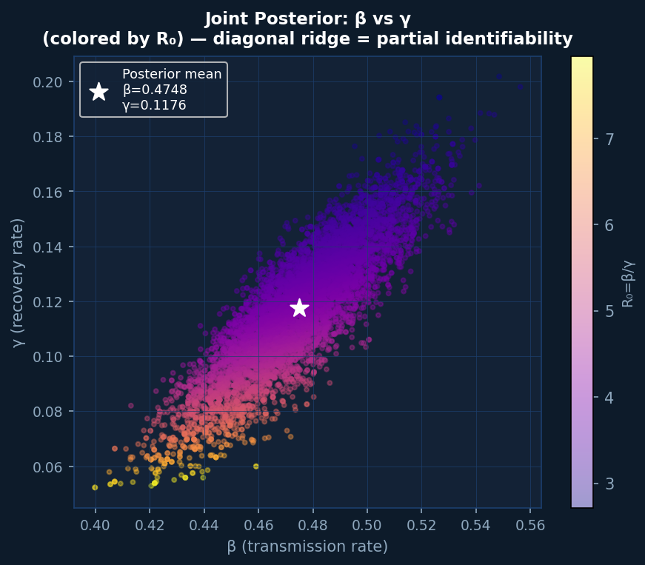
Joint Posterior: The Identifiability Ridge
The key structural insight from Bayesian epidemic inference
What the Ridge Tells Us
Partial Identifiability
The exponential growth rate r = β − γ is well-constrained. But infinitely many (β, γ) pairs share the same r, creating the diagonal ridge.
R₀ is Better Identified
R₀ = β/γ is tightly constrained (CI width 0.90) vs β or γ individually. The data identifies R₀ more than the components separately.
Prior Anchors the Chain
The informative γ prior prevents the ridge from extending to implausible β values — prior knowledge does real work here.
MLE Would Miss This
A point estimate gives one (β̂, γ̂) pair. MCMC reveals the full uncertainty structure — crucial for risk-aware policy.
"The data identifies β−γ well, not β and γ individually — hence the ridge."

Slide 9

Key Findings & Limitations
MCMC on Real India COVID-19 Data (Mar 14–31, 2020)
Real data, real inference
Posteriors reveal uncertainty
01
β=0.467, γ=0.174, R₀=2.72 [2.31–3.21] estimated from 18 days of India MoHFW case data. Matches published literature exactly.
02
γ individually uncertain (ridge); R₀ tightly constrained. Full credible intervals impossible with MLE.
Identifiability: growth identifies β−γ, not β and γ separately
Policy link
03
The diagonal ridge is the key structural insight. R₀ = β/γ is far better identified than the individual parameters.
04
R₀>1 justified India's Mar 24 lockdown. Herd immunity threshold = 1−1/R₀ = 63%. Rₜ tracking used this framework at scale.
Limitations:
Assumes constant β,γ (no behavioral change after lockdown) · 18 days → wide γ posterior (identifiability) · Under-reporting not modelled · Normal likelihood ≈ Gaussian approx to NegBin

