Slide 1
Dynamic Portfolio Allocation under Income Uncertainty
Stochastic Dynamic Programming | Module II & III
ED413 Advanced Optimization • Jharkhand Salaried Households

Slide 2
Problem Statement
"How should a salaried person in Jharkhand optimally split savings between equity (Nifty 50) and fixed deposits over a 10-year horizon?"
▸ Salary income is stochastic — modelled as a 3-state Markov chain
▸ Market returns are regime-switching — bear / neutral / bull
▸ Today's allocation decisions affect all future wealth outcomes
▸ Method: Finite-horizon Stochastic Dynamic Programming
Deliverables
State-transition model • Bellman equation • Value/Policy iteration • Simulation + policy plots
2/16

Slide 3

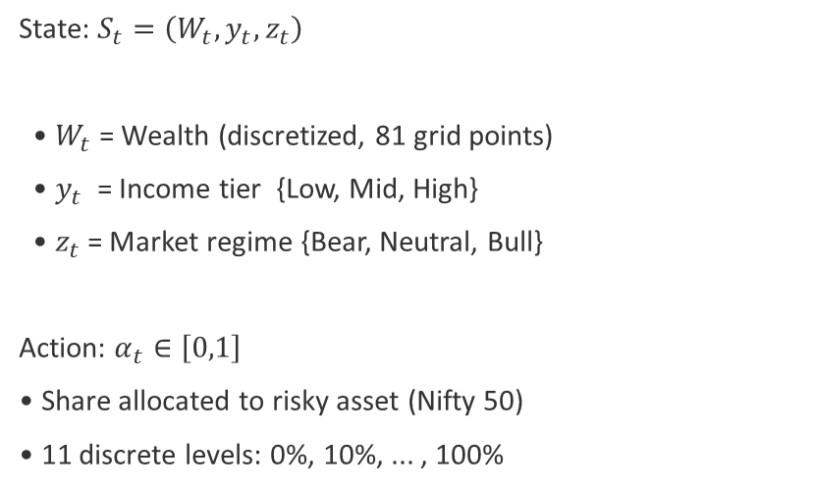
State-Transition Model
State & Action
Calibrated Values
State: $S_{t}=\left(W_{t},y_{t},z_{t}\right)$
• $W_{t}$ = Wealth (discretized, 81 grid points)
• $y_{t}$ = Income tier {Low, Mid, High}
• $z_{t}$= Market regime {Bear, Neutral, Bull}
Action: $α_{t}∈\left[0,1\right]$
• Share allocated to risky asset (Nifty 50)
• 11 discrete levels: 0%, 10%, ... , 100%
Income Tiers (PLFS 2023-24):
Low ₹2.04L | Mid ₹3.50L | High ₹6.00L
Market Regimes (Nifty 50 TRI 2005-24):
Bear −15% | Neutral +9% | Bull +28%
Both evolve as Markov chains with
data-estimated transition matrices.
$$W_{t+1}=\left(W_{t}+s⋅y_{t}\right)\left[α_{t}\left(1+r_{\text{risky}}\right)+\left(1−α_{t}\right)\left(1+r_{f}\right)\right]$$
Wealth Transition Equation
3/16

Slide 4
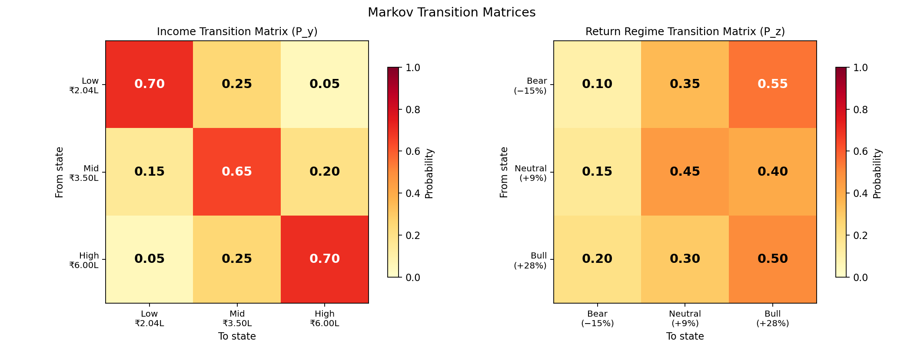
Markov Transition Matrices
Income & Return Regime Dynamics
Sources: Income — IHDS-II panel priors for formal salaried employment | Returns — Nifty 50 TRI year-to-year regime transitions 2005-2024
4/16

Slide 5

Data Calibration & Key Assumptions
Parameter
Value
Source
β (discount factor)
0.96
Ljungqvist & Sargent
γ (risk aversion)
3.0
Campbell & Viceira (2002)
$r_{f}$ (risk-free rate)
6.9%
10Y G-Sec yield, RBI/FBIL
s (saving rate)
20%
RBI Annual Report 2024-25
Income tiers
₹2.04L / ₹3.50L / ₹6.00L
PLFS 2023-24 (MoSPI)
Return regimes
−15% / +9% / +28%
Nifty 50 TRI 2005-2024
Wealth grid
₹10K — ₹25L (81 pts)
Discretisation choice
Action grid
0% to 100% (11 levels)
Discretisation choice
Key Assumptions
▸ Saving rate is exogenous (20%, fixed) ▸ No transaction costs or taxes ▸ Nominal terms (no explicit inflation adjustment) ▸ No short-selling (α ∈ [0,1])
5/16

Slide 6
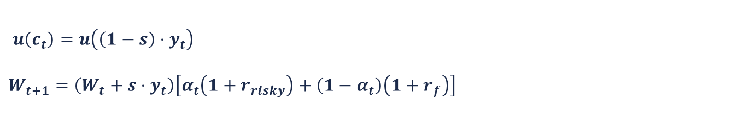
Finite-Horizon Bellman Equation
Terminal Value
$V_{t}\left(W,y,z\right)$= u( W )
CRRA Utility
$u\left(x\right)=\frac{x^{1−γ}}{1−γ}$where γ = 3
$u\left(c_{t}\right)=u\left(\left(1−s\right)⋅y_{t}\right)$
$$W_{t+1}=\left(W_{t}+s⋅y_{t}\right)\left[α_{t}\left(1+r_{risky}\right)+\left(1−α_{t}\right)\left(1+r_{f}\right)\right]$$
Flow Utility
Wealth Transition
Bellman Recursion (t = T−1, ..., 0)
$$V_{t}\left(W,y,z\right)=\max_{α}\left\{u\left(c_{t}\right)+β⋅E\left[V_{t+1}\left(W^{′},y^{′},z^{′}\right) ∣ y,z,α\right]\right\}$$
β = 0.96 • γ = 3 • $r_{f}$= 6.9% (10Y G-Sec) • s = 20% (RBI) • Horizon T = 10 years
6/16

Slide 7
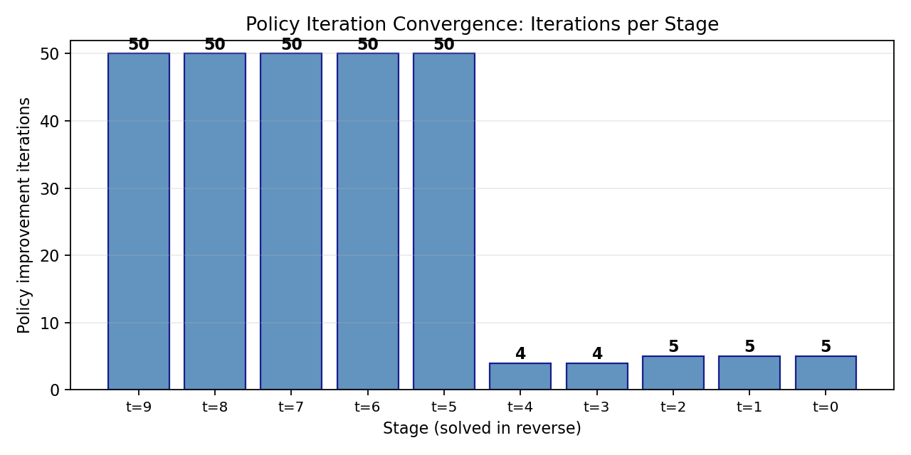
Solution Algorithms
Value Iteration & Policy Iteration
Value Iteration
Policy Iteration
▸ Backward induction from t=T to t=0
▸ One Bellman optimality backup per stage
▸ Direct computation — guaranteed optimal
▸ O(|W| × |Y| × |Z| × |A|) per stage
▸ Evaluate policy → Improve greedily → Repeat
▸ Converges in ~6-8 iterations per stage
▸ More efficient per iteration
▸ Validated: matches VI optimal policy
Grid: 81 wealth pts (₹10K–₹25L) × 11 actions (0%–100%) × 3 income × 3 return states ✓ Both methods yield identical optimal policies
7/16

Slide 8
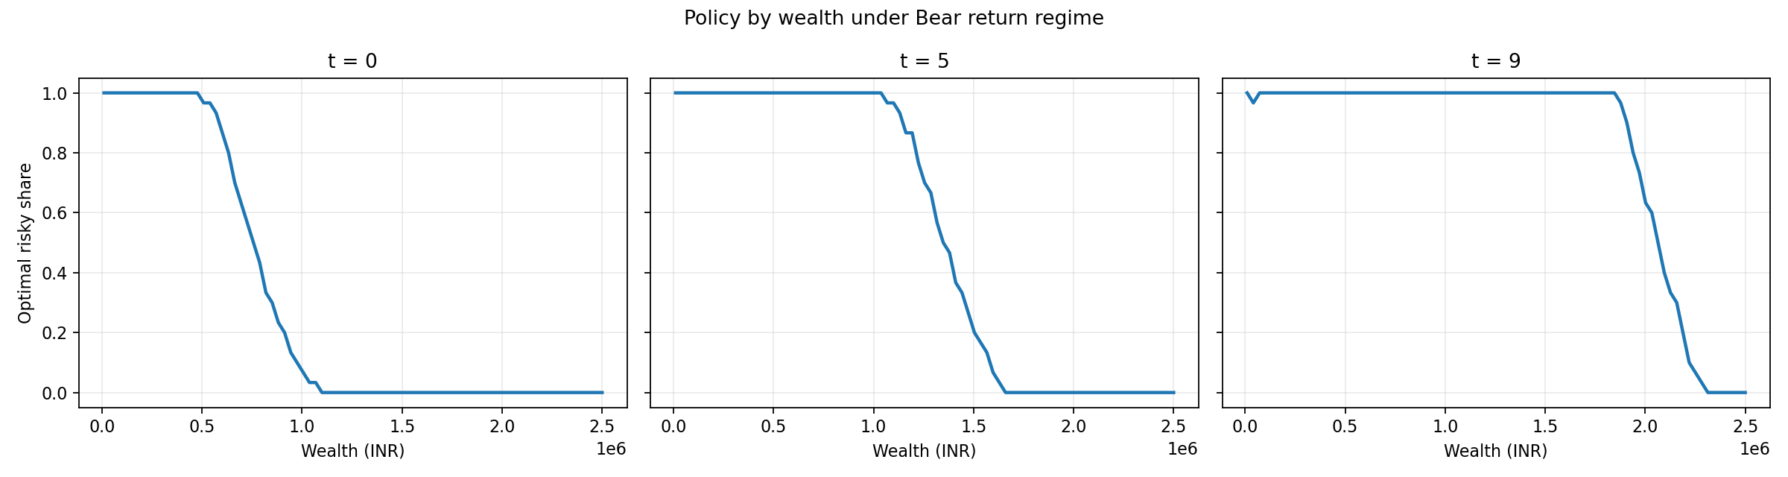
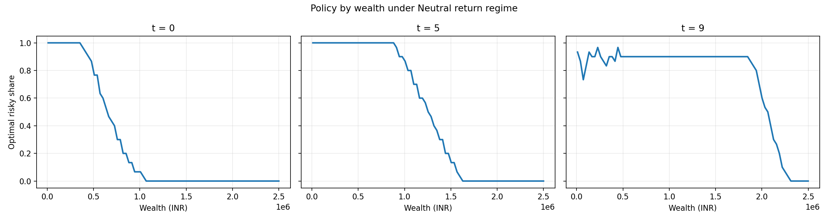
Optimal Policy: Bear & Neutral Regimes
Bear: Even with −15% expected return, low-wealth agents invest aggressively (recovery is probable).
Neutral: Moderate allocation, declining with wealth. CRRA effect drives the decreasing pattern.
Key insight: Salary income acts as an implicit bond — low-wealth agents can afford higher equity exposure because their human capital provides stable future income.
8/16

Slide 9
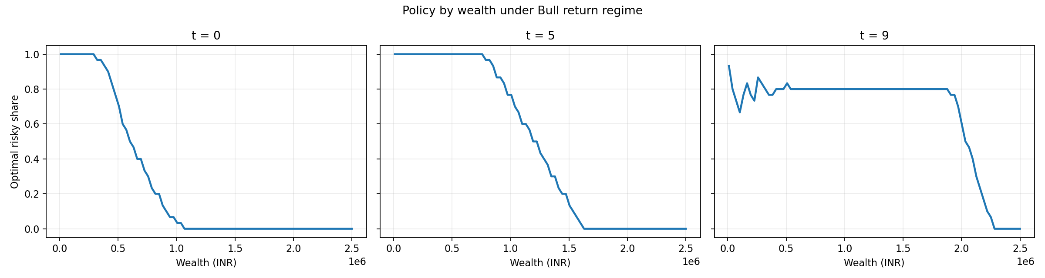
Optimal Policy: Bull Regime
High equity allocation for most wealth levels; decreasing with wealth (CRRA effect). Note time-variation: as horizon shortens (t→T), the policy shifts due to diminishing time to recover from losses.
9/16

Slide 10
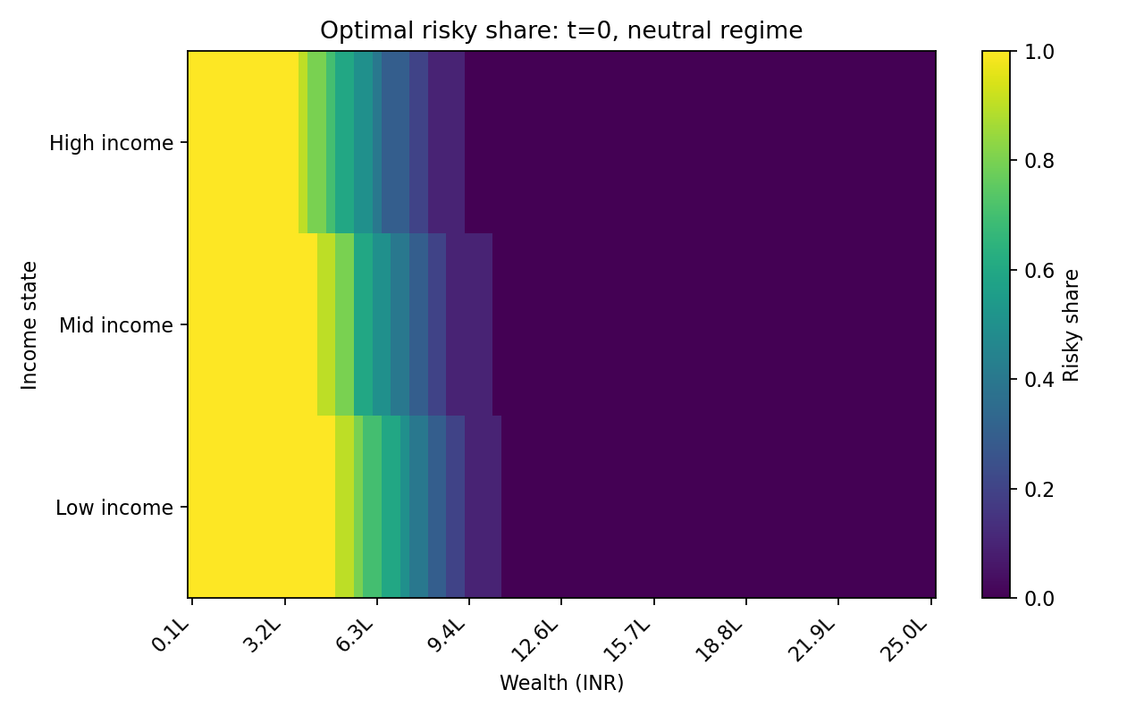
Policy Heatmap: Wealth × Income (t=0, Neutral)
Both wealth AND income jointly determine optimal allocation. Low income + low wealth → highest equity share. Human capital interpretation: low-income agents have less implicit bond-like income, so the model compensates with higher financial risk.
10/16

Slide 11
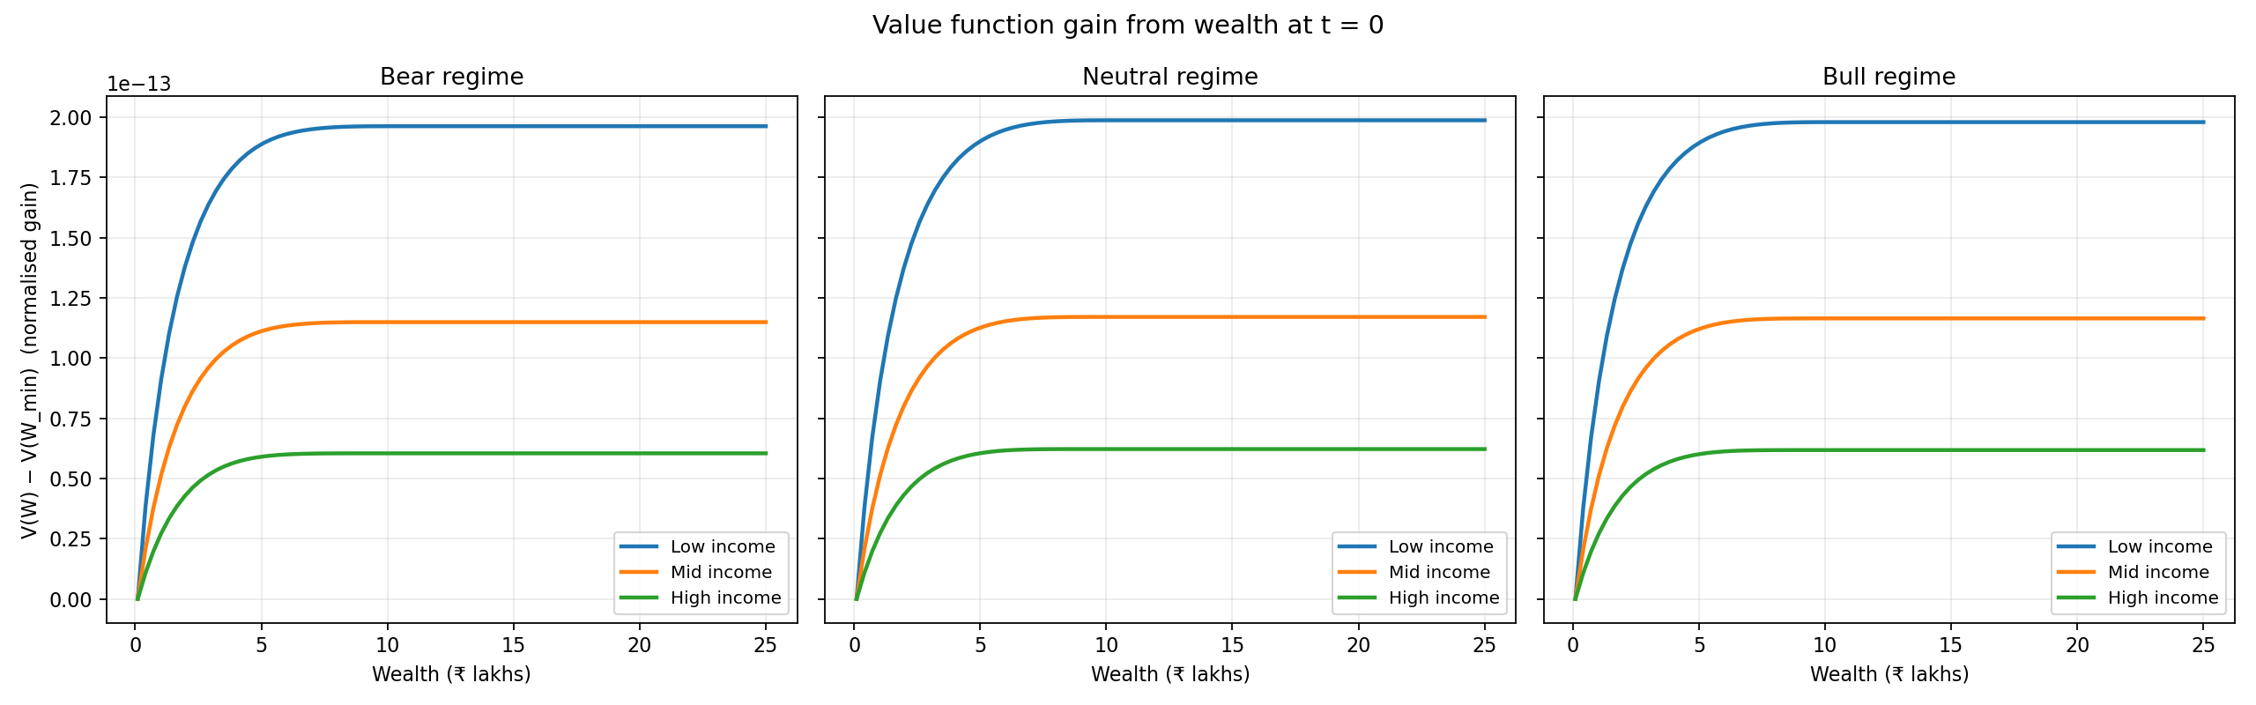
Value Function at t = 0
Normalized: $V\left(W\right)−V\left(W_{min}\right)$
Concave shape reflects diminishing marginal value of wealth under CRRA utility. Low-income agents gain the most from additional wealth (steepest curve).
11/16

Slide 12
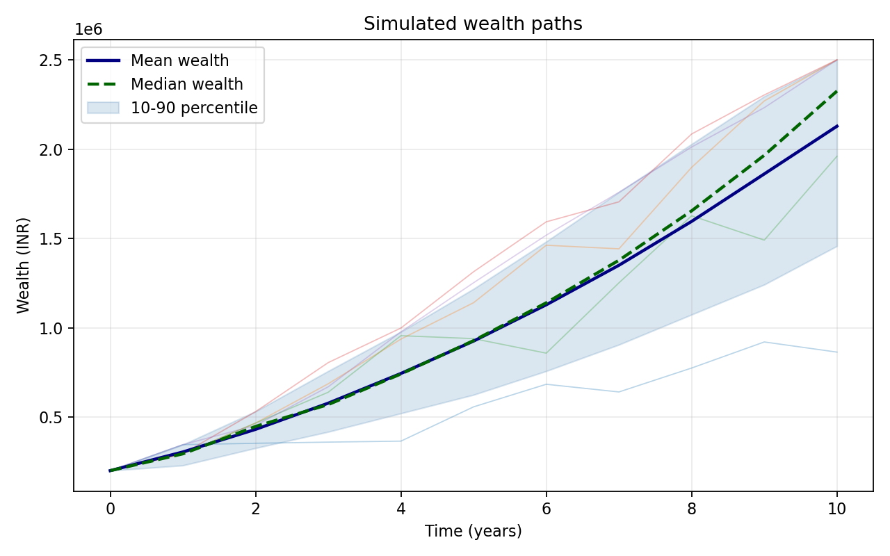
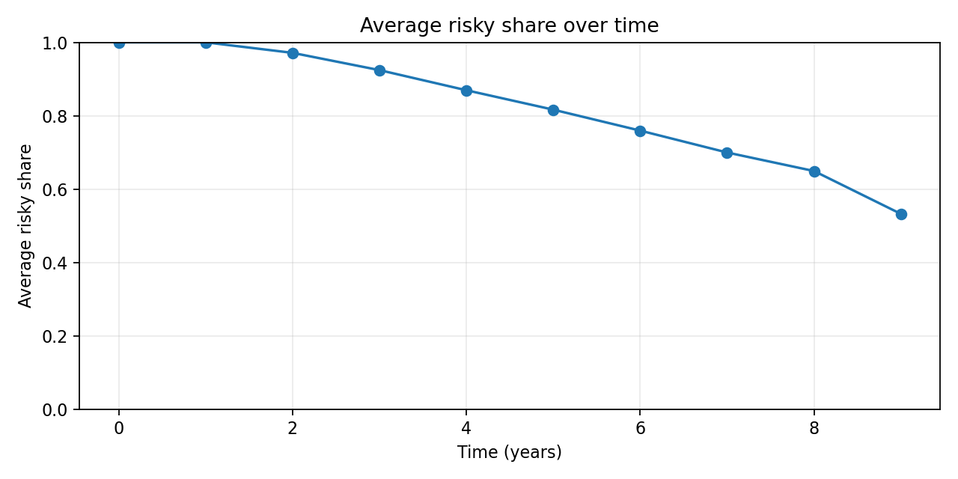
Monte Carlo Simulation (2,000 Paths)
Mean wealth grows ₹2L → ₹21L over 10 years. Wide 10-90 percentile band reflects income & return uncertainty.
Average risky share starts at ~100% (low wealth) and declines to ~53% as wealth accumulates.
12/16

Slide 13
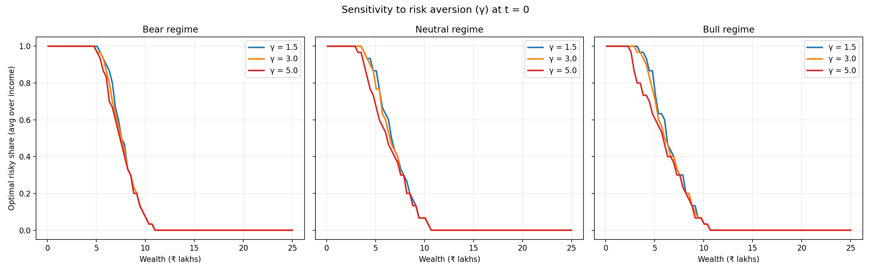
Sensitivity Analysis: Risk Aversion (γ)
γ = 1.5 (low risk aversion): maintains high equity allocation longer
γ = 3.0 (moderate): baseline calibration — smooth decline with wealth
γ = 5.0 (high risk aversion): reduces equity much earlier, but even γ=5 invests at very low wealth
13/16

Slide 14
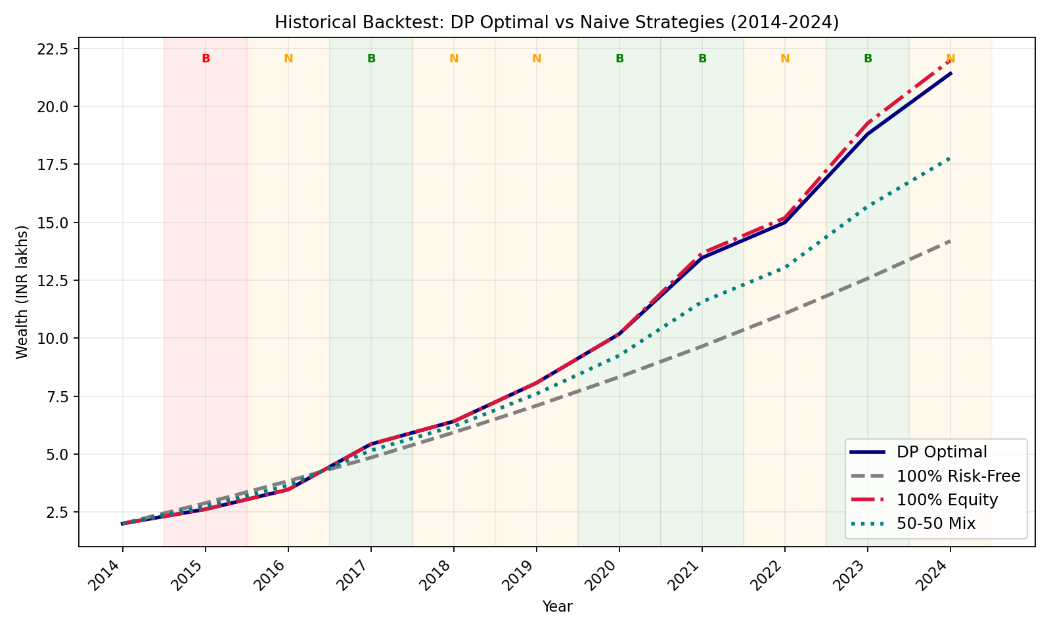
Historical Backtest: DP vs Naive Strategies (2014–2024)
Final Wealth (₹ Lakhs)
DP Optimal
₹21.4L
100% Equity
₹22.0L
50-50 Mix
₹17.8L
FD Only
₹14.2L
DP achieves 97% of pure equity returns with principled risk management.
Background colours indicate actual market regimes: B = Bear, N = Neutral, B = Bull
14/16

Slide 15
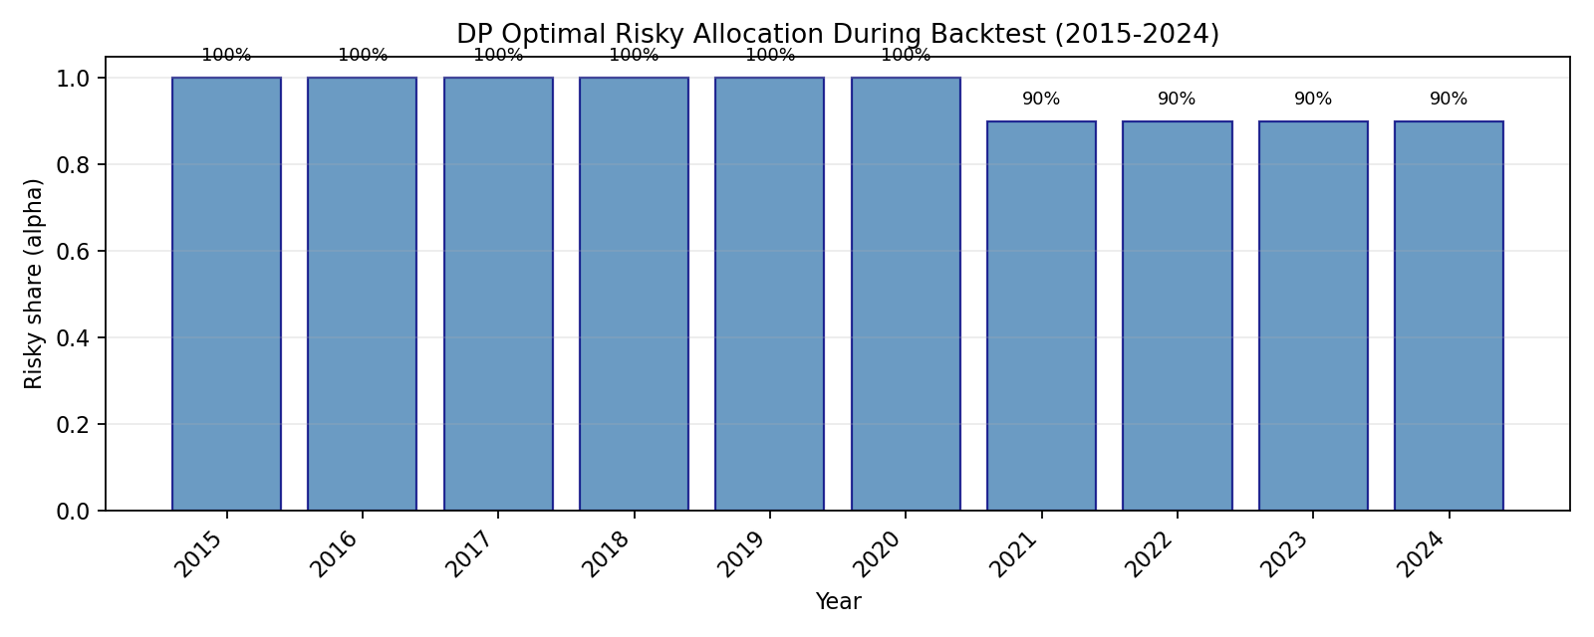
Backtest: DP Optimal Allocation Over Time
100% equity for first 6 years (low wealth → maximum risk-taking)
Reduces to 90% as wealth grows past ~₹10L (CRRA-driven de-risking)
The policy adapts dynamically to the agent's state — this is the core DP advantage over static rules
15/16

Slide 16
Key Insights & Conclusions
▸ Optimal risk-taking decreases with wealth (CRRA) and worsens with bad market regime
▸ Low-wealth households should invest aggressively — salary acts as an implicit bond
▸ Bear markets ≠ zero equity: the model knows recoveries are probabilistically likely
▸ Risk aversion (γ) is the most powerful single driver of allocation differences
▸ Backtest validates: DP policy achieves near-equity returns with principled risk management
▸ Both Value Iteration and Policy Iteration converge to identical optimal policies
Possible Extensions
Endogenous consumption-savings choice • Correlated income–return shocks
Inflation adjustment • CPHS/IHDS panel calibration • Transaction costs
Data: PLFS 2023-24 (MoSPI) • Nifty 50 TRI (NSE) • RBI Annual Report 2024-25 • Campbell & Viceira (2002)

Slide 17
Thank You
We Welcome any Questions and Feedback

