Slide 1
Time Series Analysis of Electricity Generation in India (2019–2025)
ED 405 Time Series Econometrics
Vivek Kumar
IED/10008/22

Slide 2
TABLE OF CONTENTS
01.
02.
03.
04.
05.
Introduction
Problem & Research Questions
Data
Methodology
Results & Takeaways

Slide 3
01 Introduction
Energy consumption is a key indicator of:
Economic activity
Energy demand
Industrialization

Slide 4
Questions addressed:
02 Problem & Research Questions
Problem: India’s electricity generation shows strong monthly fluctuations and an upward trend, but the underlying patterns and seasonality are unclear.
What are the key trend and seasonal components in India’s electricity generation?
Is the time series stationary?
Which time series model best fits the data?
What can we expect for the next 12 months of generation?

Slide 5
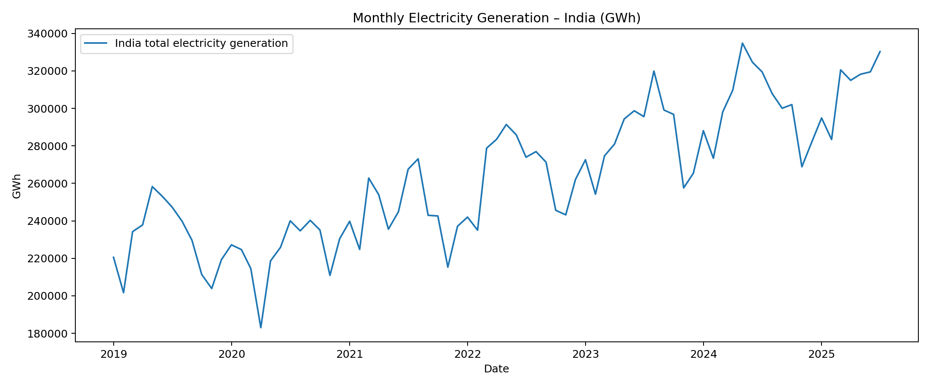
03 Data
Source: Ember Energy – India Electricity Data (2019-2025) (https://ember-energy.org/data/india-electricity-data/)
Summary:
Mean: ~2,63,000 GWh/month
Range: 1,83,000 – 3,35,000 GWh
Increasing trend with strong seasonality (summer peaks)

Slide 6
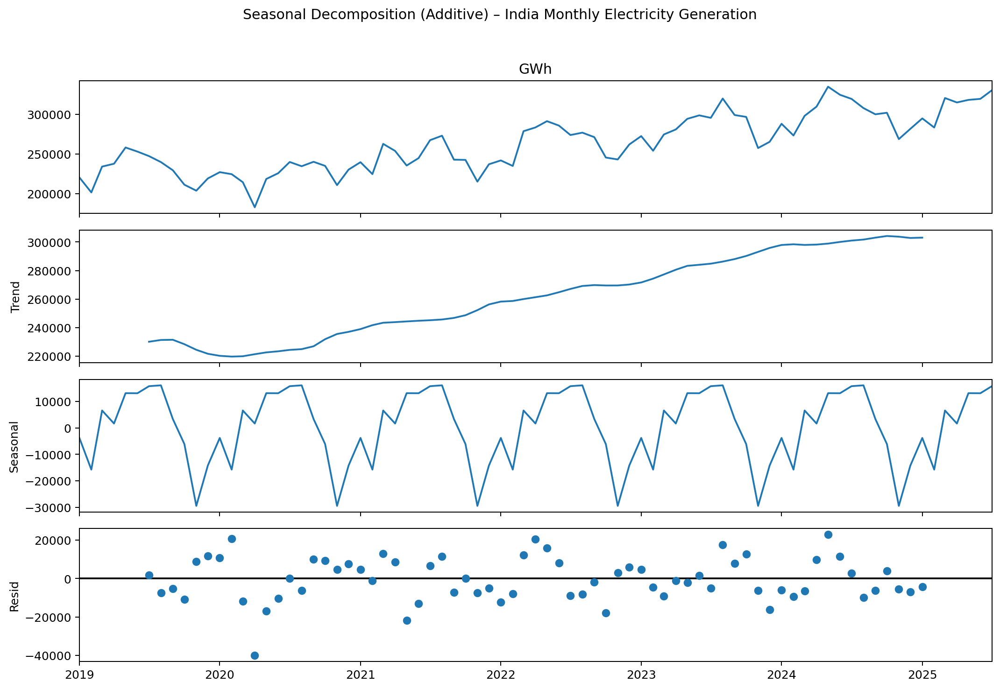
04 Methodology: Decomposition & SARIMA Modeling
Stationarity Test:
Augmented Dickey-Fuller
p ≈ 0.98 at level → non-stationary
p < 0.001 after 1st difference → stationary
Model:
Seasonal ARIMA
Selected by AIC → SARIMA (1, 1, 1)×(0, 1, 1)₁₂

Slide 7
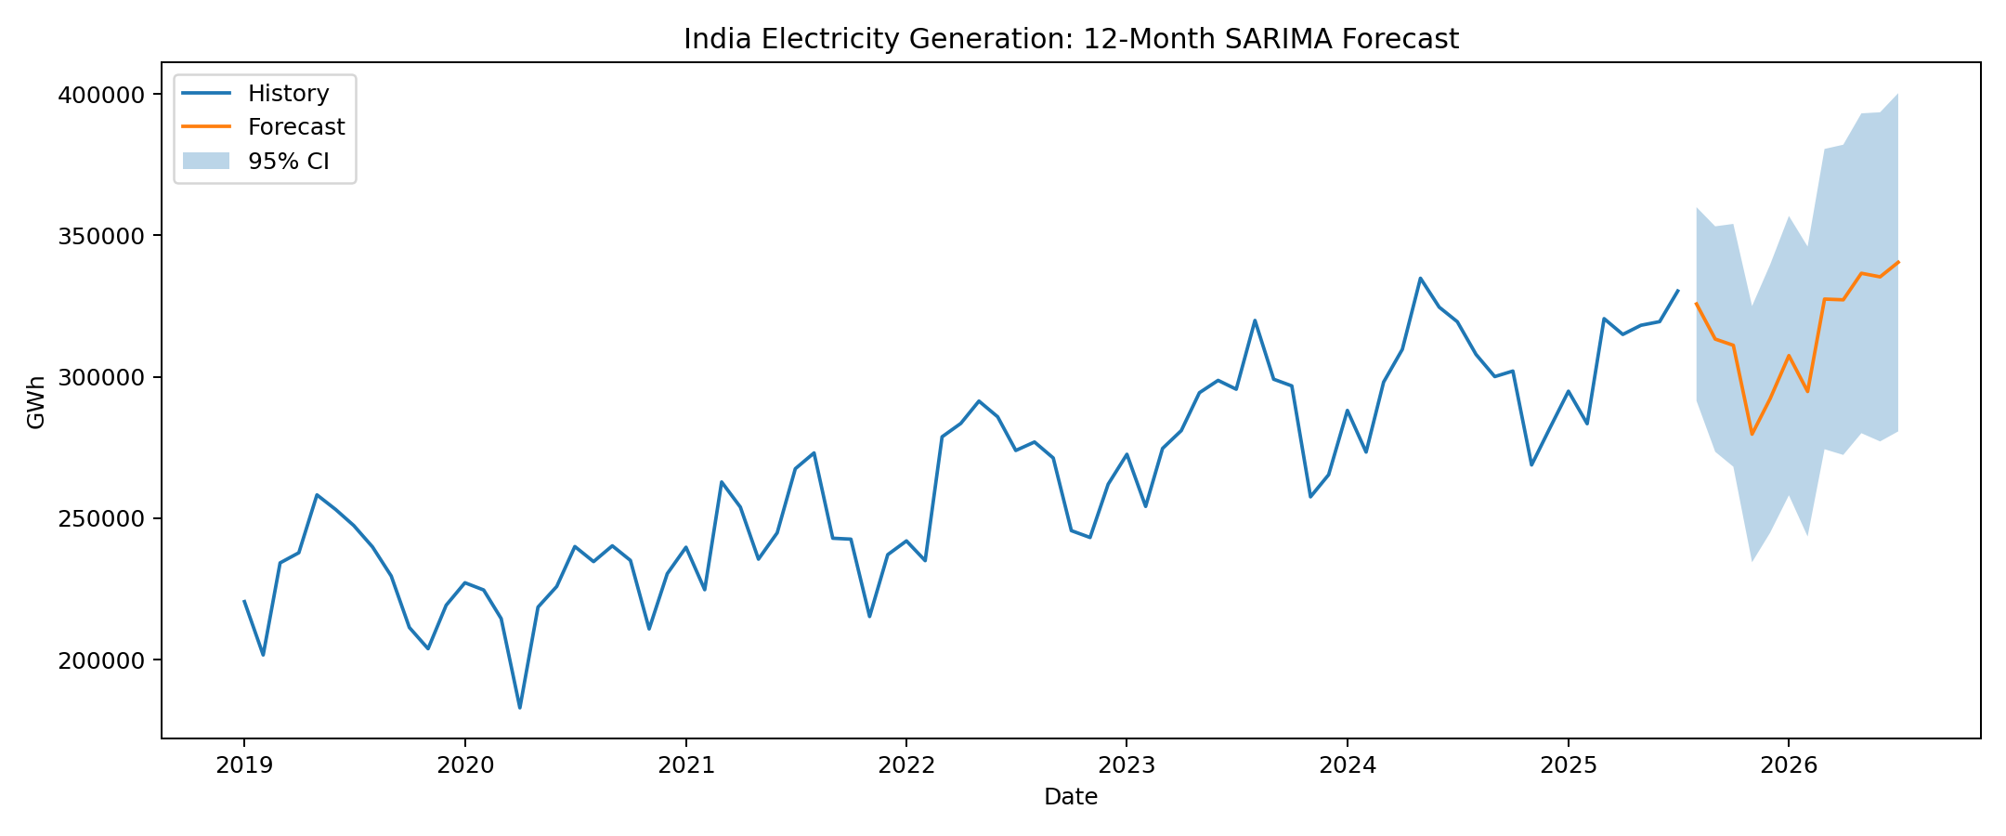
05 Results & Takeaways
Clear annual seasonality
Strong upward trend
+6–8% expected increase in next 12 months
India’s electricity generation is steadily growing and seasonally driven.
SARIMA provides a statistically sound baseline for short-term forecasting.

Slide 8
THANK YOU
Do you have any questions?
ied10008.22@bitmesra.ac.in
7870145339
Please keep this slide for attribution

Slide 9
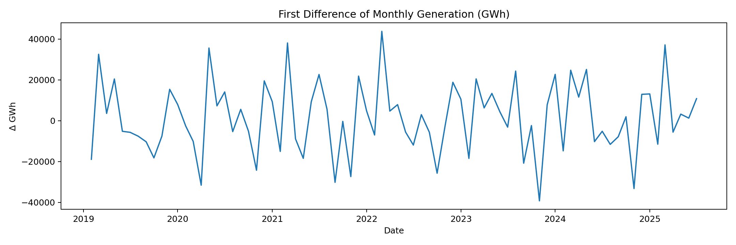
Appendix-I (First Differencing)
After first diff. it became stationary.

Slide 10
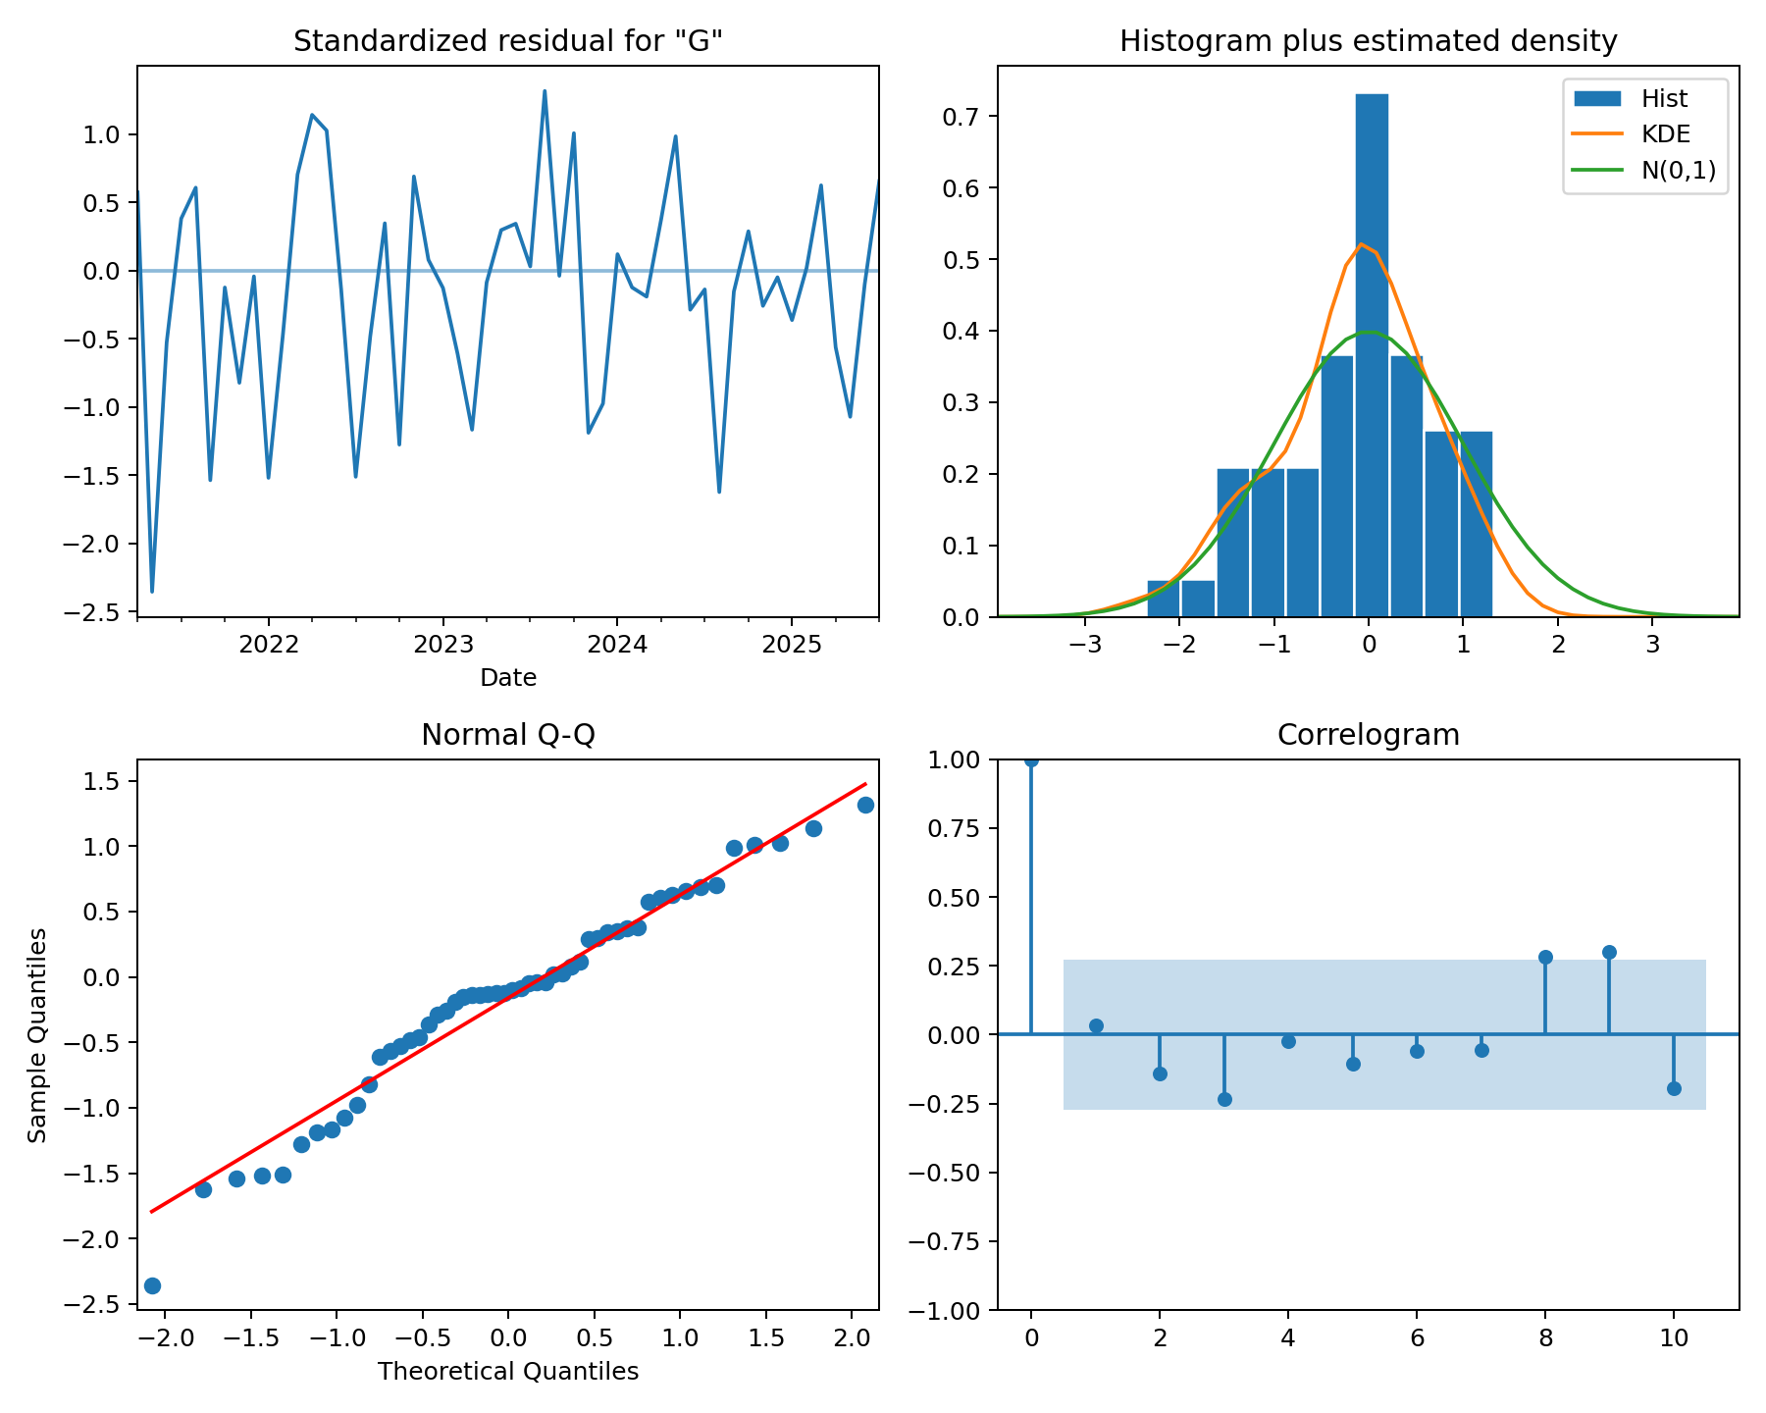
Appendix-II (Diagnostics)
Residuals should look like white noise (no visible pattern).
Checks if residuals are roughly normally distributed.
Correlogram: Tests if residuals are autocorrelated.

