Slide 1
Name: Kalabe Kebede
Lab5_Solutin
Q1. Create/draw the domain model (Class diagram) including as many of the classes, attributes, relationships, and multiplicities as possible.
Solution:
This is my current class diagram including attributes, relationships, and multiplicities may I will add more classes when I will be implementing it to get all functionality?

Slide 2
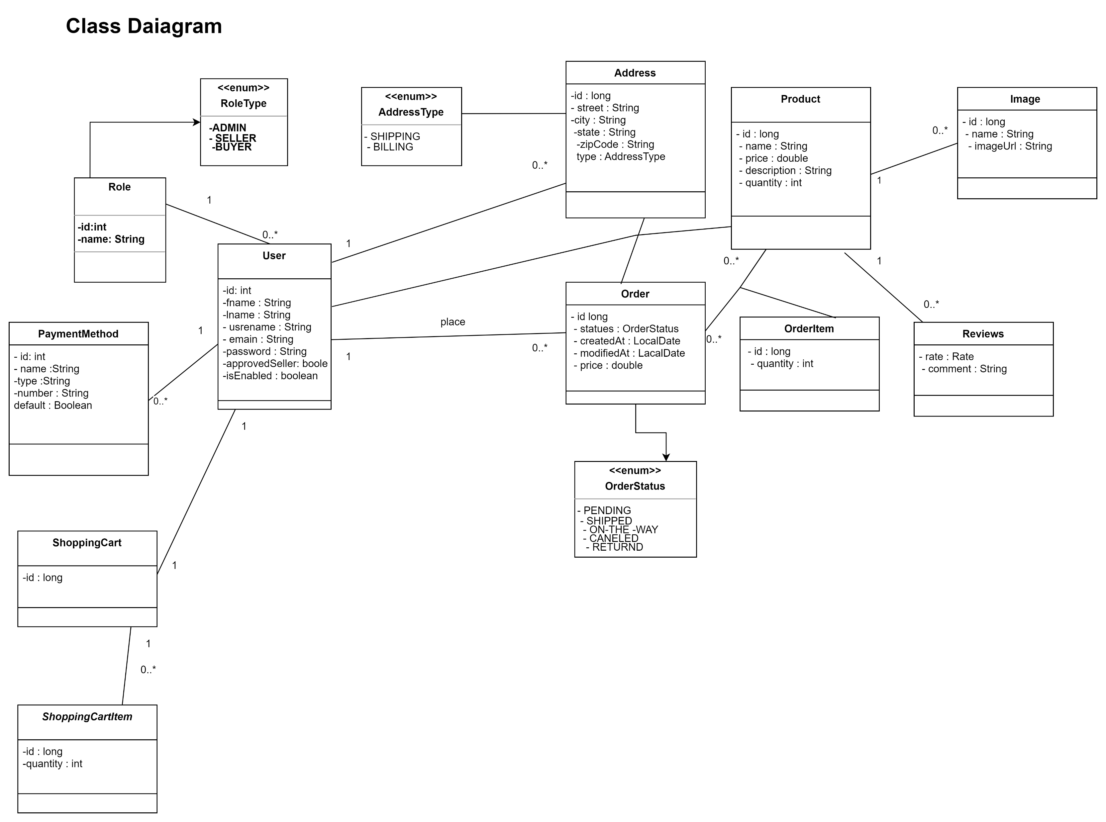

Slide 3
1. Seller logs in to the system
2. System shows all seller products and an option to add products.
3. Seller chooses to add product.
4. System displays new product form.
5. Seller enters product name, description, quantity, images, and price, and submits it.
6. System displays a success message for adding a product.
7. System goes back to point #2.
If the seller enters the wrong data in the form fields:
6. System displays an error message above each required field.
7. Seller corrects info and submits again.
8. System displays the success message of adding a product.
9. System goes back to point #2.
If the product is a duplicate for the same seller:
6. System displays a message mentioning this is a duplicate product.
7. Seller corrects info and submits again.
8. System displays the success message of adding a product.
9. System goes back to point #2.
Scenarios add product:

Slide 4
Scenarios approve seller registration
1. Admin enters the login credentials.
2. The system displays an option to the list of newly registered sellers and an option to the list of reviews.
3. Admin selects a list of sellers.
4. System displays the list of newly registered sellers that are pending to be approval.
5. Admin selects approve seller on a seller of his/her choice.
6. System displays a success message.
7. System goes back to point #4.
If admin denies seller:
5. Admin selects deny seller on a seller of his/her choice.
6. System displays that the seller has been successfully denied.
7. Continue at point #4 of the main scenario

Slide 5
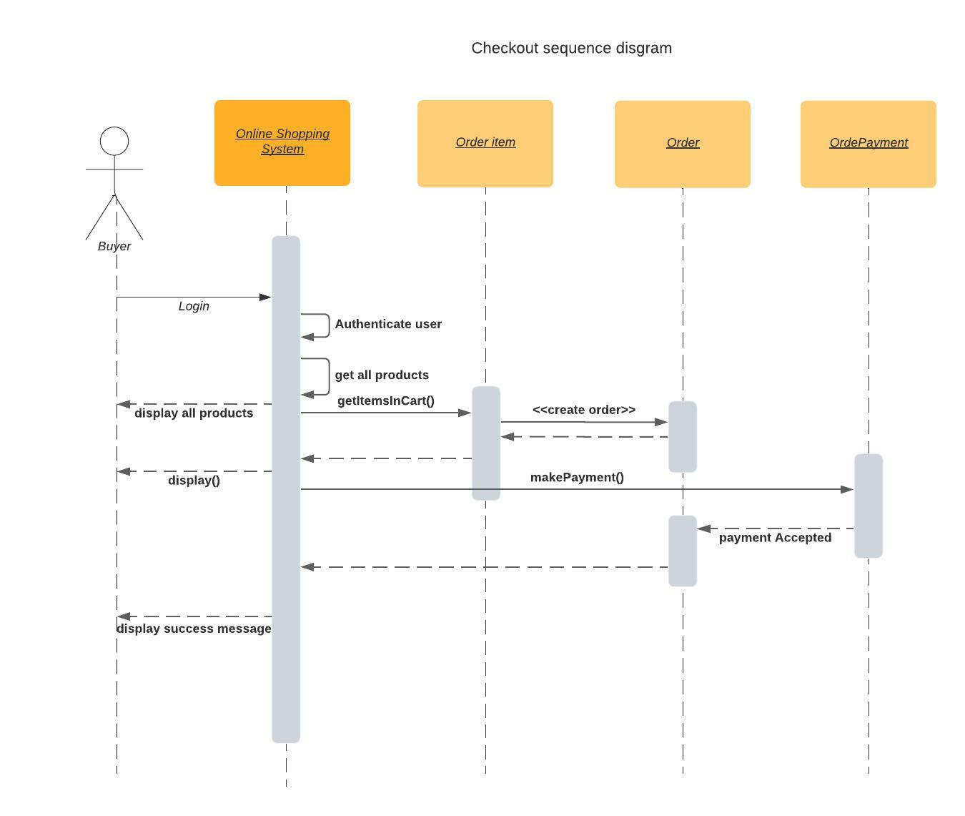
Checkout sequence diagram

Slide 6
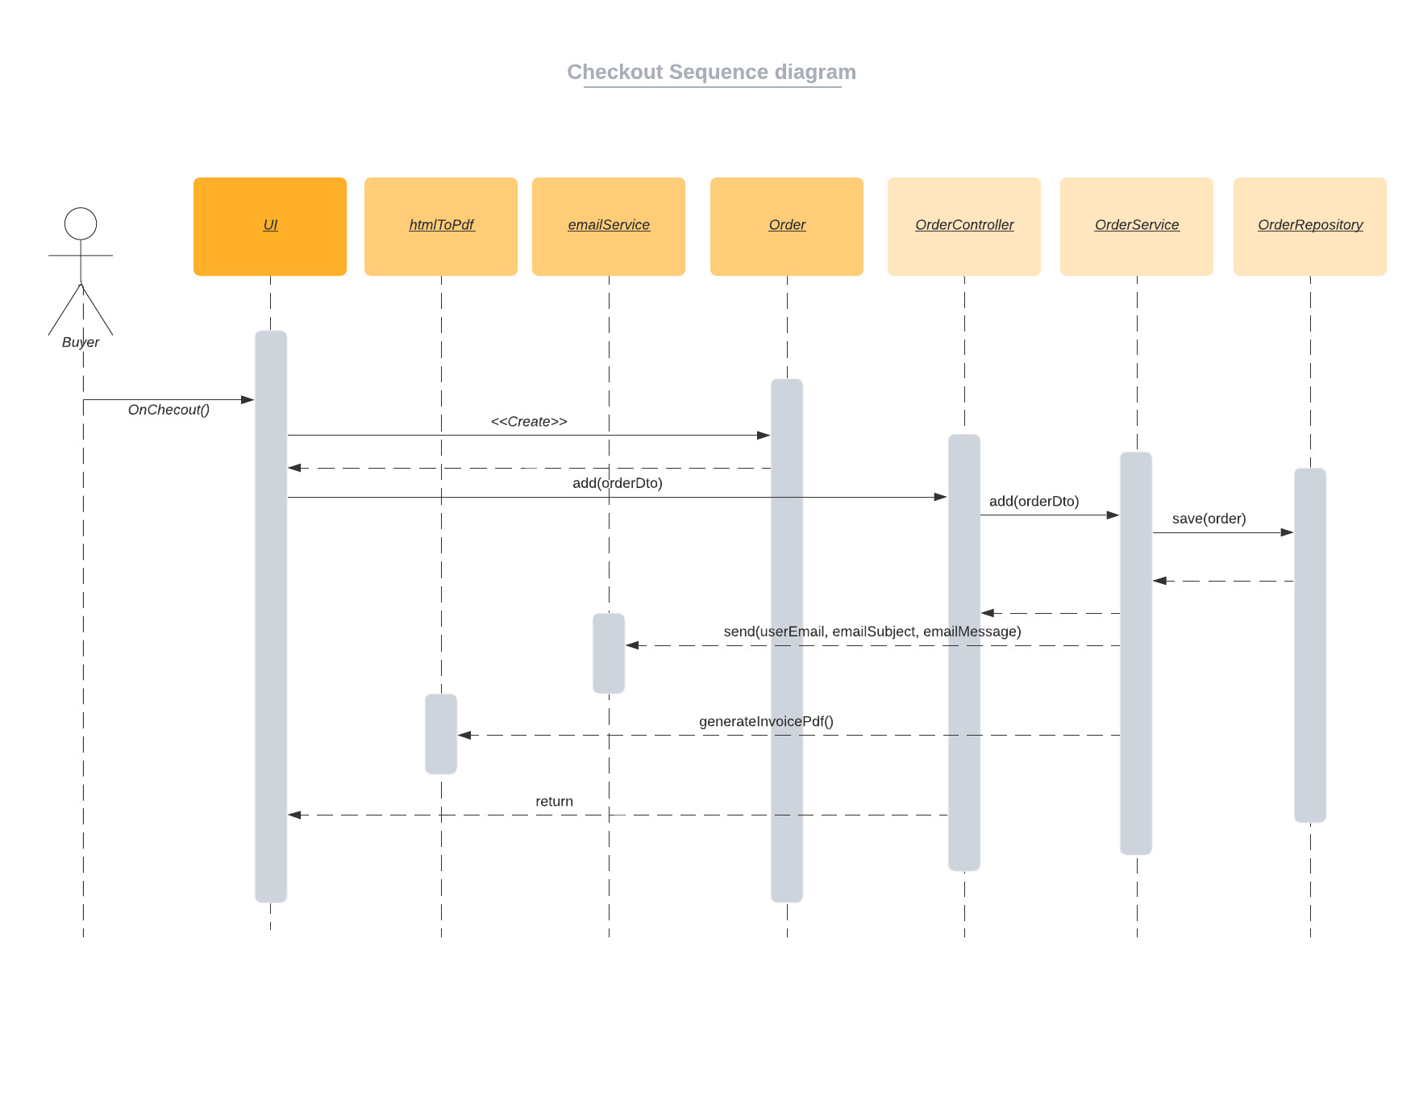
Checkout sequence diagram

