Slide 1
Java - Overview
Unit 1
Java: Overview– Variables and Arrays – Classes – Objects – Methods – Inheritance - Packages – Abstract classes – Interfaces and Inner classes

Slide 2
COURSE OUTCOME
At the end of the course, the students will be able to
Implement the concepts of java in real time application
Develop JDBC applications
Design and develop websites using HTML, JavaScript and CSS
Design and develop real-time web applications using PHP and Servlet
Build interactive web pages using XML and AJAX

Slide 3
Different Programming Paradigms
Functional/procedural programming:
program is a list of instructions to the computer
Object-oriented programming
An object in OOP language refers to a specific type or an instance of a class.
program is composed of a collection objects that communicate with each other
Object- Properties and behavior
Notes:
flexibility, easing changes to programs
easier to learn
simpler to develop, maintain and analysize

Slide 4
Procedural programming Vs OOP
It is difficult to add any new functionality or to upgrade a program.
Functions have unrestricted access to global data.
Importance is given to the operation on data rather than the data itself.
Quickly and easily carry out modification.
This approach makes it easier for programmers to change and update the program.
OOPs has made developing large programs more manageable.

Slide 5
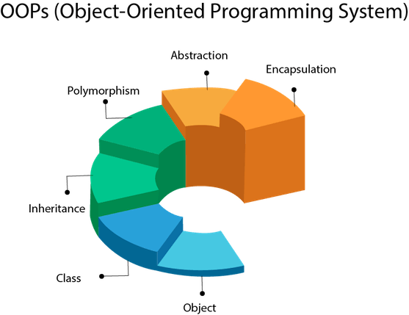
Object-oriented programming concepts
Abstraction
Encapsulation
Inheritance
Polymorphism

Slide 6
Characteristics of Object-Oriented Programming
Data Abstraction
It is the process of extracting the most relevant characteristics of
object data.
These characteristics should be uniformly possessed by all the
objects of the class.
E.g. Car

Slide 7
Characteristics of Object-Oriented Programming
Encapsulation and Information Hiding
It is a mechanism of wrapping the data and methods into a single
unit called class.
The data of a class may be hidden so that it cannot be accessed by
the outside code.
Classes have the provision to hide the data or methods from the
user.
A class member may be declared as public, protected or private.
A member declared as private cannot be accessed by any code outside the
class.
Only class members can access a private member.

Slide 8
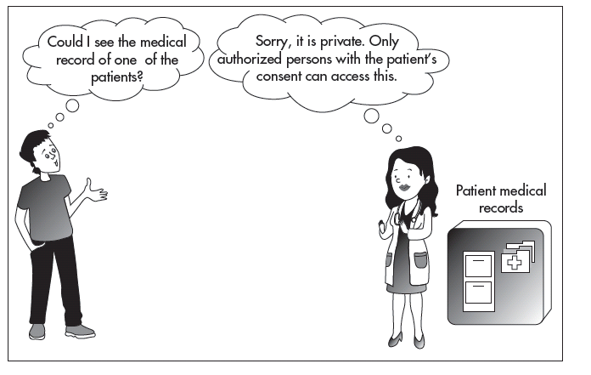
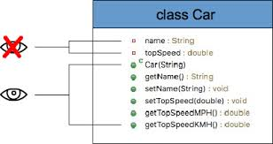
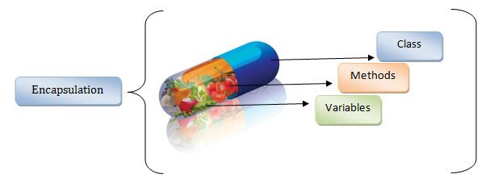
Characteristics of Object-Oriented Programming
Encapsulation and Information Hiding
Encapsulation - wrapping the data (variables) and code acting on the data (methods) together as a single unit.
In encapsulation, the variables of a class will be hidden from other classes, and can be accessed only through the methods of their current class - data hiding.

Slide 9
Access Control to Data Variables and Methods
Public : It is applied to variables, constructors, methods, and classes.
- If any of these data members are declared as public, they are accessible to all classes in all the packages.
Private : It can be applied to variables, constructors, methods, and nested classes (excluding top-level classes).
- A private member is available only to the class in which it is defined and it cannot be accessed by subclasses or any other external class.
Protected : It is applied to variables, constructors, methods, and nested classes (excluding top-level classes).
- It implies that the member can be accessed by the same class, its subclasses, and the classes in the same package.
Default : It can be applied to variables, constructors, methods, and classes. When no access specifier is used, it implies the default access. Here, the member can be accessed by the classes within the same package.

Slide 10
Characteristics of Object-Oriented Programming
Encapsulation and Information Hiding
The one declared protected can be accessed by the class members as well as members of the subclass derived from the class.
A member declared public can be accessed by any outside code.
A class may be declared public or without defining any access modifier.
A public class is accessible to any outside code, whereas the one declared without any access specifier is accessible to classes of the same package only.

Slide 11
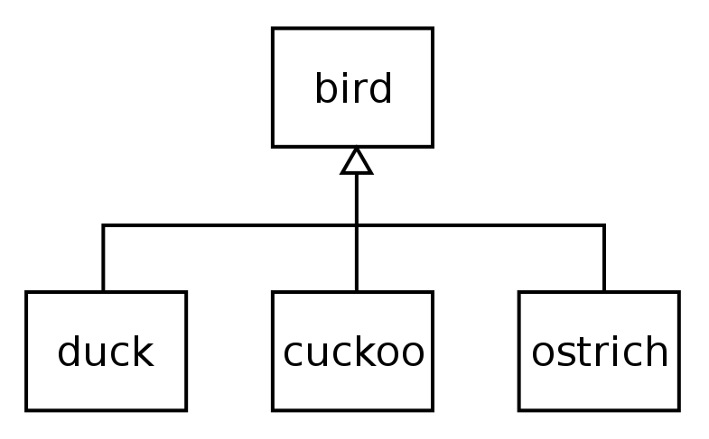
Characteristics of Object-Oriented Programming
Inheritance
A class can inherit another class;
It can make use of the data and methods defined in the base
(inherited) class without any change.
In Java, the base class is called super class.
E.g if class D inherits class B, then class B is called the base class or super class and class D is called the derived class or subclass.

Slide 12
Characteristics of Object-Oriented Programming
Benefits of Inheritance
It allows the reuse of already proven software contained in the super
class without any modification in the subclasses.
The subclass can add on the special features of a subgroup of
objects.

Slide 13
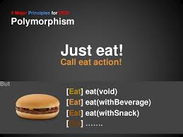
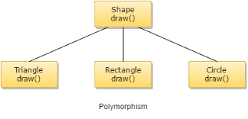
Characteristics of Object-Oriented Programming
Polymorphism
It is the concept by which a method or object takes different forms in different environments
E.g., the operator + adds two whole numbers, two decimal point
numbers, strings
Symbol * (star) shows polymorphic behavior
It is used to multiply two values, incorporate comments such as /* and */, import a package into a program like import java.awt.*;

Slide 14
JAVA Overview
Java is a high-level programming language originally developed by Sun Microsystems and released in 1995.
Java runs on a variety of platforms, such as Windows, Mac OS, and the various versions of UNIX.
The platform independence
Java is a "pure" Object Oriented Language
encapsulation, inheritance, and polymorphism
all code must be contained in a class
no free functions (functions that do not belong to some class) like C++, although someone who wants to write messy Java code certainly can

Slide 15
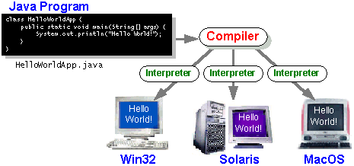
A Picture is Worth…
The output of the compiler is .class file
The Interpreter's are sometimes referred to as the Java Virtual Machines

Slide 16
Characteristics of Java
Java is simple
Java is object-oriented
Java is distributed
Java is interpreted
Java is robust
Java is secure
Java is architecture-neutral
Java is portable
Java’s performance
Java is multithreaded
Java is dynamic

Slide 17
Java Bytecode and Valid .class File
First, the Java compiler generates a class file from its source file (with .java extension).
This class file has .class extension and contains the bytecodes that are platform-independent instructions for Java virtual machine.
JVM interprets the bytecode and then translates these bytecodes into platform-specific machine-level instructions.

Slide 18
Platform Dependent
myprog.c
gcc
myprog.exe
C source code
machine code
OS/Hardware
Platform Independent
javac
myprog.class
myprog.java
bytecode
Java source code
JVM
OS/Hardware

Slide 19
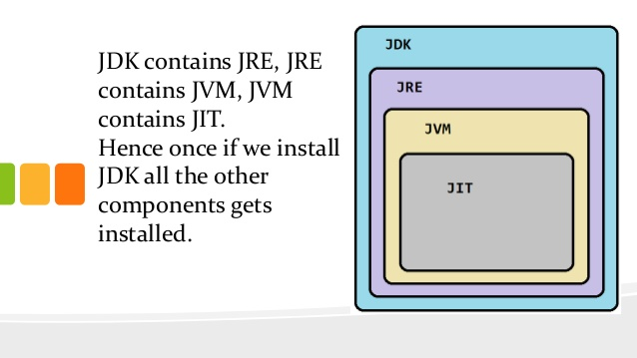
JDK – Java Development Kit
JRE – Java Runtime Environment
JVM – Java Virtual Machine

Slide 20
Exploring JDK
JDK provides the basic tools for developing and testing programs written in Java programming language. JDK developed by Sun (now continued by Oracle) provides a powerful environment for developing applications, applets, and components using Java programming language.
Version
JDK 1.02 (1995)
JDK 1.1 (1996)
Java 2 SDK v 1.2 (a.k.a JDK 1.2, 1998)
Java 2 SDK v 1.3 (a.k.a JDK 1.3, 2000)
Java 2 SDK v 1.4 (a.k.a JDK 1.4, 2002) etc
Java Standard Edition (J2SE) : J2SE can be used to develop client-side standalone applications or applets.
Java Enterprise Edition (J2EE) : J2EE can be used to develop server-side applications such as Java servlets and Java ServerPages.
Java Micro Edition (J2ME) :J2ME can be used to develop applications for mobile devices such as cell phones.

Slide 21
Update Path and Class Path Variables
To run a Java program, system environment variables (such as Path
or Classpath) need to be modified.
Path variables are set in order to run the executables (javac, java,
javadoc, and so on) from any directory. If the path variables are not
set, we need to specify the path to the executable when running it.

Slide 22
Testing Installations
For testing the installation, type the following at the command line:
C:\>javac and C:\>java
If the screenshots shown in Fig. are obtained, it implies that Java is properly installed and the path is set.

Slide 23
Basic Tools in JDK
java- It is a Java interpreter that runs applets and applications by reading and interpreting the bytecode files.
Javac- It is the Java compiler. It translates the Java source code files (with .java extension) to bytecode files (with .class extension).
Javadoc- This utility enables in the generation of HTML documentation from Java source code files.
Javah- It is a Java header file generator that produces header files for use with native methods.
Javap- This is a Java disassembler that converts bytecode files into program description.
Jdb- This is a Java debugger that enables us to find errors in our program and debug Java classes.

Slide 24
Salient Features and Benefits of Java Language
Platform-independent and portable The code, once compiled, can run on any machine that has JVM.
Object-oriented Java is an object-oriented language. The main focus is on data and the methods that manipulate the data in the particular application.
Multithreading Multithread programming is an inbuilt feature of the Java language.
Architectural neutral - the code once written, can run in any machine, irrespective of the different operating systems and different processors installed.
Rich standard library support Java standard library comprises a large number of packages, classes, interfaces, and methods that support the programming needs of diverse applications.

Slide 25
Salient Features and Benefits of Java Language
Applet programming It is a program that is different from an application program.
- It is meant to run on the client’s machine.
Dynamic Java is designed in such a way that new classes can be loaded at run time.
Distributed The language is designed to work in a distributed environment of the Internet.

Slide 26
Security Features of Java Language
In Java, all the operations are designed in such a way that they are
carried in a specific order.
Java is designed to be safe and easy to use.
Unlike C or C++, there is no provision of pointers in Java.
Garbage collection feature automatically frees up memory resources
once they are no longer required.
Java’s security model protects from hostile programs.

Slide 27
Where to Use JAVA
Mobile applications (specially Android apps)
Desktop applications
Web applications
Web servers and application servers
Games
Database connection

Slide 28
Differences and Similarities between Java and C++
Java is a pure object-oriented language, whereas C++ is both.
Java has the provision of packing classes into packages. This feature
is not available in C++.
Multiple thread programming is in-built in Java, whereas in C and
C++, the programmer has to depend on additions like message
passing interface (MPI).
There is no concept of pointers in Java, whereas both C++ as well as C
support pointers.
Java supports applets, whereas in C++, there is no such concept.
Java does not support multiple inheritances of classes.
In Java, there can be only one superclass to a subclass, whereas in C++,
there can be any numbers of super classes to a subclass.

Slide 29
A Simple Application
Example 1.1
//This application program prints Welcome
//to Java!
package chapter1;
public class Welcome {
public static void main(String[] args) {
System.out.println("Welcome to Java!");
}
}

Slide 30
Creating and Compiling Programs
On command line
javac file.java

Slide 31
Anatomy of a Java Program
Comments
Package
Reserved words
Modifiers
Statements
Blocks
Classes
Methods
The main method

Slide 32
Comments
In Java, comments are preceded by two slashes (//) in a line
Enclosed between /* and */ in one or multiple lines.

Slide 33
Package
The second line in the program (package chapter1;) specifies a package name.
chapter1, for the class Welcome. Forte compiles the source code in Welcome.java, generates Welcome.class, and stores Welcome.class in the chapter1 folder.

Slide 34
Reserved Words
Reserved words or keywords are words that have a specific meaning to the compiler and cannot be used for other purposes in the program.
For example:
class, public, static, and void.

Slide 35
Modifiers
Java uses certain reserved words called modifiers that specify the properties of the data, methods, and classes and how they can be used.
Examples: public and static , private, final, abstract, and protected.

Slide 36
Statements
A statement represents an action or a sequence of actions.
Example : System.out.println("Welcome to Java!") display the greeting "Welcome to Java!"

Slide 37
Blocks
A pair of braces in a program forms a block that groups components of a program.

Slide 38
Classes
Methods
The class is the essential Java construct.
A class is a template or blueprint for objects.
Method is a collection of statements that performs a sequence of operations to display a message on the console.
Eg: System.out.println()

Slide 39
main Method
The main method provides the control of program flow. The Java interpreter executes the application by invoking the main method.
The main method looks like this:
public static void main(String[] args) {
// Statements;
}

