Slide 1
Java
Class – Objects- Methods -Variables and Arrays

Slide 2
Quiz
Building blocks of OOP are _____
Important features of Java is ____
Why java is platform independent?
Command to compile a java program is _____
Command to execute a java program is _____
Define JDK, JRE,JVM.
Why main function in java is static?

Slide 3
Variables
Variables are containers for storing data values
Syntax:
Different types of variables, for example
String - stores text, such as "Hello". String values are surrounded by double quotes
int - stores integers (whole numbers), without decimals, such as 123 or -123
float - stores floating point numbers, with decimals, such as 19.99 or -19.99
char - stores single characters, such as 'a' or 'B'. Char values are surrounded by single quotes
boolean - stores values with two states: true or false

Slide 4
Data Type
Primitive Data Types
A primitive data type specifies the size and type of variable values
It includes byte, short, int, long, float, double, boolean and char
A primitive type has always a value
A primitive type starts with a lowercase letter
The size of a primitive type depends on the data type
Non-Primitive Data Types
Non-primitive data types are called reference types because they refer to objects.
Non-primitive data types - such as String, Arrays and Classes
Non-primitive types are created by the programmer
Non-primitive types can be used to call methods to perform certain operations.
Non-primitve types can be null.
Non-primitive types starts with an uppercase letter

Slide 5
Data Types - Primitive Data Types
Java defines eight primitive (basic) types of data
1. Integral types—byte, short, int, long
2. Floating point types—float, double
3. Character type—char
4. Boolean type—boolean

Slide 6
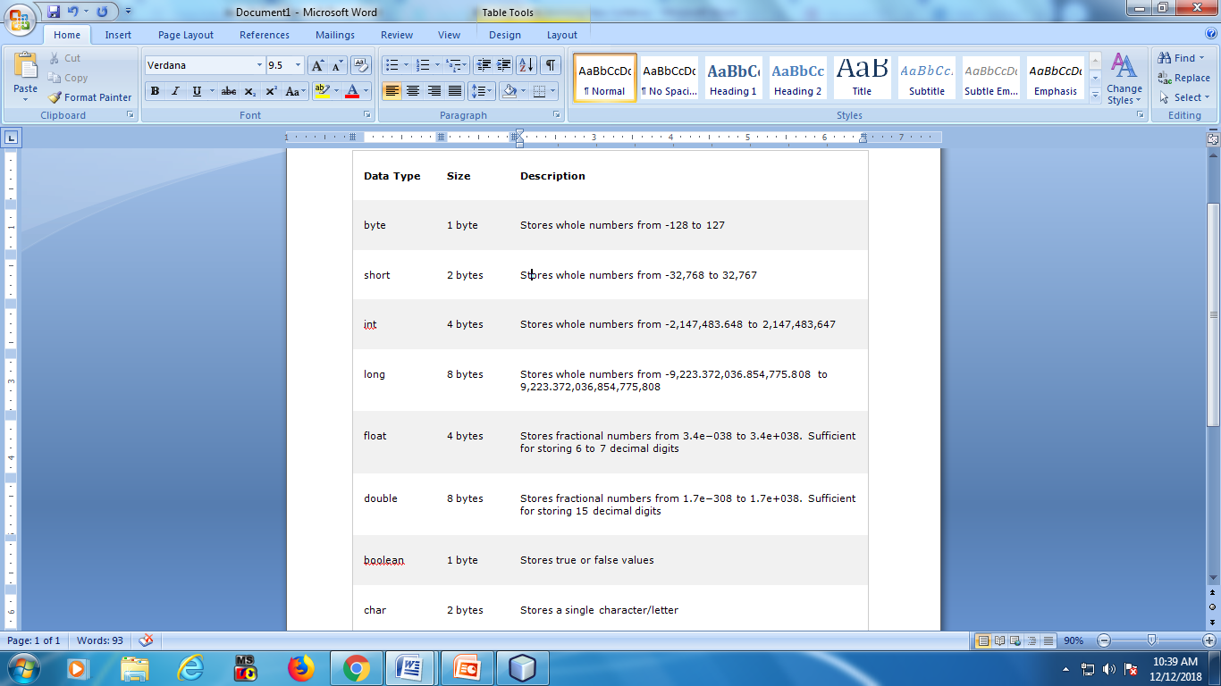
Primitive Data Types

Slide 7
Variable Example Program Ex-1
import java.io.*;
public class MyClassDatatype {
public static void main(String[] args) {
int myNum = 5;
float myFloat = 5.99f;
char myChar = 'a';
boolean myBool = true;
double myDouble = 5.678;
String myString = "Hello";
System.out.println(myNum);
System.out.println(myFloat);
System.out.println(myChar );
System.out.println(myBool);
System.out.println(myString);
System.out.println(myDouble);
}
}
Output:
E:\Anitha>javac MyClassDatatype.java
E:\Anitha>java MyClassDatatype
5
5.99
a
true
Hello
5.678

Slide 8
Integer Example Program Ex-2

Slide 9
Floating Point Numbers - Program Ex-3
Double This type is used for double-precision decimal floating point numbers, that is, 15 digits after the decimal point.

Slide 10
Introduction to Operators
1. Arithmetic operators
2. Compound assignment operators
3. Increment and decrement operators
4. Relational operators
5. Boolean logical operators
6. Bitwise logical operators
7. Shift operators
8. Special operators
If an operator takes only one operand for its operation, it is called
unary operator.
If it takes two operands, it is called binary operator.
If it takes three operands, it is called ternary operator.

Slide 11
Precedence and Associativity of Operators
According to BODMAS rule, operations in any given expression should precede in the following order :
1. Brackets
2. Order
3. Division
4. Multiplication
5. Addition
6. Subtraction

Slide 12
Basic Arithmetic Operators

Slide 13
Increment (++) and Decrement (−−) Operators

Slide 14
Relational Operator

Slide 15
Boolean Logical Operators

Slide 16
Bitwise Logical Operators

Slide 17
Classes & Objects
Class − A class can be defined as a template / blueprint that describes the behavior/state that the object of its type support.
A class is a blueprint from which individual objects are created.
To create a class, use the keyword class
Object − An object is an instance of a class.
Objects have states and behaviors.
To create an object specify the class name, followed by the object name, and use the keyword new

Slide 18
Example program
Method 1
Method 2
class MyClass { int x = 5;
public static void main(String[] args) { MyClass myObj = new MyClass(); System.out.println(myObj.x); } }
class ClassOne { int x = 5;
}
class ClassTwo {
public static void main(String[] args) { ClassOne myObj = new ClassOne(); System.out.println(myObj.x); }
}

Slide 19
Example Program

Slide 20
Access Control for Class Members
Three access specifiers are permitted:
public
protected
private
The coding with access specifiers for variables is illustrated as
Access_specifier type identifier;

Slide 21
Access Control to Data Variables and Methods
Public : It is applied to variables, constructors, methods, and classes.
- If any of these data members are declared as public, they are accessible to all classes in all the packages.
Private : It can be applied to variables, constructors, methods, and nested classes (excluding top-level classes).
- A private member is available only to the class in which it is defined and it cannot be accessed by subclasses or any other external class.
Protected : It is applied to variables, constructors, methods, and nested classes (excluding top-level classes).
- It implies that the member can be accessed by the same class, its subclasses, and the classes in the same package.
Default : It can be applied to variables, constructors, methods, and classes. When no access specifier is used, it implies the default access. Here, the member can be accessed by the classes within the same package.

Slide 22
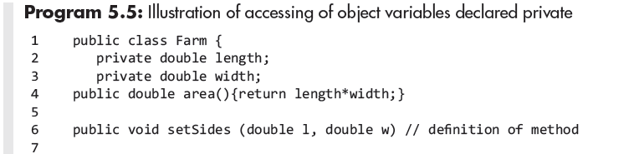
Accessing Private Members of Class

Slide 23
Accessing Private Methods of Class

Slide 24
Accessing Private Methods of Class

