Slide 1
EXPOSYS DATA LABS INTERNSHIP
KALAIVANI B

Slide 2
DOMAIN
WEB DEVELOPMENT
TITLE: MASS MAIL DISPATCHER

Slide 3
People rush towards completing their tasks
High expectations on instantaneous and spontaneous solutions, else it is a flop show
Sending mail is a PIECE OF A CAKE
It is quite easy to send to one. However, if the same needs to be done for a group of people, there comes the problem
ABSTRACT
People get bored and tired easily
This increases the high chances of occurrence of errors
Ensure validity and Improved performance
Valid mails need to be identified and messages are sent in bulk all at once

Slide 4
EXISTING SYSTEM vs PROPOSED SYSTEM
Accepts text/CSV (Comma Separated File) as input
Performs the same task of a typical mass mail dispatcher
Contents of the uploaded file are sorted as valid and invalid mail addresses
Chatbot to ensure query solving and effective user interaction
Bulk mails are sent to all the valid mails all at once
A multilanguage option to experience accesing the website in preferable language

Slide 5
FEATURES PROVIDED
FILE UPLOAD
MASS MAIL
A text/CSV file will be uploaded which is then analyzed to provide a structured list of valid and invalid mail entries.
A typing panel is provided to type the message and send the same to all the identified valid mails from the uploaded file
CHATBOT
MULTILANGUAGE
In times of query on how to access the website, the user can ping the chatbot to get their queries solved
User can enjoy using the website in their own preferred regional language for a better understanding

Slide 6
TECHNOLOGY
HTML, CSS, JS
IBM CLOUD
For defining and designing the website
For developing and deploying the chatbot

Slide 7
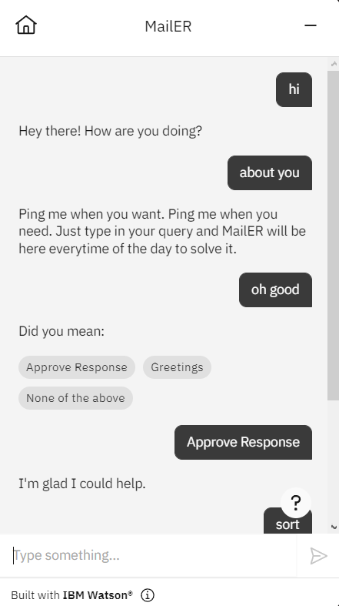
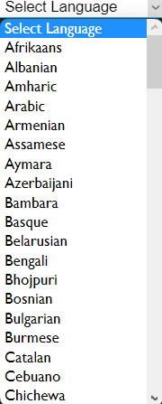
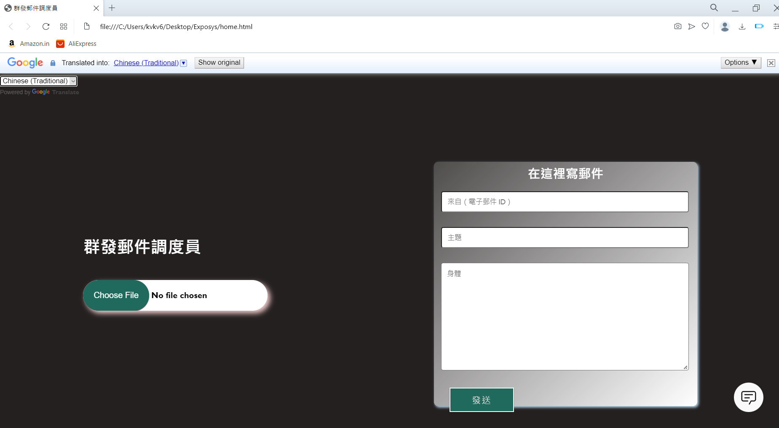
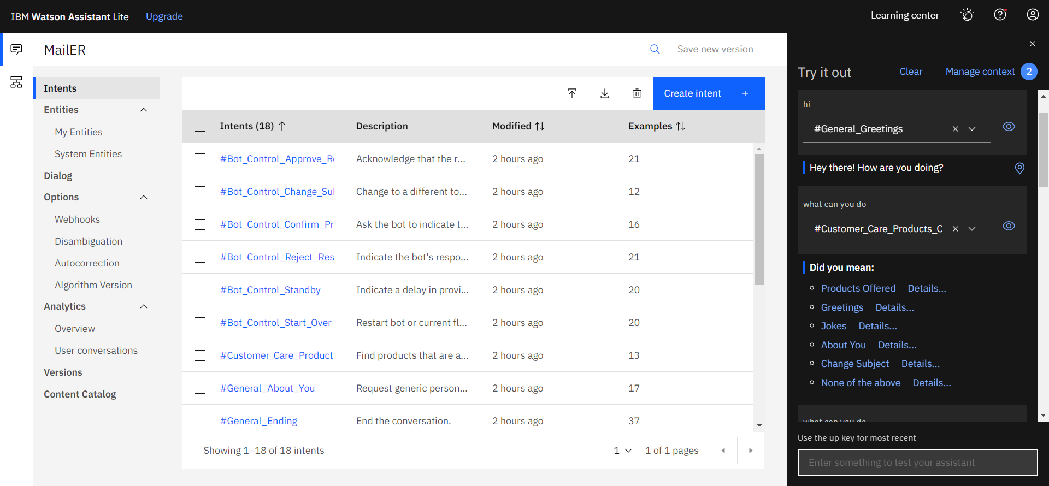
LOOK
Fly Impression Design ist ein professionelles Werbe-Design-Studio, mit einem hohen Maß an Design-Team, Fly Impression Design ist ein professionelles Werbe-Design-Studio, mit einem hohen Maß an Design-Team,

Slide 8
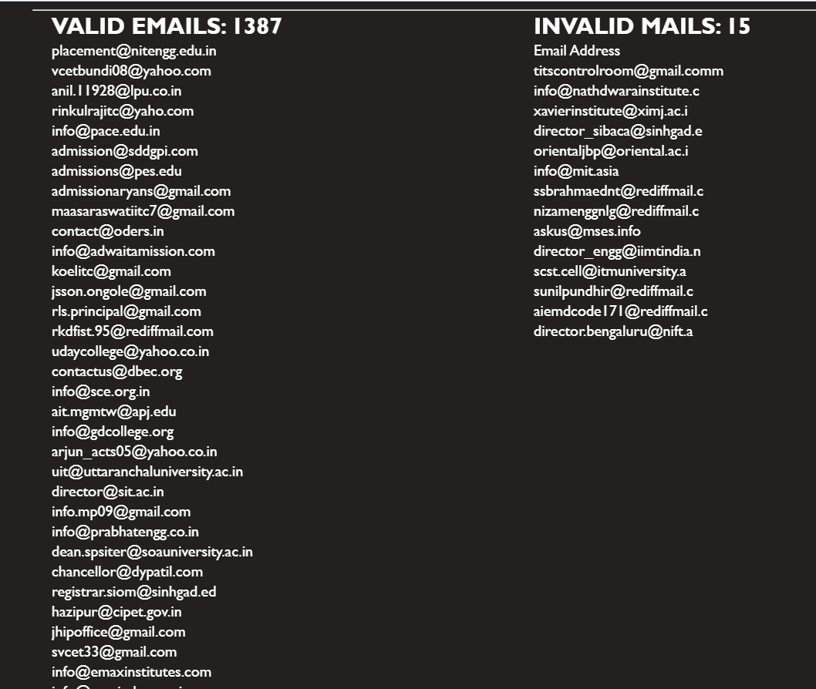
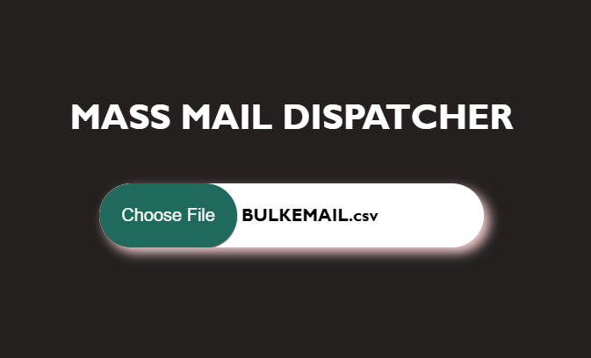
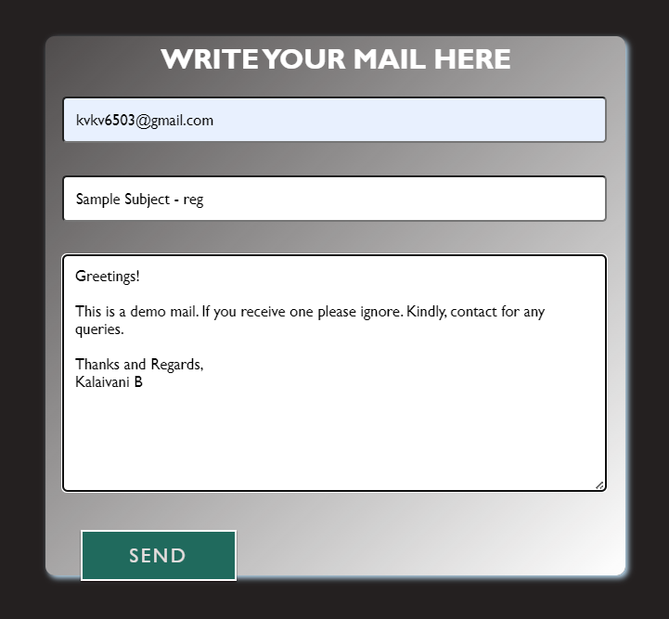
METHODOLOGY
UPLOAD THE FILE
SEND MAIL
SORT DATA

Slide 9
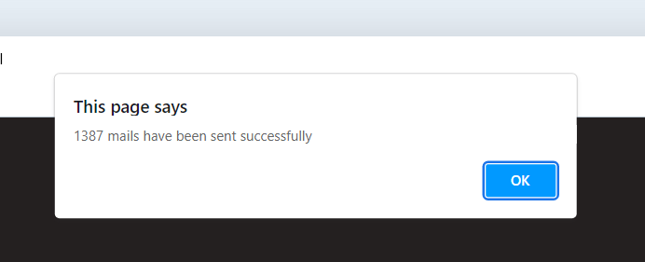
...
CONFIRMATION
MULTILANGAUGE
CHATBOT

Slide 10
CONCLUSION
A
Be in constant touch with the customers in terms of a big business or organization
B
Easy, productive and cost affordable option
C
Saves time, man power and reduces vulnerabilities

Slide 11
Thank you!!!

