Slide 1

Insulin/Glucagon Simulator
Group F
Kalaichelvi Rajendran, Khoa, Prakrithi Gupta, Quang

Slide 2
Agenda
Introduction
Problem Statement
Requirements Analysis
Process Model
Cost estimation
Mathematical Model
Hazard Analysis
Desigining
Testing
Future Improvement
Conslusion

Slide 3
Introduction
What is Diabetes?
Problems with hormone Insulin. Pancrease does not produce any insulin or the pancrease produces very little insulin.
Role of Insulin in Diabetes
Body is made up of millions of cells → to make energy theses cells need food in simpler form → when we eat or drink, much of our food is broken down into simple sugar called “glucose“ → Glucose is transported through the bloodstream to the cells of our body where it can provide energy that our body needs for daily activities.
Types of Diabetes
Type 1 – occurs when the beta cells (insulin producing cells in pancreas) are destroyed by the immune system – People with type 1 diabetes produces no insulin and must use insulin injection to control their blood glucose. – under the age of 20
Type 2 – most common for of diabetes – people with type 2 diabetes produce insulin – However the insulin secreted is either not enough or the body is unable to recognize and use it properly. – over age of 40, who are overweight – children (rise in obesity in young people).

Slide 4
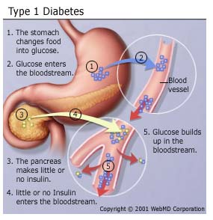
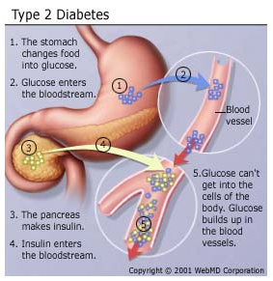
At the present time, diabetes can't be cured, but it can be treated and controlled.

Slide 5
Problem Statement
A person whose body is unable to produce Insulin in the pancreas to maintain the normal blood glucose level, requires a safe and secure device which can balance the amount of insulin/glucagon in the blood.
Insulin Glucagon Simulator:
To effectively control diabetes, our system mimics the behaviour of a healthy pancreas.
Calculates the required amount of insulin/Glucagon required, based on the critical sugar level in blood.
Makes sure that the minimum threshold is maintained, that is the daily dosage limit.
Secured with password authentication (CIA Triad)
Manual and auto mode based on the selection by physician.

Slide 6
Requirement Analysis
Functional Requirements
• Using the mathematical model, the amount of Insulin/Glucagon to be injected is analyzed.
• Inject insulin/glucagon when the blood sugar reaches critical levels.
• Real time tracking of blood sugar levels, variation in blood sugar level is shown in the message box.
• Both manual and automatic operations work depending upon the selection.
• The system sends alert messages in case of emergency.
Software Requirements
• Platform: Windows10(64 Bit).
• Programming Language: Java
• Tools: Eclipse Neon, JavaFX.
• GUI: Swing library

Slide 7
Safety Requirements
• Warning message pops up in the below 3 cases,
→ When the insulin level in the reservoir reaches the threshold.
→ When the glucagon level in the reservoir reaches the threshold.
→ When the battery goes below a certain limit.
• Only authorized person can access the system considering the safety of the patient.
The range of the Blood Sugar Level (BGL):
• Unsafe: BGL < 70 mg/dL, Glucagon is injected.
• Safe: BGL between 70-120 mg/dL.
• Unsafe: BGL > 120 mg/dL , Insulin is injected.

Slide 8
Graphical User Interface Requirements
• A power button will be displayed.
• Display of battery level and Time.
• Patient screen, Doctor screen.
• Insulin and Glucagon level indicator.
• Message screen for alerts.

Slide 14
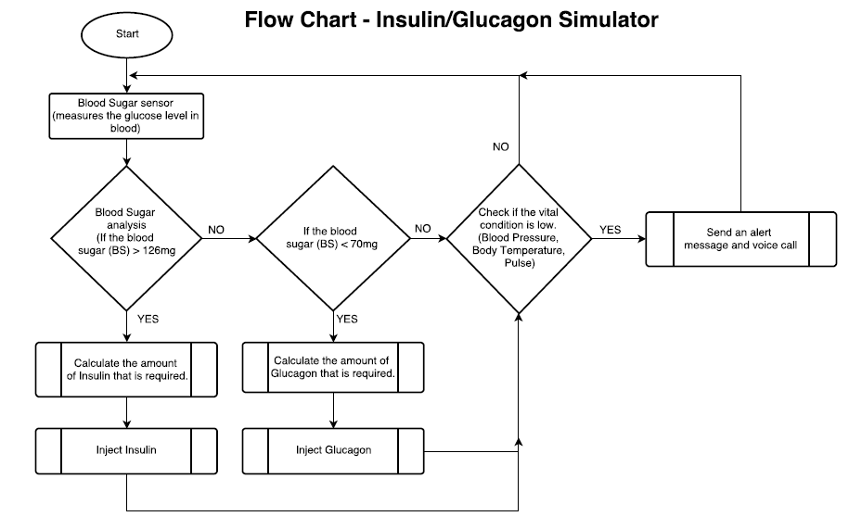
Desigining

Slide 15
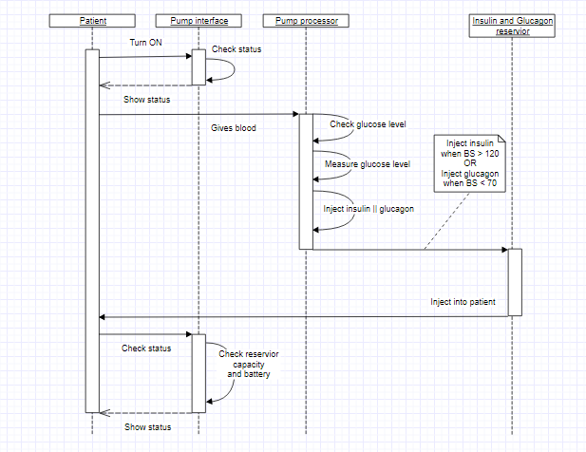
Sequence Diagram

