Slide 1

Presented By
Kalaikko S S

Slide 2
CONTENTS
What is Big Data?
5Vs
Hadoop
Why Hadoop is useful?
Hadoop vs RDBMS
HDFS Architecture
YARN Architecture
MapReduce
Hive
Pig
Pig vs Hive
Sqoop
Reference

Slide 3
What is Big Data?
Data sets that are so voluminous and complex that traditional data processing application software are inadequate to deal with them.
Big Data is data whose scale, diversity and complexity require new architecture, techniques, algorithms and analytics to manage it and extract value and hidden knowledge from it.

Slide 4
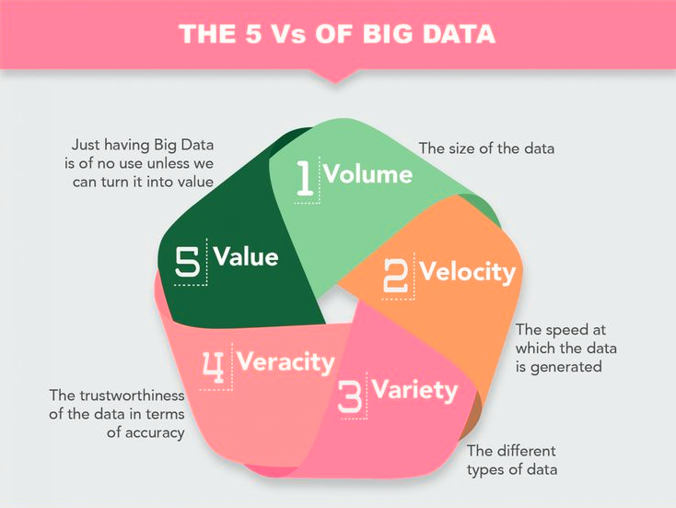
5Vs
Volume
Velocity
Variety
Value
Veracity

Slide 5
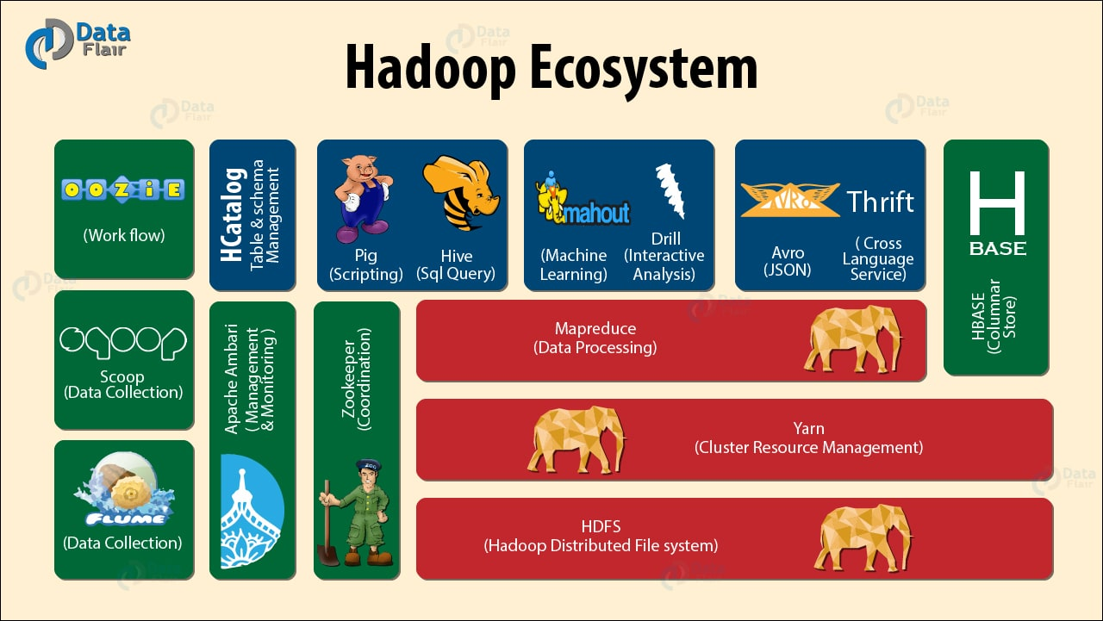
Hadoop

Slide 6

Hadoop is not Big Data.
Hadoop is not a database.
Hadoop is a bunch of tools, it has many components. HDFS and MapReduce are two core components of Hadoop.
“Write once, read any number of times without changing the content of file”.

Slide 7
Why Hadoop is useful?
SCALABLE
ECONOMICAL
EFFICIENT
RELIABLE
FREE

Slide 8
Hadoop vs RDBMS
Volume of data
Latency
Throughput
Schema
Variety of Data Handling

Slide 9
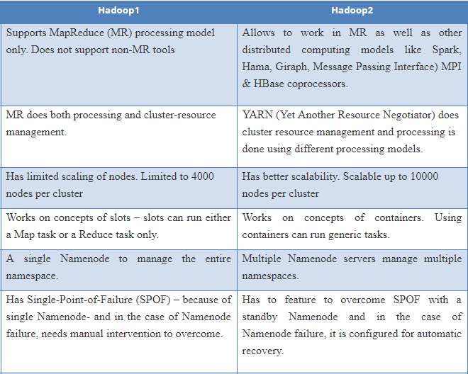

HADOOP 1 VS HADOOP 2

Slide 10
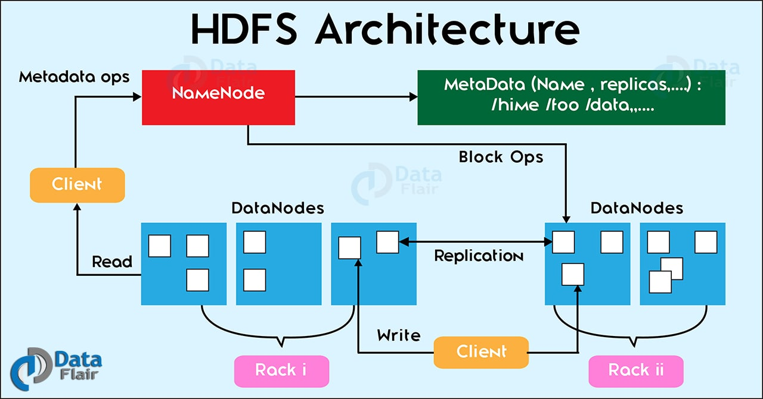
HDFS

Slide 11
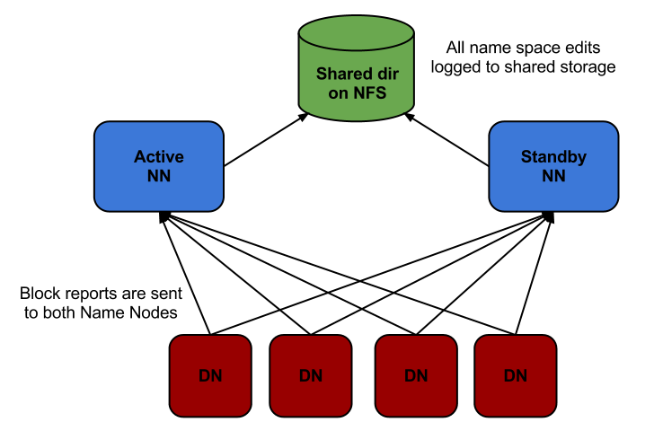
High Availability In Hadoop:
Hadoop 2.0 overcomes SPOF(Single Point Of Failure) by providing support for multiple NameNodes.
Introduces Hadoop 2.0 High Availability feature that brings in an extra NameNode (Passive Standby NameNode) to the Hadoop Architecture.
One in active configuration and the other is the Standby Node in passive configuration.

Slide 12
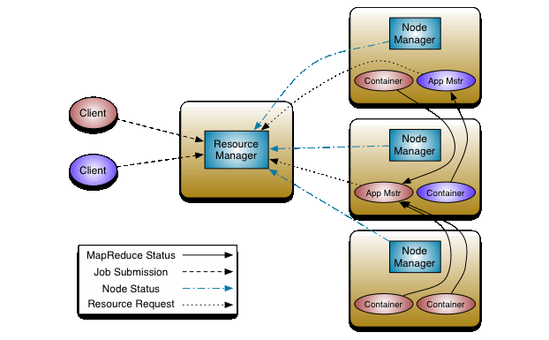
YARN(Yet Another Resource Negotiator)

Slide 13
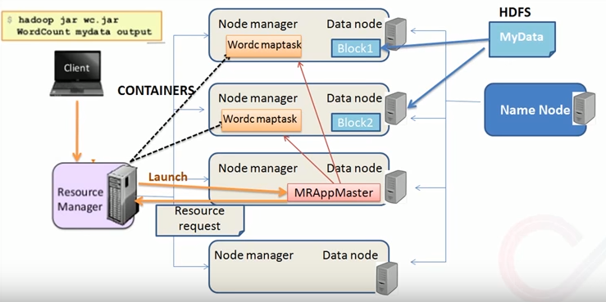

Slide 14
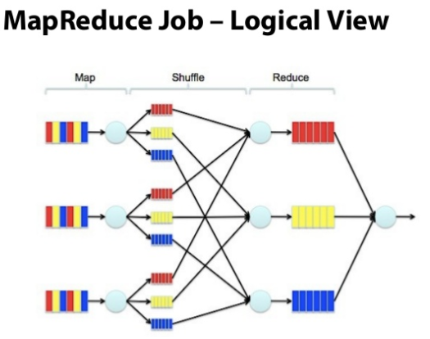
MapReduce
Software framework for easily writing applications which process vast amounts of data in-parallel on large clusters of commodity hardware in a reliable, fault-tolerant manner.
Work (complete job) which is submitted by the user to master is divided into small works (tasks) and assigned to slaves.

Slide 15
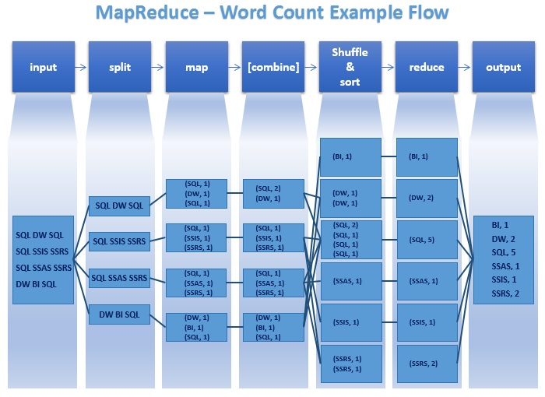

Slide 16
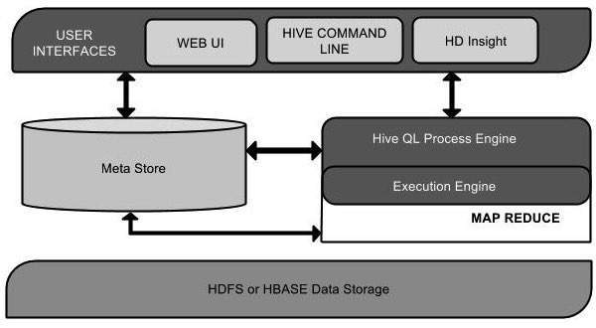

Hive
Data warehouse infrastructure tool to process structured data in Hadoop.
Platform used to develop SQL type scripts called HiveQL or HQL to do MapReduce operations.
Not a relational database.
Designed for OLAP – Online Analytical Processing.

Slide 17
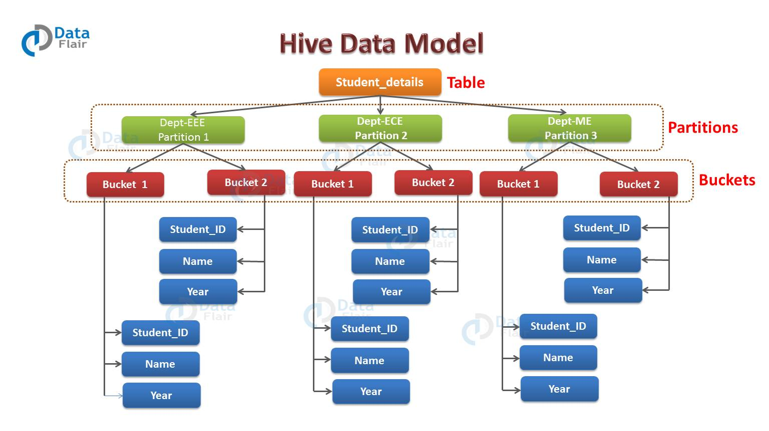

Slide 18

Pig
Tool/platform to analyze larger sets of data representing them as data flows. Pig is generally used with Hadoop.
Programmers need to write scripts using Pig Latin language.
Pig Latin is similar to SQL and it is easy to write a Pig script.
Pig provides the facility to create User-defined Functions in other programming languages such as Java and invoke or embed them in Pig Scripts.
Apache Pig analyzes all kinds of data, both structured as well as unstructured. It stores the results in HDFS. Provides operators to perform ETL (Extract, Transform, and Load) functions.

Slide 19
HIVE | PIG
Hadoop should start to run hive | Not required to start Hadoop, can run standalone mode or cluster mode
Supports only Structured data | Process both structured and unstructured data
Stores metadata in databases like darby(by default), mysql, oracle | No metadata support
Separate query language called HQL | Use own language called Pig Latin
Execute quickly, but not load quickly | Loads data effectively and quickly
Configure Hive in cluster, Pesudo mode | Installed based on shell interaction, not required any configuration, just extract tar file
For limited joins and filters go ahead with HIVE | Recommended for huge number of joins and filters.

Slide 20
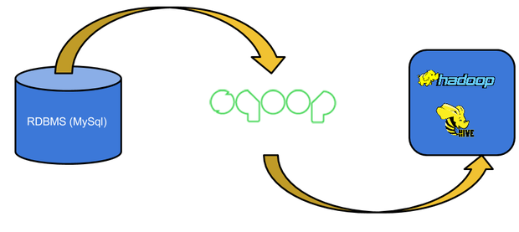
Sqoop
Sqoop is a tool designed to transfer data between Hadoop and relational database servers.
It is used to import data from relational databases such as MySQL, Oracle to Hadoop HDFS, and export from Hadoop file system to relational databases.
Each row in a table is treated as a record in HDFS. All records are stored as text data in text files or as binary data in Avro and Sequence files.
The export tool exports a set of files from HDFS back to an RDBMS.

Slide 21
PROJECT H1B Case study
The H1B is an employment-based, non-immigrant visa category for temporary foreign workers in the United States. For a foreign national to apply for H1B visa, an US employer must offer a job and petition for H1B visa with the US immigration department. This is the most common visa status applied for and held by international students once they complete college/ higher education (Masters, Ph.D.) and work in a full-time position. The data set has nearly 3 million records.

Slide 22
Reference
www.hadoop.apache.org
www.edureka.co
www.data-flair.training
www.tutorialspoint.com
www.hortonworks.com
www.slideshare.net
www.google.com
www.youtube.com

Slide 23

THANK YOU

