Slide 1



AI BASED DIABETES PREDICTION SYSYEM
(Understand the requirements and plan the design of system)
Submitted by
A.kalaimathi III ECEA
Gce Tirunelveli(9508)
Phase 1 document submission
IBM NAAN MUDHALVAN

Slide 2
WHAT IS DIABETES?
Diabetes is a disease that occurs when your blood glucose, also called blood sugar, is too high.
Glucose is your body’s main source of energy. Your body can make glucose, but glucose also comes from the food you eat
Insulin is a hormone made by the pancreas that helps glucose get into your cells to be used for energy.
If you have diabetes, Then your body doesn’t make enough insulin, or doesn’t use insulin properly. Glucose then stays in your blood and doesn’t reach your cells

Slide 3
TYPES OF DIABETES
You are more likely to develop type 2 diabetes if you have risk factors, such as overweight or obesity, and a family history
.
Two types:
•Type1
•Type2
•If you have type 1 diabetes, your body makes little or no insulin. Your immune system attacks and destroys the cells in your pancreas that make insulin
•If you have type 2 diabetes, the cells in your body don’t use insulin properly. The pancreas may be making insulin but is not making enough insulin to keep your blood glucose level in the normal range
You are more likely to develop type 2 diabetes if you have risk factors, such as overweight or obesity, and a family history

Slide 4

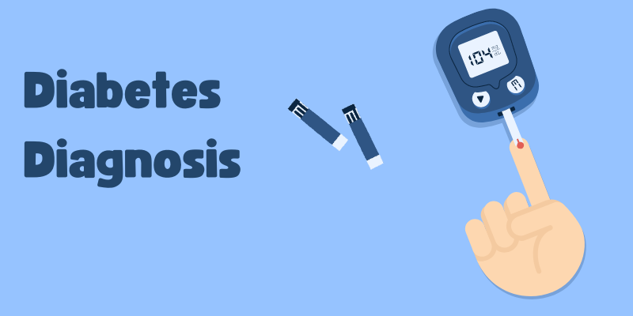

PROBLEM STATEMENT
The system aims to determine whether a patient is at risk of diabetes based on various characteristics and features and provide personalized preventive measures, allowing individuals to take proactive actions to manage their health.

Slide 5
WHAT IS THE PLAN FOR DEVELOPING THIS PROJECT
COLLECT DATASET
PREPROCESS THE DATA
SELECT FEATURES
DEPLOY THE MODEL
TRAIN A MACHINE LEARNING MODEL
EVALUATE THE MODEL

Slide 6
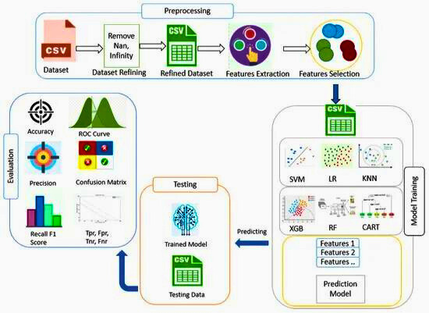
PROPOSED MODEL

Slide 7
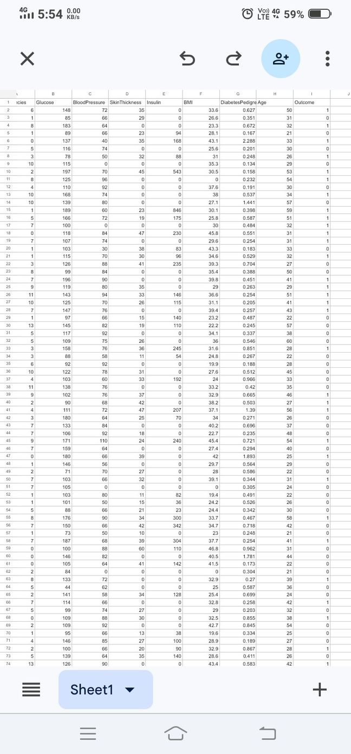
DESIGN OF THE PROBLEM
1.DATA COLLECTION
The initial step is to gather a large dataset that includes patient demographics, medical history, lab results, and other related information. This data can be obtained from electronic health records (EHRs) or other sources

Slide 8
DATASET ATTRIBUTES
•Pregnancis: Number of times pregnant
• Glucose: Plasma glucose concentration a 2 hours in an oral glucose tolerance test
• Blood Pressure: Diastolic blood pressurure(mm Hg)
• SkinThickness: Triceps skin foldt hickness (kg mm)
• Insulin 2-Hour serum insulin (mu U/ml)
•BMI: Body mass index (weight in kg/(height in m)^2)
• DiabetesPedigreeFunction: Diabetes pedigree function
•Age: Age (years)
•Outcome: Class variable (0 or 1) 268 of 768 are 1, the others are 0
Dataset source: https://www.kaggle.com/datasets/mathchi/diabetes-data-set

Slide 9
STEPS
Clean and preprocess the data. Handle missing values, outliers, and normalize features for consistency.
2.DATE
PREPROCESSING
New features may be created from the existing data to improve the predictive performance of the system.
3.FEATURES
ENGINEERING

Slide 10
STEPS
machine learning model is trained on the prepared data. The model learns to identify patterns in the data that are associated with diabetes. Choose machine learning algorithms suitable for classification tasks. Common choices include logistic regression, decision trees, random forests,
4.MODEL TRAINING
Select appropriate evaluation metrics such as accuracy, precision, recall, F1-score, and ROC-AUC to measure the model's performance.
5.EVALUATION

Slide 11
STEPS
Implement a system for monitoring the model's performance over time. Retrain the model periodically with new data to keep it up to date.
6.CONTINUOUS MONITORING
Integrate the trained model into a user-friendly interface. This could be a web or mobile app for easy accessibility.
7.DEPLOYMENT

Slide 12
BENIFITS
EARLY DETECTION
PERSONALIZED RISK ASSESSMENT:
SCALABILITY
AI systems can detect diabetes and its associated complications at an earlier stage than traditional methods. This allows for earlier intervention and improved patient outcomes.
AI systems can provide personalized risk assessments for individuals based on their individual risk factors. This can help individuals to make informed decisions about their health and lifestyle.
AI systems can be scaled to analyze large amounts of data from large populations. This makes them ideal for use in public health initiatives to identify and target individuals at high risk of developing diabetes.

Slide 13
CONCLUSION
AI-based diabetes prediction systems have the potential to revolutionize the way we detect, prevent, and manage diabetes. These systems have the potential to improve the lives of millions of people worldwide.

Slide 14
THANK YOU

