Slide 1
Employee Data Analysis using Excel
STUDENT NAME: S.KALAI SELVI
REGISTER NO:312201349
NM I’D:979D499F423035281EC4A4750BE24906
DEPARTMENT:3RD B.COM GENERAL
COLLEGE: D.R.B.C.C.C.HINDU COLLEGE.PATTABIRAM

Slide 2
PROJECT TITLE
Employee Performance Analysis using Excel

Slide 3


AGENDA
Problem Statement
Project Overview
End Users
Our Solution and Proposition
Dataset Description
Modelling Approach
Results and Discussion
Conclusion
3/21/2024 Annual Review

Slide 4

PROBLEM STATEMENT
Please provide a specific problem statement related to employee performance analysis using Excel, and I'll be happy to assist you.
Some examples of problem statements might include:- "I need to create a formula to calculate the average sales performance of employees in the eastern region
I want to generate a chart to compare the customer satisfaction ratings of different teams over the past quarter.

Slide 5

PROJECT OVERVIEW
Here's a project overview for an Employee Performance
Analysis using Excel:
Objective:
Develop an Excel-based tool to analyze and evaluate
employee performance across various metrics and KPIs.
Create a user-friendly dashboard to visualize performance
trends, identify top performers, and detect areas for
improvement.

Slide 6

WHO ARE THE END USERS?
As the end user of the Employee Performance Analysis Excel tool, I would like to have the following features and functionalities:
1. *User-friendly interface*: Easy navigation and clear labels to facilitate effortless data entry and analysis.
2. *Customizable dashboards*: Personalized views to focus on specific metrics, teams, or time periods.
3. *Automated calculations*: Formulas and functions to minimize manual data entry and reduce errors.
4. *Visualizations*: Interactive charts, graphs, and tables to help identify
trends, patterns, and outliers.
5. *Filtering and sorting*: Ability to quickly narrow down data by criteria like department, role, or performance metrics.

Slide 7

OUR SOLUTION AND ITS VALUE PROPOSITION
Value Proposition:
Data-Driven Insights: Unlock hidden trends and patterns in employee performance data to inform strategic decisions.
Improved Productivity: Streamline performance analysis and
reporting, saving time and resources.
Enhanced Decision Making: Make informed decisions on
talent development, promotions, and performance improvements.
Increased Transparency: Clearly communicate performance
expectations and progress to employees and stakeholders.
Identify Top Performers: Recognize and reward high-
achievers, boosting morale and motivationsis Excel tool, organizations can optimize their workforce, drive growth, and achieve their goals.

Slide 8
Dataset Description
Here is a description of the dataset for the Employee Performance Analysis Excel tool:
Employee ID (unique identifier)
Name
Department
Job Title
Performance Metrics (e.g., sales numbers, customer satisfaction ratings, project completion rates)
Time Period (e.g., month, quarter, year)
Targets (expected performance levels)
Actual Performance (measured performance data)
Variance (difference between actual and target performance)Comments (optional notes or feedback)Data.
d driving business success.

Slide 9

THE "WOW" IN OUR SOLUTION
Here are some potential "wow" factors in our Employee Performance Analysis Excel tool:
_Automated Insights_: Instantly generate actionable recommendations for improving employee performance, eliminating manual analysis.
2. _Interactive Visualizations_: Engaging dashboards and
charts provide real-time performance data, enabling swift identification of trends and areas for improvement.
3. _Predictive Analytics_: Leverage historical data to forecast future performance, enabling proactive decision- making.
4. _Personalized Coaching Plans_: Receive tailored guidance for each employee, optimizing development and growth.
5. _Real-time Alerts_: Instant notifications for performance milestones, warnings, or achievements, ensuring timely interventions.
3/21/2024 Annual Review
9

Slide 10
MODELLING
Modeling in the context of our Employee Performance Analysis Excel tool refers to the process of creating a mathematical representation of the relationships between different variables in the dataset.
This involves:
*Identifying key performance indicators (KPIs)*: Determining the most relevant metrics to measure employee performance.
2. *Developing scoring models*: Creating formulas to
calculate employee scores based on KPIs.
3. *Building predictive models*: Using statistical techniques to forecast future performance.Some common modeling techniques used in this context include
10

Slide 11
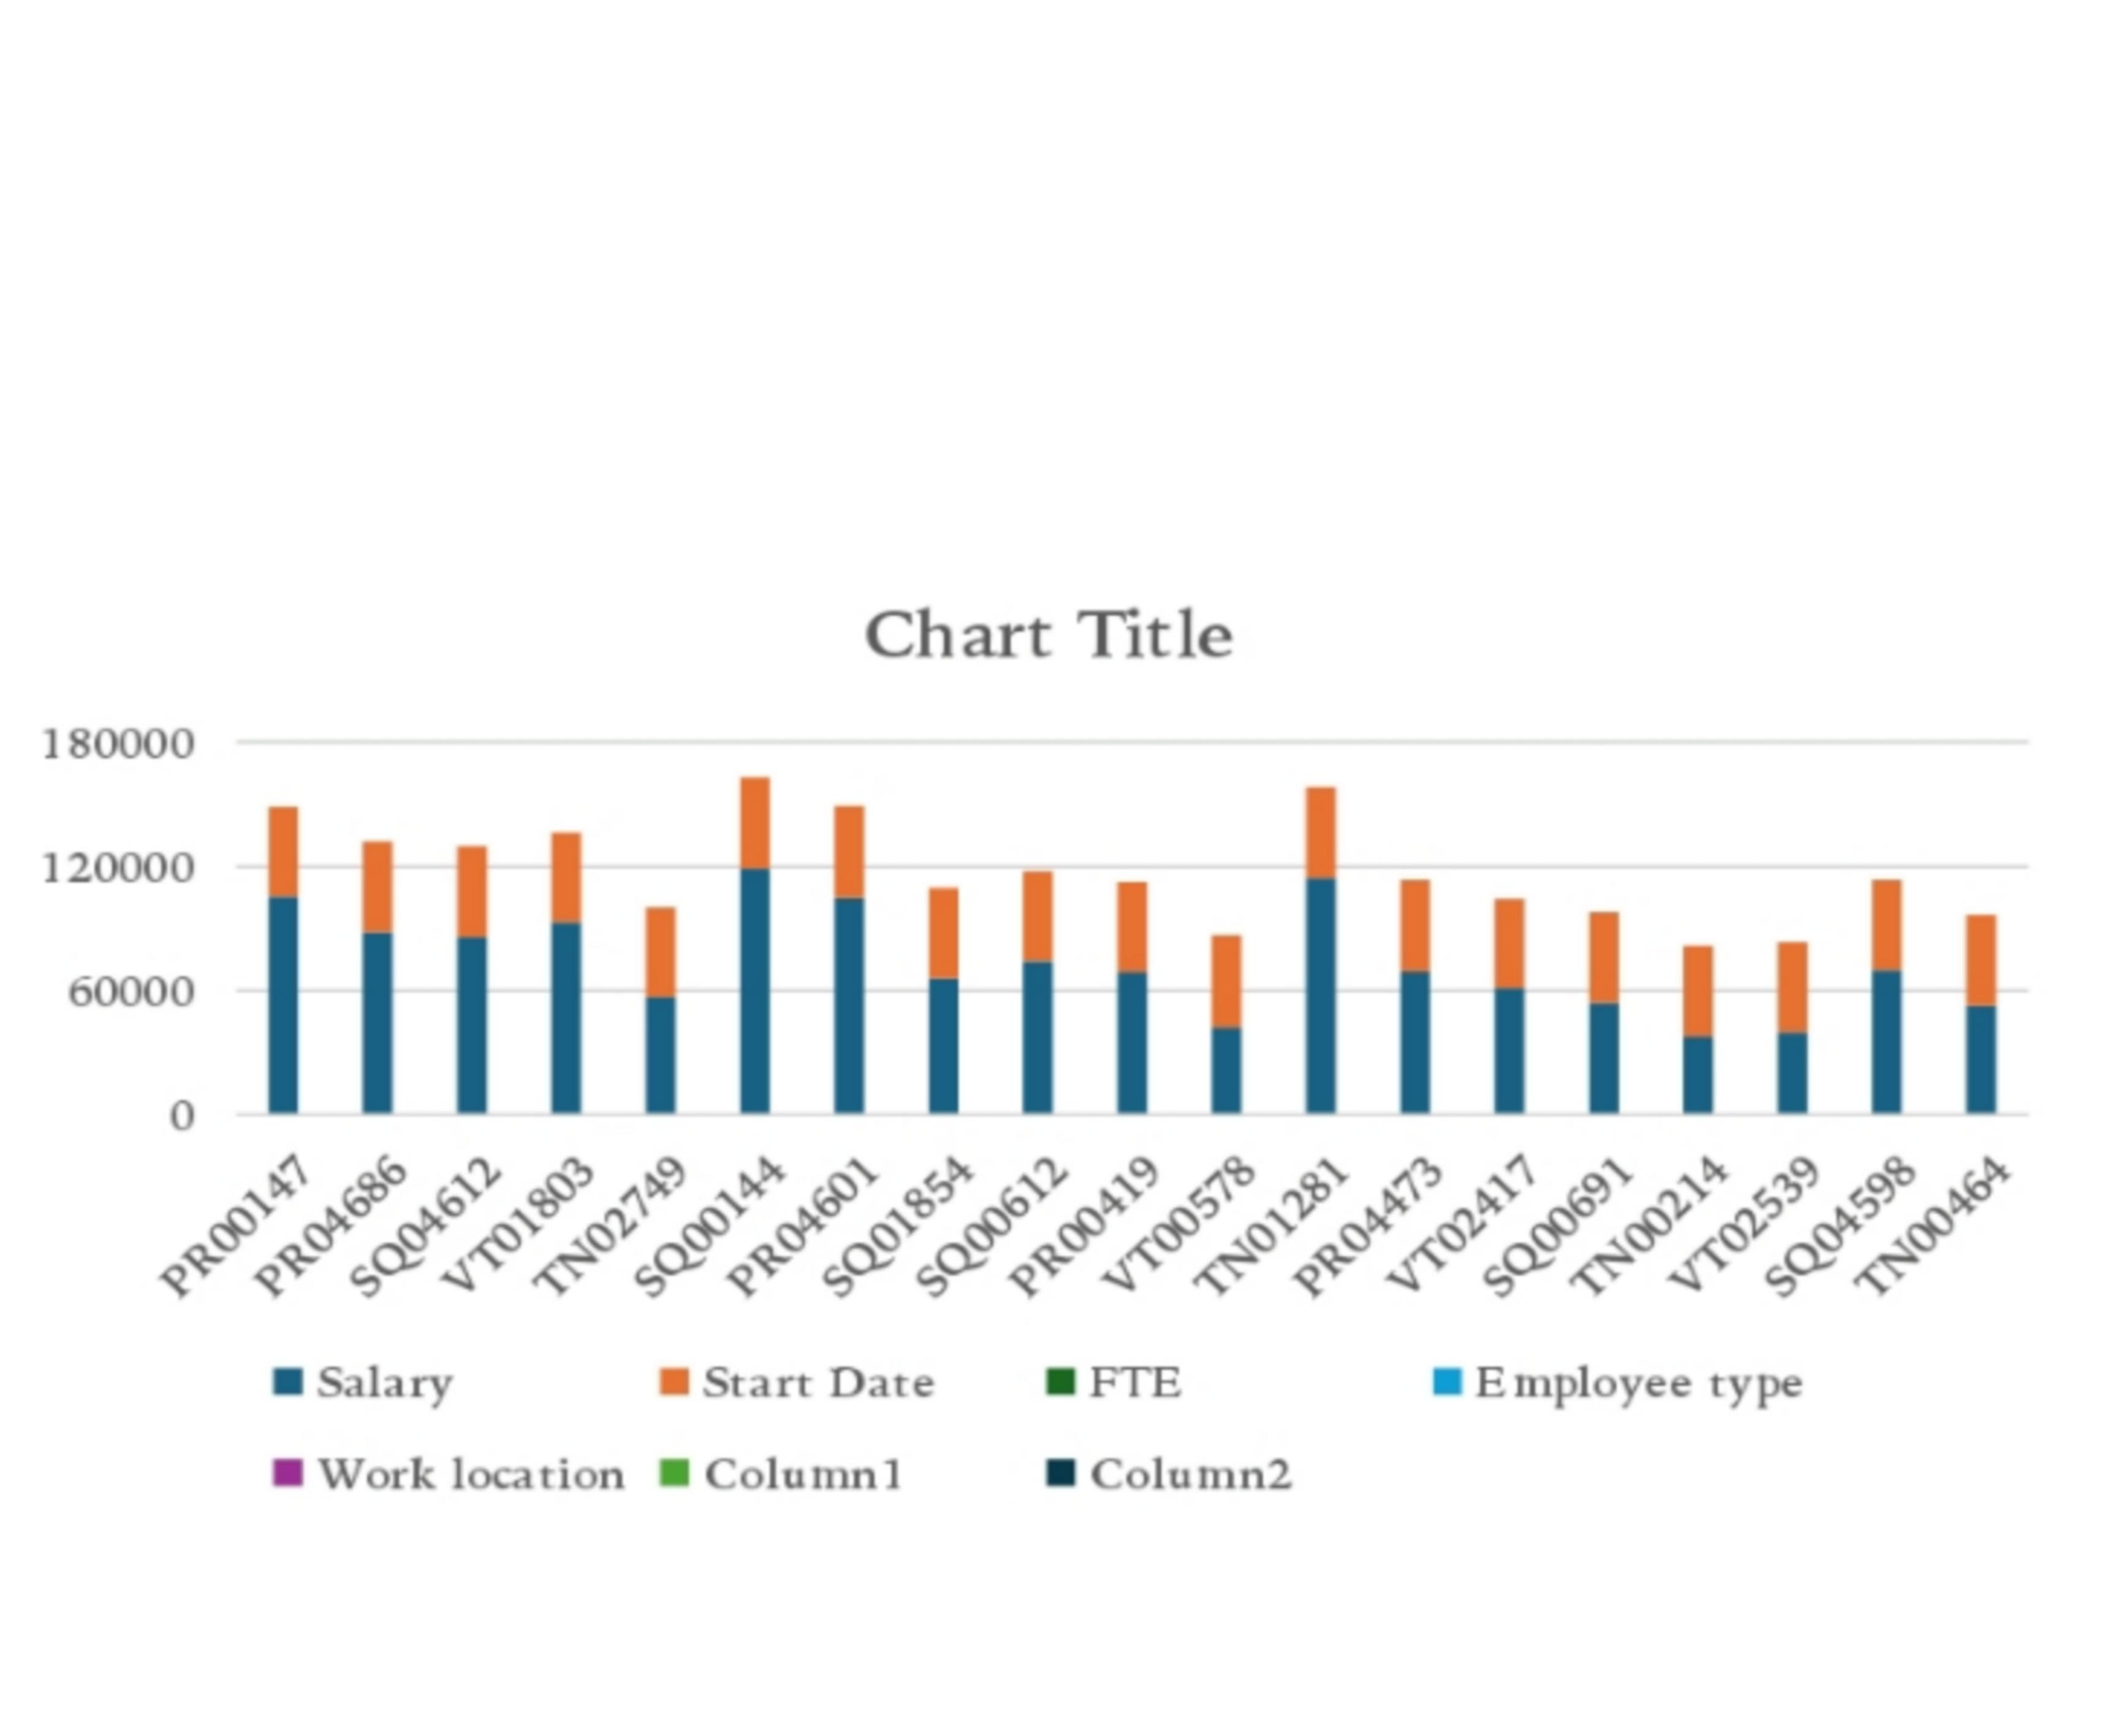
Results

Slide 12
conclusion
In conclusion, our Employee Performance Analysis Excel tool offers a comprehensive solution for organizations to effectively manage and enhance employee performance. By leveraging advanced modeling techniques, interactive visualizations, and automated insights, this tool enables:
Data-driven decision making
Personalized coaching and development
Early identification of performance issues
Recognition and rewards for top performers
Optimized resource allocation

