Slide 1



Compose Input : A demonstration of text input and validation with android compose
JAI SHRIRAM ENGINEERING COLLEGE
(An Autonomous Institution) TIRUPPUR – 638 660
Approved by AICTE, New Delhi & Affiliated to Anna University, Chennai
Recognized by UGC & Accredited by NAAC and NBA (CSE and ECE)
NM1026 – ANDRIOD APPLICATION DEVELOPMENT
BY
K.INIYA PRIYADHARSHINI – 711222104019
S.KALAIVANI– 711222104021
A.RESHMA– 711222104037
M.SWETHA- 711222104054

Slide 2
ABSTRACT:
This project explores the implementation of a user-friendly text input and validation system using Jetpack Compose, Android's modern UI toolkit.The focus is on creating dynamic and interactive input fields that validate user data in real-time, ensuring data integrity and enhancing user type text experience.
Key aspects include designing aesthetically pleasing and accessible input fields, implementing validation logic for common input types (e.g., email, password, phone number), and providing instant feedback through visual cues and error messages.
The project also emphasizes modularity, allowing developers to reuse and customize components.By leveraging Compose's declarative approach, this work demonstrates efficient UI development, fostering best practices for modern Android application design.
The modular design allows developers to easily integrate and customize these components into various parts of their applications. It also provides a foundation for advanced features, such as custom logic testing and validation for edge cases. By combining real-time feedback, error handling, and accessibility, this project offers a comprehensive approach to designing input validation systems in Jetpack Compose. Ultimately, it serves as a guide for developers to implement reusable, efficient, and user-friendly validation workflows while fostering modern Android development standards.

Slide 3
INTRODUCTION
The app is a sample project that demonstrates how to use the Android Compose UI toolkit to build a survey app. The app allows the user to answer a series of questions. It showcases some of the key features of the Compose UI toolkit, data management, and user interactions.
Text Input Field : A simple text input area allowing users to type in their data, such as email, username, or password.
Real-time Validation: The entered text will be validated as the user types, providing instant feedback on whether the input meets certain criteria.
Error Messages: Clear error messages or visual indicators (e.g., color changes, icons) when the input is invalid.
Valid Input Handling: When the input is valid, the app can proceed with further actions, such as enabling a submit button.
UI/UX Design: A user-friendly interface using Material Design components for a modern and consistent look and feel.

Slide 4
PROBLEM DEFINITION AND SOLUTION
PROBLEM DEFINITION
SOLUTION
Lack of Real-Time Feedback
Complex Validation Logic
Accessibility Issues
Modularity & Reusability
Real-Time Input Validation
Visual Feedback Mechanisms
Modular & Reusable Components
Multi-Type Support

Slide 5
ADVANTAGES
1. Real-Time User Feedback
2. Enhanced Data Integrity
3. Modular & Reusable Components
4. Time-Efficient Development
5. Improved Accessibility
6. Scalable & Customizable
7. Reduced Testing Complexity
8. Responsive & Interactive UI
9. Error Prevention & Faster Resolution
10. Cross-Screen Consistency

Slide 6
SOFTWARE AND HARDWARE REQUIREMENTS
HARDWARE REQUIREMENTS:
1.Computer or Laptop with sufficient processing
2.powerMinimum 8GB RAM
3.At least 256GB Storage
4.Android-compatible device or Emulator
5.Stable Internet Connection
SOFTWARE REQUIREMENTS:
1.Android Studio (Latest Version)
2.Java Development Kit (JDK) 8 or higher
3.Android SDK Platform Tools
4.Jetpack Compose-compatible Kotlin version
5.Emulator or Physical Device for Testing

Slide 7
IMPLEMENTATION AND MODULES
IMPLEMENTATION STEPS
1.Set up a new Android project with
Jetpack Compose support.
2.Configure necessary dependencies
for Compose and validation logic.
3.Create UI components with TextField
for capturing user input.
4.Implement state management using MutableState.
5.Define validation logic for email, password,
phone numbers, etc.
MODULES
1. UI Module
2. Validation Module
3. State Management Module
4. Testing Module
5. Accessibility Module
6. Reusable Components Module

Slide 8
Main Activity:
package com.example.surveyapplication
import android.content.Context
import android.content.Intent
import android.os.Bundle
import androidx.activity.ComponentActivity
import androidx.activity.compose.setContent
import androidx.compose.foundation.Image
import androidx.compose.foundation.layout.*
import androidx.compose.material.*
import androidx.compose.runtime.*
import androidx.compose.ui.Alignment
import androidx.compose.ui.Modifier
import androidx.compose.ui.graphics.Color
import androidx.compose.ui.layout.ContentScale
import androidx.compose.ui.res.painterResource
import androidx.compose.ui.text.style.TextAlign
import androidx.compose.ui.tooling.preview.Preview
import androidx.compose.ui.unit.dp
import androidx.compose.ui.unit.sp
import com.example.surveyapplication.ui.theme.SurveyApplicationTheme

Slide 9
class MainActivity : ComponentActivity() {
private lateinit var databaseHelper: SurveyDatabaseHelper
override fun onCreate(savedInstanceState: Bundle?) {
super.onCreate(savedInstanceState)
databaseHelper = SurveyDatabaseHelper(this)
setContent {
FormScreen(this, databaseHelper)
}
}
}
@Composable
fun FormScreen(context: Context, databaseHelper: SurveyDatabaseHelper) {
Image(
painterResource(id = R.drawable.background), contentDescription = "",
alpha =0.1F,
contentScale = ContentScale.FillHeight,
modifier = Modifier.padding(top = 40.dp)
)

Slide 10
class MainActivity : ComponentActivity() {
private lateinit var databaseHelper: SurveyDatabaseHelper
override fun onCreate(savedInstanceState: Bundle?) {
super.onCreate(savedInstanceState)
databaseHelper = SurveyDatabaseHelper(this)
setContent {
FormScreen(this, databaseHelper)
}
}
}
@Composable
fun FormScreen(context: Context, databaseHelper: SurveyDatabaseHelper) {
Image(
painterResource(id = R.drawable.background), contentDescription = "",
alpha =0.1F,
contentScale = ContentScale.FillHeight,
modifier = Modifier.padding(top = 40.dp)
)

Slide 11
Button(
onClick = { if (name.isNotEmpty() && age.isNotEmpty() && mobileNumber.isNotEmpty() && genderOptions.isNotEmpty() && diabeticsOptions.isNotEmpty()) {
val survey = Survey(
id = null,
name = name,
age = age,
mobileNumber = mobileNumber,
gender = selectedGender,
diabetics = selectedDiabetics
)
databaseHelper.insertSurvey(survey)
error = "Survey Completed"
} else {
error = "Please fill all fields"
}
},
colors = ButtonDefaults.buttonColors(backgroundColor = Color(0xFF84adb8)),
modifier = Modifier.padding(start = 70.dp).size(height = 60.dp, width = 200.dp)
)

Slide 12
{
Text(text = "Submit")
}
}
}
@Composable
fun RadioGroup(
options: List<String>,
selectedOption: String?,
onSelectedChange: (String) -> Unit
) {
Column {
options.forEach { option ->
Row(
Modifier
.fillMaxWidth()
.padding(horizontal = 5.dp)
) {
RadioButton(
selected = option == selectedOption,
onClick = { onSelectedChange(option) }
)
}
}

Slide 13
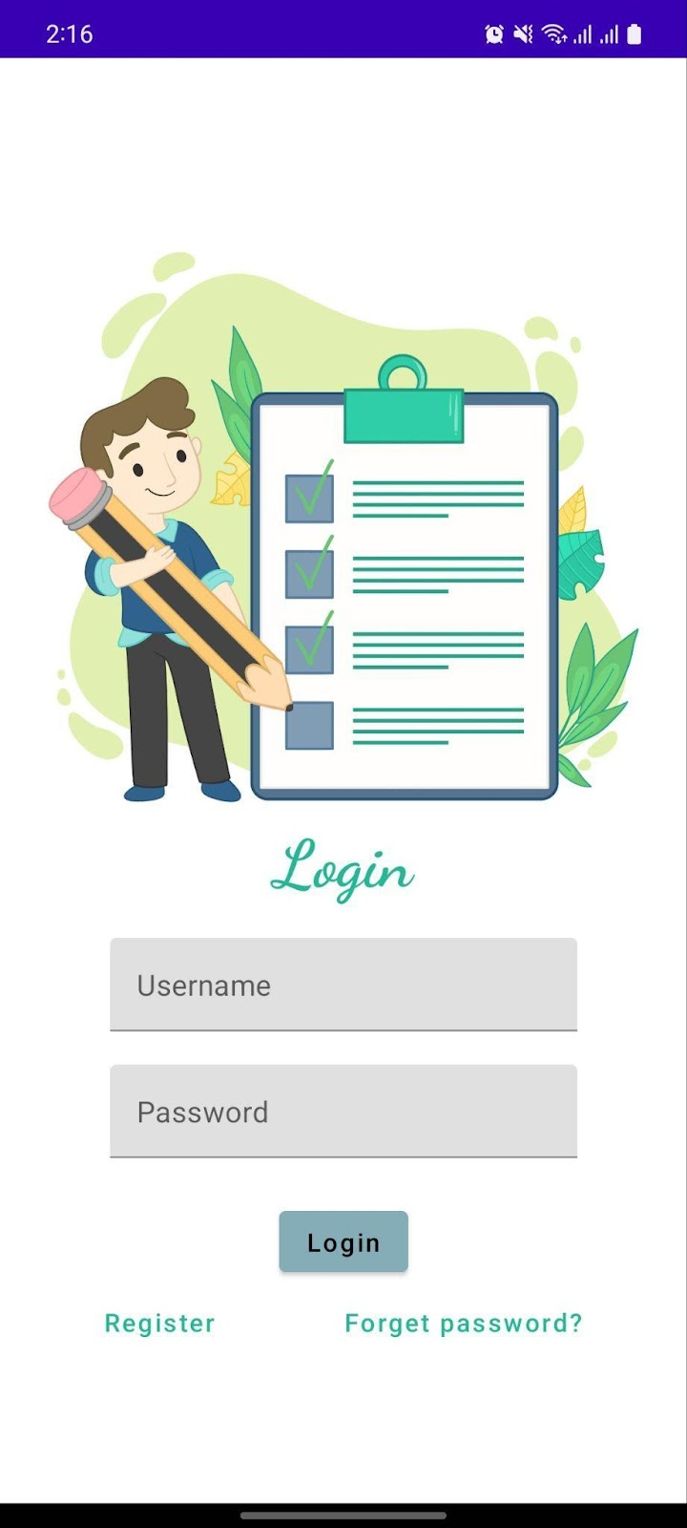
OUTPUT:
Login Page:

Slide 14
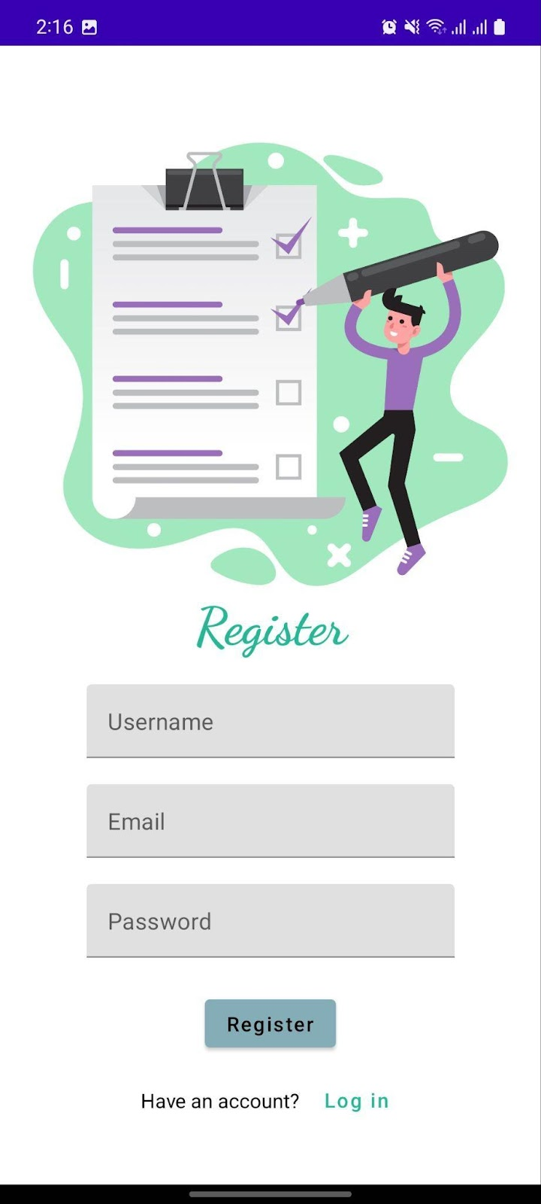
Register Page :

Slide 15
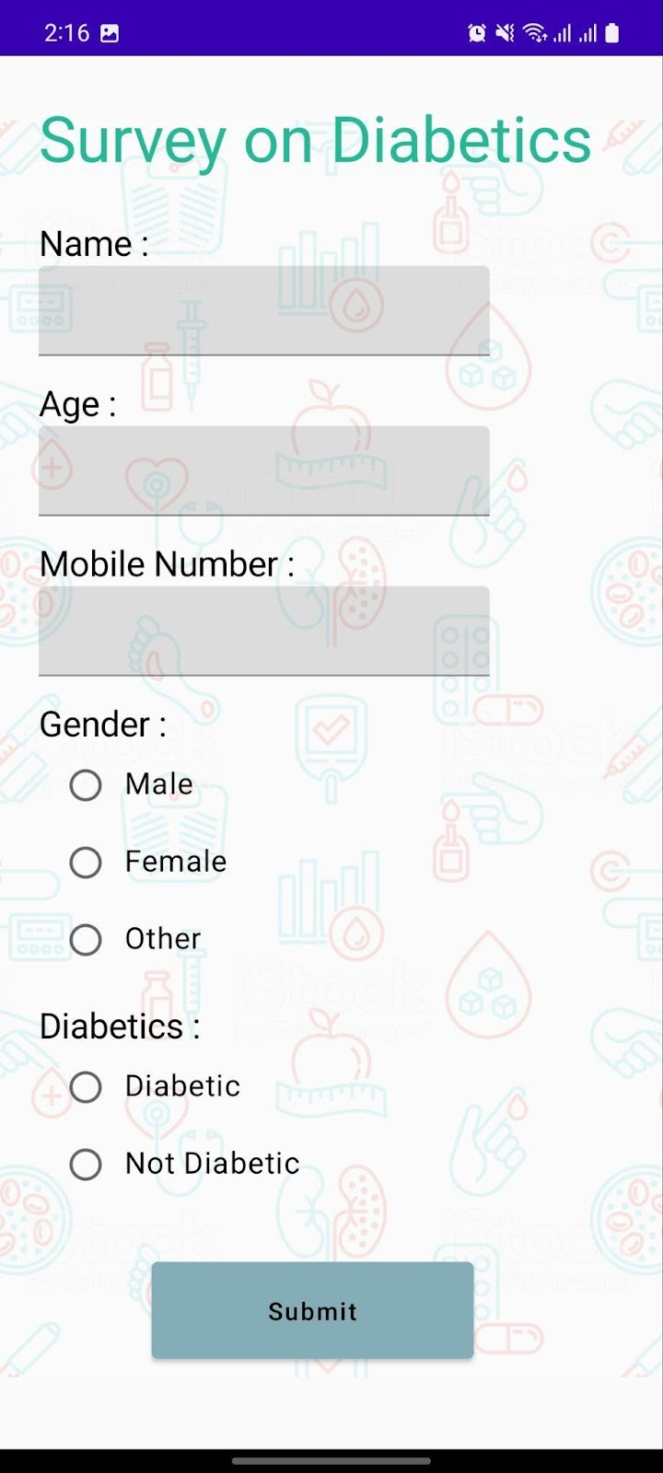
Survey Form :

Slide 16
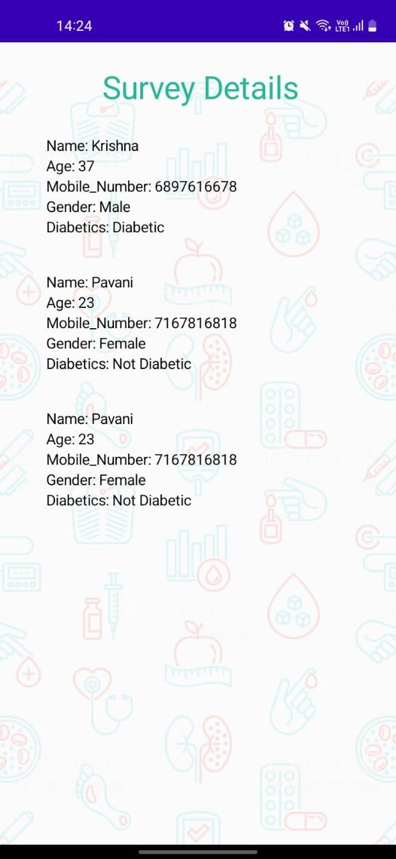
Survey Details:

Slide 17
CONCLUSION
The survey app with text input validation using Jetpack Compose. The app asks the user to enter their email, validating the input as they type.
If the email is invalid, an error message is displayed, and the "Submit" button is disabled until a valid email is entered. By using Compose’s state management and real-time validation, the UI automatically updates, ensuring a smooth and efficient user experience.
This approach makes it easy to manage input validation while keeping the code clean and responsive, ideal for a survey app where accurate user data is crucial.

