Slide 1
The Most important components in syncfusion..
KALAIVANI M
SF4616

Slide 2

tHE MOST IMPORTANT COMPONENTs
DATA GRID
CHART
LISTVIEW
SCHEDULE
LIST VIEW
PDF VIEWER
EXCEL LIBRARY

Slide 3
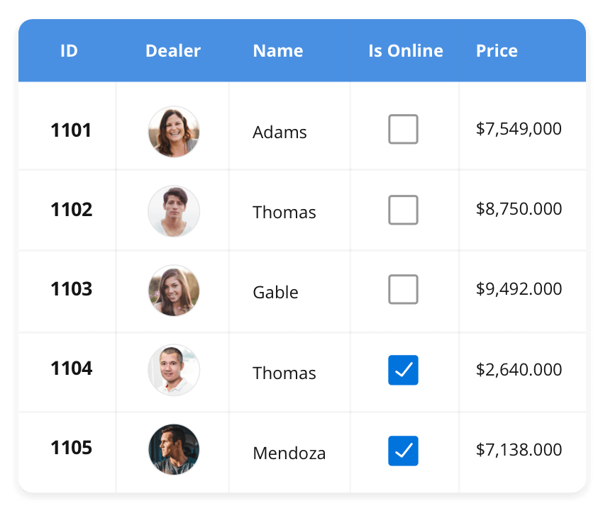



Data grid
The DataGrid control is a high-performance grid component that helps display and manipulate large amounts of data in a tabular format. Its rich feature set includes functionalities like data binding, sorting, grouping, editing, filtering, swiping, dragging, resizing, loading more items, pull-to-refresh, and exporting to Excel and PDF file formats.
SUPPORTED PLATFORMS:
Javascript Angular React Vue Blazor Flutter ASP.NET MVC ASP.NET Core
WinForms WPF Xamarin Flutter WinUI .NET MAUI UWP
Xarmarin Flutter UWP Javascript .NET MAUI

Slide 4
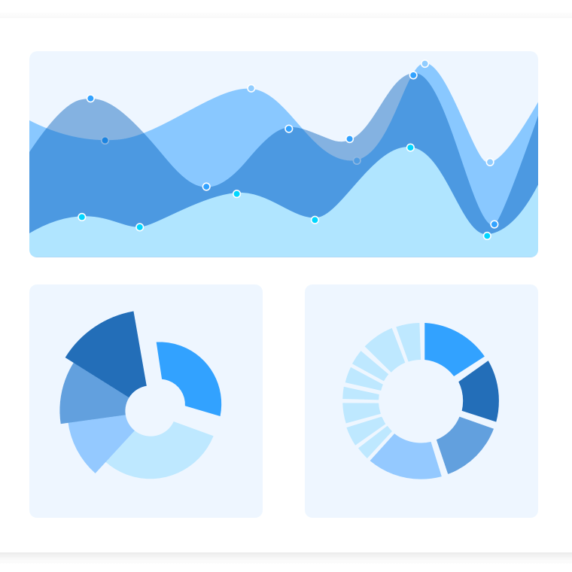
Charts
The Charts control can plot a wide range of chart types, ranging from line charts to specialized financial charts. Its rich feature set includes functionalities like data binding, multiple axes, legends, animation, data labels, annotations, trackballs, tooltips, and zooming.
SUPPORTED PLATFORMS:
Javascript Angular React Vue Blazor Flutter ASP.NET MVC ASP.NET Core
WinForms WPF Xamarin Flutter WinUI .NET MAUI UWP
Xarmarin Flutter UWP Javascript .NET MAUI

Slide 5
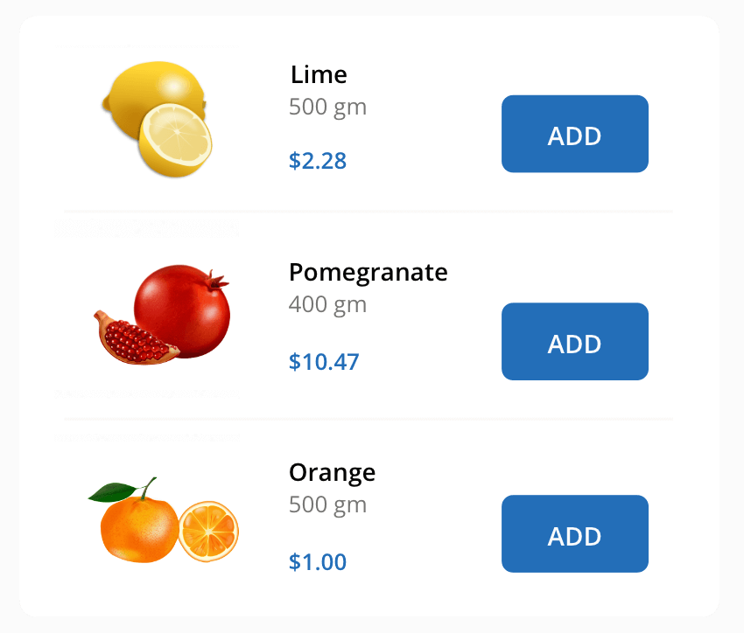
List VIEW
The List View renders a set of data items with UI views or custom templates. It has many features like grouping, sorting, filtering, paging, swiping, multiple selection, drag and drop, and different layout types. The List View control has been optimized to work with large amounts of data.

Slide 6

Thank you…
.

