Slide 1

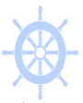

PIPELINE MANAGER
From Amshuhu iTech Solutions Pvt. Ltd.
DFLTS Training Pack
Version 1.0

Slide 2


DFLTS Activities
DFLTS Training Pack
Initial Set Up
Create an Opportunity
DFLTS Review
Reports for DFLTS
Notification
Marketing Material

Slide 3
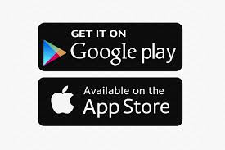
Initial Set Up
DFLTS Training Pack
DGM / DSM will create a DFLTS user account using the web tool (https://shell.isteer.co)
DFLTS will receive a welcome email with user name (email id) and password
DFLTS downloads Pipeline Manager App from App Store or Play store
DFLTS uses the received user name and password to login into the account

Slide 4
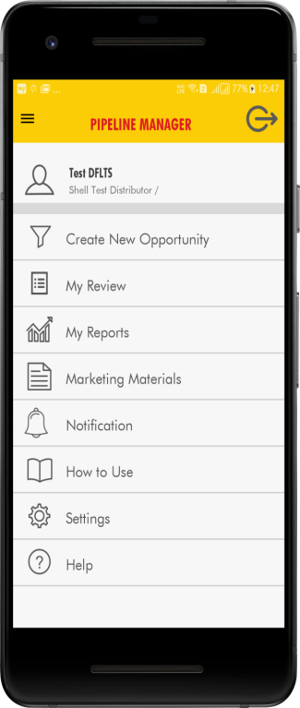
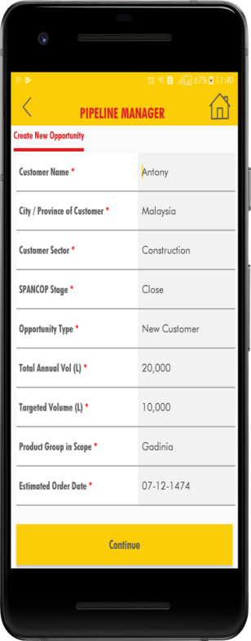
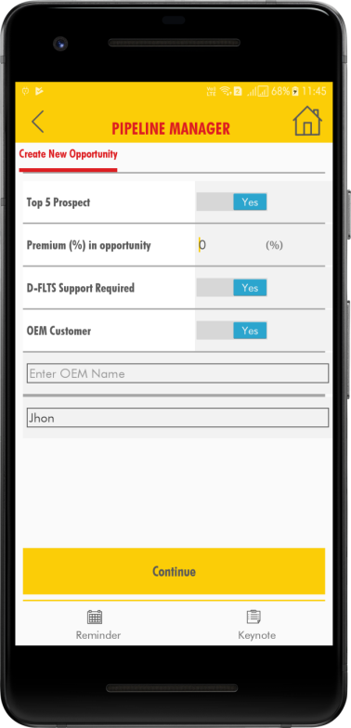
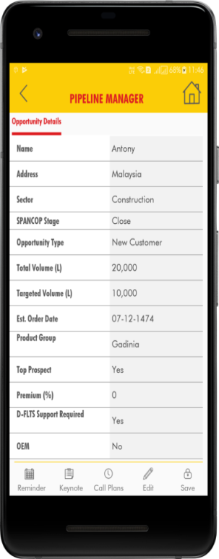
Opportunity Management
DFLTS Training Pack
Creating New Opportunities for DSR
Notes
Click on opportunity Name to view full details and click edit in bottom menu

Slide 5
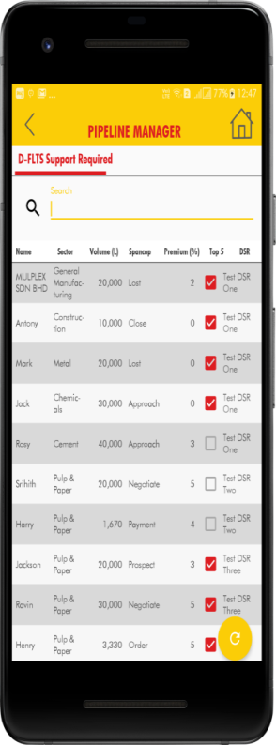
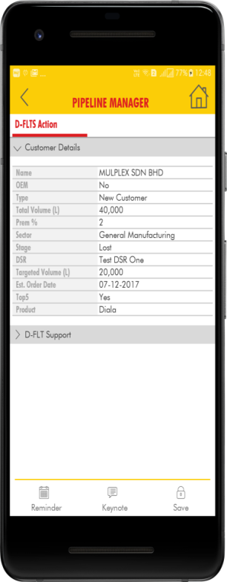
DFLTS Review
DFLTS Training Pack
Review opportunity assigned to DFLTS
Notes
Update technical support activities to opportunity.

Slide 6

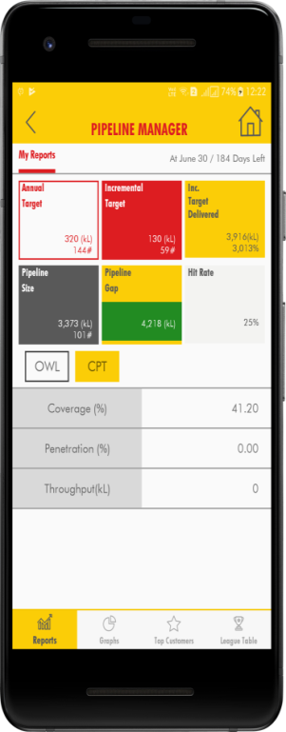
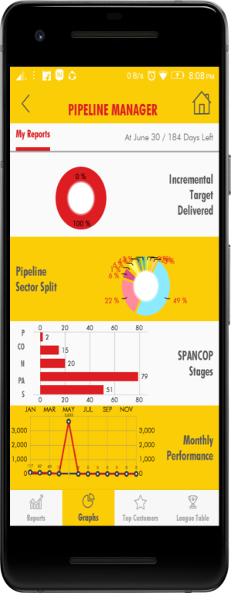
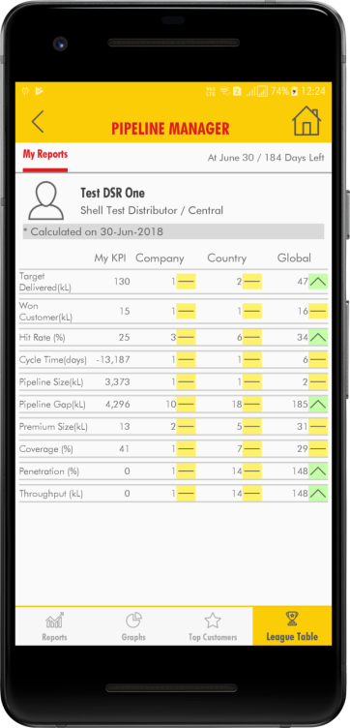
Reports
DFLTS Training Pack
KPI View
Chart View of KPI and sector wise split
Top 5 Opportunity
League Table for
Notes
Click on icon and bottom menu to view different reports
Click on chart to view bigger chart view
League table will show your performance. And your ranking with in the system.

Slide 7

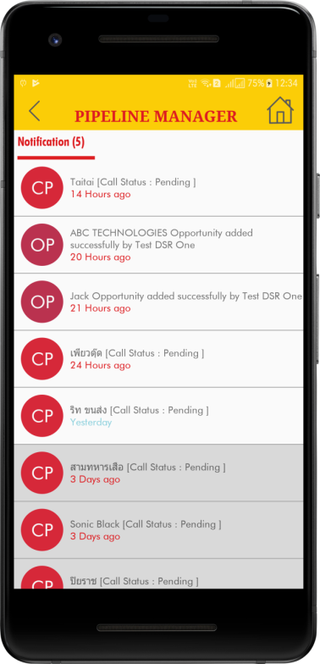
Notification
DFLTS Training Pack
Receiving Notification
Viewing Notification
Action on Notification
Deleting Notification
Notes
Be online to receive proper notification
Notification will be sent on the date of call plan
You will receive notification if DSM / DFLTS adds new opportunity for you
CP - Call Plan Notification (Click to view call plan details)
OP – Opportunity Notification (Click to view opportunity details)
Delete by sliding left or right based on device type

Slide 8
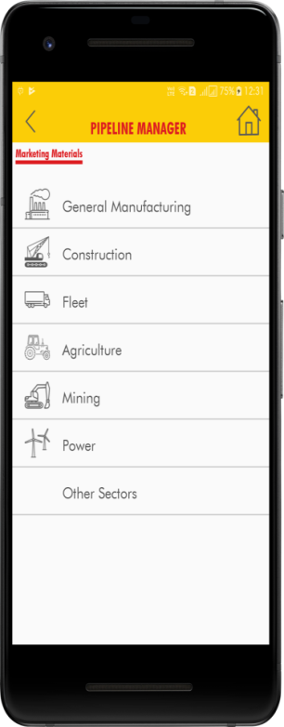
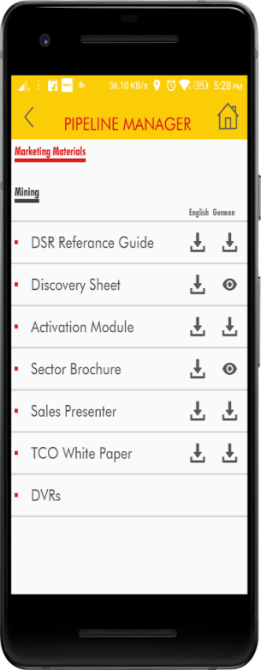
Marketing Material
DFLTS Training Pack
Select Sector
View Support Documents Available
Download Documents
View downloaded documents
Notes
Documents are available in both English and Local Language based on the country.
Documents will be downloaded only when you click on same. Once it is downloaded and available in your mobile, click on view icon to view.
If new version of document is released system will indicate, new document available. You can download new or keep old version.
You can share documents to customer, through WhatsApp or email based on your device applications.

