Slide 1



PIPELINE MANAGER
From Amshuhu iTech Solutions Pvt. Ltd.
DSM Training Pack
Version 1.0

Slide 2


DSM Activities
DSM Training Pack
Initial Set Up
Basic Activities
Annual Activities
Monthly Activities
Opportunity Management
Reports Viewing

Slide 3



Initial Set Up
DSM Training Pack
Initial super user account will be created by Amshuhu Support Team.
Super user (DGM / DSM) will receive the welcome mail with login details.
Super user (DGM / DSM) can login using web tool (https://shell.isteer.co)
Icons and its function
To Add New
To Filter
To Edit
To Change Status
Active Status
Inactive Status

Slide 4
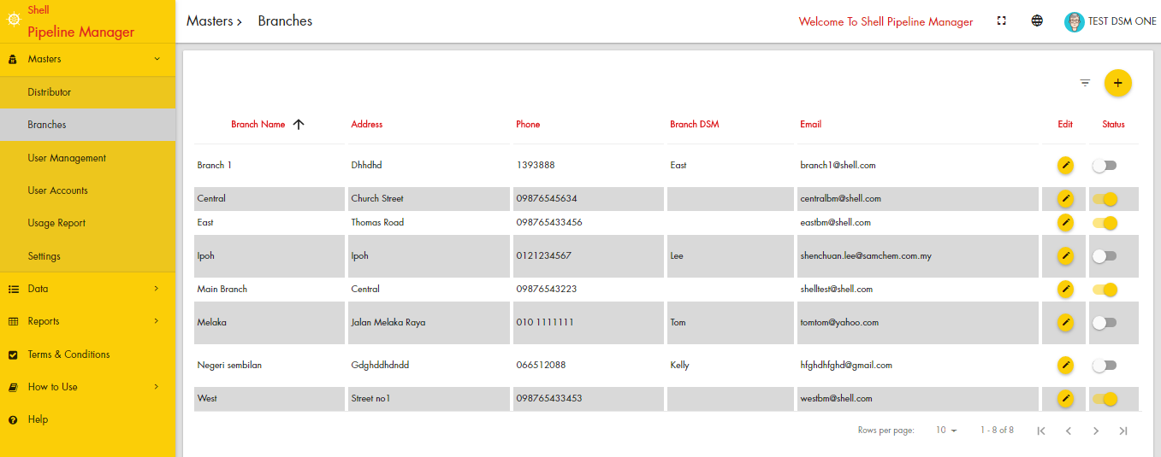
Basic Activities
DSM Training Pack
Create and Manage Branches
Create and Manage Users
Notes
Menu for both Branches and User Management are under Masters.
Click on User Management to view , add, modify and delete user.
User Account will show total users available for your company in different category.
Usage Report to view usage by all users

Slide 5
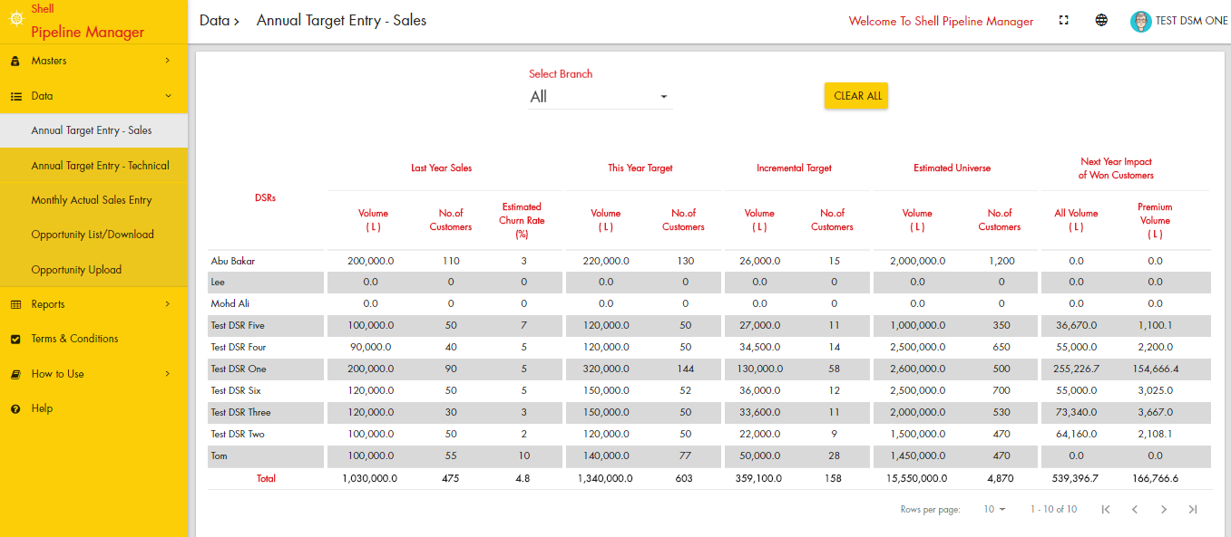
Annual Activities
DSM Training Pack
Update Annual Target for all DSRs (Sales)
Update Annual Target for DFLTS (Technical)
Notes
Click on the numbers to update last year sales and expected churn rate against each DSR / DFLTS.
Update current year target. System will calculate incremental target.
Next year impact on this year WON customer is only for your indication.
You need to update only after 1st Jan of every year.
You can revise target during middle of the year.

Slide 6
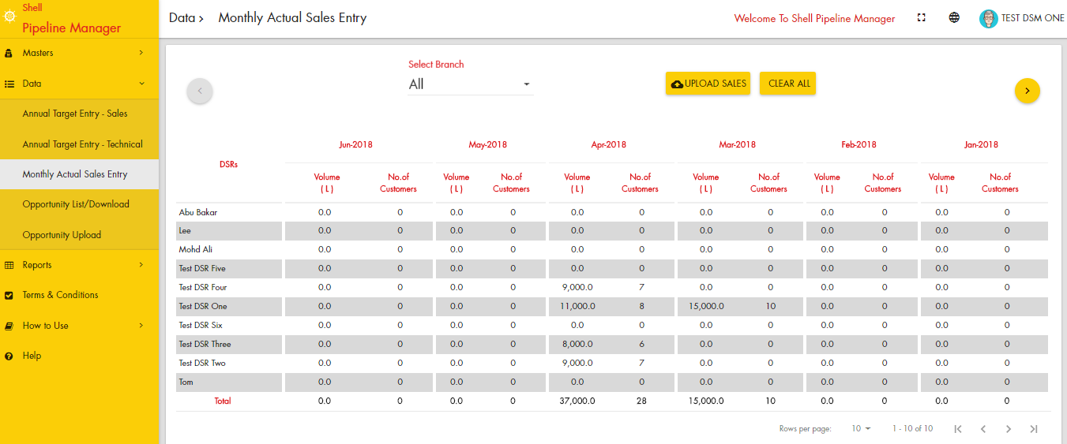
Monthly Activities
DSM Training Pack
Update monthly sales data all DSRs (Sales)
Notes
Click on the numbers to update monthly sales .
You can download in excel and upload also. But we prefer online update to avoid any mismatch. It will take only 5 minutes to update it online.
System will generate automated OWL / CPT csv files, which you submit every month to shell based on this data. Correct data updates will simplify your work.

Slide 7
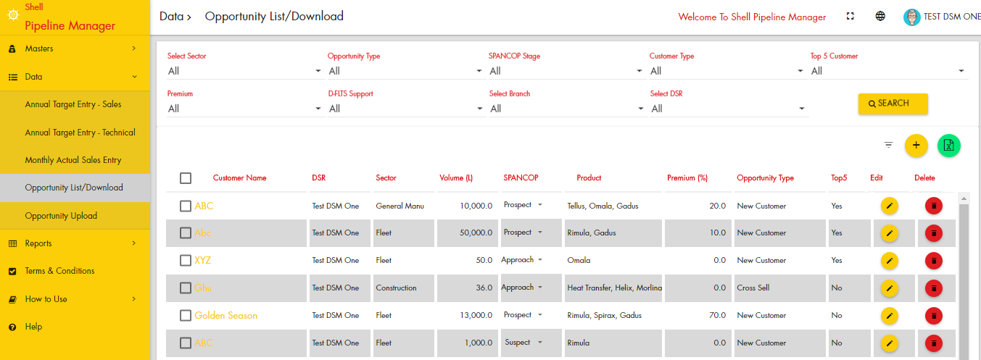
Opportunity Management
DSM Training Pack
View Opportunities Created by DSRs
Update an Opportunity
Add an opportunity to DSR
Notes
You could search and filter and view opportunity.
You can reassign opportunity.
Download opportunity into excel.
You can upload opportunity using “Opportunity Upload” menu link. Sample excel file available in that screen

Slide 8
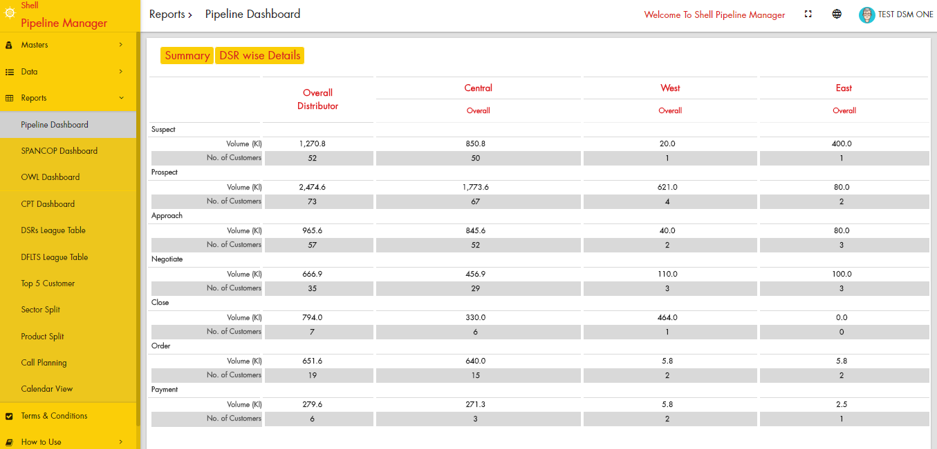
Report Viewing
DSM Training Pack
View Reports like Pipeline, SPANCOP, Top 5 Customers and Call Planning
Aggregated Reports like OWL, CPT, Product Split and Sector Splits
Comparative Reports like DSR and DFLTS League Table
Calendar view to review Monthly, Daily call plans / POPSA of all DSRs
Notes
You can view by overall or DSR wise.
You can assign different color code for each DSR which will be displayed in calendar view. Color can be assigned in user edit in user management.
In calendar view each day has a rectangle with number which day total visit, click on those numbers to view details. Number in legend will show monthly visit numbers of each DSR.

