Slide 1



PIPELINE MANAGER
From Amshuhu iTech Solutions Pvt. Ltd.
DSR Training Pack
Version 1.0

Slide 2
DSR Activities
DSR Training Pack
Initial Set Up
Opportunity Management
Call Planning / POPSA
Notification
Marketing Material
Reports Viewing

Slide 3

Initial Set Up
DSR Training Pack
DGM / DSM will create the DSR user account using web tool (https://shell.isteer.co)
DSR will receivea welcome email with user name (email id) and password
DSR downloads Pipeline Manager App from App Store or Play store
DSR uses the received user name and password to login into the account

Slide 4
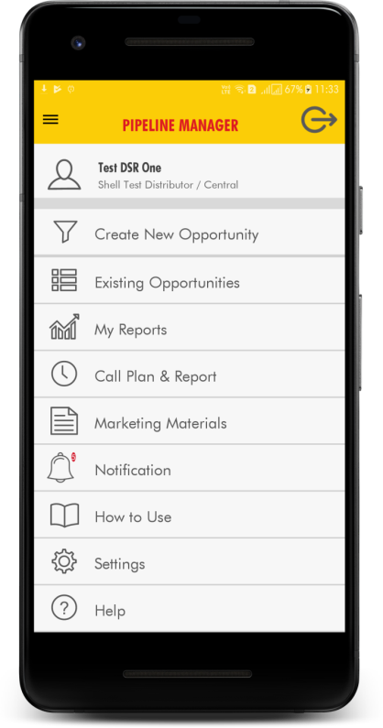
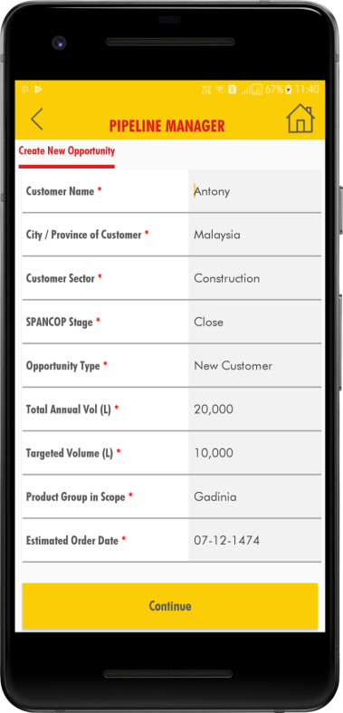
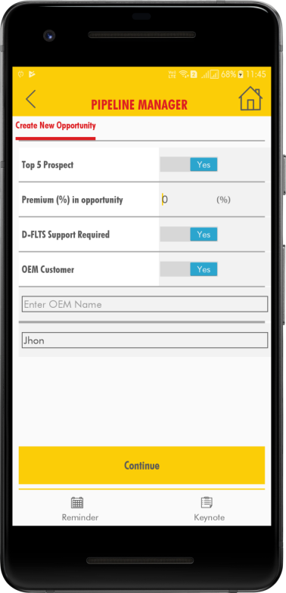
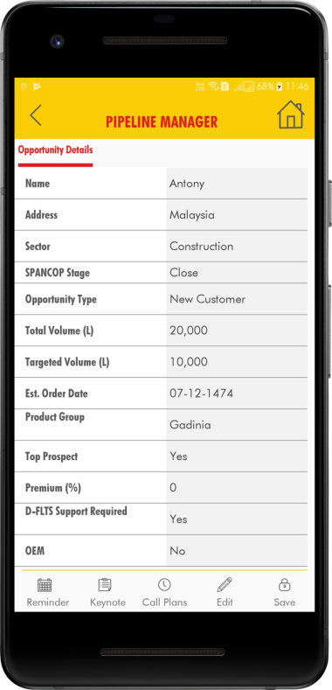
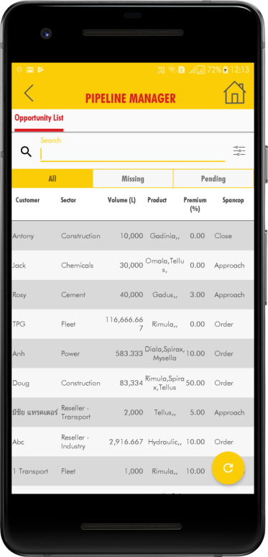
Opportunity Management
DSR Training Pack
Creating New Opportunities
Changing Status of Opportunities
Changing Other Details in Opportunities
Accepting / Rejecting Opportunity Uploaded by Shell team
Notes
Click on opportunity status to change status
Click on opportunity Name to view full details and click edit in bottom menu
Click on pending in list title to view opportunities uploaded by shell and pending for your acceptance. On click you will see more details. You also have option to accept or reject . When accepted it will be added to your opportunity list. When you reject it will ask for reason.

Slide 5
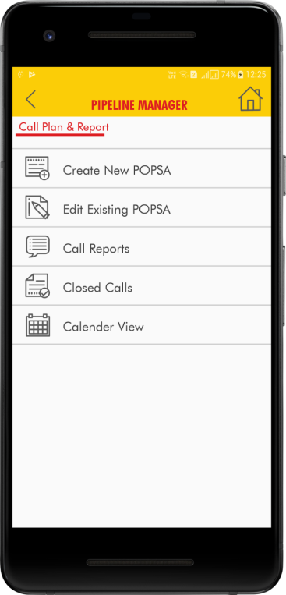
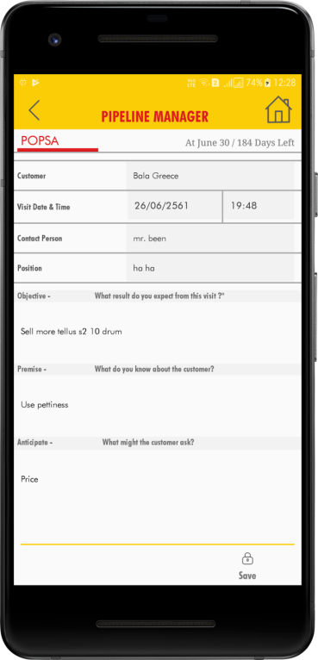
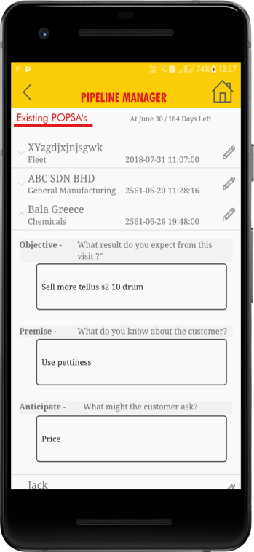
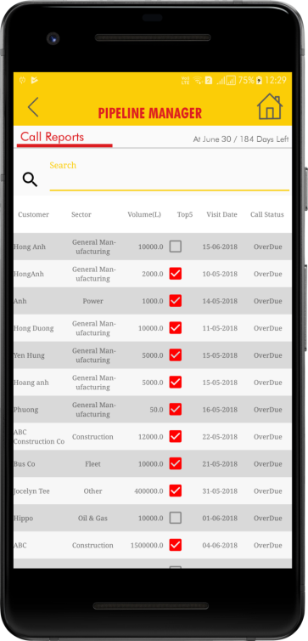
Call Planning and POPSA
DSR Training Pack
Creating New Call Plan / POPSA
Modify future Call Plan / POPSA
Close Pending Call Plan / POPSA
Review old Call Plans / POPSA
Notes
POPSA is optional
After visiting customer update What was Discussed and Actions to complete the call. Till then it will be listed as Pending for 7 days after planned date. After 7 days it will be listed as overdue.
Calendar view is also available for better planning.
You will receive notification on mobile on the planned date.

Slide 6
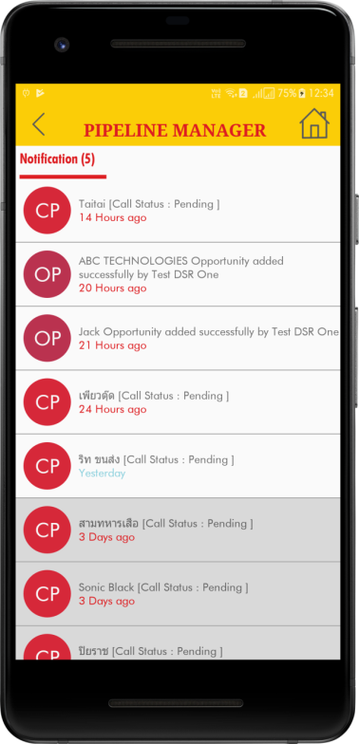
Notification
DSR Training Pack
Receiving Notification
Viewing Notification
Action on Notification
Deleting Notification
Notes
Be online to receive proper notification
Notification will be sent on the date of call plan
You will receive notification if DSM / DFLTS adds new opportunity for you
CP - Call Plan Notification (Click to view call plan details)
OP – Opportunity Notification (Click to view opportunity details)
Delete by sliding left or right based on device type

Slide 7
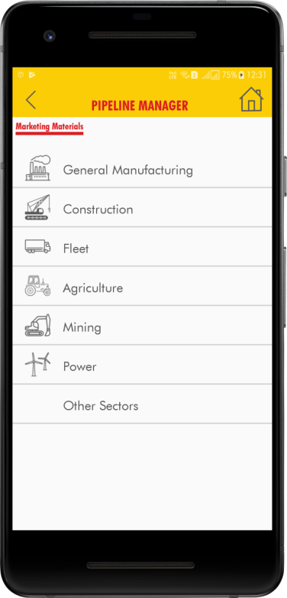
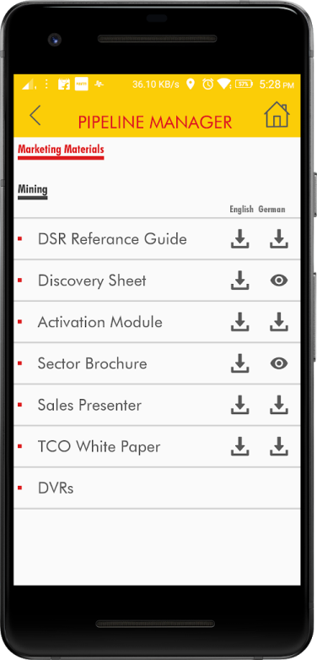
Marketing Material
DSR Training Pack
Select Sector
View Support Documents Available
Download Documents
View downloaded documents
Notes
Documents are available in both English and Local Language based on the country.
Document will be downloaded only when you click on same. Once it is downloaded and available in your mobile, click on view icon to view.
If new version of document is released system will indicate, new document available you can down new or keep old version.
You could share documents to customer, through WhatsApp or email based on your device applications.

Slide 8
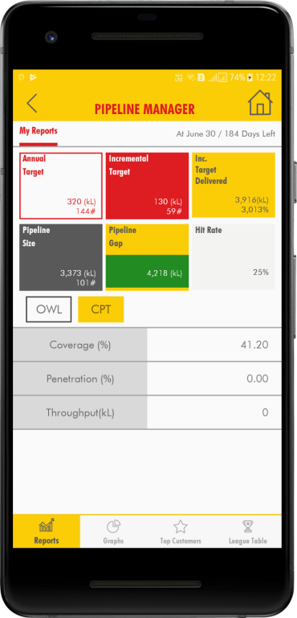
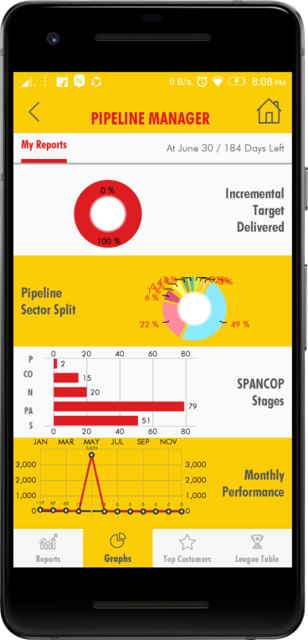
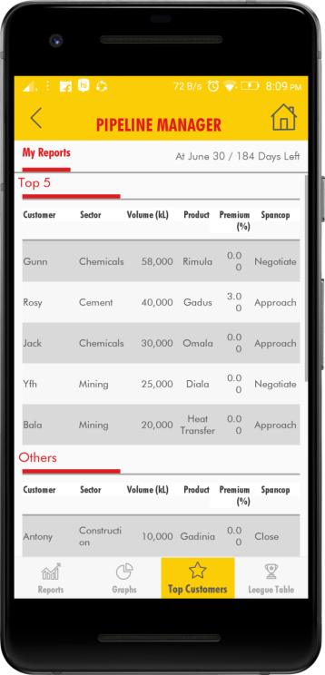
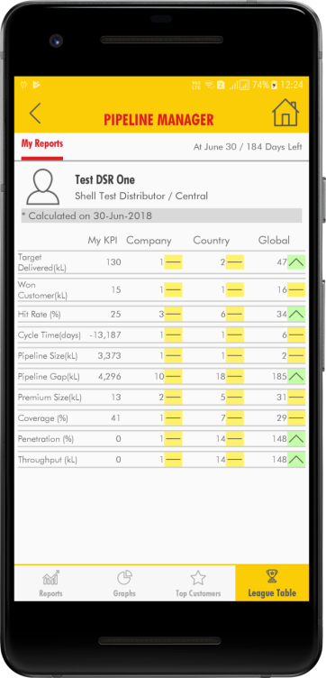
Reports
DSR Training Pack
KPI View
Chart View of KPI and sector wise split
Top 5 Opportunity
League Table for
Notes
Click on icon and bottom menu to view different reports
Click on chart to view bigger chart view
League table will show your performance. And your ranking within the system.

