Slide 1
TNSDC-Generative AI
RAINFALL PREDICTION USING CNN
Presented by : ABDUL KALAM.P,
au211521104002,
Pre-Final Student,
Computer Science and Engineering,
Panimalar Institute of Technology.

Slide 2
OUTLINE
Proposed Solution
System Approach
Algorithm
Problem Statement
Result
Conclusion

Slide 3
PROBLEM STATEMENT
Accurate prediction of rainfall is crucial for various sectors including agriculture, water resource
management, disaster preparedness, and urban planning. Traditional methods for rainfall prediction
often rely on statistical models and historical data, which may not capture the complex spatial and
temporal patterns inherent in meteorological data. Deep learning techniques, particularly Convolutional
Neural Networks (CNNs), offer a promising avenue for improving the accuracy of rainfall prediction by
leveraging the spatial dependencies present in weather data.The problem statement involves
developing a deep learning model, specifically utilizing CNN architecture, for predicting rainfall. The
model will be trained on historical meteorological data including parameters such as temperature
humidity, wind speed, and pressure, obtained from various weather stations distributed across the target
region. The goal is to accurately predict rainfall amounts at different spatial and temporal scales, ranging
from local to regional levels, with high precision and reliability.

Slide 4
PROPOSED SOLUTION
The proposed solution focuses on developing a
Convolutional Neural Network (CNN) tailored for accurate rainfall prediction. Leveraging historical meteorological data from diverse weather stations, the CNN architecture will capture spatial dependencies crucial for precise forecasts. Through rigorous preprocessing and iterative training, the model will be optimized to enhance prediction accuracy. Techniques such as cross-validation and hyperparameter tuning will ensure robustness and prevent overfitting. Evaluation using metrics like mean squared error and correlation coefficient will validate the model's effectiveness. Once validated, the trained CNN will be deployed for practical applications, providing stakeholders in agriculture, water resource management, and disaster preparedness with actionable insights and timely forecasts. This data-driven approach offers reliable predictions, supporting informed decision-making across various sectors.

Slide 5
SYSTEM APPROACH
The system approach to rainfall prediction utilizes Convolutional Neural Networks (CNNs) for precise forecasts. Historical meteorological data undergoes rigorous preprocessing to ensure quality. The CNN architecture captures spatial dependencies, learning intricate patterns crucial for accurate predictions. Through iterative training and validation, including techniques like cross-validation and hyperparameter tuning, the model optimizes performance. Evaluation using robust metrics like mean squared error ensures accuracy. Once validated, the CNN model is deployed, offering stakeholders timely forecasts for decision-making in agriculture, water resource management, and disaster preparedness. Continuous monitoring and feedback refine the system's effectiveness, highlighting collaborative efforts across meteorology, data science, and application domains.

Slide 6
ALGORITHM
Data Preprocessing: Historical meteorological data, including variables such as temperature, humidity, wind speed, and pressure, are collected from various weather stations. The data undergoes preprocessing to handle missing values, outliers, and inconsistencies, ensuring data quality.
Feature Extraction: Relevant features are extracted from the preprocessed data to serve as inputs for the CNN model. This may involve techniques such as normalization and feature scaling to standardize the data.
CNN Architecture Design: The CNN architecture is carefully designed to capture spatial dependencies within the meteorological data. This typically involves the use of convolutional layers to extract features and pooling layers to reduce dimensionality.
Model Training: The CNN model is trained iteratively using the preprocessed data. The dataset is split into training and validation sets, with the model learning to recognize patterns and relationships within the data.

Slide 7
ALGORITHM-CONT.
5. Hyperparameter Tuning: Key parameters of the CNN model, such as learning rate, batch size, and network architecture, are fine-tuned to optimize performance. Techniques such as grid search or random search may be employed to find the optimal hyperparameters.
6. Evaluation: The trained CNN model is evaluated using validation data to assess its performance. Metrics such as mean squared error, root mean squared error, and correlation coefficient are commonly used to measure the model's accuracy in predicting rainfall.
7. Deployment: Once the CNN model demonstrates satisfactory performance, it is deployed for practical applications. Stakeholders can utilize the model's predictions for decision-making in various sectors, including agriculture, water resource management, and disaster preparedness.
3/21/2024 Annual Review

Slide 8
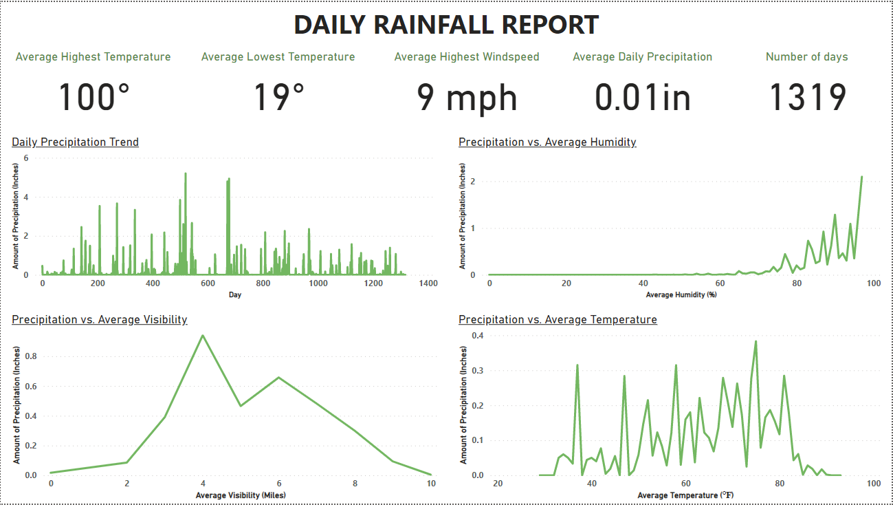
RESULT

Slide 9
CONCLUSION
In Conclusion,Utilizing CNN algorithms for waterfall prediction offers significant advantages, including automatic feature extraction, spatial
hierarchy representation, and scalability. These algorithms excel in
analyzing diverse data sources, providing robust predictions across
different environmental conditions. Despite being perceived as black
boxes, efforts to enhance interpretability through techniques like attention mechanisms aid in understanding model decisions. CNNs hold promise
for advancing understanding of waterfall dynamics, contributing to effective conservation and management efforts. However, challenges such as data scarcity and model generalization require further research for maximizing CNNs' potential in waterfall prediction.
3/21/2024 Annual Review

