Slide 1
B.Tech. C.E.
Semester: VII
Capstone project:
PrepGen- Smarter Learning, Powered by AI
Presented by : Himadri Rathore
Divyansh Bohra
Kalash Maheshwari
Faculty Mentor :Dr.Vikas Jain

Slide 2
PrepGen-Smarter Learning, Powered by AI
An AI-powered personalized learning platform designed specifically for university students. It helps them organize study material, summarize content, generate quizzes, identify weak areas, and resolve doubts quickly — all in one integrated system.
What the Platform Does :
Understands & processes uploaded notes/documents
Generates flashcards, summaries & quizzes automatically
Resolves doubts via AI chatbot trained on the student’s content
Tracks learning progress using spaced repetition & analytics

Slide 3
"When learning meets intelligence and intelligence meets intent — technology becomes a personal tutor, not just a tool."

Slide 4
Why this problem?
Students struggle to organize and revise study material effectively.
Finding relevant, syllabus-specific content is time-consuming.
There is a lack of tools for self-assessment and performance tracking.
Quick and accurate doubt resolution is often unavailable, especially during exams.

Slide 5
Purpose:
To build an AI-powered platform that streamlines the entire study process.
Features include note organization, content summarization, quiz generation, and doubt resolution.
Tailors learning paths based on each student’s individual performance and needs.
Need:
Current tools (like Google or generic AI bots) are not context-aware or personalized.
No integration between study material, assessment, and revision tools.
A unified, adaptive learning assistant is needed to enhance academic efficiency and reduce exam stress.

Slide 6
Project Objectives
1. Build an AI-powered personalized learning engine that adapts to each student’s performance and progress.
2. Develop tools to generate quizzes, auto-summarize study materials (PDFs, PPTs, YouTube) from user-uploaded content.
3.Implement intelligent semantic search and real-time doubt resolution using local AI models with minimal external dependency.
4.Reduce External Dependencies: Develop core AI and NLP features using self-hosted or open-source alternatives to minimize reliance on third-party APIs and proprietary models.
5. Ethical Learning Analytics & Fairness-Aware AI:
Develop an interactive analytics dashboard that offers real-time insights into student performance while integrating fairness-aware algorithms to ensure unbiased recommendations, assessments, and content generation—promoting transparency, inclusivity, and ethical learning outcomes.

Slide 7
Feasibility
Technical feasibility:
Leverages open-source, pretrained NLP models like T5, BART, and Sentence-BERT.
No custom training required — only prompt engineering and fine-tuning for user-specific outputs.
Integration with Hugging Face ensures scalability without high compute costs.

Slide 8
Feasibility
Economic feasibility:
Entire project operates within free-tier limits using:
MongoDB Atlas for database
Vercel or Render for hosting
Hugging Face Hub for model access
No upfront investment required for deployment or basic usage.

Slide 9
Team capability
The 3-member team is efficiently divided by expertise:
  Frontend: UI/UX, content display
  Backend: API handling, database management
  AI/NLP: Prompt design, GenAI integration, content adaptation

Slide 10
Features
1. User Management
User login via Gmail (OAuth2)
Personalized database instance (MongoDB) per user
Secure session management
User profile view (progress, history, bookmarks)
2. Content Upload & Parsing
Upload files: PDF, PPT, DOCX, and previous year question papers
Extract text from each file
Store uploaded content in user’s personal MongoDB collection.

Slide 11
Features
3. AI-Based Summarization
Use pretrained models (e.g., T5, BART) to summarize:
  Uploaded notes
  Video transcripts
Display summarized notes to the user
User profile view (progress, history, bookmarks)
4. Quiz Generator
Generate MCQs or short quizzes based on:
  Uploaded notes
  Previous year papers
Provide multiple quizzes for each topic

Slide 12
Features
5.YouTube Video Integration
Accept YouTube video links from users
Extract transcript using API or scraping
Summarize video transcript into notes
6. Performance Analysis
Evaluate quiz results
Identify strong and weak areas per topic
Visual progress dashboard for tracking improvement

Slide 13
Features
6. AI Chatbot for Doubt Solving (RAG-Based)
Accept user questions
Step 1: Search user notes using semantic vector search (FAISS)
Step 2: If no match, fallback to web search (e.g., SerpAPI)
Step 3: Generate answer using LLM (e.g., GPT or open-source model)
Label response origin: “From Notes” or “From Web”

Slide 14
Features
7. Combines key features to enhance learning and engagement:
Ask Again: Regenerate chatbot answers with rephrased prompts.
Retry & Improve: Retake quizzes and get AI suggestions until mastery.
Smart UI/UX: Dark mode, responsive design, typing animation, and loading indicators for a smooth user experience.

Slide 15
Features
8. Future Optional Features (Stretch Goals)
Voice-based chatbot using Whisper (for Hindi or local languages)
Flashcard generator from notes
Reminders or quiz scheduling
Leaderboard (if gamification is needed)
Personalised study features
Flashcards

Slide 16
Tools and technology
Frontend: React.js + Tailwind CSS
AI/NLP:Hugging Face Transformers (T5, BART), Sentence-BERT, FAISS
Backend:FastAPI (Python)
Database:MongoDB Atlas (Free Cloud Tier)
Authentication:Google OAuth2
File Parsing:pdfminer.six (PDFs), python-docx (DOCX), python-pptx (PPTX)
Web Fallback:SerpAPI (Free Tier) for external search
YouTube Input:youtube-transcript-api (yt-dlp not used)
Hosting:Vercel (Frontend), Render or Railway (Backend)

Slide 17
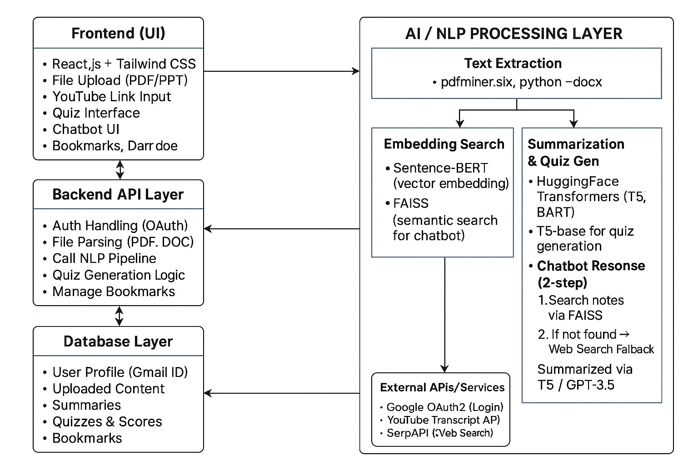

Slide 18
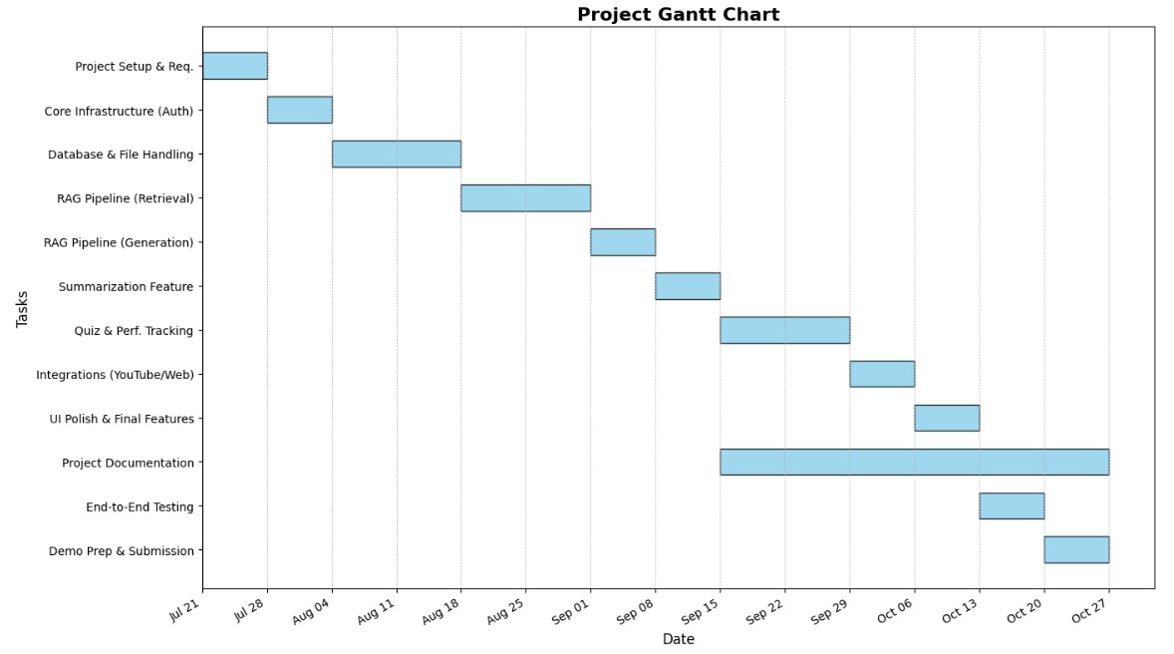

Slide 19
Key Constraints considered
Data Privacy: All user data is securely stored per user using Gmail-based authentication.
Response Time: Prioritizes quick access from stored/generated content; web search is fallback only.
Internet Dependency: Offline mode not supported, but minimal APIs are used to reduce latency and external reliance.

Slide 20
Literature review
Introduction
As higher education institutions confront increasing student diversity, digital distraction, and exam-related anxiety, personalized AI systems have emerged as a promising solution to enhance exam preparedness. This review synthesizes recent studies that explore the application, benefits, and limitations of artificial intelligence—particularly large language models (LLMs), intelligent tutoring systems (ITS), and chatbots—in personalized learning and assessment contexts.
Limitations of Traditional Learning Systems
Traditional learning management systems (LMSs) and one-size-fits-all exam preparation tools fail to account for individual learner differences in pace, prior knowledge, and retention capability. Adaptive learning platforms, in contrast, have demonstrated higher efficacy in both engagement and outcomes. Kulik & Kulik (1991) found that intelligent tutoring systems (ITS) produced a median effect size of 0.66, indicating substantial improvement over conventional instruction. These systems help learners transition from the 50th to the 75th percentile in achievement (Maity & Deroy, 2024). Benefits of AI-Based Personalization
Squirrel AI showed a statistically significant increase in exam scores and reduced dropout rates by up to 50% in Chinese middle school settings (Cui et al., 2019). These results confirm the scalability and efficacy of AI-powered adaptive learning.

Slide 21
Role of LLMs and Chatbots in Education
Recent advancements in large language models (e.g., GPT-4) enable dynamic content generation, real-time feedback, and personalized learning trajectories. Studies by Sajja et al. (2023) highlight that NLP-driven AI assistants improved learner satisfaction and engagement metrics in higher education contexts. In another deployment, AI-generated quizzes and flashcards using GPT-3 increased performance by 15 percentile points over traditional methods (Baillifard et al., 2023). AI chatbots also promote metacognitive awareness and motivation. A systematic literature review by Subramanian et al. (2023) classified chatbot benefits as skill improvement (32%), increased efficiency (25%), motivation (13%), and 24/7 availability (11%).
Institutional Adoption and Market Trends
AI tools are increasingly being adopted by universities to improve outcomes and reduce faculty burden. Georgia Tech’s Jill Watson chatbot, deployed as a virtual teaching assistant, successfully responded to over 40% of student queries without human intervention. Commercial platforms like Alice.Tech, which raised $4.8 million in seed funding in 2025, have institutionalized AI tutors for exam preparation across U.S. and European universities. The global AI-in-education market is projected to grow from $5.6 billion in 2024 to over $88 billion by 2032, with a compound annual growth rate (CAGR) of 31% (EdTech Digest, 2024).
Challenges and Limitations
Despite their promise, AI systems are not without limitations. LLMs may hallucinate or generate incorrect information. Tack & Piech (2022) found GPT-3 underperformed human educators in pedagogical helpfulness, with a negative delta of –0.93. Moreover, over-reliance on AI could lead to cognitive off-loading, where students bypass deep learning in favor of quick answers. Ethical concerns around academic integrity, data privacy, and plagiarism also persist (Yan et al., 2023; Springer, 2024).
Conclusion
The literature overwhelmingly supports the integration of AI-powered systems for personalized exam preparation. These tools bridge significant gaps in traditional methods by offering adaptive, scalable, and learner-centric experiences. However, they must be implemented thoughtfully, with safeguards to ensure pedagogical integrity and ethical compliance. This project builds upon these validated insights to design a university-focused platform that harnesses LLMs and adaptive analytics to transform the exam preparation experience.

Slide 22
References (APA Style)
Baillifard, A., Gabella, M., Banta Lavenex, P., & Martarelli, C. S. (2023). Implementing Learning Principles with a Personal AI Tutor. arXiv preprint arXiv:2309.10892.
Cui, W., Xue, Z., & Thai, K.-P. (2019). Performance comparison of an AI-based Adaptive Learning System in China. arXiv:1901.10268.
Graesser, A. C., McNamara, D. S., et al. (2005). AutoTutor: A tutor with dialogue in natural language. Behavior Research Methods.
Kulik, C.-L. C., & Kulik, J. A. (1991). Effectiveness of computer-based instruction: A meta-analysis. Review of Educational Research.
Maity, S., & Deroy, A. (2024). Generative AI and Its Impact on Intelligent Tutoring Systems. arXiv:2410.10650.
Sajja, R., et al. (2023). Artificial Intelligence–Enabled Intelligent Assistant for Personalized and Adaptive Learning in Higher Education. arXiv.
Subramanian, A., et al. (2023). Role of AI chatbots in education: Systematic literature review. Int. Journal of Educational Technology.
Tack, A., & Piech, C. (2022). The AI Teacher Test: GPT-3 vs Human Teachers. arXiv:2210.03629.
Yan, L., Sha, L., Zhao, L. (2023). Challenges of LLMs in Education. MDPI Information.
EdTech Digest. (2024). AI in Education Market Trends and Forecast 2024–2032.

Slide 23
Future scope:
Lack of Benchmarking Tools
No standard framework to measure AI-tutor effectiveness during prototyping makes evaluation tricky.
Data Security & Compliance
Implementing secure storage, encryption, and GDPR/FERPA-compliant flows adds legal and technical overhead.
Integration Complexity
Integrating AI modules with existing LMS platforms (e.g., Moodle, Canvas) requires significant backend work.
Language restrictions
Making a tool that integrates all languages for inclusivity.

