Slide 1
Exploring the cityreality of New York to Create a price
Coursera Applied Data Science Capstone Project
July 28, 2019

Slide 2
introduction
In our latest market report, the average sales price in Manhattan rose substantially in the four weeks leading up to May 1, while the number of recorded sales was up slightly. And there were some notable sales last month, including the most expensive - a penthouse at the new Peter Marino-designed condo The Getty, just steps from the High Line, which sold for $59 million ($5,826/ft²). Here, as we near the end of June, we're taking a look at current listings and the average price for condos by neighborhood (excluding units in contract). In Brooklyn, neighborhoods with the highest averages include DUMBO and Brooklyn Heights while in Manhattan, some of the priciest neighborhoods are downtown and on the Upper East Side. Take a look to see average neighborhood condo prices but if you're ready to dive-in to your search, start here.

Slide 3
Data acquisition & Cleaning
The following sources were used in this project
Wikipedia (for rooms information)
Google Reviews, Architectural Digest, Lonely Planet (for top Paris landmarks)
Carto (for Paris location data to map out boundaries of arrondissement)
Foursquare (for venue information data and location)
The data was gathered using web-scraping, making calls to the Foursquare API, and downloading geojson files.
Minor data cleansing was done including adding simplified arrondissement column names, getting rid of duplicates, and deleting unnecessary columns.

Slide 4
Exploratory data analysis
The majority of our exploratory data analysis focused on using longitude and latitude information to make maps and other visuals in order to better understand where landmarks and other points of interests were located
We utilized choropleth maps, dot maps, and content tables

Slide 5
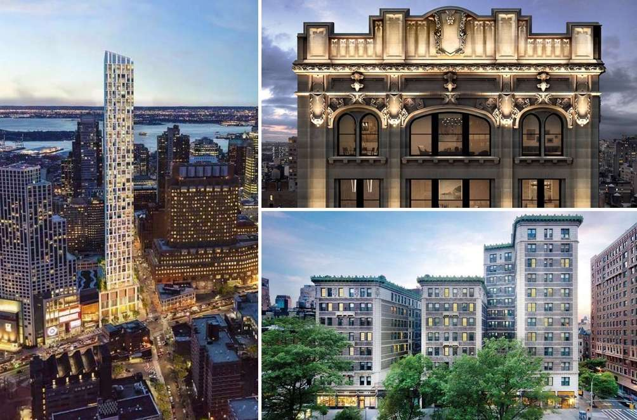
Condo flats of newyork
The first exploratory data analysis performed a choropleth and boundary map of Paris to get a visual of how and where the arrondissements are located.
Then, we used 2005 Population information to shade each arrondissement, where darker red means higher population density and lighter red means lower population density.
Notice the arrondissements are ordered in a clockwise fashion starting from the center and spiraling outward

Slide 6

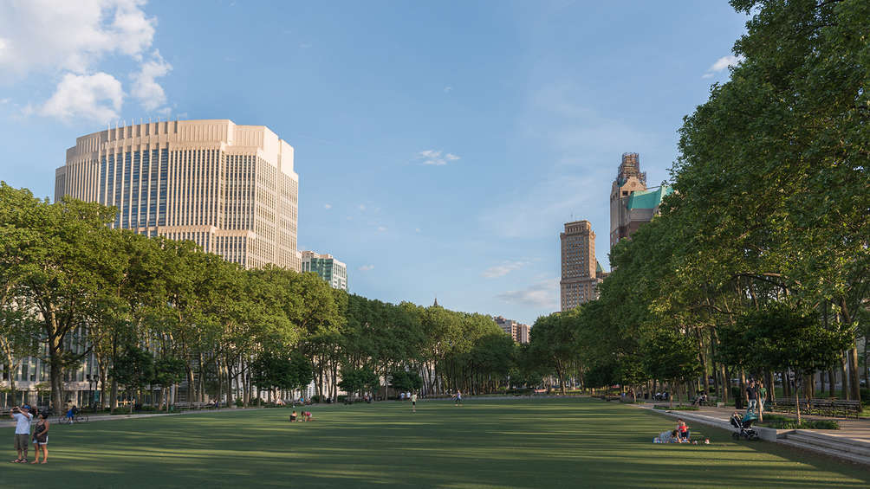
Brooklyn
I created a map that showed the top landmarks of Paris according to users on Google, Lonely Planet, and other travel websites.

Slide 7
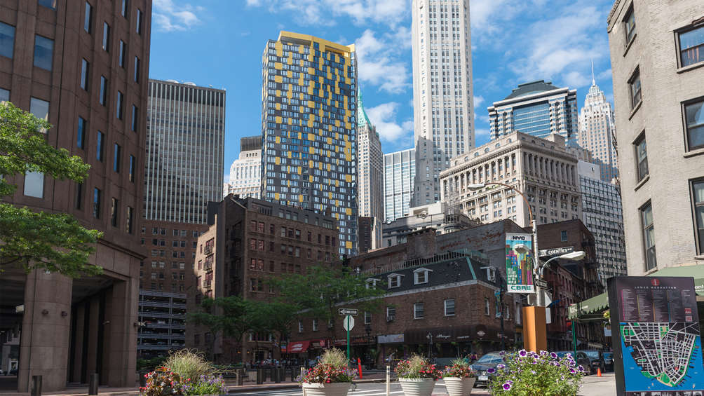
Financial District + Battery Park City
I created a map that showed the top landmarks of Paris according to users on Google, Lonely Planet, and other travel websites.

Slide 8
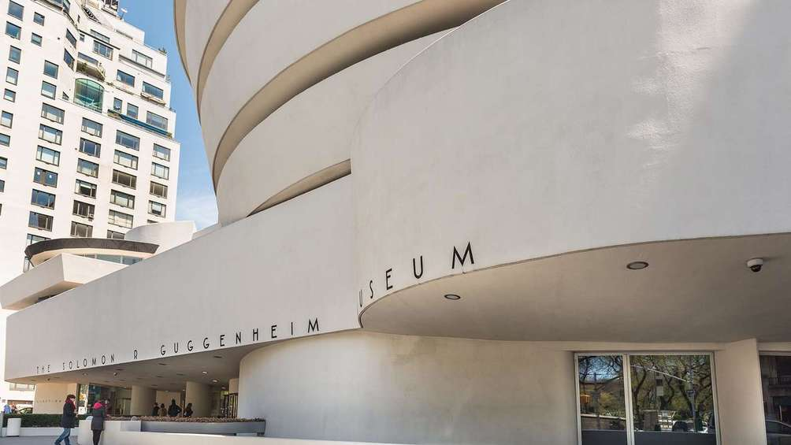
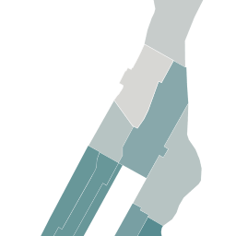
Upper East Side
This close up map shows in detail the location of a few major landmarks, including the Louvre, the Champs-Élysées, and the Musée d’Orsay.

Slide 9
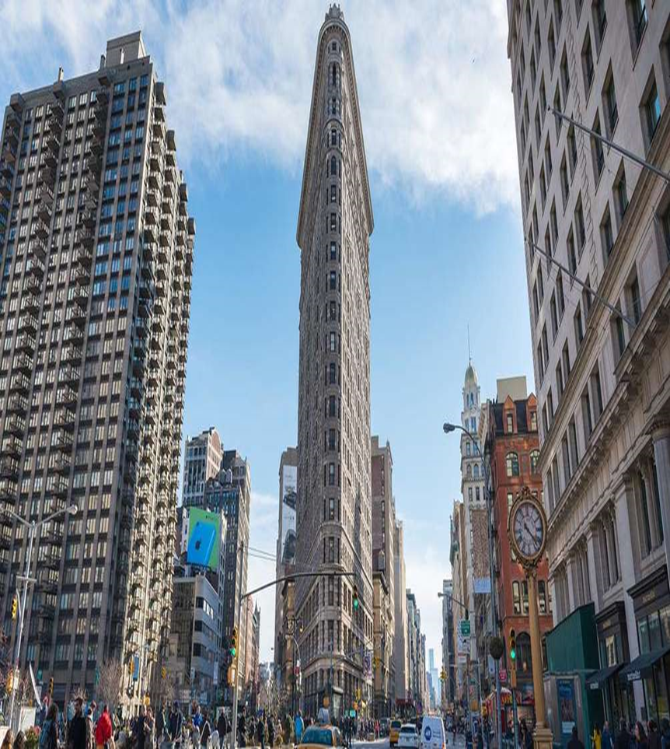
Downtown
We downloaded venues data from Foursquare and clustered the venues and venue category by arrondissement. We created the table below which shows the top 10 most common venues per arrondissement.

Slide 10
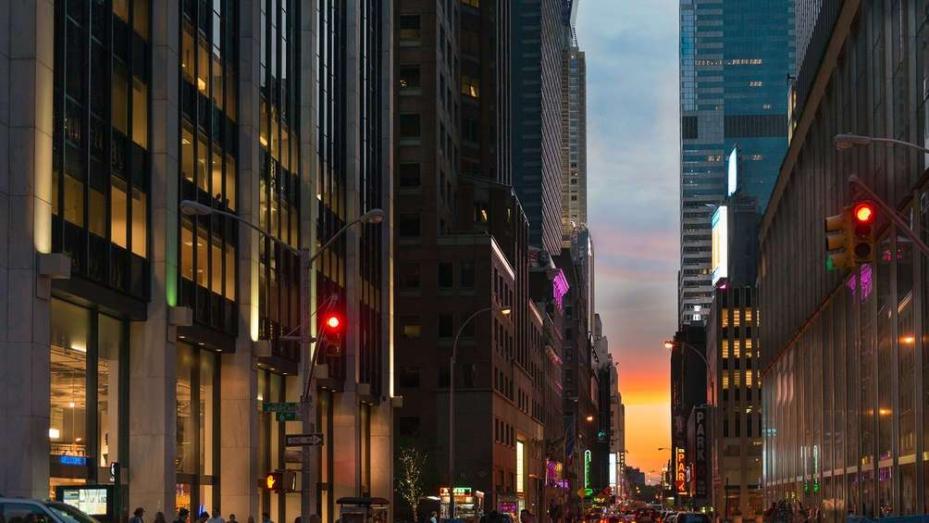
Midtown
If you were near the Eiffel Tower and are in the mood for French food, you have over 30 options around you within a short walk of the Tower. Besides the two restaurants that are within the Eiffel Tower complex, you can also head over to Le Casse Noix or Pottoka.

Slide 11
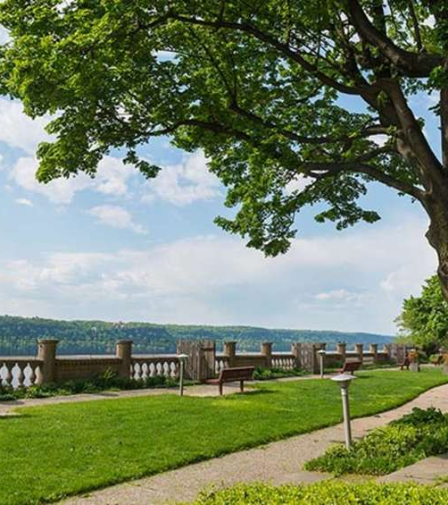
Upper Manhattan
If you were near the Eiffel Tower and are in the mood for French food, you have over 30 options around you within a short walk of the Tower. Besides the two restaurants that are within the Eiffel Tower complex, you can also head over to Le Casse Noix or Pottoka.

Slide 12
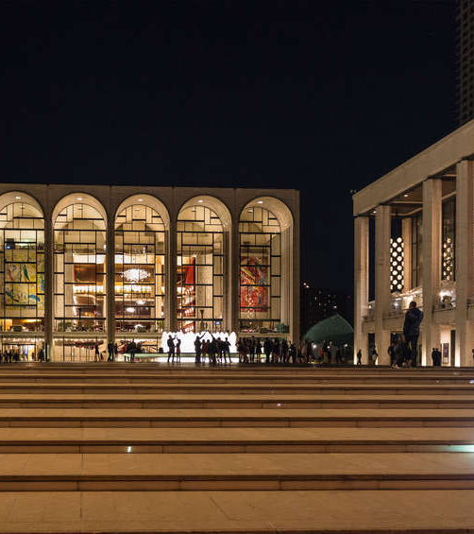
Upper west side
If you were near the Eiffel Tower and are in the mood for French food, you have over 30 options around you within a short walk of the Tower. Besides the two restaurants that are within the Eiffel Tower complex, you can also head over to Le Casse Noix or Pottoka.

Slide 13
Day 1
Head over to the 7th Arrondissement for a full day of exploring! Up first, the famous Eiffel Tower, along the River Seine. You can choose to make your way to the top or take pictures around the surrounding garden and plaza.
Have yourself a picnic on the green gardens surrounding the Eiffel Tower. You can visit the nearby Marché de Saxe Farmers Market to pick up farm grown picnic food.
Sit down for some afternoon tea at the nearby Aux Cerises Tea Room.
Learn more about France’s military history by visiting Les Invalides complex, which features museums and monuments.
There are many local French restaurants to try out, including more than 30 within walking distance from the Eiffel Tower. Some of the closest restaurants include Le Jules Verne and Restaurant 58 Tour Eiffel.
After dinner, stroll around the Seine as you wait for the Eiffel Tower to light up in the night sky. Perhaps stop by for dessert at Boulangerie Desgranges across the river.

Slide 14
Day 2
Start your day at the west end of the Champs-Élysées at the famous landmark, the Arc de Triomphe. Built 1836 to honor those who died during the French Revolution and the Napoleonic Wars, this is perhaps Paris’s most well-known landmark after the Eiffel Tower.
Stroll down the most famous street in the world, the Champs-Élysées. Browse the many boutiques and luxury stores that line its sides as you head east.
Make a stop at the The Grand Palais and admire its architecture.
Stop by the Ladurée Paris Royale bakery for a quick lunch or picnic items. Looking for something more substantial? Le Dalí is a nearby French restaurant.
Enjoy the weather and the slow Parisian lifestyle by grabbing a bench at the Tuileries Garden for some people watching.
Cross the river to the Musée d’Orsay, where you can spend the late afternoon among famous French artworks.
For dinner, the French restaurants L'Atelier de Joël Robuchon or Guy Savoy are close by. The bistro L'Avant-Comptoir des Cochons is also close by.
For a nightcap, Prescription Cocktail Club and Chez Nous wine bar are not too far away.

Slide 15
Day 3
Go early to Le Lourve to beat the crowds and get the museum to yourself. Be sure to say hi to the Mona Lisa.
Sample some French cheese at Fromagerie Barthélemy and pick up some items for a picnic lunch at the Palais du Luxembourg and its surrounding gardens.
The Pantheon is a short walk away from the Garden and is a mausoleum containing the remains of distinguished French citizens.
Craving some seafood? L'Avant Comptoir de la Mer has you covered. How about some Italian? Head over to Oenosteria.
End the night by visiting the Latin Quarters for some drinks at a local bar. Crowd favorites include Castor Club or wine bar L'Avant Comptoir.
Alternatively, enjoy an indie film at La Filmothèque du Quartier Latin or a performance at the Odéon – Théâtre de l'Europe.

Slide 16
Day 4
Begin the day along the Seine at Cathédrale Notre-Dame de Paris, the famous cathedral known for its architecture.
If you’re still not tired of museums, the Centre Pompidou is a modern museum with interesting architecture.
Other close by landmarks include the small islands, Île Saint-Louis and Île de la Cité, as well as La Conciergerie and Saint-Jacques Tower
Ready for another picnic by the Seine? Visit Fromagerie Laurent Dubois for food. Nearby restaurants include Le Petit Châtelet, Comme chai Toi, or Anahuacalli.
Make the trek across the Seine to catch a performance in the Bastille neighborhood. Venues include Opéra Bastille for opera or Café de la Danse for modern music.
Food options near the venue include Gaspard de la Nuit (French), Nove (Italian), and Café Ginger (Asian fusion/Vegan) for dinner.
La Moustache Blanche and Berliner Wunderbar are good options for drinks.

Slide 17
Day 5
Make a day trip trek out to the Palace of Versailles and explore its grand architecture and lush gardens.
Disneyland Paris is another option to the far east of the city.
This can also be a catch up day to do any activities you weren’t able to squeeze in during the previous few days or to wander around Paris and find a new adventure!

Slide 18
Conclusion
The itinerary I created made many assumptions on time, money, weather, and duration of stay.
I want to emphasize that itineraries are just general guild lines and travelers can choose to deviate if, say, they find the Louvre to be only an hour visit or that reading in the Jardin de Luxembourg should be an all-day activity accompanied by French cheese and wine.
I learned a lot about scraping data, visualizing it, and making maps that can provide guidance for creating a travel plan.
I hope to further explore venue tips, ratings, and distance between venues.
I can’t wait for my first trip to Paris!

