Slide 1


Data Analysis and Visualisation on Magist

Slide 2
Analysis on:
(No of Tech_Products sold ) X (No of Non_Tech_Products_sold)
Year wise analysis on Tech_Products sold
No of Orders delivered (on_time X Delay)
Average Time taken to deliver
(Tech_Sellers) X (Non_Tech_Sellers)
Year wise analysis on No of Customers, who buy Tech_Products

Slide 3
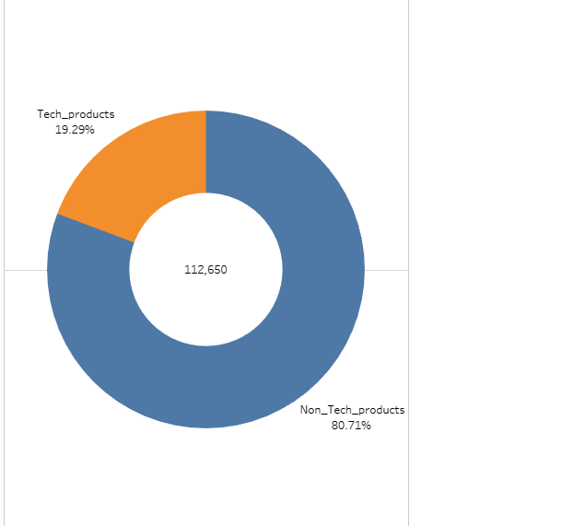
No Tech_Products and Non_Tech_Products sold as of given Data

Slide 4
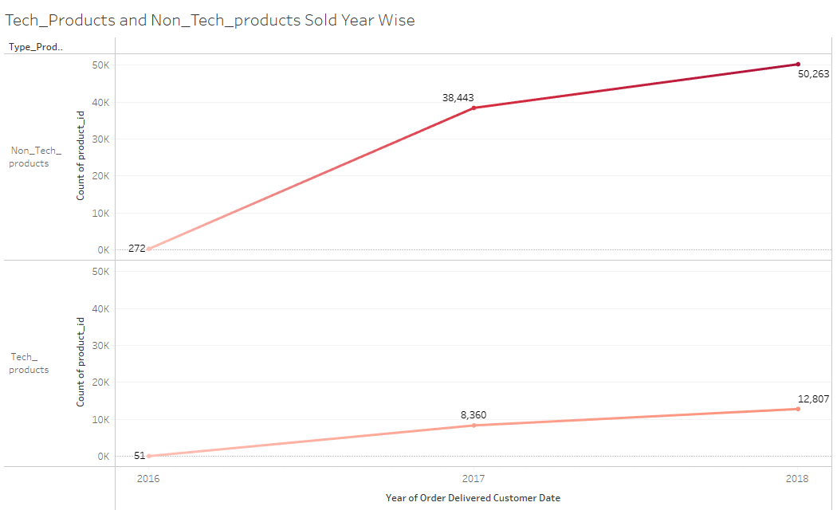

Slide 5
Year wise Overview on few Tech_Products:
Year | 2016 | 2017 | 2018
Computers | - | 15 | 18
Computers_accessories | 10 | 887 | 1018
Electronics | 1 | 240 | 392
Air_conditioning | 3 | 58 | 67

Slide 6
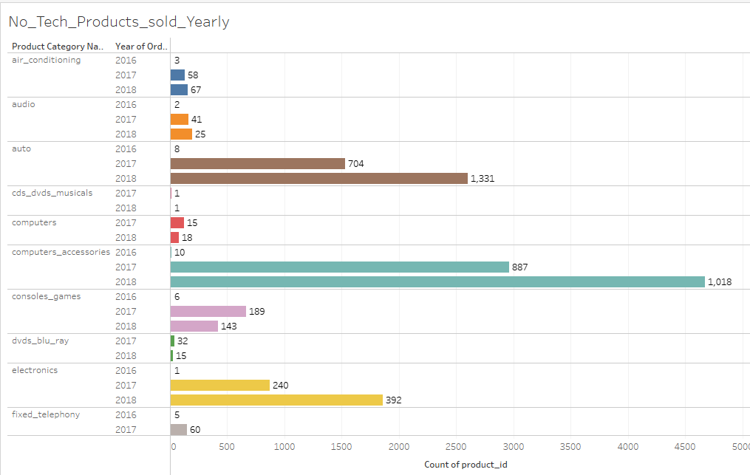

Slide 7
Evaluation on Orders:
 | No_Orders
On_Time_Delivery | 89810
Delay | 6666
Others | 2965
Total | 99441

Slide 8
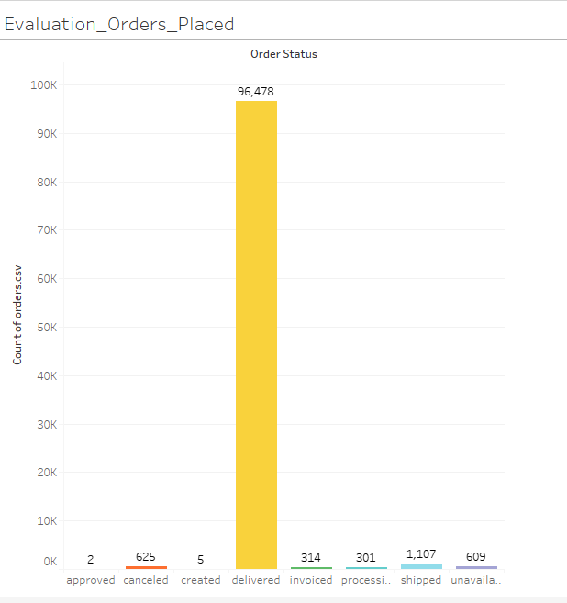
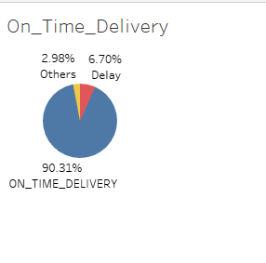

Slide 9
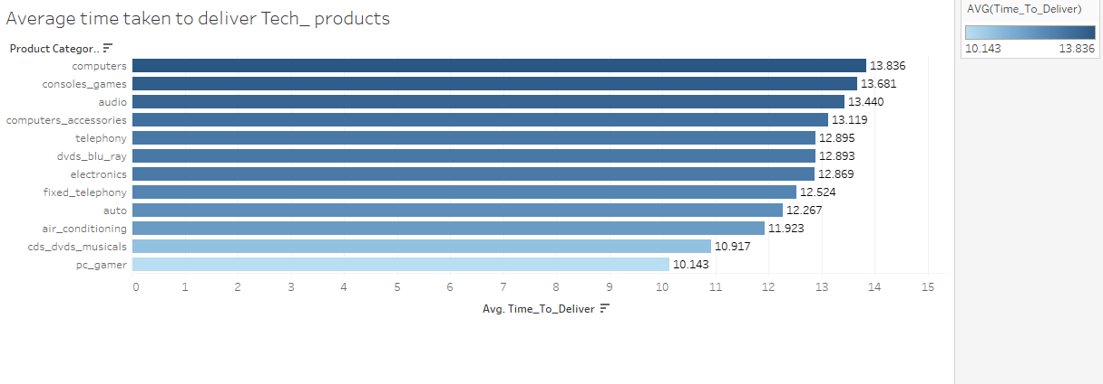
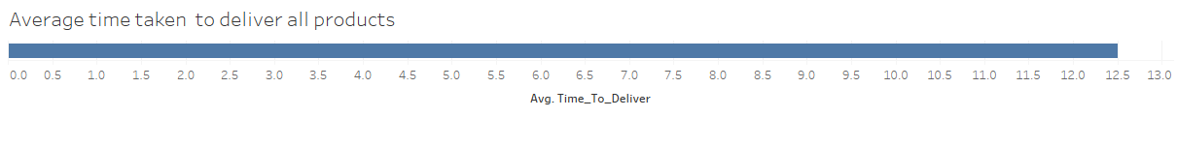

Slide 10
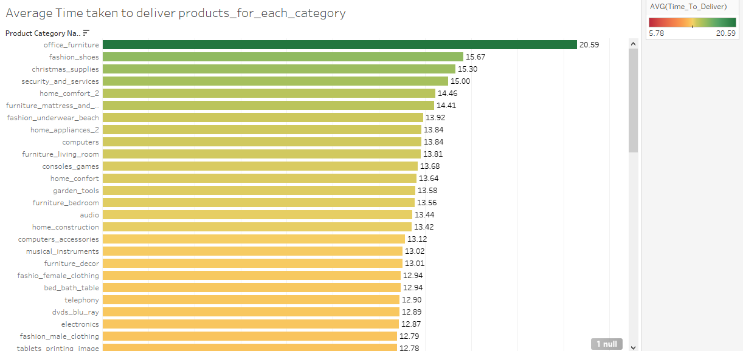

Slide 11
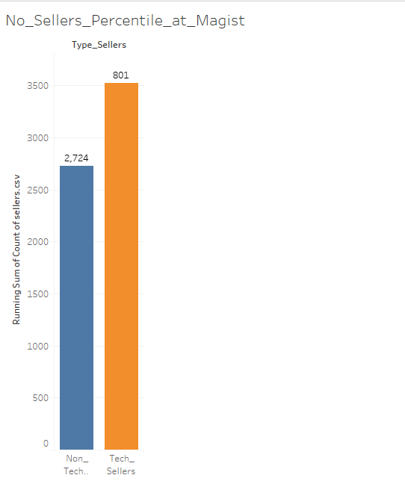
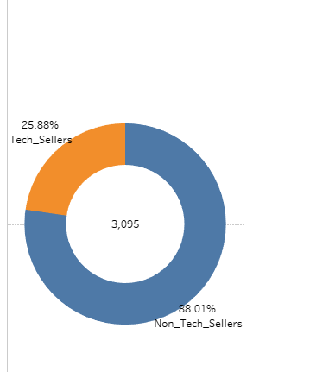
Tech_Sellers and Non_Tech_Sellers at Magist:

Slide 12
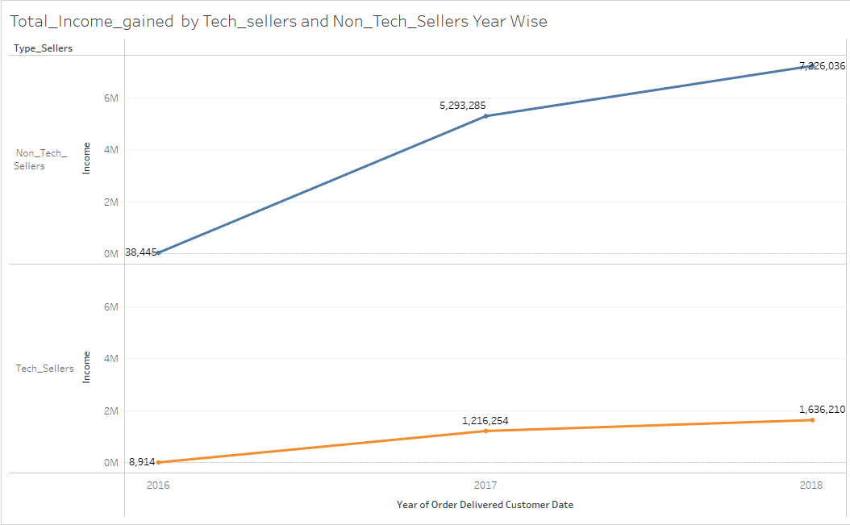

Slide 13
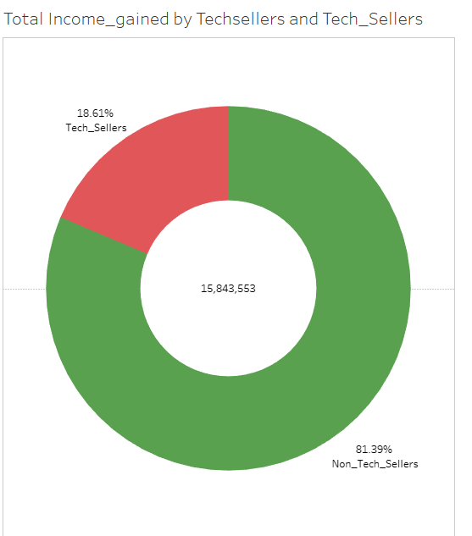
Total Income gained by Tech_Sellers and Non_Tech_Sellers ( 2016 to 2018)

Slide 14
Analysis on Customers Year wise:
Year | 2016 | 2017 | 2018
Non_Tech_Customers | 226 | 33556 | 43802
Tech_Customers | 46 | 7412 | 11539

Slide 15
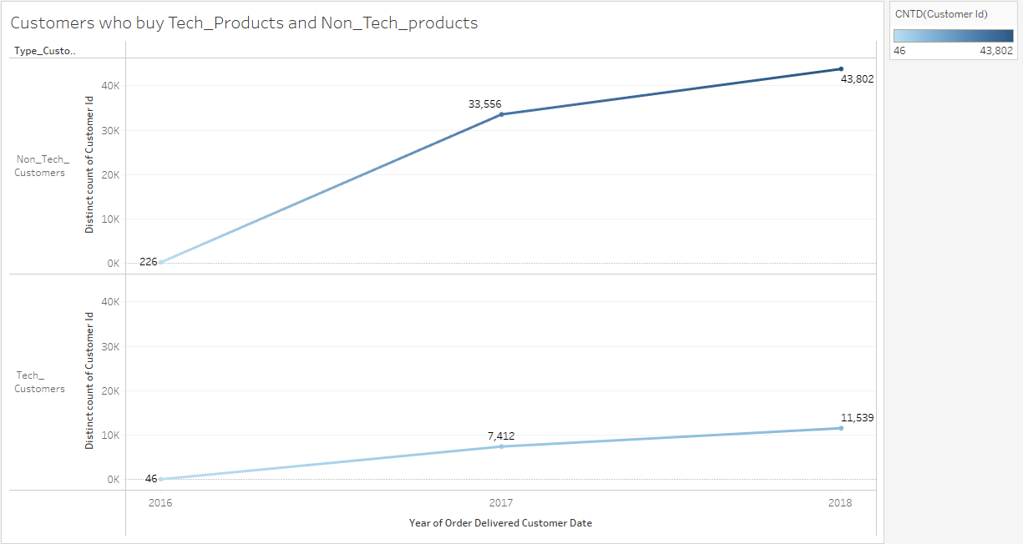

Slide 16
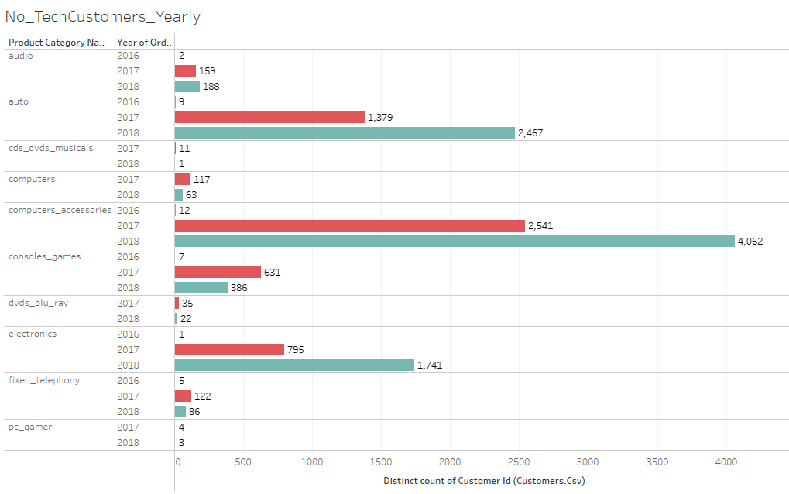

Slide 17
Conclusion:
Magist is a general Online Store for all Products but not specific to only Tech_Products
No_Tech_Customers (2016 to 2018): 19.56%
Total_Income_gained_by_Tech_Sellers( 2016 to 2018): 18.61%
No_Tech_Products_Sold (2016 to 2018): 19.29%

