Slide 1

Job Market Analysis and Recommendation System
Next Hikes IT Solutions
Project_8: Job Market
Prepared by: Kalavathi Alegapalli
Date:20/06/2025

Slide 2
Dataset Summary – Upwork Job Listings
Dataset Overview
Source: Upwork job postings
Total Records: 244,828 rows
Columns: 8 key features
Feature Name | Description
Title | Job title or role being advertised
Link | Direct URL to the job posting
Published_date | Timestamp when the job was posted
Is_hourly | Boolean indicating if the job is hourly-based
Hourly_low | Minimum hourly rate (if applicable)
Hourly_high | Maximum hourly rate (if applicable)
Budget | Fixed budget for non-hourly jobs
Country | Country of the client posting the job

Slide 3
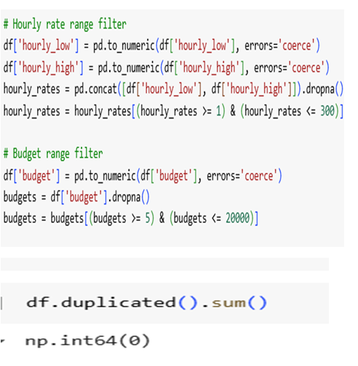
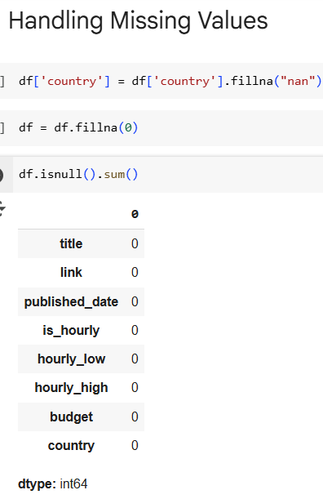
Data Cleaning and Outlier Detection
✅ No Missing Values All columns (title, link, published_date, is_hourly, hourly_low, hourly_high, budget, country) contain 0 null entries → Ensures completeness and reliability of dataset
✅ No Duplicate Rows df.duplicated().sum() returns 0 → Confirms uniqueness of job listings
Preprocessing Filters Applied
🔹 Hourly Rate Filter
Converted hourly_low and hourly_high to numeric
Valid range: $1 to $300
Removed outliers and non-numeric entries
🔹 Budget Filter
Converted budget to numeric
Valid range: $5 to $20,000
Ensures realistic financial data

Slide 4
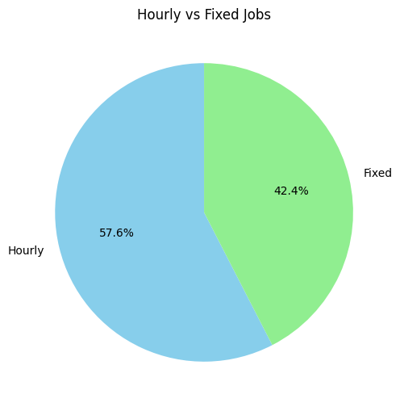
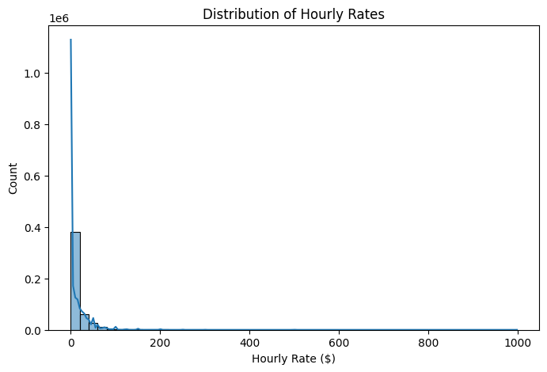
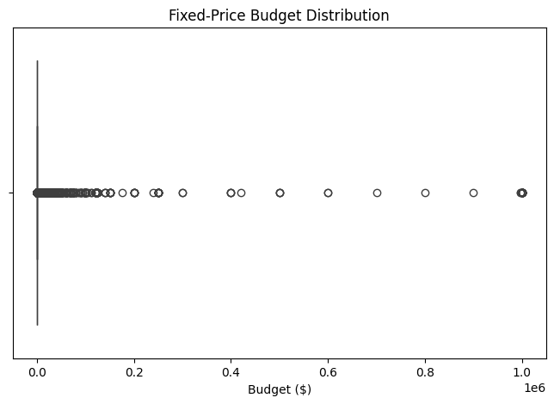
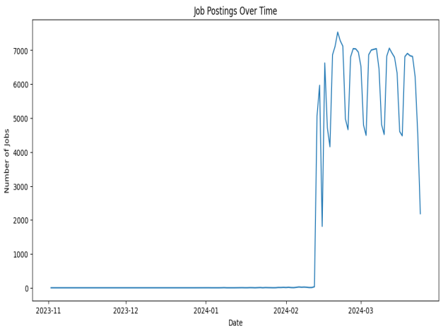
Job Trends & Budget Overview
Hourly vs Fixed Jobs: Hourly jobs make up 57.6%, showing a preference for flexible work over fixed-price contracts.
Hourly Rate Distribution: Most jobs offer lower hourly rates, with fewer listings as rates increase.
Fixed-Price Budget Distribution: Budgets cluster at the lower end, though high-value projects do exist as outliers.
Job Postings Over Time: Job postings show periodic spikes, with an overall upward trend in activity.

Slide 5
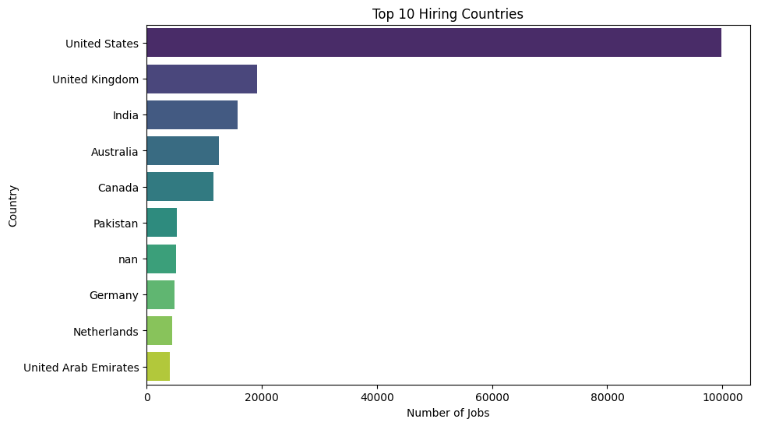
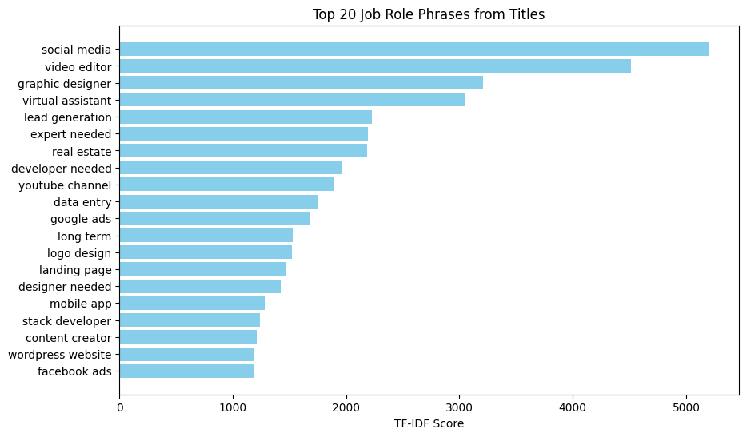
Global Hiring Trends & In-Demand Job Roles Top Hiring Countries:
Top 10 Hiring Countries
The United States leads by a wide margin in job postings, showing its dominance in freelance hiring.
The UK, India, and Australia follow, indicating strong demand from English-speaking markets.
Emerging economies like the Philippines and Ukraine also appear, reflecting global outsourcing trends.
This distribution highlights where freelancers may find the most opportunities geographically.
Top 20 Job Role Phrases from Titles
"Social media" tops the list, showing high demand for digital marketing and online engagement roles.
Creative and support roles like video editor, graphic designer, and virtual assistant are highly sought after.
Technical roles such as mobile app developer and Slack developer also make the cut, though less prominently.
The TF-IDF scores suggest these phrases are not just frequent, but uniquely relevant to job titles.

Slide 6
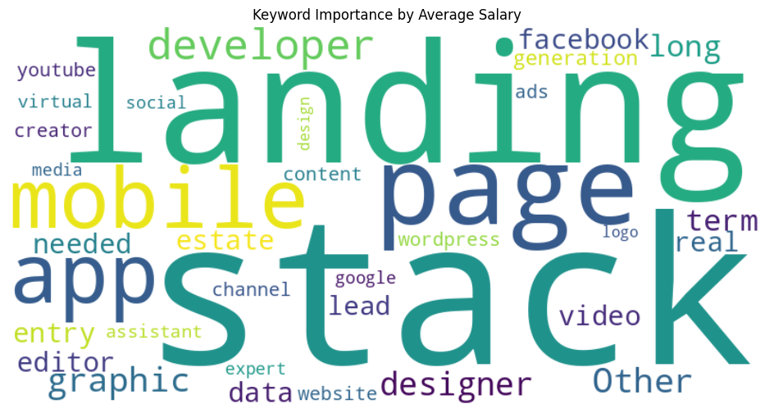
Evaluating Sales Dynamics Through Store Operations, Customer Patterns, and Promotions
1. Store Type Influence on Sales:
- Sales trends differ by store type, suggesting that location or store format influences purchasing behavior
- Helpful in targeting marketing and resource allocation per store category
2. Assortment vs Sales:
- Broader assortments (`Assortment B` and `C`) yield higher average sales compared to basic setups
- Reinforces the role of product diversity in driving revenue
3. Impact of School Holidays:
- Noticeable dip in sales during school holidays suggests reduced footfall or family spending adjustments
4. Competition Effects:
- Increased competition correlates with subtle sales dips, especially near newer competitor stores
- Useful for geo-targeted promotions or competitive pricing strategies

Slide 7
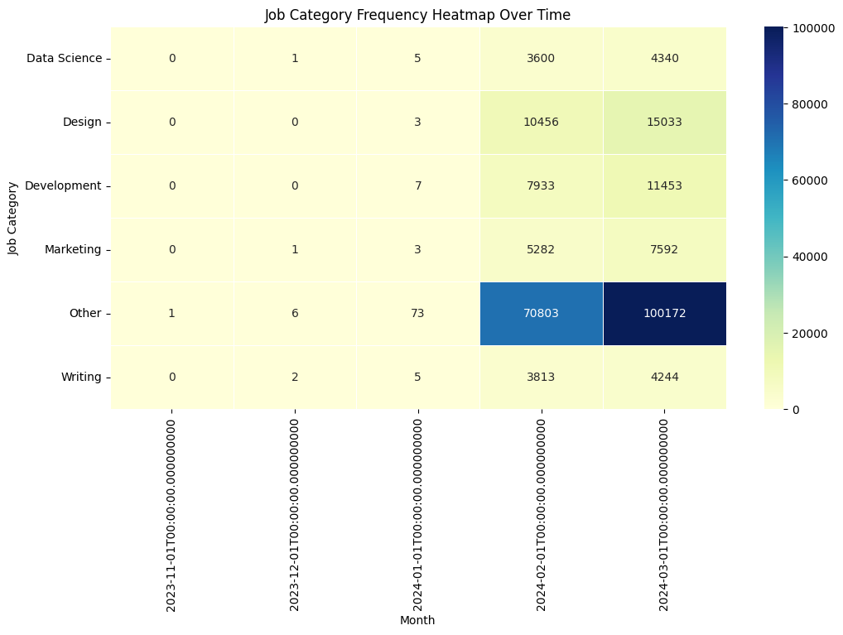
Job Category Trends (Dec 2013 – Sep 2014)
"Other" category dominates job postings, with major spikes in January and September 2014, reaching over 70,000 and 100,000 respectively.
Design and Development roles show gradual growth, especially in mid to late 2014.
Data Science, Marketing, and Writing categories remain relatively low in frequency throughout the period.
The overall trend suggests a surge in generalized or uncategorized job postings, possibly due to platform expansion or reclassification.
This timeline offers a historical snapshot of shifting demand across job categories, useful for long-term market analysis.

Slide 8
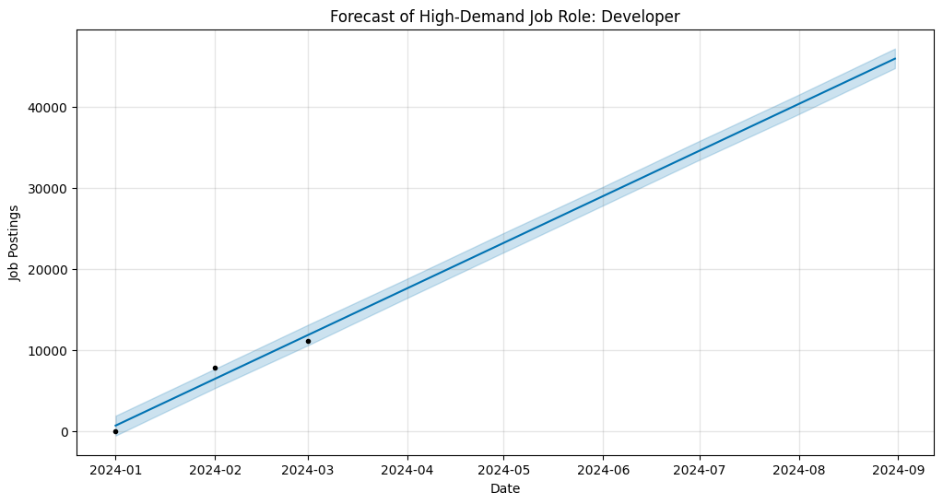
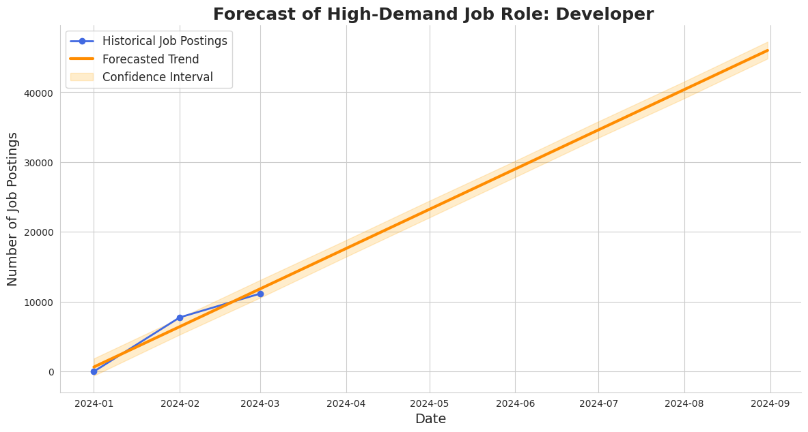
Long-Term Forecast of Developer Job Demand (2021–2024)
Graph 1: Blue Forecast Model
Developer job postings show steady growth from 2021 through early 2024.
The forecast projects continued upward momentum, with moderate confidence in the trend.
This suggests sustained demand for developer roles across the tech industry.
Graph 2: Orange Forecast Model
Similar growth pattern observed, with slightly wider confidence intervals indicating more variability.
The forecast still points to rising job volumes, reinforcing the long-term relevance of developer skills.
Useful for strategic workforce planning and career alignment in tech.

Slide 9
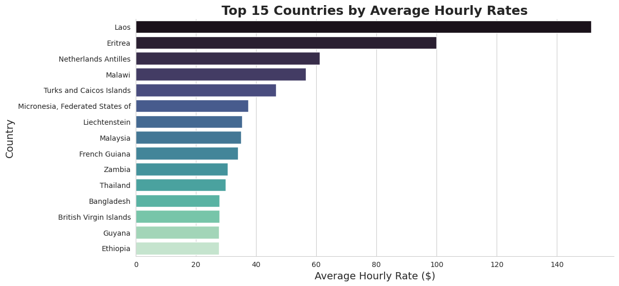
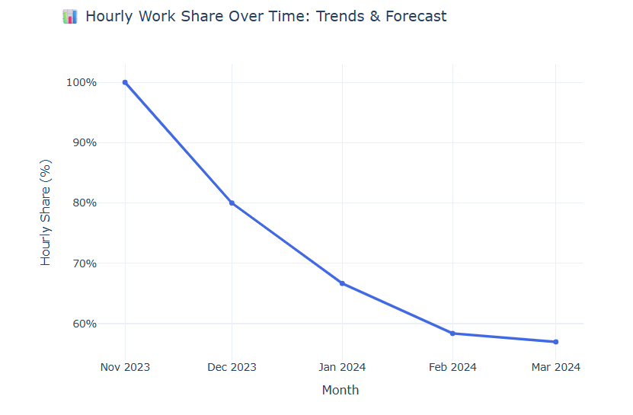
Global Hourly Rates & Freelance Work Trends
Top Countries by Hourly Rate: Laos, Switzerland, and Netherlands Antilles lead with the highest average hourly rates, while India and the U.S. rank lower despite high job volumes.
Hourly Work Share Trend: The share of hourly jobs has declined sharply from over 90% in Nov 2023 to below 60% by Mar 2024, signaling a shift toward fixed-price or alternative work models.

Slide 10

AI-Powered Job Matching & Market Insights:
The system uses NLP to autofill resumes and recommend jobs based on detected skills like Python, SQL, and TensorFlow.
Top recommended roles fall under AI/ML, with average salaries reaching ₹40L, especially in cities like Bangalore and Hyderabad.
Key skills driving matches include Python, AWS, PyTorch, and MLOps—highlighting demand for advanced data and ML capabilities.
Visuals show job distribution by location and category, helping users align their resumes with high-value opportunities.

Slide 11
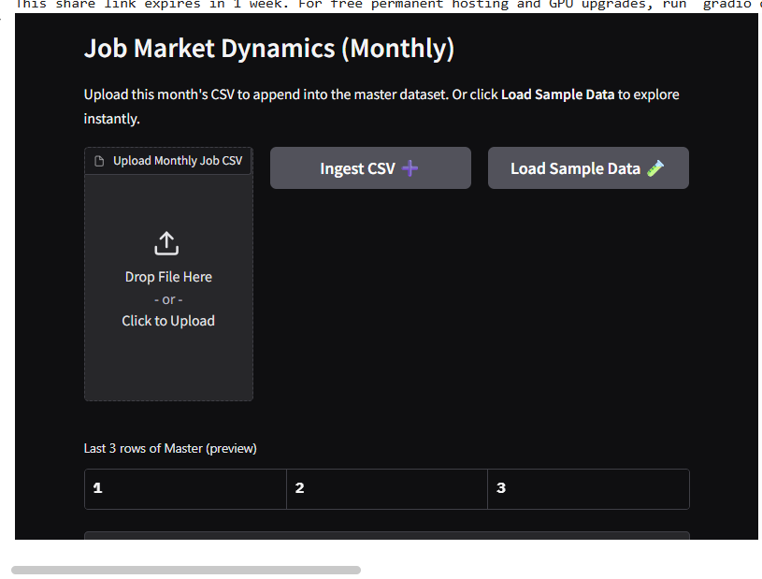
Monthly Job Market
Only 5 new job postings were recorded, all for Data Analyst roles in Hyderabad, with 0% remote share.
The median salary for the latest month stands at ₹12L, with some listings reaching up to ₹24L.
Top trending skills include AWS, PyTorch, and Pandas, while TensorFlow and SQL show slight decline.
Hourly work share and remote opportunities have dropped, indicating a shift toward on-site, salaried roles.
Useful for tracking hiring momentum, salary benchmarks, and evolving skill demand.

Slide 12
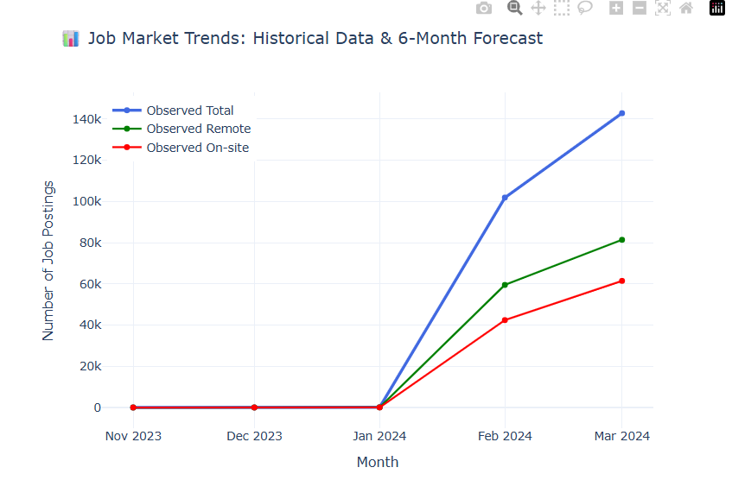
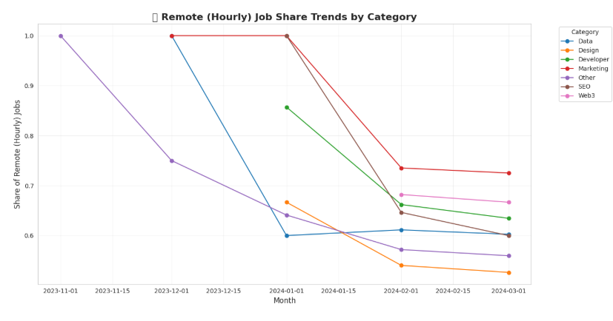
Surge in Job Postings & Remote Work Growth
📘 Graph 1: Job Postings Overview
Total job postings surged from January to March 2024, reaching 140k.
Remote roles grew faster than on-site, hitting 80k, indicating strong demand for flexible work.
📗 Graph 2: Remote (Hourly) Job Share by Category
Developer and Data roles consistently lead in remote hourly job share.
SEO and Web3 show lower and more volatile trends, reflecting niche or location-tied demand.

Slide 13
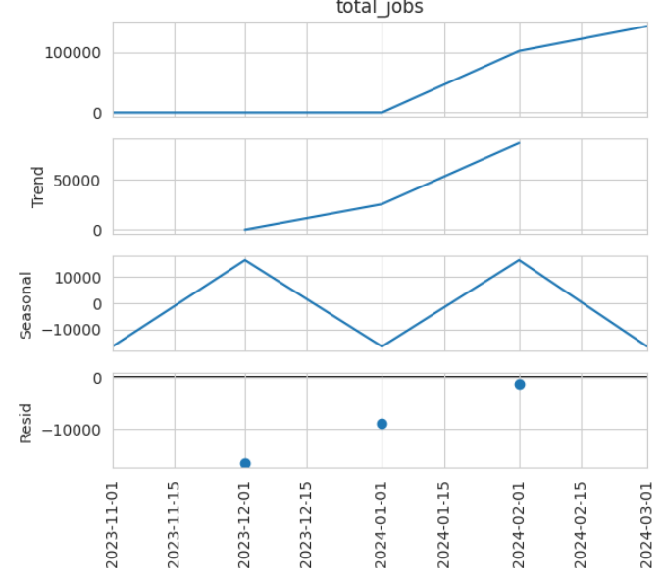
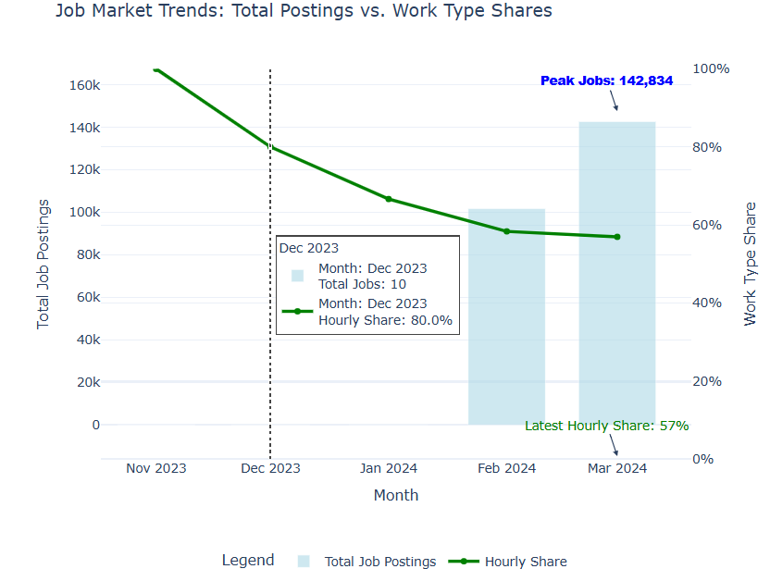
Job Market Trends & Work Type Shifts
🔵Graph 1: Total Postings vs. Work Type Shares
Job postings peaked at 142,834 in January 2024, then slightly declined.
The hourly work share dropped from 80% in December to 57% in March, indicating a shift toward fixed-price or salaried roles.
Graph 2: Time Series Decomposition of Total Jobs
The trend shows a steady rise in job volume, especially between January and February 2024.
Seasonal patterns reveal peaks around December and February, with dips in January and March.

Slide 14
CONCLUSION
Built a comprehensive freelance job market analysis using visualizations, forecasting, and model evaluation.
Identified key hiring countries, high-demand roles, and salary-linked keywords driving market value.
Applied ML & DL models (Linear Regression, LSTM, CNN, GRU) to predict job trends, with deep models outperforming traditional ones.
Forecasts show rising demand for developer roles and remote work, with hourly share declining over time.
Decomposed time series trends and transformed job data into actionable insights for strategic planning and presentation.

Slide 15
REFERENCE
Hands-On Time Series Analysis with Python by B V Vishwas Covers ARIMA, SARIMA, and LSTM models with practical forecasting applications.
Python Machine Learning by Sebastian Raschka & Vahid Mirjalili Includes ensemble methods like Random Forest and XGBoost, widely used in Rossmann sales prediction projects.
Deep Learning for Time Series Forecasting by Jason Brownlee Focuses on LSTM and sequence modeling, ideal for replicating deep learning approaches in time series tasks.
GeeksforGeeks: LSTM in TensorFlow Explains LSTM architecture, implementation in TensorFlow, and its application in time series forecasting.
Analytics Vidhya: Introduction to LSTM Provides a conceptual overview of LSTM networks, their gates, and how they solve long-term dependency issues.

Slide 16
THANK YOU

