Slide 1

LLM Project: Building a News Research Tool
Next Hikes IT Solutions
Project_9: News Research Tool
Prepared by: Kalavathi Alegapalli
Date:05/10/2025

Slide 2
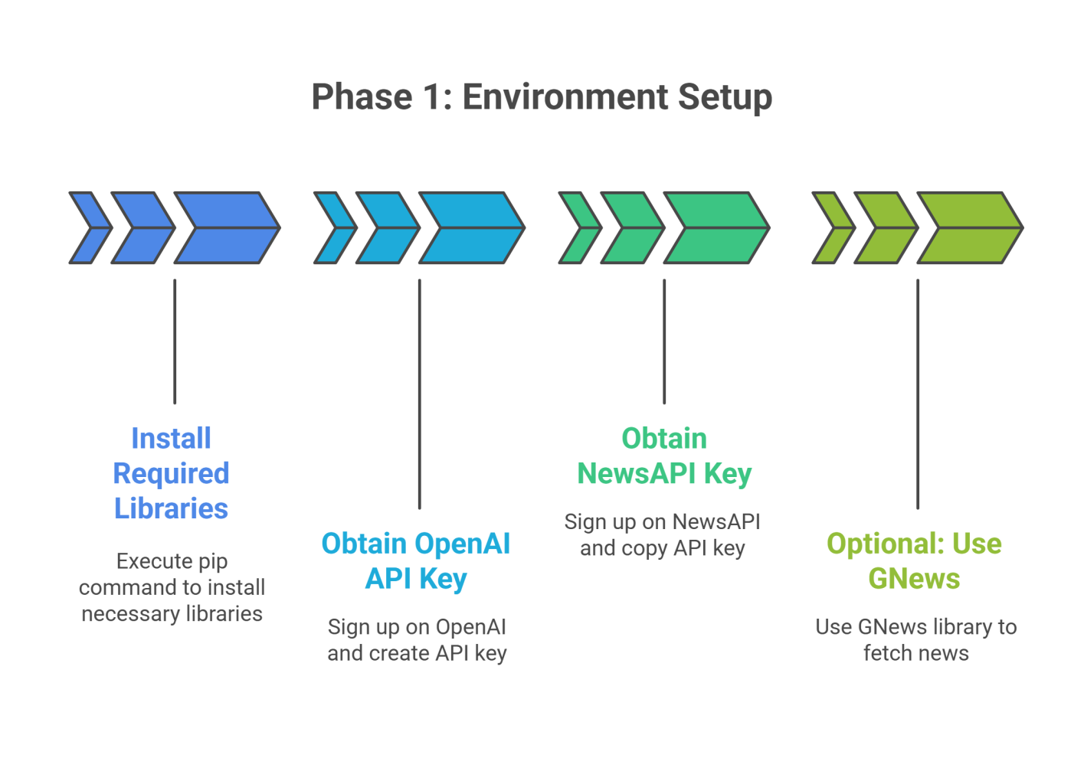
Phase 1: Environment Setup
Install Required Libraries – Install Streamlit, LangChain, OpenAI, NewsAPI, GNews, FPDF, and Pandas for building the AI news tool.
Set Up API Keys – Obtain OpenAI API key for AI summarization and NewsAPI key for fetching news articles.
Optional GNews Integration – Use GNews library as an alternative for Google News scraping without API limits.
Python Environment Ready – Ensure Python environment (local or Colab) is configured and libraries are installed properly.
Secure API Keys – Keep keys private; for production, use .env files or Streamlit secrets to avoid exposing them.

Slide 3
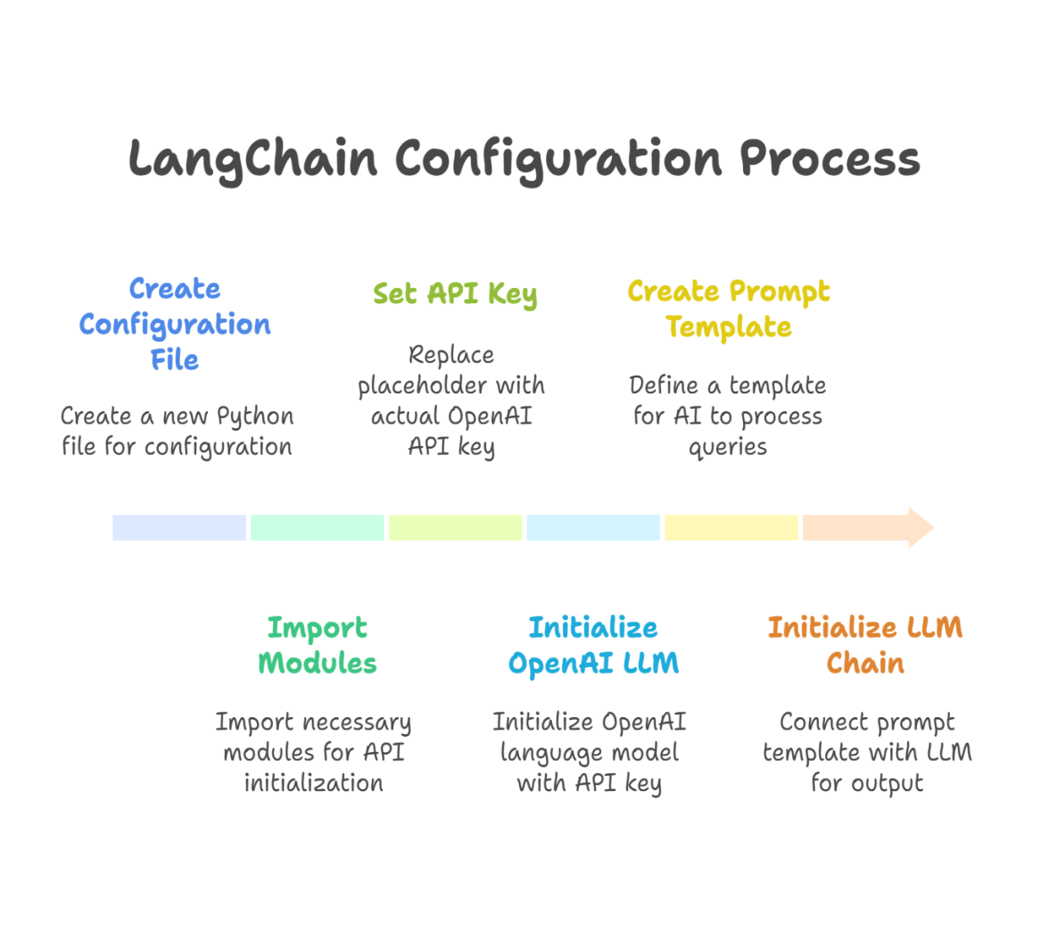
Phase 2: LangChain Configuration
Create Config File – Create langchain_config.py to centralize AI setup and prompts.
Import Modules – Use OpenAI, LLMChain, and PromptTemplate from LangChain.
Initialize OpenAI API – Connect your OpenAI API key to the LangChain LLM.
Define Prompt Template – Guide AI on how to summarize news for the given query.
Set Up LLM Chain – Connect the prompt template with the AI model to generate outputs.

Slide 4
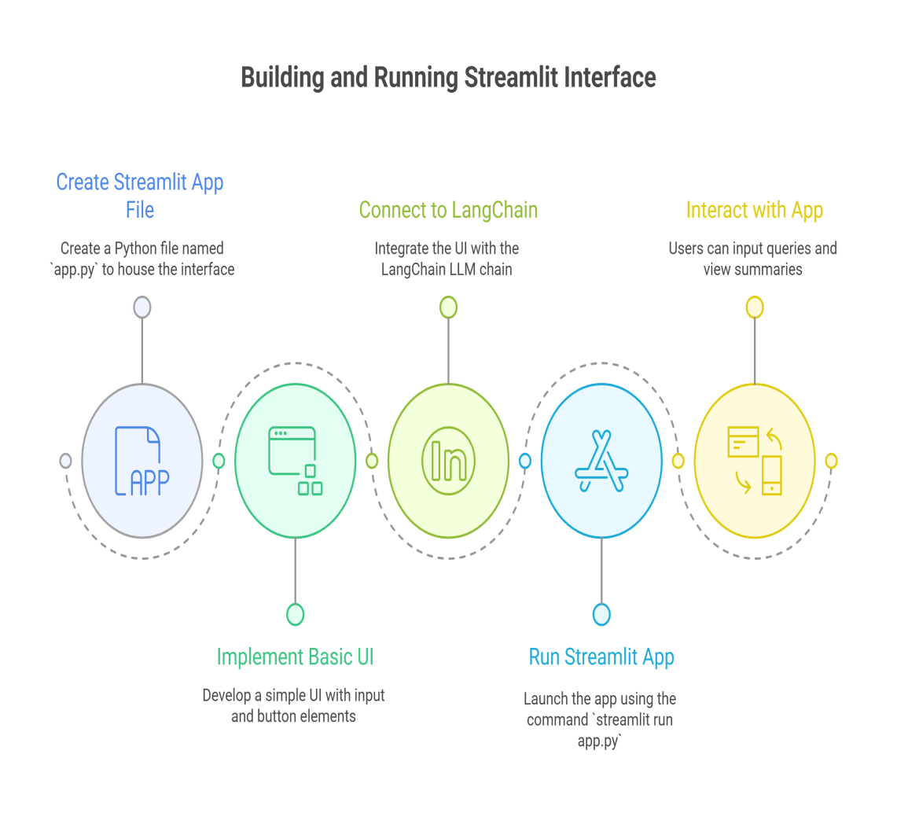
Phase 3: Building Streamlit Interface
Create App File – Create app.py as the main Streamlit interface for user interaction.
Import LLM Chain – Import llm_chain from langchain_config.py to connect the AI model.
Design Basic UI – Use st.title, st.write, and st.text_input for headers, instructions, and query input.
Trigger AI Summarization – Use st.button to run the query through LangChain and display the summary.
Run App Locally – Execute streamlit run app.py to launch the web interface and test the tool.

Slide 5
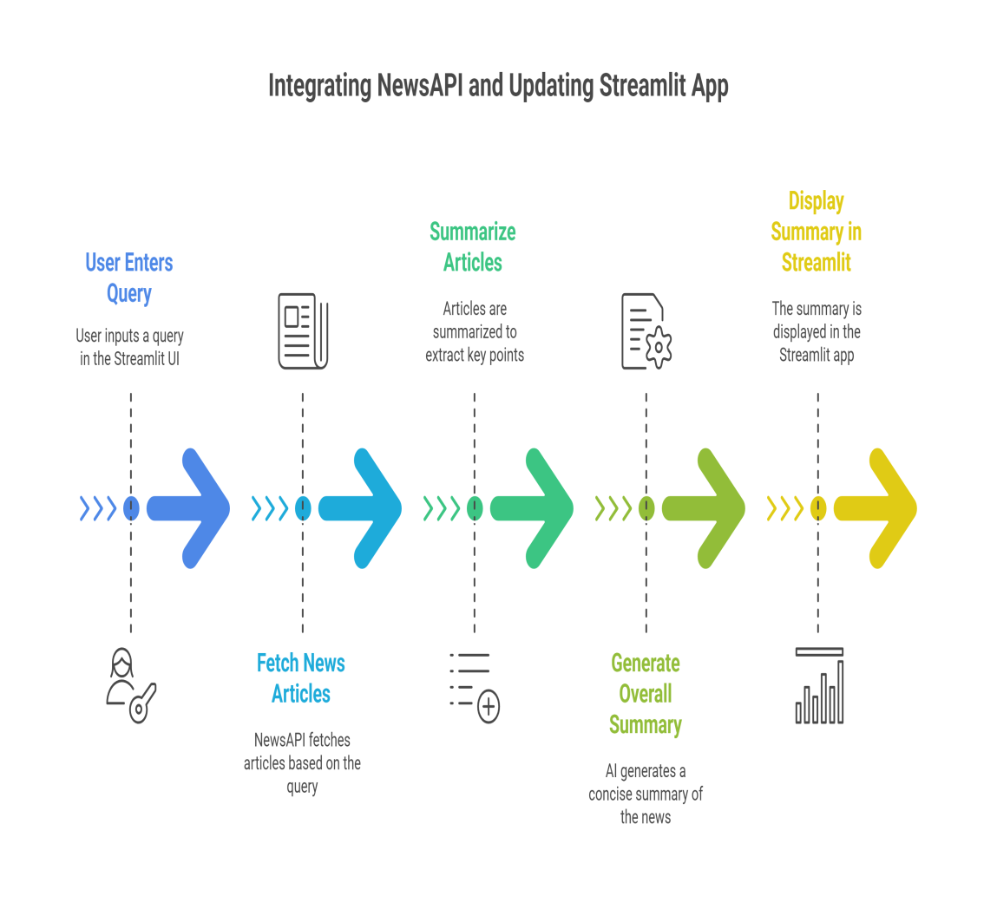
Phase 4: Enhancing the Tool
Integrated NewsAPI – Connected NewsAPI to fetch real-time and relevant news articles based on user queries.
Created Summarization Functions – Built functions to extract and combine article descriptions into concise summaries.
Enhanced LangChain Prompt – Added a prompt template to guide AI in generating overall research summaries.
Updated Streamlit App – Modified app.py to use the new get_summary() function and display AI-generated insights.
Improved User Experience – Delivered a more powerful and intelligent news analysis tool with real-time AI summarization.

Slide 6
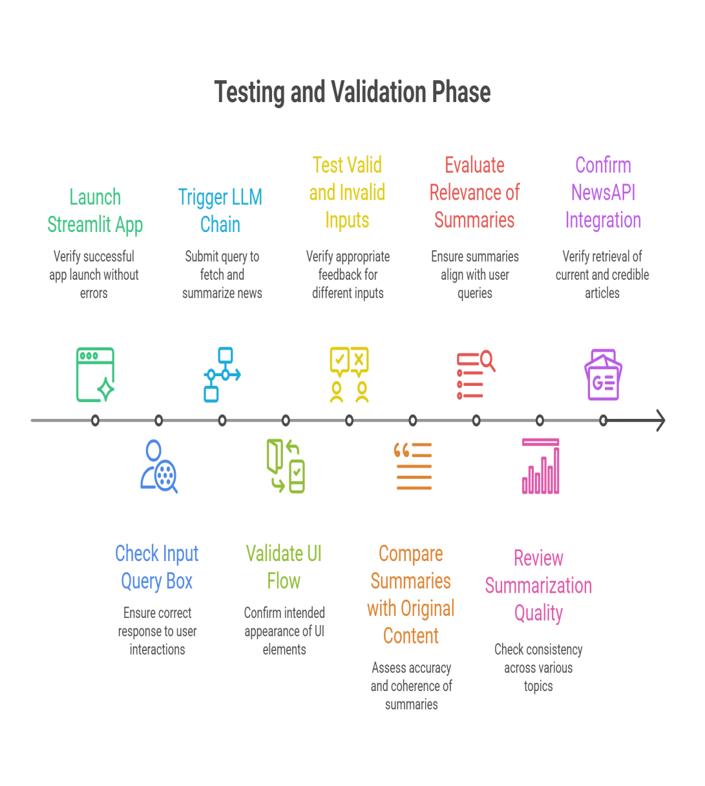
Phase 5: Testing and Validation
Verified that the Streamlit app runs smoothly without any errors.
Tested input and output flow — entering a query returns summarized news articles.
Checked accuracy, relevance, and clarity of generated summaries.
Validated NewsAPI integration for reliable and up-to-date news retrieval.
Ensured overall tool stability, usability, and consistent summarization quality.

Slide 7
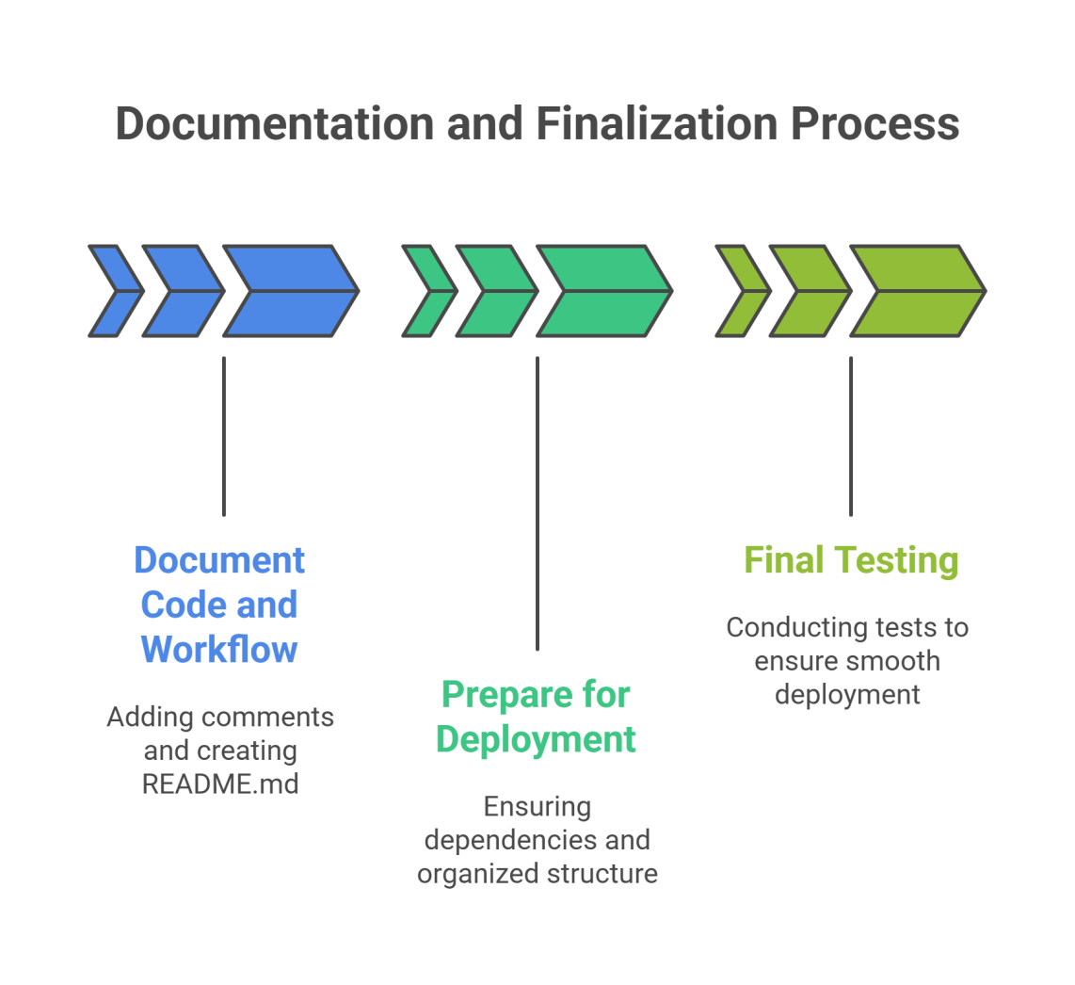
Phase 6: Documentation and Finalization
Added clear comments and documentation across all Python files for better readability.
Created a README file describing project overview, setup steps, and usage instructions.
Ensured all dependencies are properly listed in requirements.txt.
Cleaned and organized project structure, removing unused code and files.
Performed final testing to confirm smooth execution and readiness for deployment.

Slide 8
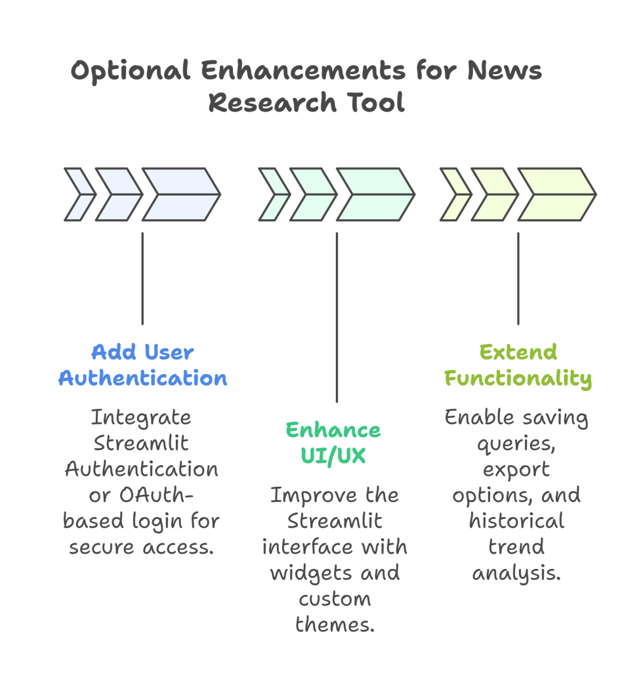
Phase 7: Optional Enhancements from your News Research Tool project
Added user authentication to ensure only authorized users can access the research tool.
Enhanced UI/UX with Streamlit widgets, progress bars, and a clean professional layout.
Enabled saving and exporting of user queries and summaries for later analysis or reporting.
Introduced historical data analysis to track changes in news trends and sentiment over time.
Improved overall usability and security, making the tool more robust and enterprise-ready.

Slide 9
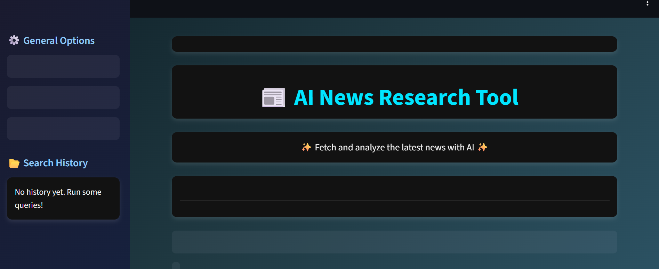
AI News Research Tool dashboard:

Slide 10
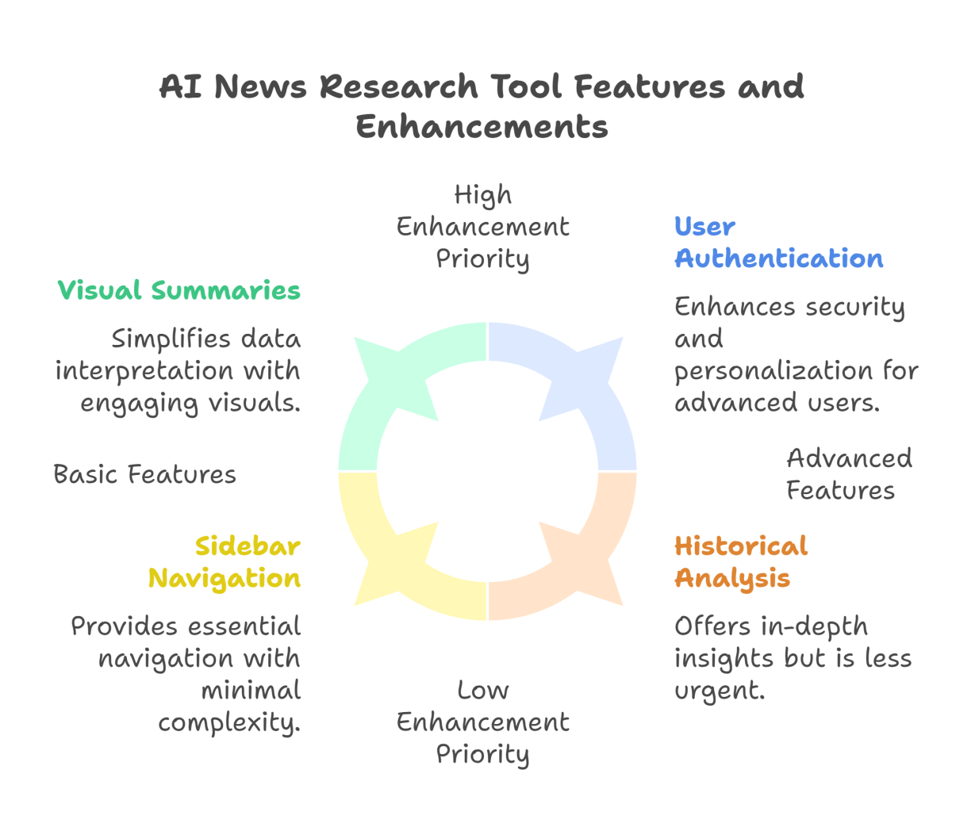
AI News Research Tool dashboard:
Purpose-Driven Design: The dashboard is built to help users fetch and summarize the latest news articles using AI, making it ideal for equity analysts, journalists, and researchers.
Streamlit-Powered Interface: It features a clean, dark-themed layout with a sidebar for navigation and a main panel for query input and results—suggesting it's developed using Streamlit.
Sidebar Functionality: The sidebar includes "General Options" and "Search History," allowing users to manage settings and revisit past queries once the tool is in use.
Interactive Query System: Users can enter custom queries (e.g., “EV market trends”) to retrieve and summarize relevant news articles using AI models like OpenAI via LangChain.
Engaging Visuals & Messaging: The dashboard title and tagline (“✨ Fetch and analyze the latest news with AI ✨”) add a friendly, modern touch while clearly communicating its core functionality.

Slide 11
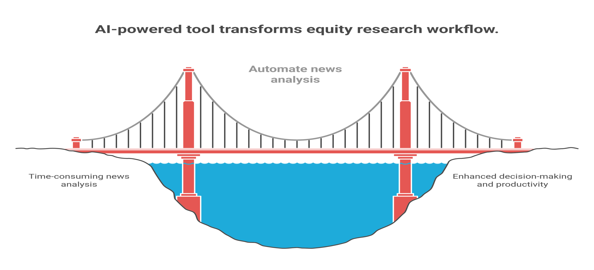
CONCLUSION

Slide 12
REFERENCE
LangChain Documentation LangChain Python API Reference — https://python.langchain.com/ → Used for integrating Large Language Models (LLMs) into the project pipeline.
OpenAI API Documentation OpenAI Developer Platform — https://platform.openai.com/docs → Provided guidance for initializing and using the OpenAI API for text summarization.
NewsAPI Developer Guide NewsAPI Official Site — https://newsapi.org/docs → Used for fetching and filtering real-time news articles relevant to equity research.
Streamlit Documentation Streamlit: The fastest way to build data apps — https://docs.streamlit.io/ → Reference for developing an interactive and user-friendly web interface.
“Hands-On Machine Learning with Scikit-Learn, Keras & TensorFlow” (Aurélien Géron, 2022) → Provided insights into practical AI and ML applications used to enhance model understanding and summarization processes.
“Building AI Applications with LangChain” by Andrew Ng (DeepLearning.AI, 2023) → Helped understand how to structure LLM-based pipelines using LangChain for real-world projects.

Slide 13
THANK YOU

