Slide 1
Lana Ilana Territory Sales Performance Analysis
January 2022 – December 2025 | 4-Year Revenue, Store and Customer Review
Notes:
Today I'll walk you through a sales performance analysis for the Lana Ilana territory, covering four full years of data from January 2022 through December 2025. We'll look at revenue trends, store-level performance, customer behavior, and product category mix — and end with concrete actions the territory can take going forward.

Slide 2
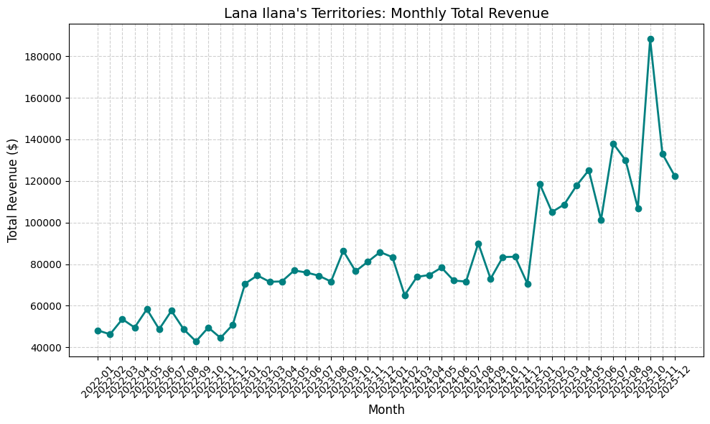
2022/01 – 2025/12 Total Revenue
Overview
$3.93M
total revenue over 4 years
+150% growth
2022: $598K → 2025: $1.50M
Peak: October 2025
$188K in a single month — all-time record
Notes:
Let's start with the big picture. Over the four-year window, Lana Ilana's territory generated $3.93 million in total revenue. The headline number is growth: revenue went from $598K in 2022 to $1.5 million in 2025 — a 150% increase. The single best month was October 2025 at $188K, which is the all-time record for the territory. As you can see on the chart, the trend is clearly upward, with momentum accelerating in the most recent year.

Slide 3
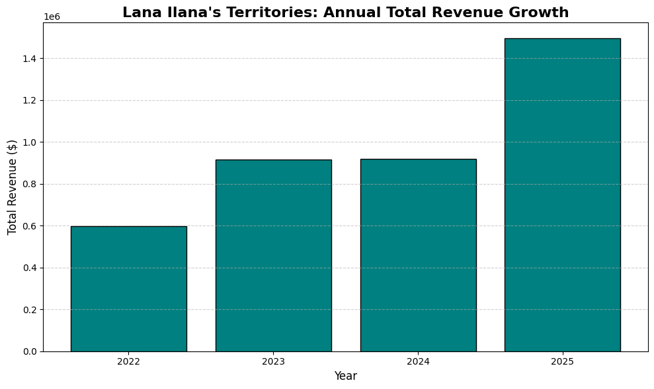
Yearly Growth Momentum
Annual Revenue
2022 $598K
2023 $917K +%53
2024 $920K +%0
$1.50M +%63
Highlights
First major jump between 2022–2023
Plateau in 2024 — growth stalled
Sharp rise from November 2024
Notes:
Breaking it down year by year tells a more interesting story. The first big jump happened between 2022 and 2023 — a 53% increase. Then in 2024, growth essentially stalled — almost flat compared to 2023. But starting in late 2024, we see a sharp rise that continues through all of 2025, ending the year up another 63%. So the territory isn't growing steadily — it's growing in distinct waves. Understanding what triggered the late-2024 inflection point is critical, and I'll come back to that.

Slide 4
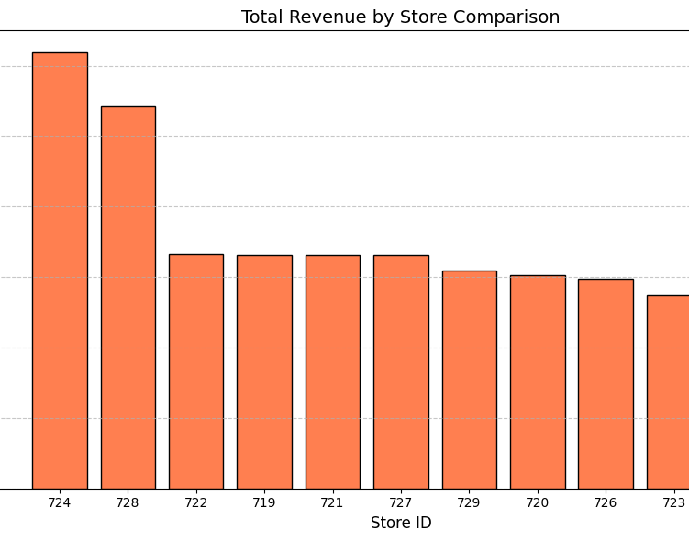
Store Comparison
30%
of territory revenue comes from only 2 stores
#1 Store 724
Miami, FL — $619K
#2 Store 728
Tallahassee, FL — $542K
Florida stores outperform the other 9 locations.
Notes:
When we look at the 11 stores in the territory, performance is highly uneven. Just two stores — 724 in Miami and 728 in Tallahassee — account for 30% of total territory revenue. Store 724 alone brought in $619K, and store 728 brought in $542K. Both are in Florida. The remaining nine stores cluster much closer together. This concentration is both an opportunity and a risk.

Slide 5
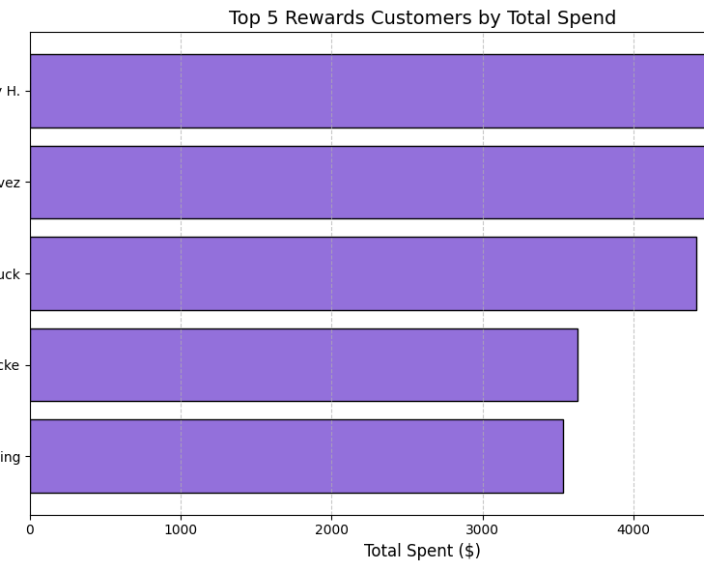
Top Customers
5x
Top 5 customers spend 5x more than the average rewards customer
$4,217 avg. spend of top 5
$844 overall rewards customer average
10.6%
of transactions use the rewards program — major growth potential
Notes:
On the customer side, the rewards program reveals a clear pattern. The top 5 rewards customers spend 5 times more than the average rewards member — about $4,200 each, versus $844 for the average member. But here's the catch: only 10.6% of all transactions come from rewards members at all. That means we have very limited visibility into the other ~89% of our customer base, and there's significant room to grow the program.

Slide 6
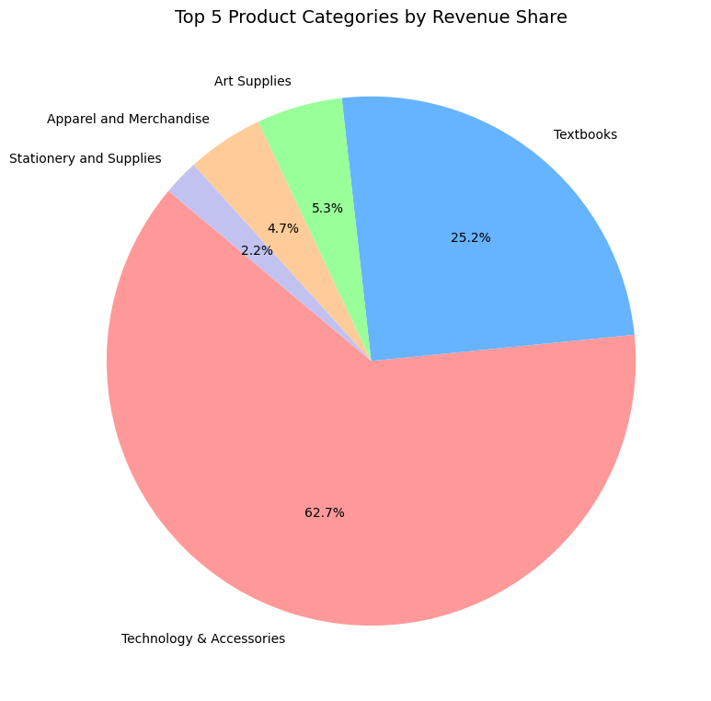
Category Breakdown
88%
of revenue comes only from Technology and Textbooks
Technology & Accessories
62.7% — dominant category
Textbooks
25.2% — second largest share
Other 3 categories together only 12% — portfolio is too narrow.
Notes:
Looking at what we actually sell, the product mix is heavily skewed. 88% of revenue comes from just two categories: Technology & Accessories at 62.7%, and Textbooks at 25.2%. The other three categories — art supplies, apparel, and stationery — together make up only 12%. So while Technology is driving the growth we saw earlier, the territory is also heavily dependent on it. A change in tech demand could hit hard.

Slide 7
What Can Be Done?
1. Replicate the Florida success model across other stores
Miami (724) and Tallahassee (728) outperform the other 9 stores. Customer profile, product mix and operational practices should be studied and transferred to other locations.
2. Expand the rewards program
Only 10.6% of transactions come from rewards customers. Checkout sign-up incentives, welcome discounts and an SMS opt-in campaign can push this into double digits.
3. Diversify the category portfolio
88% of revenue comes from just 2 categories (Technology + Textbooks) — concentration risk. Cross-sell campaigns in art supplies and apparel can reduce dependency.
4. Analyze the source of the 2025 momentum
The trigger behind the sharp rise starting late 2024 should be identified (new product, price change, campaign). If the cause is repeatable, 2026 growth can be secured.
Notes:
So what should the territory do with these findings? Four actions:
First, replicate the Florida success model. Stores 724 and 728 are clearly doing something right — we should study their customer profile, product mix, and operations and apply those lessons to the other nine stores.
Second, expand the rewards program. With only 10.6% participation, even modest sign-up incentives at checkout could meaningfully grow it.
Third, diversify the category portfolio. Being 88% dependent on two categories is risky — cross-sell campaigns in art supplies and apparel can build a buffer.
And fourth, analyze what drove the late-2024 momentum. If we can identify the trigger — whether it was a new product, a price change, or a campaign — we can repeat it and secure 2026 growth.
Thank you — happy to take questions.

