Slide 1
Driver Drowsiness Detection System (DDDS)
Graduation Project
KHALED ALREFAI-220212334
Supervisor: Asst. Prof. Emel Koç

Slide 2

Project Overview
01
Uses Eye Aspect Ratio (EAR) and Mouth Aspect Ratio (MAR)
Detects driver drowsiness using
facial features:
02
Supports both threshold and machine learning-based detection
03
Triggers alarm and logs events to prevent accidents

Slide 3
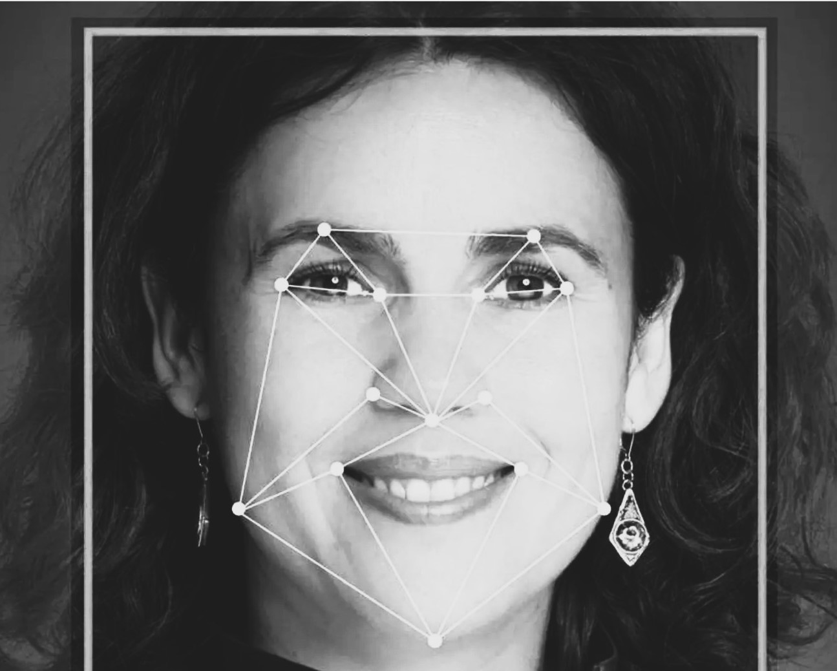



System Workflow
Capture& Detect
Capture face using webcam
Detect landmarks with MediaPipe
Calculate& Evaluate
Calculate EAR and MAR
Evaluate thresholds or use TFLite model
Trigger
Trigger alarm if drowsiness detected

Slide 4
EAR / MAR Detection & Thresholds
EAR = Eye Aspect Ratio – measures eye openness
01
MAR = Mouth Aspect Ratio – measures yawning
02
03
Threshold values: EAR < 0.21, MAR > 0.6
If EAR/MAR exceed limits for 25+ frames → Drowsy

Slide 5
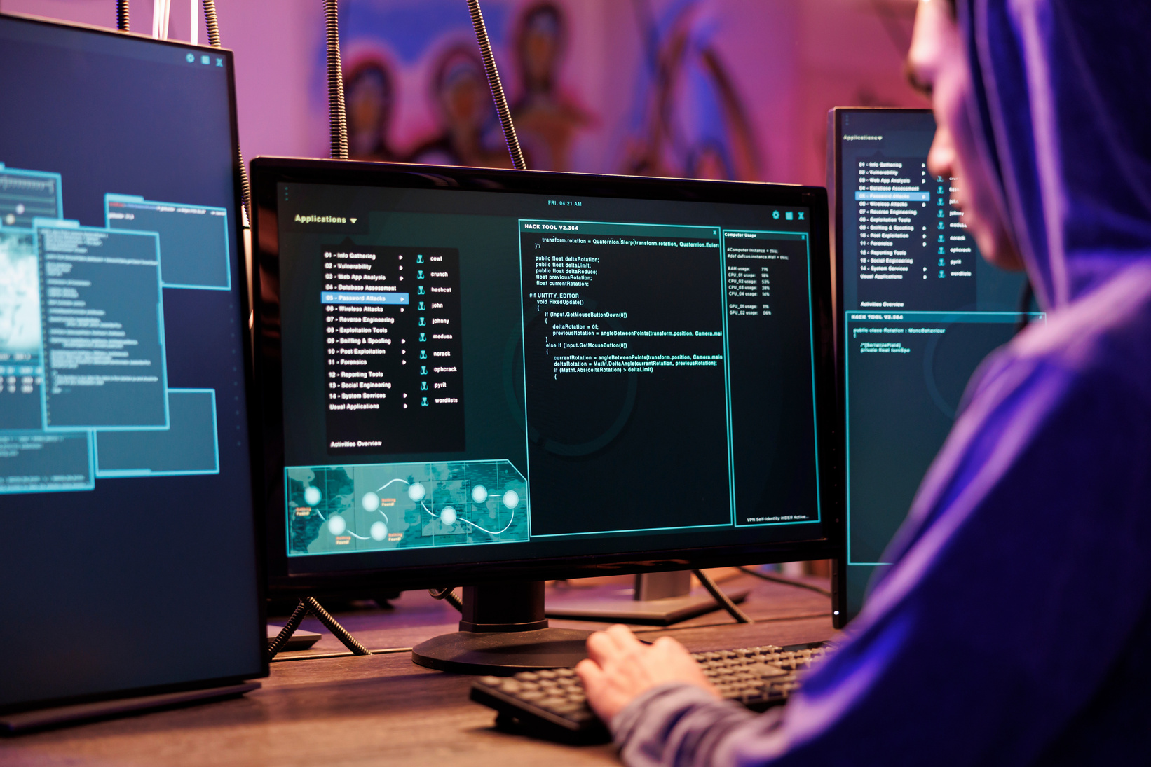
01
Two modes:
TinyML Integration
System has two modes: --simulate (threshold-based) and ML-based
02
TFLite model:
It takes EAR and MAR as input
03
Probability
Outputs probability of drowsiness (0–1)
04
Inference
Model inference uses TensorFlow Lite Interpreter

Slide 6



System Architecture & Internal Structure
Code Flow & Control Logic
Modular script-based structure (Python) Facial detection via MediaPipe (EAR/MAR calculations).
Data Flow: Camera → Landmark Detector → EAR/MAR → Threshold/Model → Alarm.
Acceptance tests simulate frame capture, processing, and alert triggering.
Class-like modular division: EAR.py, MAR.py, tflite_inference.py, soundLog.py
`tflite_inference.py` runs the system – starts webcam, detection loop.
`--simulate` mode uses only thresholding logic.
EAR and MAR calculated per frame, checked against thresholds.
Alarm & Logging Mechanism
Alarm is played using pygame in a separate thread.
Log file records detection events with timestamps.
Alarm auto-stops when alert condition is no longer met.

Slide 7

Hardware-Ready Design
Testing and Results
Real-time EAR/MAR and state displayed on frame
• System logs when DROWSY state is detected
• Visual FPS and EAR/MAR shown to user
• Tested under various lighting and motion conditions
System runs on any PC or microcontroller with camera input
• Compatible with ESP32-CAM, Raspberry Pi, or laptops
• Offline: No internet required
• Thresholds and model can be tuned based on hardware

Slide 8
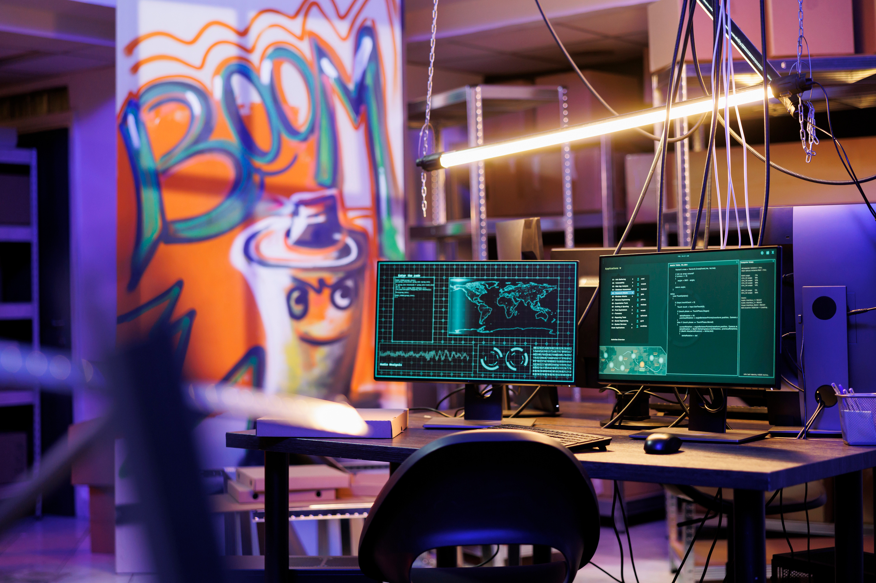


Conclusion
Challenges & Improvements
Camera quality impacts detection reliability
• Threshold values are tunable per environment
Deployment Readiness
System is modular and fully functional
• Easily deployable on multiple platforms
• Accurate, lightweight, and real-time

Slide 9
Thank You!
• Presentation, demo, and report are fully complete.
PRESENTED BY:
KHALED ALREFAI
220212334
SUPERVISOR:
ASST. PROF. EMEL KOÇ
COMPUTER ENGINEERING.

