Slide 1
Bioinformatics Final Project
Kaleb Ducharme

Slide 2
Bioinformatics Final Project
Problem
Planning
Product
Issues and Future

Slide 3
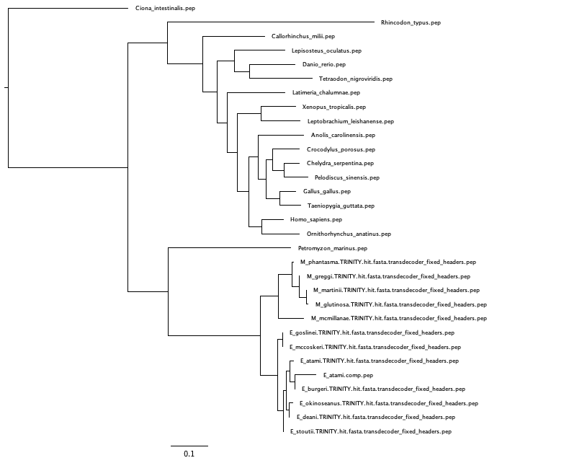
Problem
Background
What are Phylogenetic Trees?
Used to show evolutionary relationship between organisms
What is Phylogenomics?
Establish the evolutionary relationships between genes
Gene families
Gene predictions
Gene Evolution

Slide 4

Problem
Process
What is the process?
Cleaning Data
A bit of a pain
Removing duplicates
Removing low e-scores
Fixing frame shifts/internal stop codons
Too many/ not enough sequences?
More/less strict selection
Steps
Find a target
Find similar sequences in your transciptomes
Align the similar sequences
Make a tree from the alignment
Clean Data

Slide 5
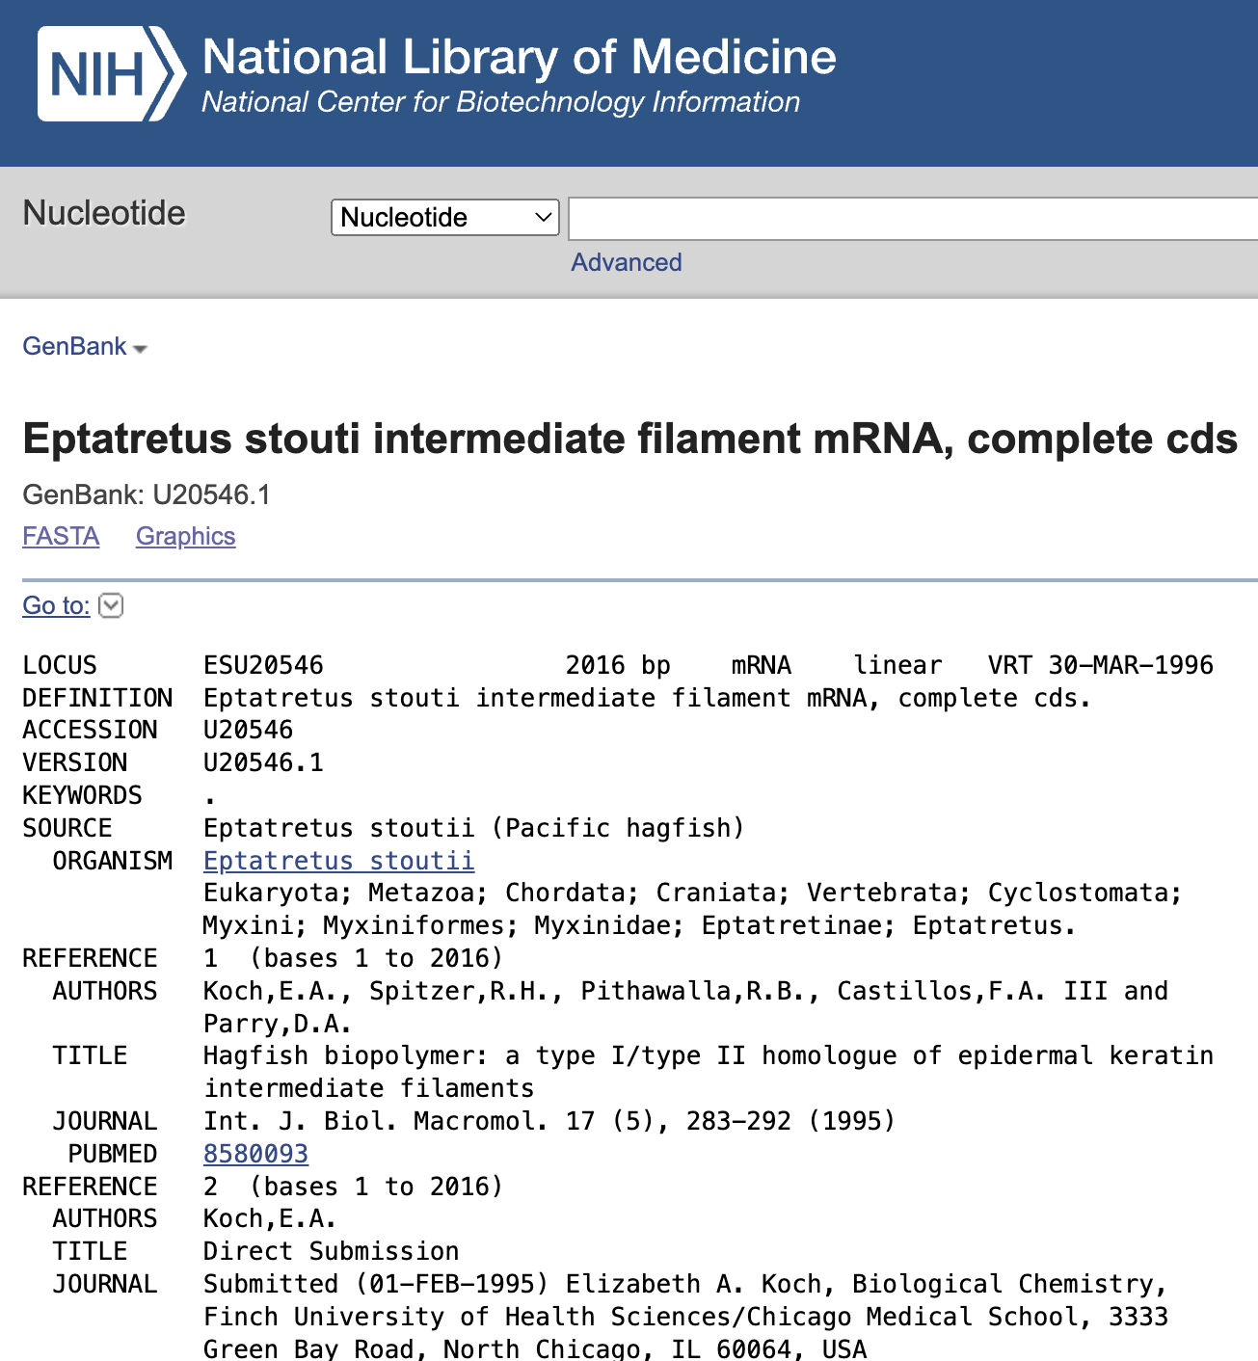
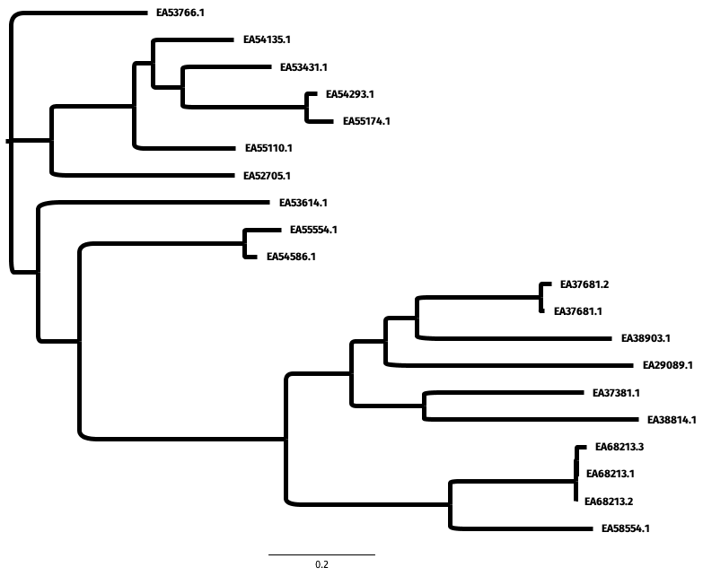
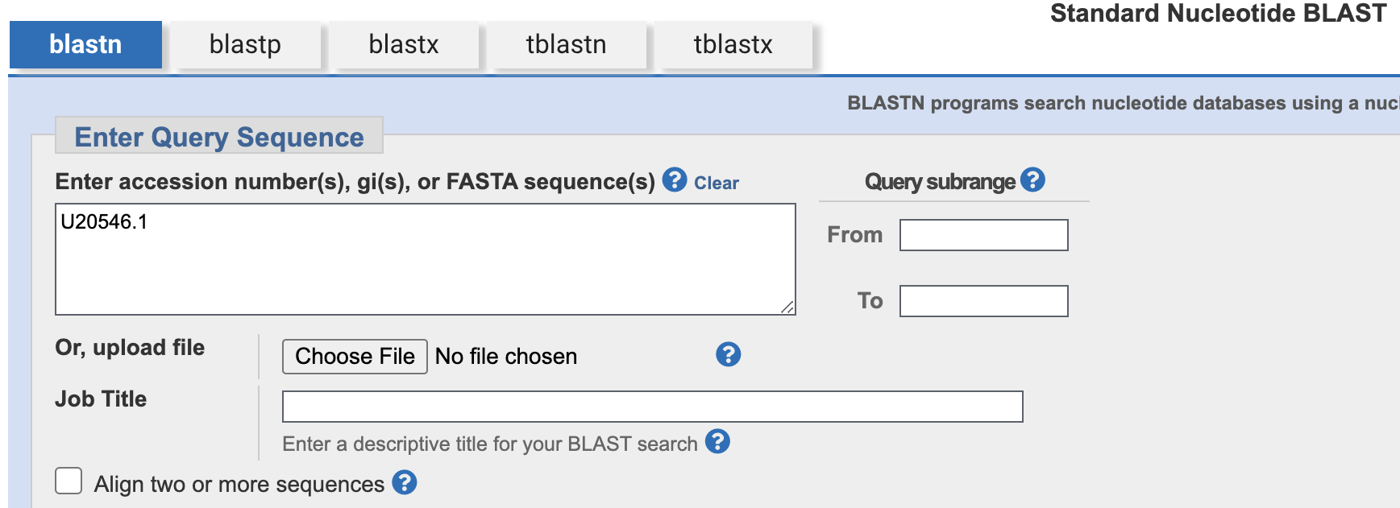

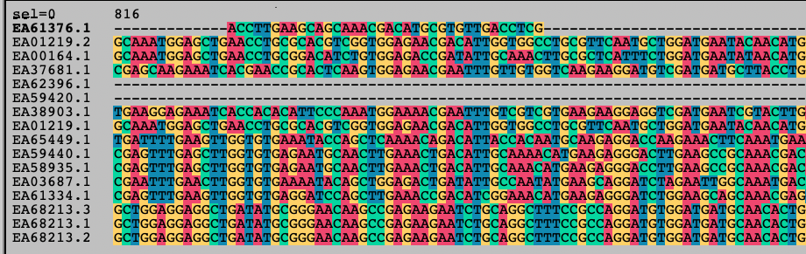
Problem
Diagram
How can we make this easier?

Slide 6
Bioinformatics Final Project
Problem
Planning
Product
Issues and Future

Slide 7
Planning
Initial Plan
How can we make this easier?
Automate the process of taking transcriptomes and turning them into trees
Less time spent setting up subprocesses
Reproducibility
Cleaner working environment
Make the cleaning process easier
Don’t need to remember how to individually process each step’s file outputs
Stats can be seen relative to each other, rather than individually

Slide 8



Planning
Pipeline
Automate the process of taking transcriptomes and turning them into trees
Setup Times
5 minutes
10 minutes
5 minutes
20 minutes
20 minutes
Process back to fasta format
Remove Duplicates
Find Transcripts
Align
Build Tree
INPUT
OUTPUT

Slide 9
Planning
Pipeline
Automate the process of taking transcriptomes and turning them into trees
Setup Time
5 minutes
Pipeline Script
5 minutes
10 minutes
5 minutes
20 minutes
20 minutes
Process back to fasta format
Remove Duplicates
INPUT
Find Transcripts
Align
Build Tree
OUTPUT
INPUT
OUTPUT

Slide 10
Planning
Visualizer
Make the cleaning process easier
grep
Directory searching
Make an automated cleaning script that runs until a good tree/alignment output
Way outside my knowledge
less
xml parsing
cut
Make human cleaning of data easier
Put all the stats in one place to make viewing easier
./visualizer.py

Slide 11
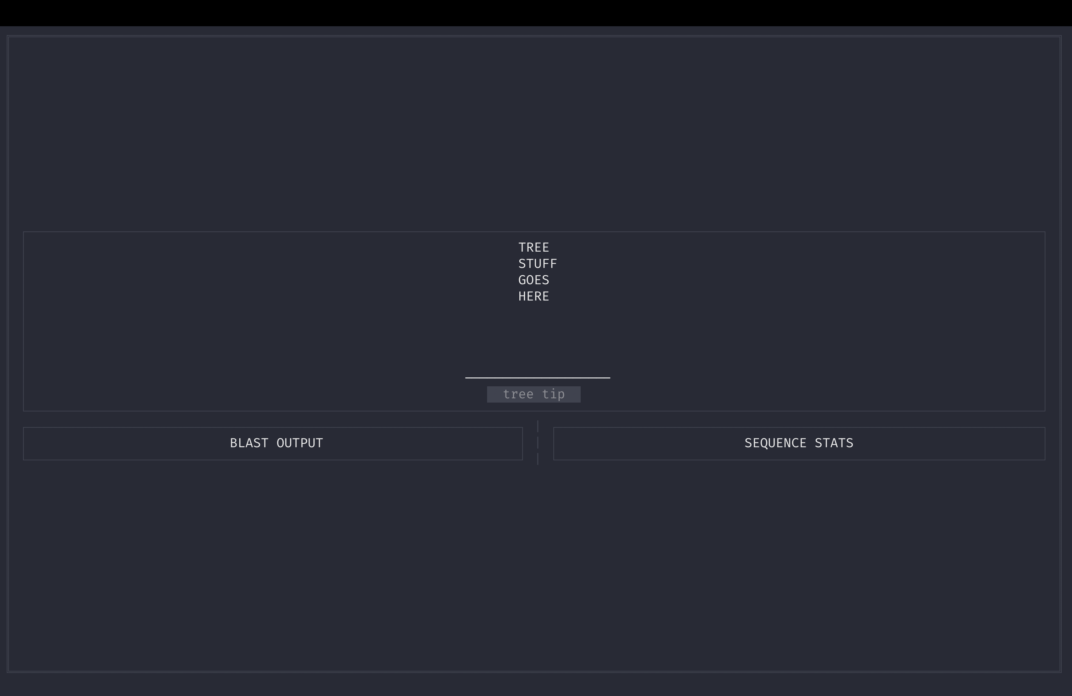
Planning
Visualizer
Make the cleaning process easier
./visualizer.py

Slide 12
Bioinformatics Final Project
Problem
Planning
Product
Issues and Future

Slide 13
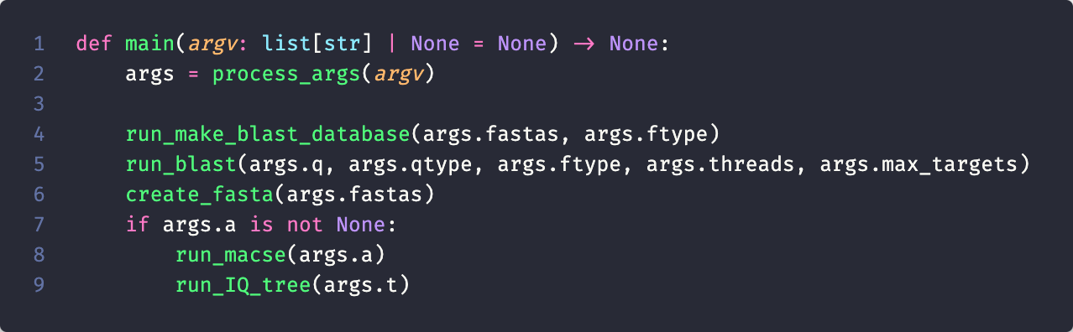
Product
Pipeline
Pipeline Script
Basic implementation of a pipeline
Most processes use subprocess module to run
Python mainly used for file management of outputs

Slide 14
Product
Usage
Pipeline Script
usage: pipeline.py [-h] -q Q -qtype {nucl,prot} -fastas FASTAS -ftype {nucl,prot} [-max_targets MAX_TARGETS] [-a A] [-t T]
pipeline script to take query sequence and fastas, and create blast database, blasts the sequences, aligns output, and creates tree
options:
-h, --help show this help message and exit
-q Q query sequence
-qtype {nucl,prot} querry sequence type (prot, nucl)
-fastas FASTAS directory location of fasta file(s)
-ftype {nucl,prot} database fasta type (prot, nucl)
-max_targets max number of target seqs while running blast
-a A, -alignemnt A location of macse jar file, if not given, script will stop after blast output
-t T, -threads T number of threads to allow subprocesses to use

Slide 15
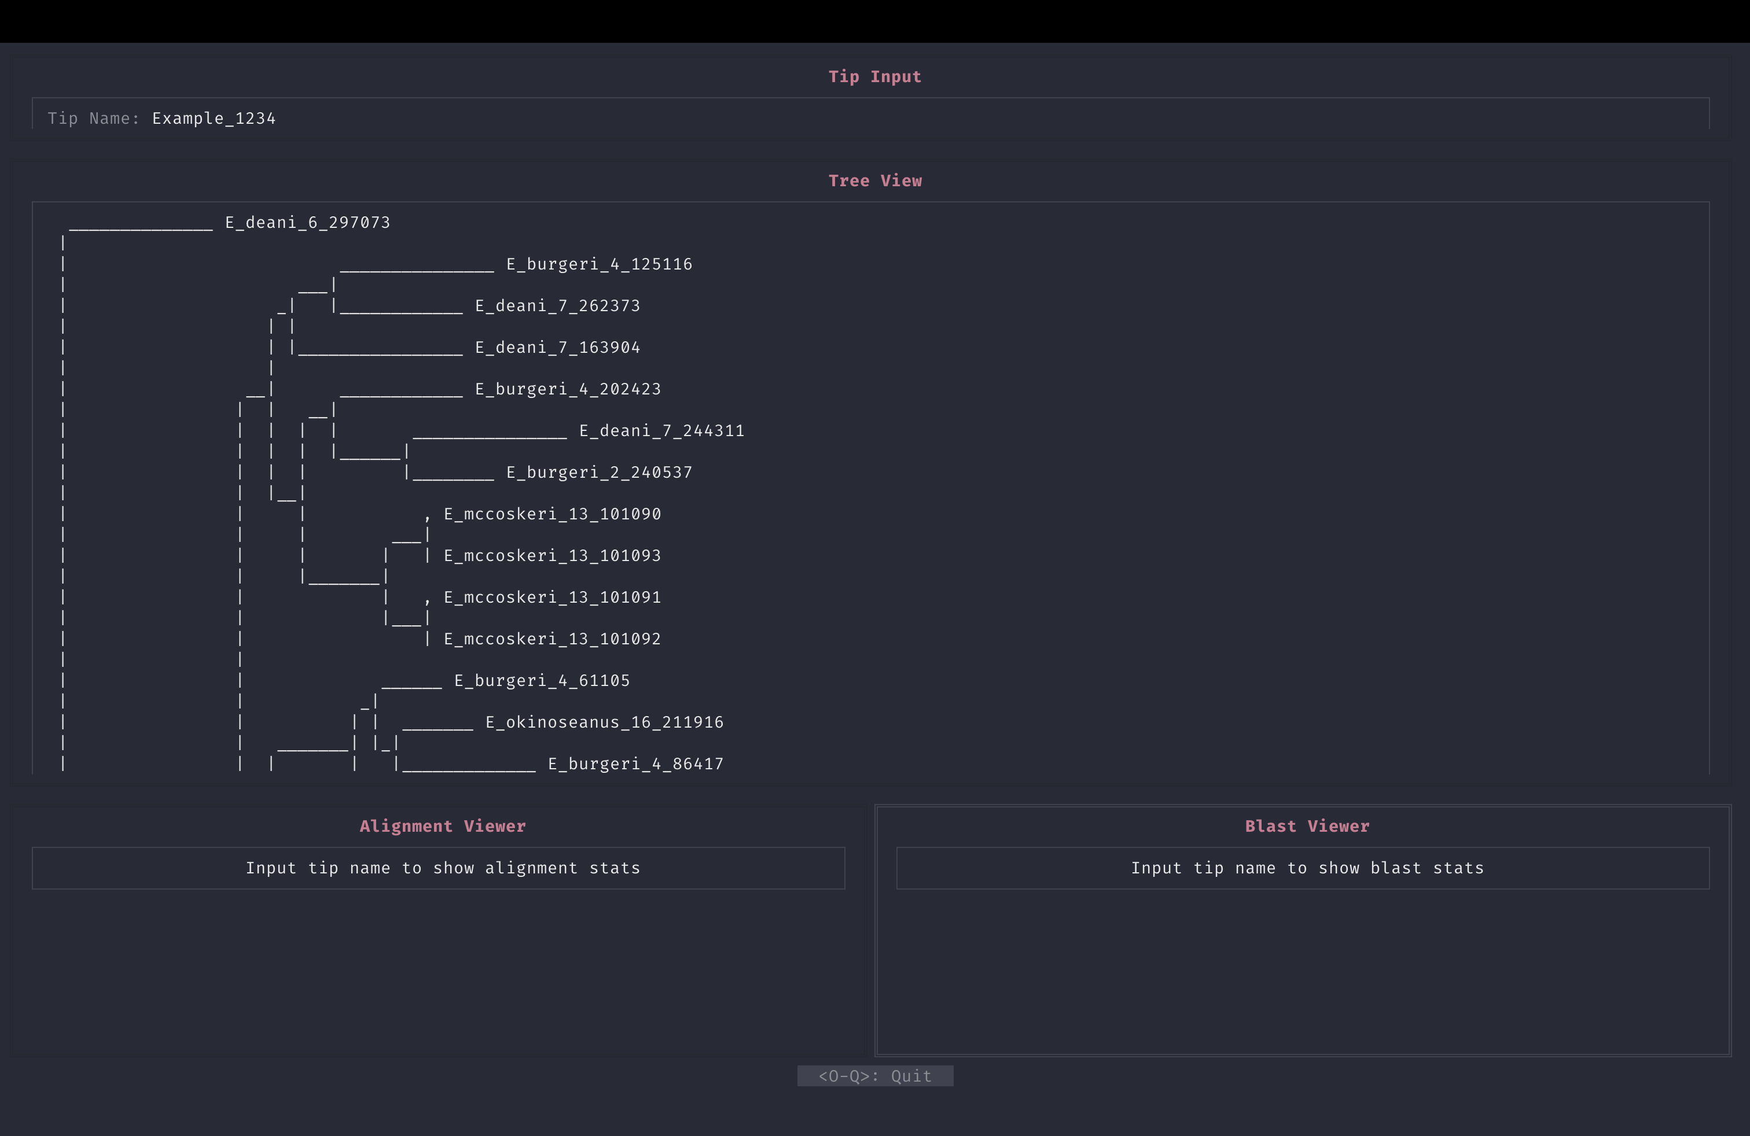
Product
Visualizer
Visualizer
Uses PyTermGUI
Uses Widget System
Tip Input Widget
User input for tip selection
Tree Viewer Widget
Shows phylogenetic tree in ascii
Blast Viewer Widget
Shows statistics in a table
Alignment Viewer Widget
Shows statistics in a table

Slide 16
Product
Visualizer

Slide 17
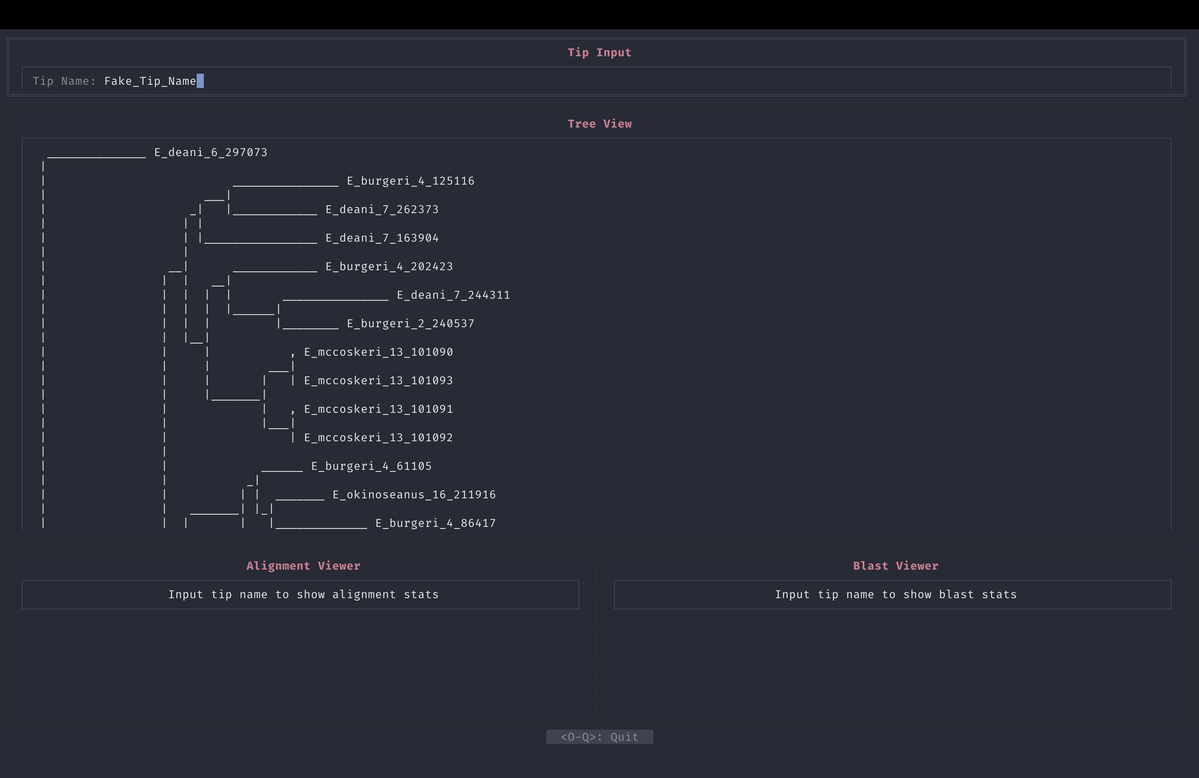
Product
Visualizer

Slide 18
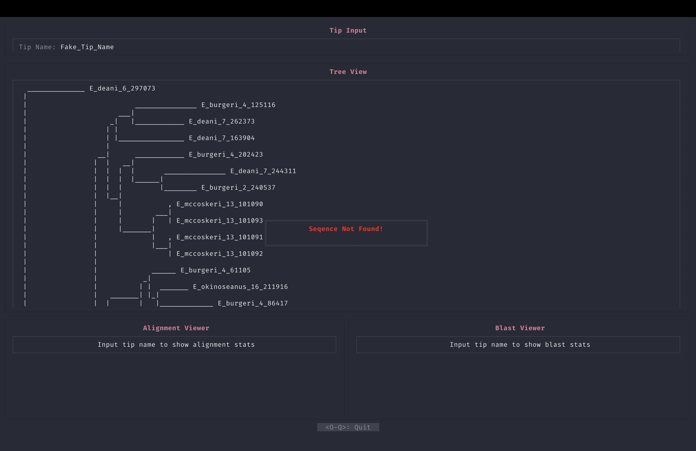
Product
Visualizer

Slide 19
Product
Visualizer

Slide 20

Product
Visualizer

Slide 21
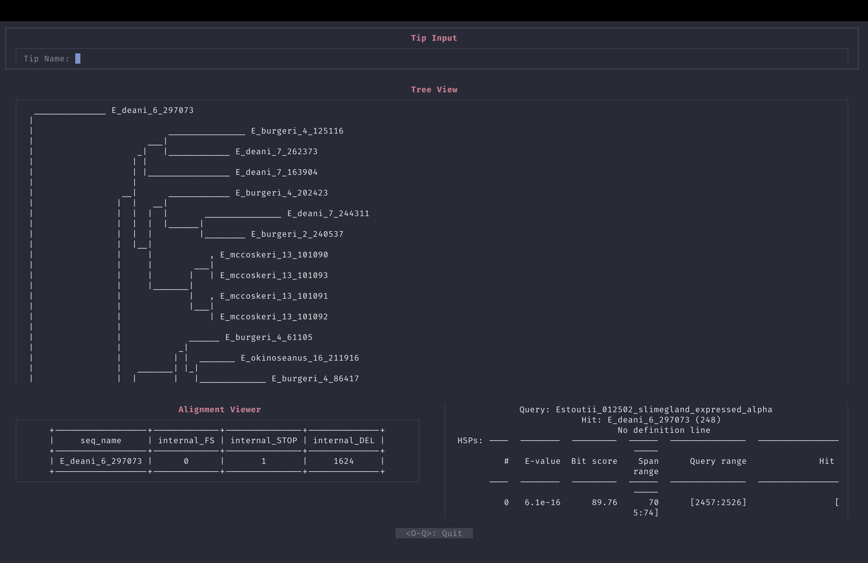
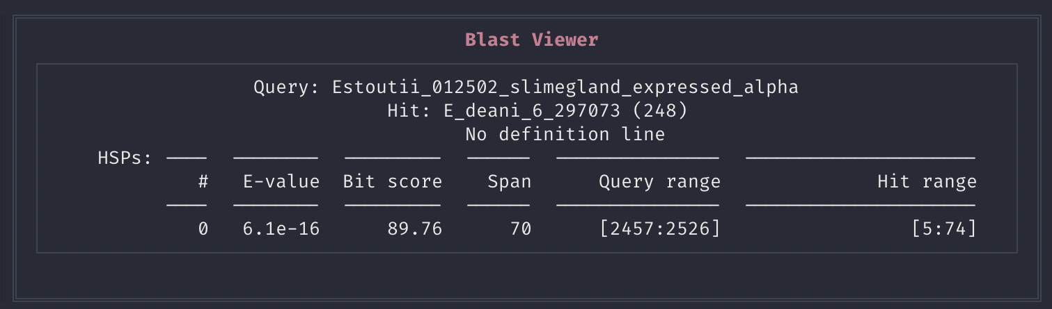
Product
Visualizer

Slide 22
Bioinformatics Final Project
Problem
Planning
Product
Issues and Future

Slide 23
Issues and Future
Pipeline
Pipeline Script
Issues
Extremely basic arguments allowed
No fine control over subprocesses from command line
Future
Give user more control through command line, but keep simplicity
Don’t want user to have to submit 100 arguments each time they run the script
Maybe store commands in external file, and script can pull from there?
Reproducible and Simple

Slide 24
Issues and Future
Visualizer
Visualizer
Issues
Bio.phylo is not the best
No way to just save as a string?
Ascii trees are a little hard to read
Future
Add more viewing options
Actual alignment viewer?
Could even do nucleotide colors
Adding arguments to the script to run each Widget separate
Could just look at the tree/alignment/etc

Slide 25
Bioinformatics Final Project
Questions?

