Slide 1
EE386: Digital Signal Processing Lab 8: Music Synthesis of Take on Me by A-Ha using MATLAB
Presented by Paco Ellaga
CSULB ID: 009602331

Slide 2
Take On Me
Released in October 19, 1984 by A-Ha
Norwegian new wave band
Duration: 3 minutes 10 seconds
Music Video https://www.youtube.com/watch?v=djV11Xbc914
Sheet Music https://musescore.com/user/7339591/scores/4536026

Slide 3
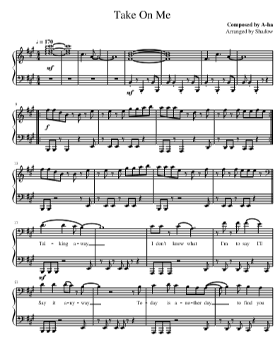
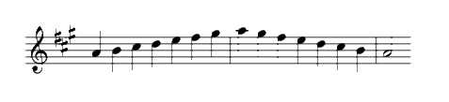
Musical Analysis
Musical Score found on MuseScore by user “Shadow”
Played in A-major at 170 BPM
4/4 scale
60*1000 = 60000 ms/min
60000/170 = 352.941176471 ms/beat

Slide 4
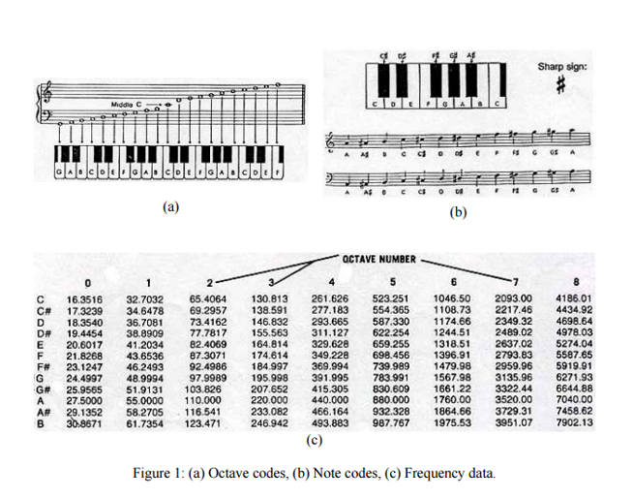
Note Duration Analysis
Since 352.941176471 is ms / beat
Half note -> 705.882352942 ms
Dotted quarter note -> 529.411764707 ms
Quarter note -> 352.941176471 ms
Eighth note -> 176.470588236 ms

Slide 5
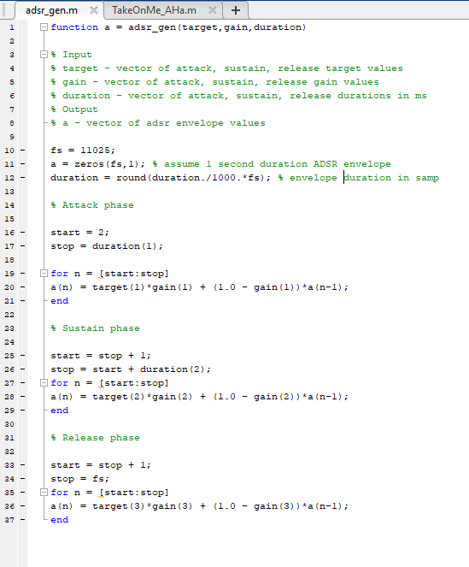
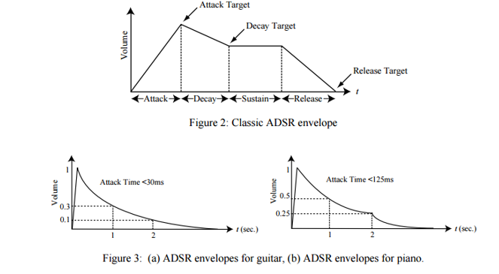
MATLAB Translation
Ratio is [125;625;250] for half notes
[88.24; 441.18; 176.47] == Half
[66.18; 330.89; 132.36] == Dotted Quarter
[44.12; 220.59; 88.24] == Quarter
[22.06; 110.3; 44.12] == Eighth

Slide 6
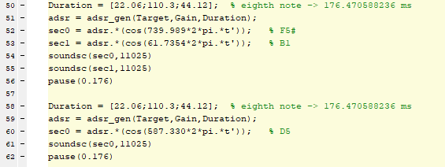
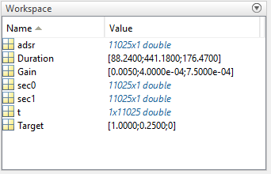
Frequency Presets
Sample Frequency = 11025 Hz
Uses adsr * cos(2 * pi * f * t) where adsr == amplitude
Sec0 == Treble note and Sec1 = Bass note

