Slide 1
Inter-Process Communication
Processes within a system may be independent or cooperating
Independent process cannot affect or be affected by the execution of another process
Cooperating process can affect or be affected by the execution of another process
Information sharing:-Since several users may be interested in the same piece of information ,we must provide an environment to allow concurrent access to such information.
Computation speedup:- If we want a particular task to run faster, we must
break it into subtasks, each of which will be executing in parallel with the other.
Modularity:-We may want to construct the system in a modular fashion, dividing the system functions into separate processes or threads
Convenience. Even an individual user may work on many tasks at the same time. For instance, a user may be editing, listening to music, and compiling in parallel.
Cooperating processes need inter-process communication (IPC)
Two models of IPC
  Shared memory
  Message passing

Slide 2
Type of IPC
There are two fundamental models of interprocess communication: shared memory and message passing.
In the shared-memory model, a region of memory that is shared by cooperating processes is established.
Processes can then exchange information by reading and writing data to the shared region.
In the message-passing model, communication takes place by means of messages exchanged between the cooperating processes.

Slide 3
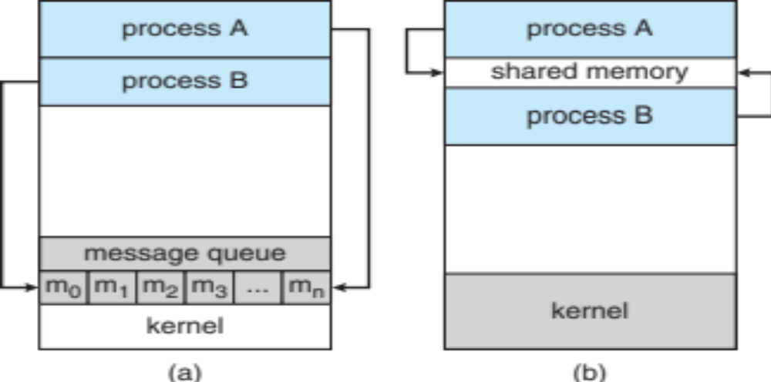
Communications Models
(a) Message passing. (b) shared memory.

Slide 4
Interprocess Communication – Shared Memory
Shared memory can be faster than message passing,
since message-passing systems are typically implemented using system calls and thus require the more time-consuming task of kernel intervention. In
shared-memory systems, system calls are required only to establish shared memory regions. Once shared memory is established, all accesses are treated
as routine memory accesses, and no assistance from the kernel is required.

Slide 5
Shared Memory vs Mesage Passing
Recent research on systems with several processing cores indicates that message passing provides better performance than shared memory on such systems.
Shared memory suffers from cache coherency issues, which arise because shared data migrate among the several caches.
As the number of processing cores on systems increases, it is possible that we will see message passing as the preferred mechanism for IPC.

Slide 6
Shared-Memory Systems
Interprocess communication using shared memory requires communicating processes to establish a region of shared memory.
Typically, a shared-memory region resides in the address space of the process creating the shared-memory segment.
Other processes that wish to communicate using this shared-memory segment must attach it to their address space.
Recall that, normally, the operating system tries to prevent one process from accessing another process’s memory.
Shared memory requires that two or more processes agree to remove this restriction.
They can then exchange information by reading and writing data in the shared areas.
The form of the data and the location are determined by these processes and are not under the operating system’s control.
The processes are also responsible for ensuring that they are not writing to the same location simultaneously.

Slide 7
The producer–consumer problem
A producer process produces information that is consumed by a consumer process.
For example, a compiler may produce assembly code that is consumed by an assembler.
The assembler, in turn, may produce object modules that are consumed by the loader.
The producer–consumer problem also provides a useful metaphor for the client–server generally think of a server as a producer and a client as a consumer.
For example, a web server produces (that is, provides) HTML files and images, which are consumed (that is, read) by the client web browser requesting the resource.

Slide 8
The producer–consumer problem
One solution to the producer–consumer problem uses shared memory.
To allow producer and consumer processes to run concurrently, we must have available a buffer of items that can be filled by the producer and emptied by the consumer.
This buffer will reside in a region of memory that is shared by the producer and consumer processes.
A producer can produce one item while the consumer is consuming another item.
The producer and consumer must be synchronized, so that the consumer does not try to consume an item that has not yet been produced.

Slide 9
Buffer-Shared Memory
Two types of buffers can be used. The unbounded buffer places no practical limit on the size of the buffer.
The consumer may have to wait for new items, but the producer can always produce new items.
The bounded buffer assumes a fixed buffer size. In this case, the consumer must wait if the buffer is empty, and the producer must wait if the buffer is full.

Slide 10
Bounded Buffer
Let’s look more closely at how the bounded buffer illustrates interprocess communication using shared memory.
The following variables reside in a region of memory shared by the producer and consumer processes:
#define BUFFER SIZE 10
typedef struct {
. . .
}item;
item buffer[BUFFER SIZE];
int in = 0;
int out = 0;
The shared buffer is implemented as a circular array with two logical pointers: in and out.
The variable in points to the next free position in the buffer; out points to the first full position in the buffer.
The buffer is empty when in ==out; the buffer is full when ((in + 1) % BUFFER SIZE) == out.
Example:
10 buffer size
1,2,3,4,5 -in
1,2 -out
3,4,5,6,7,8,9,10,11,12-in
In =12
Out=3
(12+1)%10=3 buffer is full

Slide 11
The producer process using shared memory.
while (true)
{ /* produce an item in next produced */
while (((in + 1) % BUFFER SIZE) == out)
; /* do nothing */
buffer[in] = next produced;
in = (in + 1) % BUFFER SIZE;
}
The consumer process using shared memory.
item next consumed;
while (true) { while (in == out);
/* do nothing */
next consumed = buffer[out];
out = (out + 1) % BUFFER SIZE;
/* consume the item in next consumed */
}

Slide 12
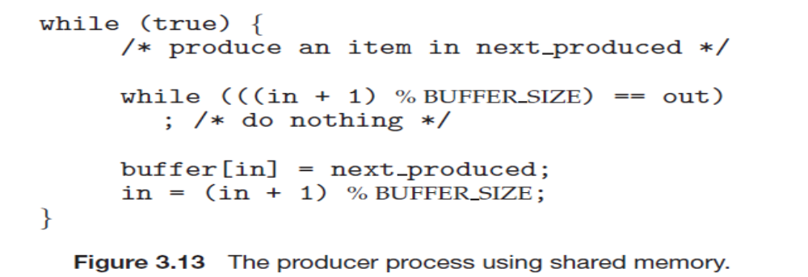
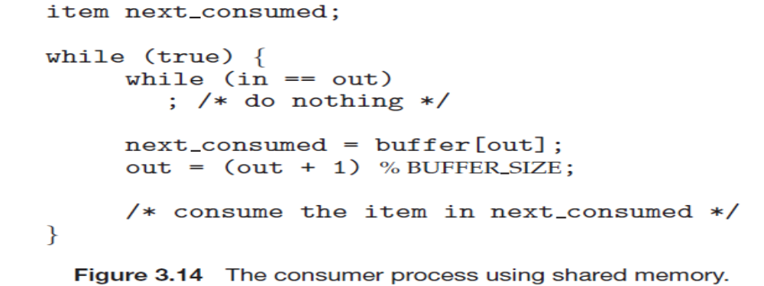

Slide 13
Message-Passing Systems
Message passing provides a mechanism to allow processes to communicate and to synchronize their actions without sharing the same address space.
It is particularly useful in a distributed environment, where the communicating processes may reside on different computers connected by a network.
For example, an Internet chat program could be designed so that chat participants communicate with one another by exchanging messages.
A message-passing facility provides at least two operations:
send(message) receive(message)

Slide 14
If processes P and Q want to communicate, they must send messages to and receive messages from each other: a communication link must exist between them.
Here are several methods for logically implementing a link and the send()/receive() operations:
• Direct or indirect communication
• Synchronous or asynchronous communication
• Automatic or explicit buffering

Slide 15
Naming- direct communication
Processes that want to communicate must have a way to refer to each other.
They can use either direct or indirect communication.
Under direct communication, each process that wants to communicate must explicitly name the recipient or sender of the communication. In this
scheme, the send() and receive() primitives are defined as:
• send(P, message)—Send a message to process P.
• receive(Q, message)—Receive a message from process Q.

Slide 16
Naming- Indirect communication
With indirect communication, the messages are sent to and received from mailboxes, or ports.
A mailbox can be viewed abstractly as an object in to which messages can be placed by processes and from which messages can be removed.
Each mailbox has a unique identification.
For example, POSIX message queues use an integer value to identify a mailbox.
A process can communicate with another process via a number of different mailboxes, but two processes can communicate only if they have a shared mailbox.
The send() and receive() primitives are defined as follows:
• send(A, message)—Send a message to mailbox A.
• receive(A, message)—Receive a message from mailbox A.

Slide 17
Synchronization
There are different design options for implementing each primitive.
Message passing may be either blocking or nonblocking—also known as synchronous and asynchronous.
• Blocking send. The sending process is blocked until the message is received by the receiving process or by the mailbox.
• Non-blocking send. The sending process sends the message and resumes operation.
• Blocking receive. The receiver blocks until amessage is available.
• Non-blocking receive. The receiver retrieves either a valid message or a null.

Slide 18
Buffering-Message Passing
Whether communication is direct or indirect, messages exchanged by communicating processes reside in a temporary queue. Basically, such queues can be implemented in three ways:
Zero capacity. The queue has a maximum length of zero; thus, the link cannot have any messages waiting in it.
In this case, the sender must block until the recipient receives the message.
• Bounded capacity. The queue has finite length n; thus, at most n messages can reside in it.
If the queue is not full when a new message is sent, the message is placed in the queue, and the sender can continue execution without waiting.The link’s capacity is finite, however. If the link is full, the sender must block until space is available in the queue.
• Unbounded capacity. The queue’s length is potentially infinite; thus, any number of messages can wait in it. The sender never blocks.

