Slide 1
Semaphores

Slide 2
Semaphore
A semaphore S is an integer variable that, apart from initialization, is accessed only through two standard atomic operations: wait() and signal().
The wait() operation was originally termed P (from the Dutch proberen, “to test”); signal() was originally called V (from verhogen, “to increment”).
The definition of wait() is as follows:
wait(S) {
while (S <= 0); // busy wait
S--;
}
The definition of signal() is as follows:
signal(S)
{ S++;
}
Trap???????????

Slide 3
Semaphore
All modifications to the integer value of the semaphore in the wait() and signal() operations must be executed indivisibly.
That is, when one process modifies the semaphore value, no other process can simultaneously modify that same semaphore value.
In addition, in the case of wait(S), the testing of the integer value of S (S ≤ 0), as well as its possible modification (S--), must be executed without interruption.

Slide 4
Semaphore Usage
Operating systems often distinguish between counting and binary semaphores.
The value of a counting semaphore can range over an unrestricted domain.
The value of a binary semaphore can range only between 0 and 1.
Thus, binary semaphores behave similarly to mutex locks.
In fact, on systems that do not provide mutex locks, binary semaphores can be used instead for providing mutual exclusion.

Slide 5
Semaphore Usage
Counting semaphores can be used to control access to a given resource consisting of a finite number of instances.
The semaphore is initialized to the number of resources available.
Each process that wishes to use a resource performs a wait() operation on the semaphore (thereby decrementing the count).
When a process releases a resource, it performs a signal() operation (incrementing the count).
When the count for the semaphore goes to 0, all resources are being used.
After that, processes that wish to use a resource will block until the count becomes greater than 0.

Slide 6
Semaphore Usage
We can also use semaphores to solve various synchronization problems.
For example, consider two concurrently running processes: P1 with a statement S1 and P2 with a statement S2.
Suppose we require that S2 be executed only after S1 has completed.
We can implement this scheme readily by letting P1 and P2 share a common semaphore synch, initialized to 0.
In process P1, we insert the statements
S1;
signal(synch);
In process P2, we insert the statements
wait(synch);
S2;
Because synch is initialized to 0, P2 will execute S2 only after P1 has invoked signal(synch), which is after statement S1 has been executed.

Slide 7
Semaphore Implementation
Now suppose there is a resource whose number of instance is 4. Now we initialize S = 4 and rest is same as for binary semaphore.
Whenever process wants that resource it calls P or wait function and when it is done it calls V or signal function.
If value of S becomes zero than a process has to wait until S becomes positive.
For example, Suppose there are 4 process P1, P2, P3, P4 and they all call wait operation on S(initialized with 4).
If another process P5 wants the resource then it should wait until one of the four process calls signal function and value of semaphore becomes positive.

Slide 8
Semaphore Implementation
To overcome the need for busy waiting, we can modify the definition of the wait() and signal() operations as follows:
When a process executes the wait() operation and finds that the semaphore value is not positive, it must wait.
However, rather than engaging in busy waiting, the process can block itself.
The block operation places a process into a waiting queue associated with the semaphore, and the state of the process is switched to the waiting state.
Then control is transferred to the CPU scheduler, which selects another process to execute.
A process that is blocked, waiting on a semaphore S, should be restarted when some other process executes a signal() operation.
The process is restarted by a wakeup() operation, which changes the process from the waiting state to the ready state.
The process is then placed in the ready queue

Slide 9
Problem in this implementation of semaphore
Whenever any process waits then it continuously checks for semaphore value (look at this line while (s==0); in P operation) and waste CPU cycle.
To avoid this another implementation is provided below.
In this implementation whenever process waits it is added to a waiting queue of processes associated with that semaphore.
This is done through system call block() on that process.
When a process is completed it calls signal function and one process in the queue is resumed. It uses wakeup() system call.
P(Semaphore s) | V(Semaphore s)
{ s = s - 1; if (s < 0) { // add process to queue block(); } } | { s = s + 1; if (s >= 0) { // remove process p from queue wakeup(p); } }

Slide 10
Bounded Buffer Problem
Bounded buffer problem, which is also called producer consumer problem, is one of the classic problems of synchronization.
What is the Problem Statement?
There is a buffer of n slots and each slot is capable of storing one unit of data. There are two processes running, namely, producer and consumer, which are operating on the buffer.

Slide 11
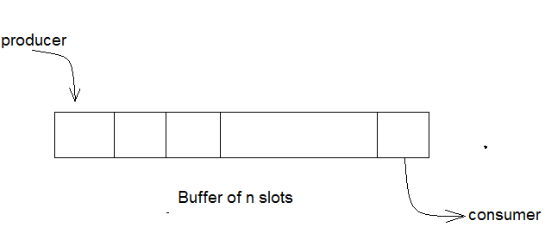
A producer tries to insert data into an empty slot of the buffer.
A consumer tries to remove data from a filled slot in the buffer.
As you might have guessed by now, those two processes won't produce the expected output if they are being executed concurrently.
There needs to be a way to make the producer and consumer work in an independent manner.

Slide 12
Bounded Buffer Problem Solution
One solution of this problem is to use semaphores. The semaphores which will be used here are:
mutex, a binary semaphore which is used to acquire and release the lock.
empty, a counting semaphore whose initial value is the number of slots in the buffer, since, initially all slots are empty.
full, a counting semaphore whose initial value is 0.
At any instant, the current value of empty represents the number of empty slots in the buffer and full represents the number of occupied slots in the buffer.

Slide 13
Bounded Buffer Problem Solution-Producer Operation
The pseudo-code of the producer function looks like this: do { // wait until empty > 0 and then decrement 'empty' wait(empty); // acquire lock wait(mutex); /* perform the insert operation in a slot */ // release lock signal(mutex); // increment 'full' signal(full); } while(TRUE) | Looking at the above code for a producer, we can see that a producer first waits until there is at least one empty slot.
 | Then it decrements the empty semaphore because, there will now be one less empty slot, since the producer is going to insert data in one of those slots.
 | Then, it acquires lock on the buffer, so that the consumer cannot access the buffer until producer completes its operation.
 | After performing the insert operation, the lock is released and the value of full is incremented because the producer has just filled a slot in the buffer.
Empty S-Decrement
Full S -Increment

Slide 14
Bounded Buffer Problem Solution-The Consumer Operation
The pseudo-code for the consumer function looks like this: do { // wait until full > 0 and then decrement 'full' wait(full); // acquire the lock wait(mutex); /* perform the remove operation in a slot */ // release the lock signal(mutex); // increment 'empty' signal(empty); } while(TRUE); | The consumer waits until there is atleast one full slot in the buffer. Then it decrements the full semaphore because the number of occupied slots will be decreased by one, after the consumer completes its operation.
 | After that, the consumer acquires lock on the buffer.
 | Following that, the consumer completes the removal operation so that the data from one of the full slots is removed. Then, the consumer releases the lock.
 | Finally, the empty semaphore is incremented by 1, because the consumer has just removed data from an occupied slot, thus making it empty
Full S -Decrement
Empty S-Increment

Slide 15
Dining Philosophers Problem
The dining philosophers problem is another classic synchronization problem which is used to evaluate situations where there is a need of allocating multiple resources to multiple processes.
What is the Problem Statement?
Consider there are five philosophers sitting around a circular dining table.
The dining table has five chopsticks and a bowl of rice in the middle as shown in the below figure.
At any instant, a philosopher is either eating or thinking. When a philosopher wants to eat, he uses two chopsticks - one from their left and one from their right.
When a philosopher wants to think, he keeps down both chopsticks at their original place.

Slide 16
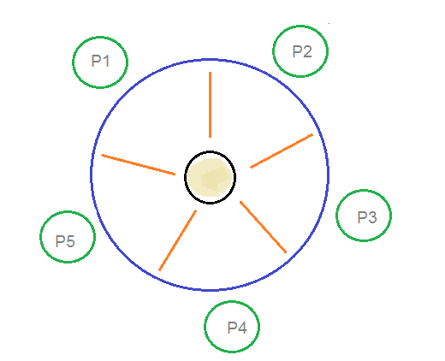

Slide 17
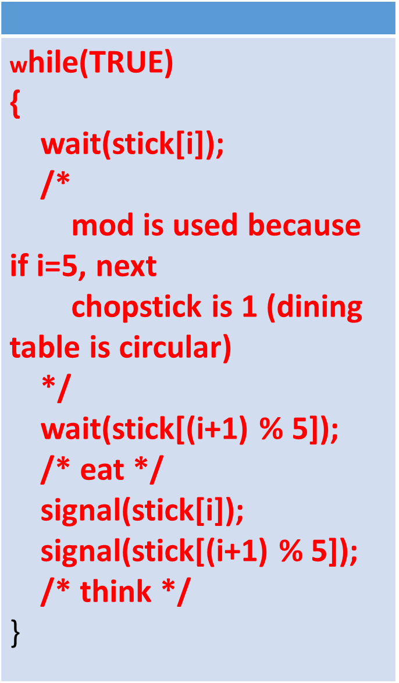
Dining Philosophers Problem Solution
From the problem statement, it is clear that a philosopher can think for an indefinite amount of time.
But when a philosopher starts eating, he has to stop at some point of time.
The philosopher is in an endless cycle of thinking and eating.
An array of five semaphores, stick[5], for each of the five chopsticks.
The code for each philosopher looks like:---->

Slide 18
Dining Philosophers Problem Solution
When a philosopher wants to eat the rice, he will wait for the chopstick at his left and picks up that chopstick.
Then he waits for the right chopstick to be available, and then picks it too. After eating, he puts both the chopsticks down.
But if all five philosophers are hungry simultaneously, and each of them pickup one chopstick, then a deadlock situation occurs because they will be waiting for another chopstick forever.
The possible solutions for this are:
A philosopher must be allowed to pick up the chopsticks only if both the left and right chopsticks are available.
Allow only four philosophers to sit at the table.
That way, if all the four philosophers pick up four chopsticks, there will be one chopstick left on the table.
So, one philosopher can start eating and eventually, two chopsticks will be available. In this way, deadlocks can be avoided.

Slide 19
What is Readers Writer Problem?
Readers writer problem is another example of a classic synchronization problem. There are many variants of this problem, one of which is examined below.
The Problem Statement
There is a shared resource which should be accessed by multiple processes.
There are two types of processes in this context. They are reader and writer.
Any number of readers can read from the shared resource simultaneously, but only one writer can write to the shared resource.
When a writer is writing data to the resource, no other process can access the resource.
A writer cannot write to the resource if there are non zero number of readers accessing the resource at that time.

Slide 20
The Solution
From the above problem statement, it is evident that readers have higher priority than writer.
If a writer wants to write to the resource, it must wait until there are no readers currently accessing that resource.
Here, we use one mutex m and a semaphore w.
An integer variable read_count is used to maintain the number of readers currently accessing the resource.
The variable read_count is initialized to 0. A value of 1 is given initially to m and w.
Instead of having the process to acquire lock on the shared resource, we use the mutex m to make the process to acquire and release lock whenever it is updating the read_count variable.

Slide 21
And, the code for the reader process looks like this:
while(TRUE)
{
//acquire lock
wait(m);
read_count++;
if(read_count == 1)
wait(w);
//release lock
signal(m);
/* perform the reading operation */
// acquire lock
wait(m);
read_count--;
if(read_count == 0)
signal(w);
// release lock
signal(m);
}
The code for the writer process looks like this:
while(TRUE)
{
wait(w);
/* perform the write operation */
signal(w);
}

Slide 22
The Solution
As seen above in the code for the writer, the writer just waits on the w semaphore until it gets a chance to write to the resource.
After performing the write operation, it increments w so that the next writer can access the resource.
On the other hand, in the code for the reader, the lock is acquired whenever the read_count is updated by a process.
When a reader wants to access the resource, first it increments the read_count value, then accesses the resource and then decrements the read_count value.
The semaphore w is used by the first reader which enters the critical section and the last reader which exits the critical section.
The reason for this is, when the first readers enters the critical section, the writer is blocked from the resource. Only new readers can access the resource now.
Similarly, when the last reader exits the critical section, it signals the writer using the w semaphore because there are zero readers now and a writer can have the chance to access the resource.

Slide 23
Monitor
To overcome the timing errors that occurs while using semaphore for process synchronization, the researchers have introduced a high-level synchronization construct i.e. the monitor type.
A monitor type is an abstract data type that is used for process synchronization.
Being an abstract data type monitor type contains the shared data variables that are to be shared by all the processes and some programmer-defined operations that allow processes to execute in mutual exclusion within the monitor.
A process can not directly access the shared data variable in the monitor; the process has to access it through procedures defined in the monitor which allow only one process to access the shared variables in a monitor at a time.

Slide 24
The syntax of monitor is as follow:
monitor monitor_name
{
//shared variable declarations
procedure P1 ( . . . ) {
}
procedure P2 ( . . . ) {
}
procedure Pn ( . . . ) {
}
initialization code ( . . . ) {
}
}

Slide 25
Monitor-Conditional Variables
A monitor is a construct such as only one process is active at a time within the monitor.
If other process tries to access the shared variable in monitor, it gets blocked and is lined up in the queue to get the access to shared data when previously accessing process releases it.
Conditional variables were introduced for additional synchronization mechanism.
The conditional variable allows a process to wait inside the monitor and allows a waiting process to resume immediately when the other process releases the resources.
The conditional variable can invoke only two operation wait() and signal().
Where if a process P invokes a wait() operation it gets suspended in the monitor till other process Q invoke signal() operation i.e. a signal() operation invoked by a process resumes the suspended process.

Slide 26
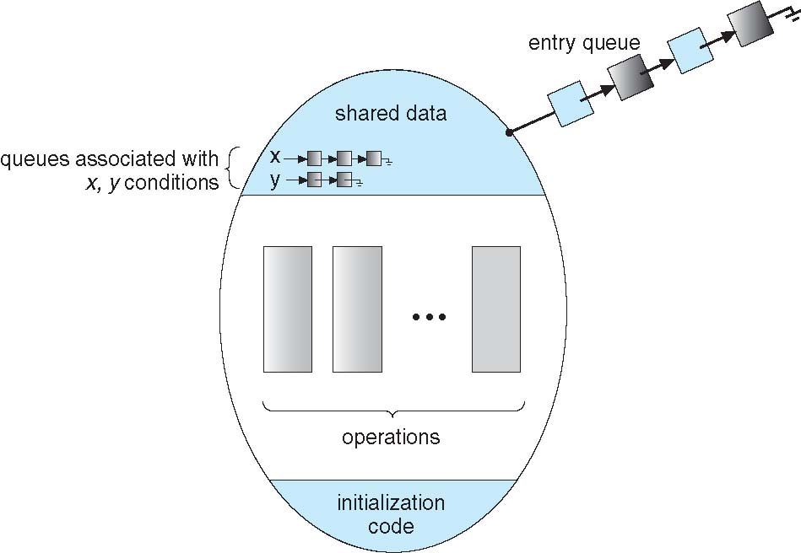
Monitor with Condition Variables

Slide 27
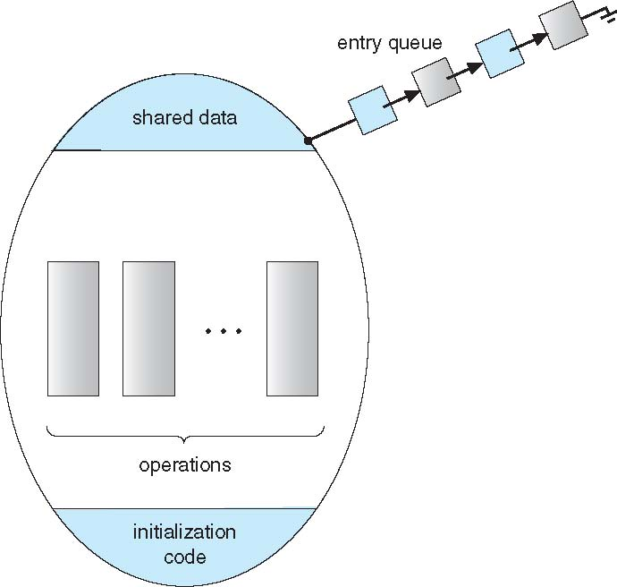
Schematic view of a Monitor

Slide 28
Basis for Comparison | Semaphore | Monitor
Basic | Semaphores is an integer variable S. | Monitor is an abstract data type.
Action | The value of Semaphore S indicates the number of shared resources availabe in the system | The Monitor type contains shared variables and the set of procedures that operate on the shared variable.
Access | When any process access the shared resources it perform wait() operation on S and when it releases the shared resources it performs signal() operation on S. | When any process wants to access the shared variables in the monitor, it needs to access it through the procedures.
Condition variable | Semaphore does not have condition variables. | Monitor has condition variables.

