Slide 1
Linux Boot Process

Slide 2
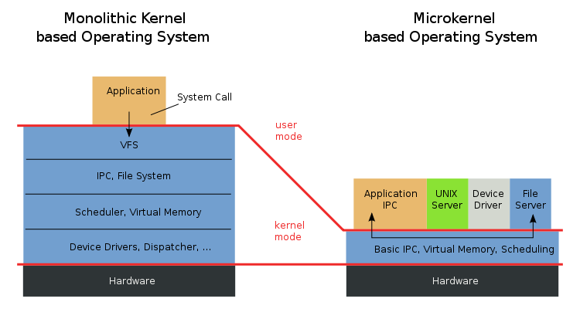
Types of Kernel

Slide 3
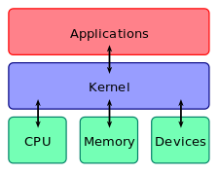
Kernel
A kernel is the central part of an operating system. It manages the operations of the computer and the hardware - most notably memory and CPU time.
There are two types of kernels:
A microkernel, which only contains basic functionality;
A monolithic kernel, which contains many device drivers.
A computer user never interacts directly with the kernel. It runs behind the scenes and cannot be seen, except for the text logs that it prints.

Slide 4
Role of the kernel
The kernel is the most fundamental part of an operating system.
It can be thought of as the program which controls all other programs on the computer.
When the computer starts, it goes through some initialization (booting) function, such as checking memory.
It is responsible
It provides services so programs can request the use of the network card, the disk or other piece of hardware (the kernel forwards the request to special programs called device drivers which control the hardware), manages the file system and sets interrupts for the CPU to enable multitasking.
Many kernels are also responsible for ensuring that faulty programs do not interfere with the operation of others, by denying access to memory that has not been allocated to them and restricting the amount of CPU time they can consume.
It is the heart of the operating system. for assigning and unassigning memory space which allows software to run.

Slide 5
Monolithic kernel
Monolithic kernel is a single large process running entirely in a single address space.
It is a single static binary file. All kernel services exist and execute in the kernel address space.
The kernel can invoke functions directly. Examples of monolithic kernel based OSs: Unix, Linux.

Slide 6
Microkernels
In microkernels, the kernel is broken down into separate processes, known as servers.
Some of the servers run in kernel space and some run in user-space.
All servers are kept separate and run in different address spaces. Servers invoke "services" from each other by sending messages via IPC (Interprocess Communication).
This separation has the advantage that if one server fails, other servers can still work efficiently.
Examples of microkernel based OSs: Mac OS X and Windows NT

Slide 7
Linux Boot Process
Press the power button on your system, and after few moments you see the Linux login prompt.
Have you ever wondered what happens behind the scenes from the time you press the power button until the Linux login prompt appears?
The following are the 6 high level stages of a typical Linux boot process.

Slide 8
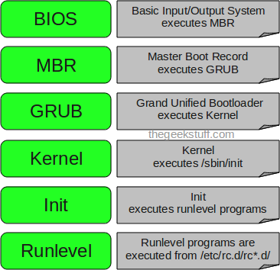

Slide 9
BIOS
BIOS stands for Basic Input/Output System
Performs some system integrity checks
Searches, loads, and executes the boot loader program.
It looks for boot loader in floppy, cd-rom, or hard drive.
Once the boot loader program is detected and loaded into the memory, BIOS gives the control to it.
So, in simple terms BIOS loads and executes the MBR boot loader.

Slide 10
MBR
MBR stands for Master Boot Record.
It is located in the 1st sector of the bootable disk. Typically /dev/hda, or /dev/sda
MBR is less than 512 bytes in size. This has three components 1) primary boot loader info in 1st 446 bytes 2) partition table info in next 64 bytes 3) mbr validation check in last 2 bytes.
It contains information about GRUB
So, in simple terms MBR loads and executes the GRUB boot loader.

Slide 11
GRUB
GRUB stands for Grand Unified Bootloader.
If you have multiple kernel images installed on your system, you can choose which one to be executed.
GRUB displays a splash screen, waits for few seconds, if you don’t enter anything, it loads the default kernel image as specified in the grub configuration file.
GRUB has the knowledge of the filesystem (the older Linux loader LILO didn’t understand filesystem).
Grub configuration file is /boot/grub/grub.conf (/etc/grub.conf is a link to this). The following is sample grub.conf of CentOS.
#boot=/dev/sda
default=0
timeout=5
splashimage=(hd0,0)/boot/grub/splash.xpm.gz
hiddenmenu
title CentOS (2.6.18-194.el5PAE)
root (hd0,0)
kernel /boot/vmlinuz-2.6.18-194.el5PAE ro root=LABEL=/
initrd /boot/initrd-2.6.18-194.el5PAE.img
As you notice from the above info, it contains kernel and initrd image.
So, in simple terms GRUB just loads and executes Kernel and initrd images

Slide 12
Kernel
Mounts the root file system as specified in the “root=” in grub.conf
Kernel executes the /sbin/init program
Since init was the 1st program to be executed by Linux Kernel, it has the process id (PID) of 1. Do a ‘ps -ef | grep init’ and check the pid.
initrd stands for Initial RAM Disk.
initrd is used by kernel as temporary root file system until kernel is booted and the real root file system is mounted. It also contains necessary drivers compiled inside, which helps it to access the hard drive partitions, and other hardware.

Slide 13
Init
Looks at the /etc/inittab file to decide the Linux run level.
Following are the available run levels
0 – halt
1 – Single user mode
2 – Multiuser, without NFS
3 – Full multiuser mode
4 – unused
5 – X11
6 – reboot
Init identifies the default initlevel from /etc/inittab and uses that to load all appropriate program.
Execute ‘grep initdefault /etc/inittab’ on your system to identify the default run level
If you want to get into trouble, you can set the default run level to 0 or 6. Since you know what 0 and 6 means, probably you might not do that.
Typically you would set the default run level to either 3 or 5.

Slide 14
Runlevel programs
When the Linux system is booting up, you might see various services getting started.
For example, it might say “starting sendmail …. OK”. Those are the runlevel programs, executed from the run level directory as defined by your run level.
Depending on your default init level setting, the system will execute the programs from one of the following directories.
Run level 0 – /etc/rc.d/rc0.d/
Run level 1 – /etc/rc.d/rc1.d/
Run level 2 – /etc/rc.d/rc2.d/
Run level 3 – /etc/rc.d/rc3.d/
Run level 4 – /etc/rc.d/rc4.d/
Run level 5 – /etc/rc.d/rc5.d/
Run level 6 – /etc/rc.d/rc6.d/
Please note that there are also symbolic links available for these directory under /etc directly. So, /etc/rc0.d is linked to /etc/rc.d/rc0.d.
Under the /etc/rc.d/rc*.d/ directories, you would see programs that start with S and K.
Programs starts with S are used during startup. S for startup.
Programs starts with K are used during shutdown. K for kill.
There are numbers right next to S and K in the program names. Those are the sequence number in which the programs should be started or killed.
For example, S12syslog is to start the syslog deamon, which has the sequence number of 12. S80sendmail is to start the sendmail daemon, which has the sequence number of 80. So, syslog program will be started before send mail.

Slide 15
Runlevels
0 | Halt the system.
1 | Single-user mode (for special administration).
2 | Local Multiuser with Networking but without network service (like NFS)
3 | Full Multiuser with Networking
4 | Not Used
5 | Full Multiuser with Networking and X Windows(GUI)
6 | Reboot.

Slide 16
The X Window System is a widely used system for managing GUIs on single computers and on networks of computers.

Slide 17
Boot Strapping
Bootstrapping is the process of loading a set of instructions when a computer is first turned on or booted.
During the startup process, diagnostic tests are performed, such as the power-on self-test (POST), that set or check configurations for devices and implement routine testing for the connection of peripherals, hardware and external memory devices.
The boot loader or bootstrap program is then loaded to initialize the OS.

Slide 18
Boot Strapping
Prior to bootstrapping a computer is said to start with a blank main memory.
The bootstrap allows the sequence of programs to load in order to initiate the OS.
The OS is the main program that manages all programs that run on a computer and performs tasks such as controlling peripheral devices like a disc drive, managing directories and files, transmitting output signals to a monitor and identifying input signals from a keyboard.

Slide 19
Shutdown
UNIX was not made to be shut down, but if you really must, use the shutdown command.
After completing the shutdown procedure, the -h option will halt the system, while -r will reboot it.
The reboot and halt commands are now able to invoke shutdown if run when the system is in run levels 1-5, and thus ensure proper shutdown of the system, but it is a bad habit to get into, as not all UNIX/Linux versions have this feature.
If your computer does not power itself down, you should not turn off the computer until you see a message indicating that the system is halted or finished shutting down, in order to give the system the time to unmount all partitions.
Being impatient may cause data loss.

