Slide 1

Generative AI in Software Engineering

Slide 2

Integrating Generative AI in Software Development Lifecycle (SDLC)

Slide 3

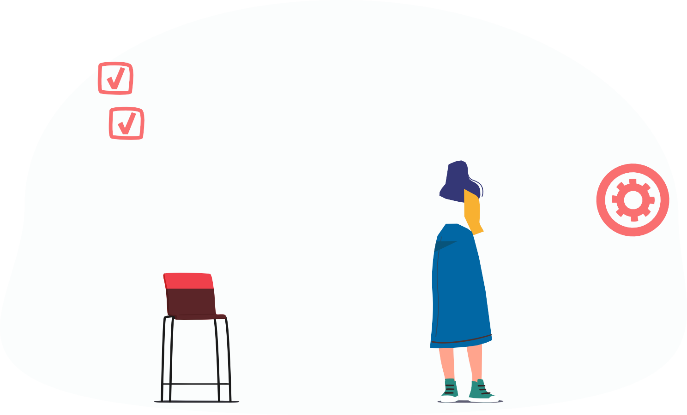




Engage and Think
What impact does Generative AI integration into the SDLC have on traditional software developer roles and what new challenges could arise from AI-driven application development?
Think about how Generative AI can transform the development process and what steps are needed to address new challenges and fully leverage the benefits of this technology.

Slide 4



Learning Objectives
By the end of this lesson, you will be able to:
Create well-written prompts that optimize interactions with Generative
AI systems in various scenarios.
Make use of writing, productivity, and programming GPTs and devise implementation strategies
Develop a custom GPT assistant to integrate AI-driven insights into software development
Integrate Generative AI across the SDLC stages to improve efficiency,
accuracy, and innovation in software development processes

Slide 5
Understanding the Next Frontier: Generative AI

Slide 6

What Is Generative AI?
Generative artificial intelligence (GenAI) refers to a category of AI systems that focus on
generating new content.
Generative AI = Generative + AI
Generate content (Text, image, audio, video, and code)
Using artificial intelligence
It is a subset of artificial intelligence that leverages machine learning and deep learning techniques to generate data.

Slide 7
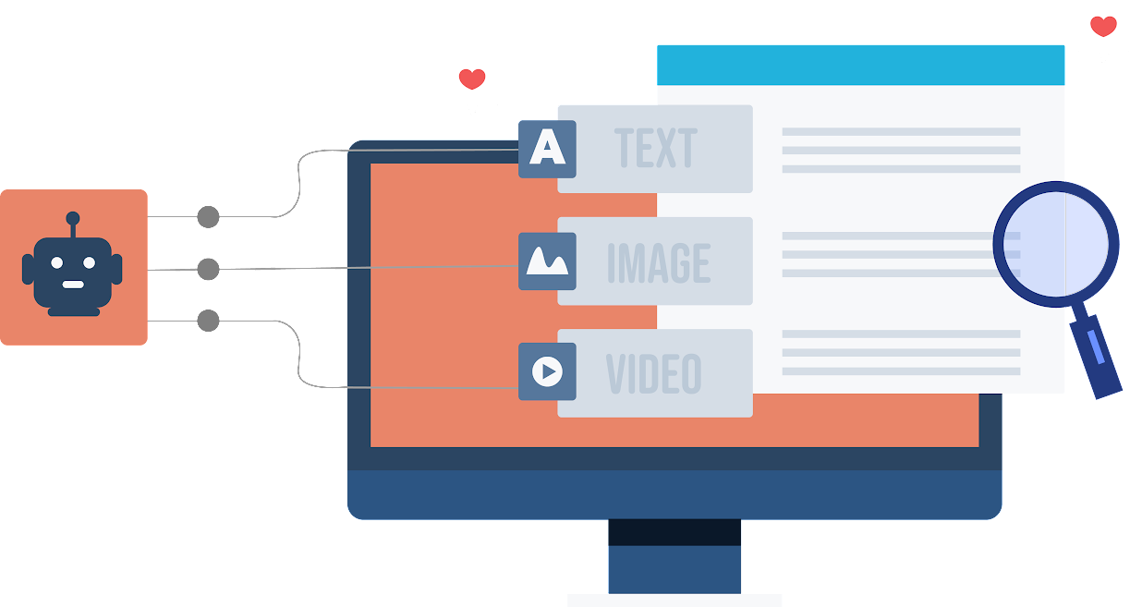
Objectives of Generative AI
It is designed to independently generate new content by
deriving its structure from recognized patterns.
It assists in solving complex problems by generating numerous potential solutions, thus offering users a wide array of options.
It boosts human creativity by producing unique outcomes, enabling users to discover new ideas and possibilities.

Slide 8
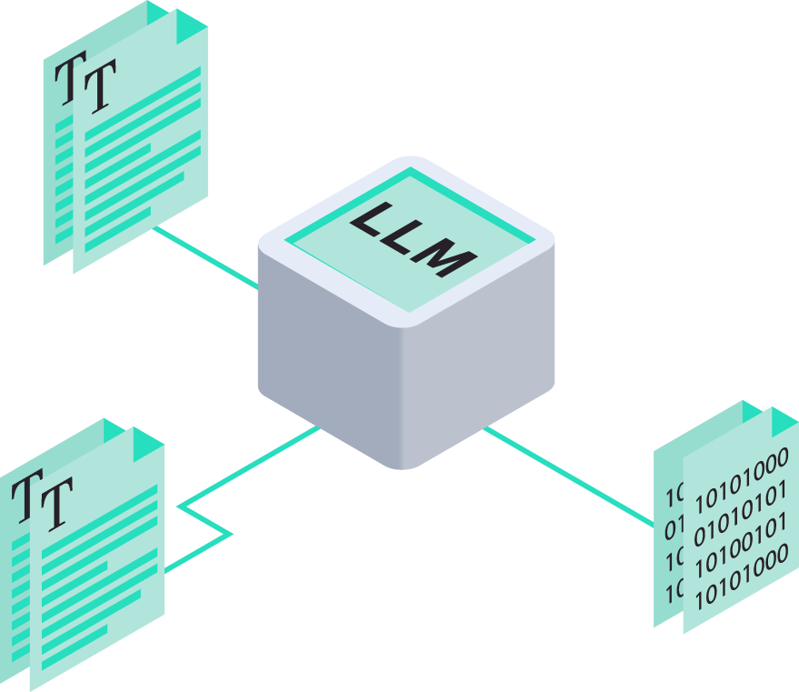
Generative AI and LLM
Large Language Models (LLMs) provide a foundation for Generative AI by offering powerful, pretrained
models capable of understanding and generating human-like text across various tasks and domains.
Generative AI can serve as building blocks for more advanced models, enabling the development of innovative AI systems that create content ranging from natural language text to images and music.

Slide 9
Large Language Models(LLM)
They are state-of-the-art AI models designed to comprehend and generate human language and perform natural language processing tasks like translation, classification, and so on.
Refers to the significant size and complexity of these models, which contain hundreds of millions or even billions of parameters
Large
Denotes their primary function, which is to understand and generate human language
Language
Describes them as mathematical representations that capture the patterns and structure of language data
Model

Slide 10
Widely Used LLMs
Model | Developer | Key features
GPT 3.5/4 | OpenAI | Helps generate content, text summarization, sentiment analysis, data extraction, and language translations. The GPT 4 upgraded version bolsters multimodal capabilities, including the power to process different formats other than texts, like images and videos.
Gemini | Google | Aids in complex problem-solving and code generation
Llama | Meta AI | Enables natural language understanding, content creation, and language translation
Falcon | Technology Innovation Institute(TII) | Provides language translation, commonsense reasoning, and sentiment analysis
Claude | Anthropic | Supports open-ended dialogs, coding tasks, and data analysis of visual inputs like charts and graphs

Slide 11
Software Development: The Generative AI Way

Slide 12
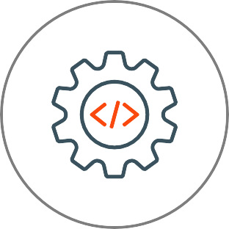


What Is Software Development Lifecycle (SDLC)?
SDLC is a process used by software development teams to design, develop, and test software.
It defines the various stages or phases that are typically followed in the development of software.
Project planning
Requirement gathering and analysis
Designing
Implementation
Testing
Deployment
Maintenance
It is a systematic and disciplined approach to software development that aims to create high-quality, reliable, and maintainable software.

Slide 13
Project Planning
Project planning
Definition
Requirement gathering and analysis
This phase involves defining the project's scope, including resources, timelines, and cost estimates, to ensure proper management and execution.
Designing
Implementation
Testing
Gen AI’s role
It can assist in drafting project documents and simulating stakeholder Q&A to refine project objectives.
Deployment
Maintenance

Slide 14
Requirement Gathering and Analysis
Project planning
Definition
Requirement gathering and analysis
This phase focuses on gathering all necessary requirements from stakeholders to define the project goals and the software's intended capabilities.
Designing
Implementation
Testing
Gen AI’s role
This phase focuses on gathering all necessary requirements from stakeholders to define the project goals and the software's intended capabilities.
Deployment
Maintenance

Slide 15
Designing
Project planning
Definition
Requirement gathering and analysis
This phase centers on designing the software's architecture and detailed design decisions to provide a blueprint for the implementation phase.
Designing
Implementation
Testing
Gen AI’s role
It can assist in producing architectural and technical designs, as well as creating UI/UX mockups and prototypes for rapid iteration.
Deployment
Maintenance

Slide 16
Implementation
Project planning
Definition
Requirement gathering and analysis
This phase entails the actual coding of the software based on previously defined design specifications and requirements.
Designing
Implementation
Testing
Gen AI’s role
It can assist in providing code snippets and pseudocode to support implementation.
Deployment
Maintenance

Slide 17
Testing
Project planning
Definition
Requirement gathering and analysis
This phase involves testing the developed software against the initial requirements to ensure it meets the necessary standards and functionalities.
Designing
Implementation
Testing
Gen AI’s role
It can assist in writing test cases and scripts and drafting detailed test plans.
Deployment
Maintenance

Slide 18
Deployment
Project planning
Definition
This phase focuses on deploying the software into a production environment where end-users can begin to use the product.
Requirement gathering and analysis
Designing
Implementation
Testing
Gen AI’s role
It can assist in generating deployment scripts, user manuals, and release notes.
Deployment
Maintenance

Slide 19
Maintenance
Project planning
Definition
Requirement gathering and analysis
This phase involves updating, patching, and enhancing software to address defects, boost performance, and meet evolving user needs.
Designing
Implementation
Testing
Gen AI’s role
It can assist in creating documentation for system updates and in drafting communications for maintenance efforts.
Deployment
Maintenance

Slide 20


Top Generative AI Software Development Tools
Is an AI coding assistant
Offers contextualized help throughout the software development lifecycle,
including code completions and chat assistance
GitHub Copilot
Is a part of Amazon CodeWhisperer
Provides IDE features to assist software development, such as code assistance, generation, refactoring, and optimization
Amazon Q

Slide 21


Top Generative AI Software Development Tools
Is a chatbot developed by OpenAI
Generates information, code snippets, and design suggestions, assisting in
project management, problem-solving, and code generation
ChatGPT
Is an open-source library
Helps in requirement analysis, refining, and prioritization through advanced natural language processing models
Hugging Face Transformers

Slide 22


Top Generative AI Software Development Tools
Is a versatile productivity AI tool
Offers Generative AI capabilities to assist in documentation for an efficient
software development process.
Notion
Is a GenAI tool
Assists in software design by offering insights, architecture patterns, and best practices to streamline system planning and implementation
Software Architect GPT

Slide 23
Generative AI vs. Traditional Software Development
Creating a front-end of a food ordering application traditionally vs. with GenAI tools for efficiency
Expected development duration
traditionally:
Application description
The food ordering application allows users to browse food items, add them to a cart, make purchases, and manage their user accounts.
Designing: 3 week
Building: 5 week
Testing: 3 week
Note
These timeframes are approximate and can vary based on the complexity of the application, team size, expertise, and other factors.

Slide 24



Demo: Creating a Food Ordering Application Using Generative AI Tools
Duration: 20 minutes
Demonstrate how to create a food ordering application using Gen AI tools such as Uizard and ChatGPT
for enhanced functionality and user experience
You are leading a development team tasked with creating a food ordering application. Your goal is to integrate Generative AI tools to enhance both the functionality and user experience of the app.
In this demonstration, focus on designing the user interface, generating the application architecture, and developing all necessary components using GenAI tools
Note: Refer to the demo document for detailed steps 04_Creating_a_Food_Ordering_Application_Using_Generative_AI_Tools

Slide 25
Impact of Generative AI in Software Development
Integrating Generative AI in software development can have both positive and
negative effects.
Positive impact
Negative impact
Generative AI in software development makes things faster, better, and more creative with overall efficiency.
Rapid integration of Generative AI might introduce issues such as biases and security concerns, and adapting to it may not be easy for everyone.

Slide 26
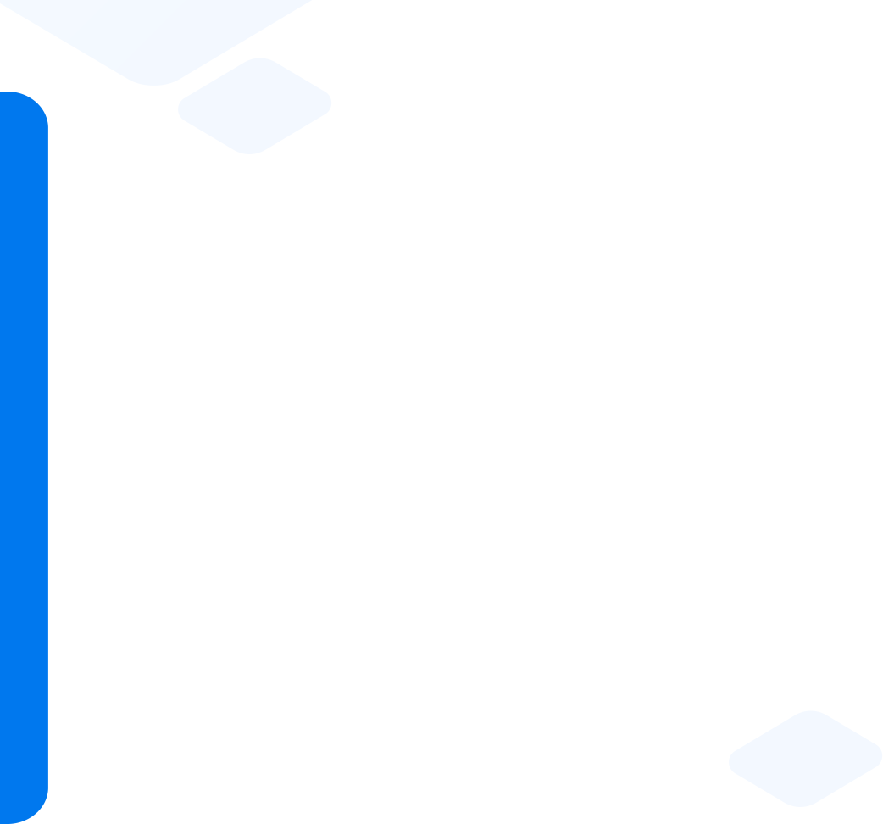
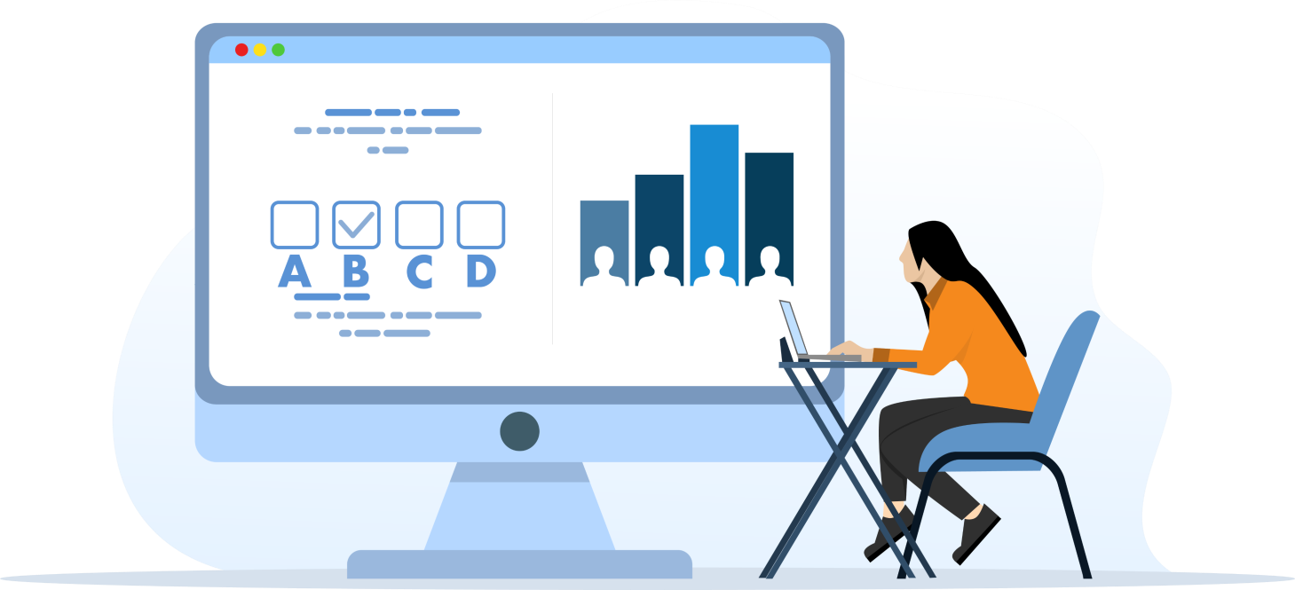
Quick Check
In the project planning phase of a complex e- commerce application, which Generative AI tool can best assist in refining project scope and timelines based on predictive analytics?
GitHub Copilot
Amazon CodeWhisperer
ChatGPT4
Hugging Face Transformer

Slide 27
Use Case on Accenture

Slide 28
Use Case: Problem Statement
Accenture’s velocity platform team sought to enhance developer productivity and streamline their software engineering processes. Traditional coding methods were consuming excessive time and effort, slowing down project timelines and increasing workload.

Slide 29

Use Case: Solution
Accenture integrated Amazon CodeWhisperer, an AI tool that interprets natural language, generates correct code in multiple languages, and offers real-time IDE support.
The tool aims to reduce manual coding efforts for repetitive and boilerplate tasks, significantly streamlining the coding process and freeing up developer time for more complex issues.
Amazon CodeWhisperer boosted Accenture's Velocity team productivity, reducing repetitive task time by up to 30% and enhancing focus on software quality, security, and performance.

Slide 30






Guided Practice
Overview Duration: 30 minutes
The objective is to study the difference in creating a digital voting system web app with or without
using Generative AI tools. The actual task is to understand how these approaches differ.
By engaging in this task, participants will see how Generative AI impacts SDLC. Key comparison points include time efficiency and software quality.
Task:
Compare the software with and without the use of Generative AI for the following factors:
Time efficiency
Software quality

Slide 31

Key Takeaways
GenAI is a subset of artificial intelligence that leverages machine learning and deep learning techniques to generate data.
Prompts guide the GenAI to understand the context and specific
requirements of the task.
GPT models can be classified in several ways, depending on their functions and users.
The role of the Generative AI in the SDLC includes improving efficiency in requirement analysis, design, build, testing, deployment, and support and maintenance.

Slide 32



Practice Project
Building a Digital Clinic DoctorPlus with Generative AI
The objective is to develop a digital clinic management system, DoctorPlus, using Generative AI tools. The primary task is to understand the development process and how Generative AI tools can be leveraged to enhance software development.
By engaging in this task, participants will gain practical experience in software development while leveraging Generative AI tools, enhancing their ability to tackle complex software challenges effectively.
Task:
Generate a clinic management system architecture using MS Copilot
Design the UI for the clinic management system using Uizard
Convert the images generated from Uizard into Bootstrap scripts
Generate the REST APIs for the backend using GitHub Copilot

Slide 33


Additional Resources
Refer to this for basic understanding of Generative AI Top Generative AI Tools: Boost Your Creativity
Refer to this link for some Generative AI tools for software
development
https://www.calsoftinc.com/blogs/generative-ai-and-the-changing-face- of-software-development-lifecycle.html
Refer to this link for future transformation of SDLC using Generative AI https://www.forbes.com/sites/forbestechcouncil/2023/11/17/how- generative-ai-is-transforming-todays-and-tomorrows-software- development-life-cycle/?sh=618f54295246
Refer this link for the Accenture case study https://aws.amazon.com/blogs/machine-learning/how-accenture-is- using-amazon-codewhisperer-to-improve-developer-productivity/

Slide 34
Q&A

