Slide 1
L.A.R.P.
LOCALISED AMENDMENT RESILIENCE PLATFORM
Regulatory change, traced to the clauses and files that need attention
Singapore LegalTech Â· SMU LIT Hackathon 2026
HUMAN REVIEW REMAINS FINAL

Slide 2
Regulatory alerts stop too early
02
Existing horizon scanners answer one question
Lawyers still have to answer the operational question
What changed in the law?
Which confidential files now need review?
1
Read the alert
2
Search document stores
3
Compare clauses manually
4
Draft and validate changes
Manual search and clause review consume billable time and can miss affected files
L.A.R.P. | SMU LIT Hackathon 2026

Slide 3
One workflow from source to working copy
03
01
02
03
04
05
MONITOR
COMPARE
TRACE
REVIEW
DOWNLOAD
Official Acts, Bills and consultations
Past and present legal text
Affected contract families and clauses
AI suggestions with legal sources
Approved Word working copy
The source contract stays untouched in Cloudflare R2
Only the downloaded working copy contains approved edits
L.A.R.P. | SMU LIT Hackathon 2026

Slide 4
Demo route: PDPA and Workplace Fairness
04
PDPA
WORKPLACE FAIRNESS ACT
Current compliance review
Future readiness review
Historical comparison and commenced duties Priority screening for privacy clauses Clause-level diff review
Passed but uncommenced Employment document screening Preparation without false breach findings
LIVE DEMO
1
Pick a law
2
Read the summary and timeline
3
Filter affected files
4
Trace the dependency
5
Accept or reject edits
L.A.R.P. | SMU LIT Hackathon 2026

Slide 5
Evidence and human control
05
01
Official evidence
02
AI draft
Singapore Statutes Online and approved government sources ground the legal position.
The model proposes summaries and clause changes. It does not make the final legal decision.
03
Cached review
04
Lawyer approval
Stored results avoid repeat processing and preserve the basis for each priority.
Counsel accepts, rejects or edits every change before downloading a working copy.
SERVER
STORAGE
OUTPUT
Credentials remain server-side
R2 originals remain read-only
Approved edits download as a copy
L.A.R.P. | SMU LIT Hackathon 2026

Slide 6
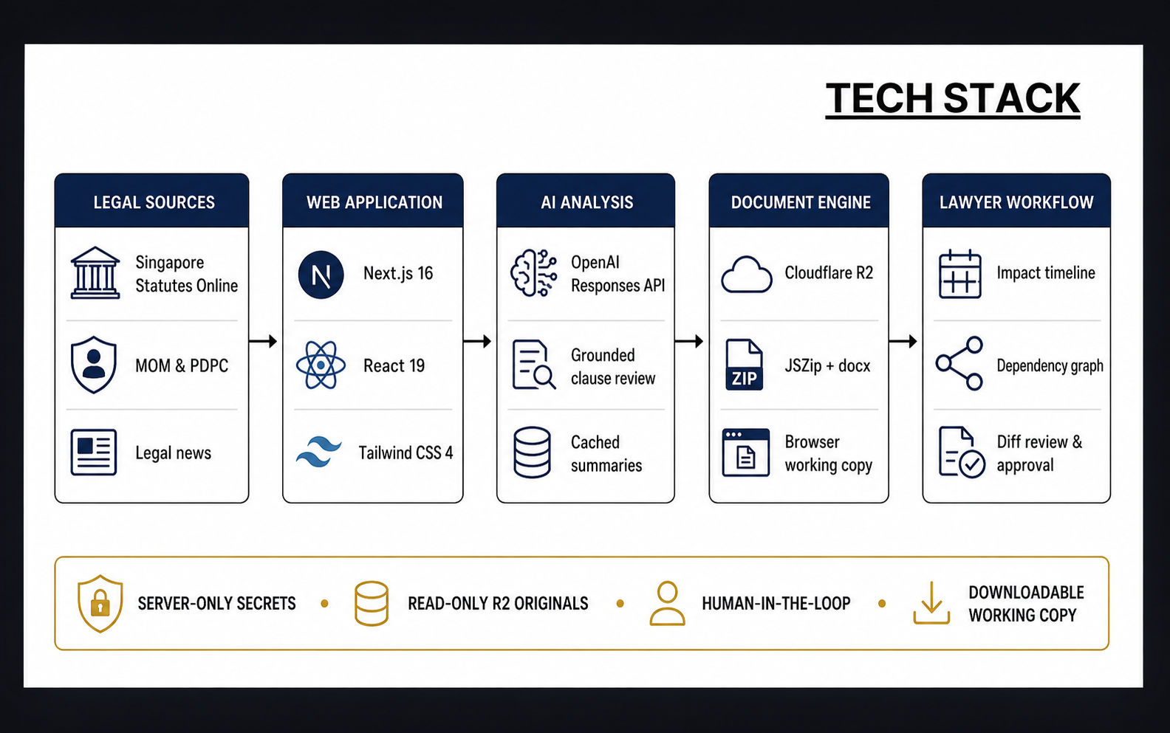
06

Slide 7
What comes next
01
Microsoft Word Track Changes
02
Billable review timer
Accepted suggestions appear as native reviewable edits in active agreements.
Review time is recorded by document and client matter.
03
Earlier Bill monitoring
04
Law firm pilots
Legal teams can prepare documents before commencement dates arrive.
Real matters will test relevance, drafting quality and review speed.
Regulatory monitoring becomes a review queue lawyers can act on
L.A.R.P.

