Slide 1
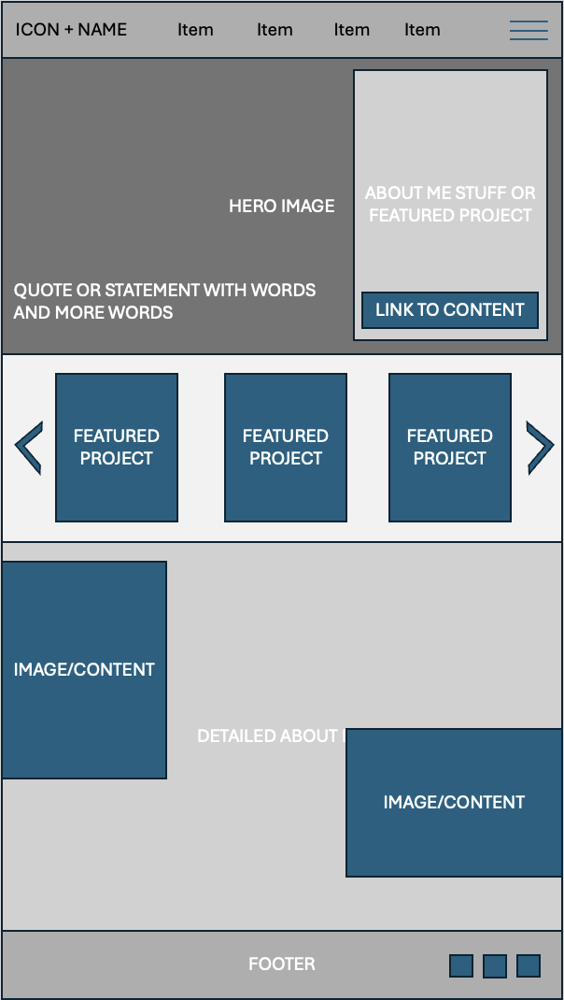
Portal Page Site Plan
Kaleb Andelin
Wireframe

Slide 2


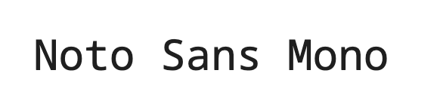
Details
Logo
I like yerba mate, so I want to use it
to represent my page
Colors
Fonts

