Slide 1
Contact Manager
By: Kaleb, Braedon, Julia, Tristan, & Ege

Slide 2
ABOUT US
Kaleb | Front End | HTML, CSS, & JS
Braedon | Front End Project Manager | PowerPoint, Graphs, & JS
Julia | API | PHP & SwaggerHub
Tristan | API | PHP & SwaggerHub
Ege | Database | Digital Ocean & MySQL

Slide 3




Technology Used
Digital Ocean
Which cord?
Discord.
Hosting Server
& Database
Messaging
& Organization
SwaggerHub
API Endpoints
github
Repository
& Version Control

Slide 4
Things That went well :)
Databases aren’t built in a day… | Positive Contact! | Read Function
But ours was! Ege is awesome. He made the entire database in day. What a boss. | The communication between group members has been super professional and positive! | The awesome individuals working on API were able to add an endpoint that allows us to see the full details of contacts. Awesome!

Slide 5
Things that didn’t go well :(
Fashionably Late | Trello & Goodbye | Oops All API’s
Our group wasn’t filled until the second week of class… Bummer! | We started a Trello board that was last seen with one post. Some scholars claim it may still exist buried beneath the sands of time. | Originally we intended for only three API’s to exist. Now there’s upwards of seven! This had a significant impact on our plans for the project.

Slide 6
Gant chart – initial

Slide 7
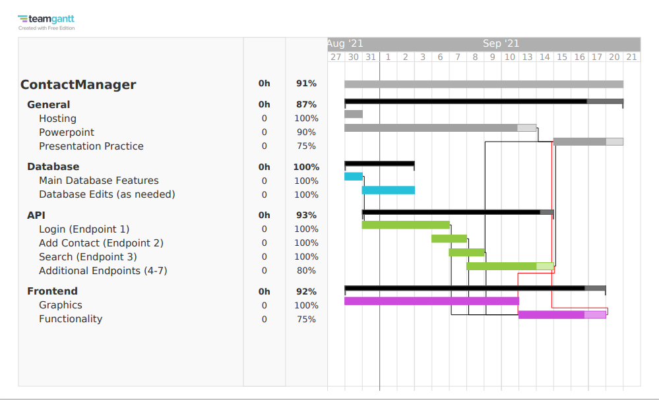
Gant chart – Final

Slide 8
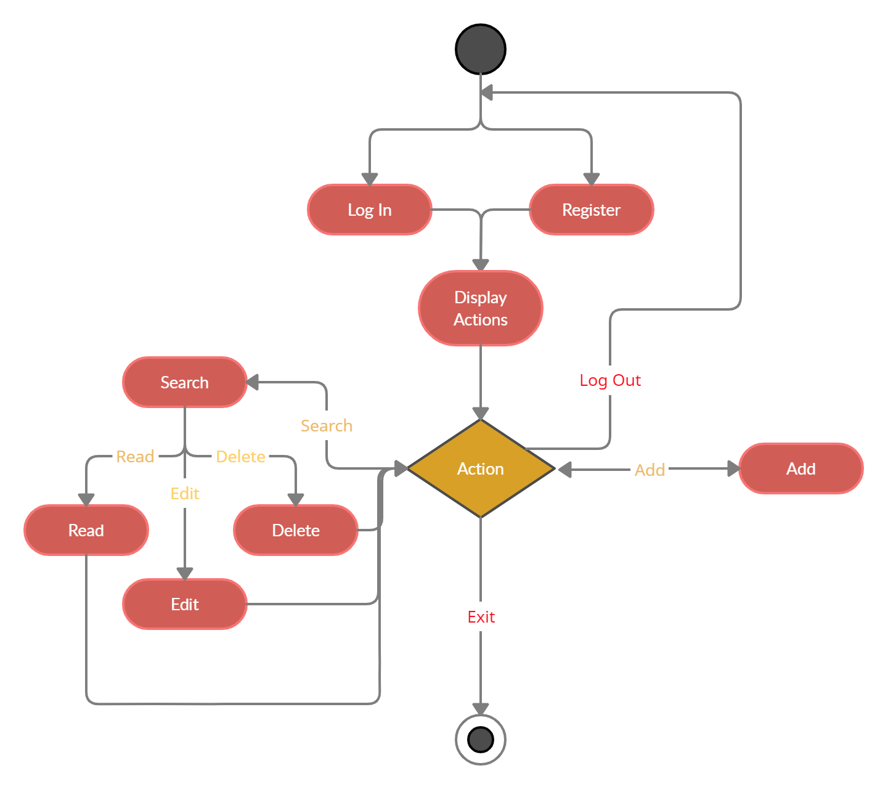
Entity Relationship Diagram (ERD)

Slide 9
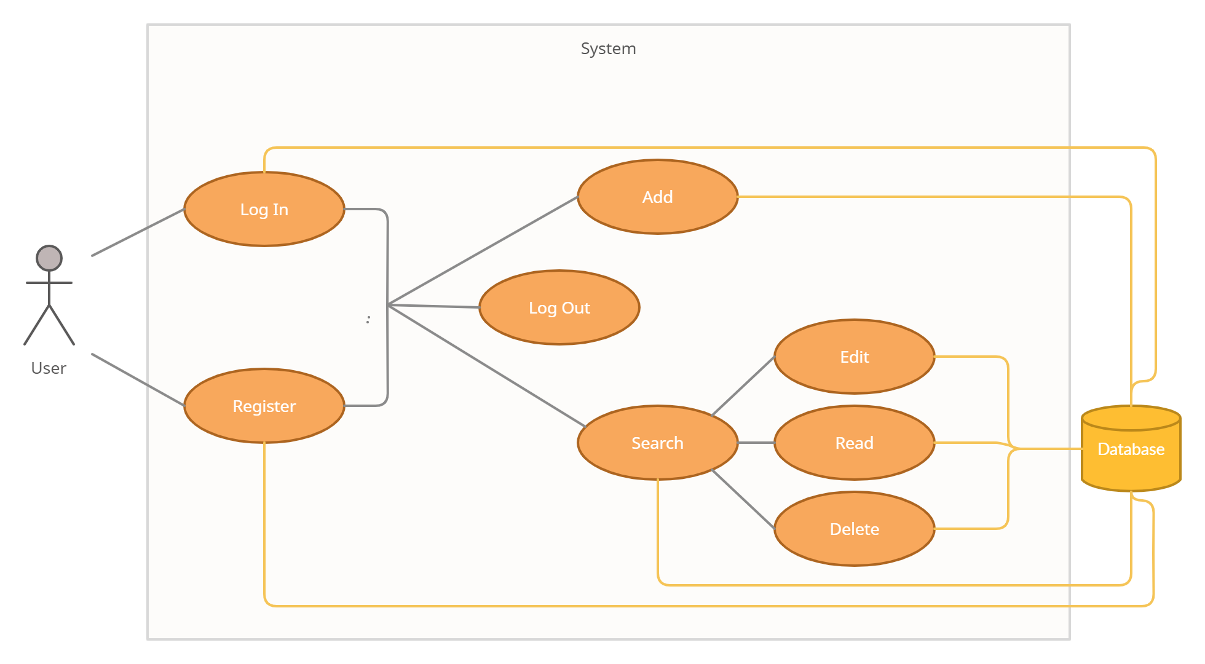
Use case diagram

Slide 10
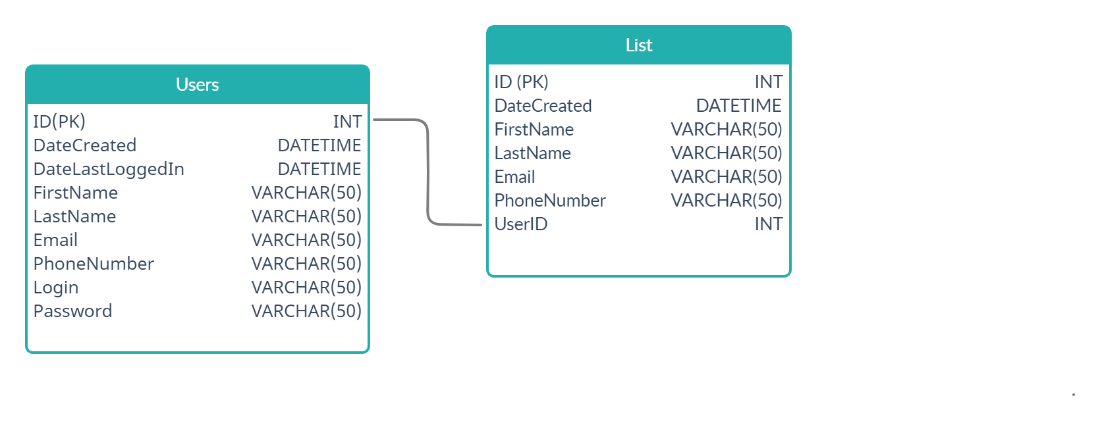
Database
Two Tables : Users and List
USERS
ID
DateCreated
DateLastLoggedIn
FirstName
LastName
Email
PhoneNumber
Login
Password
LIST
ID
DateCreated
FirstName
LastName
Email
PhoneNumber
UserId

Slide 11
APi
Login
register
Input: login, password
Output: user ID, first name, last name
Input: first name, last name, email, phone number, login, password
Output: user ID
Add contact
Delete contact
Input: first name, last name, email, phone number, user ID
Output: print statement
Input: user ID, contact ID
Output: print statement

Slide 12
api
Read contact
Edit contact
Input: user ID, contact ID
Output: first name, last name, email, phone number
Input: first name, last name, email, phone number, user ID, contact ID
Output: print statement
Search contact
Input: search keywords, user ID
Output: first name and contact ID of matches

Slide 13
Demo & Links
Demonstration of the Register API
Swaggerhub Link!
Website Demonstration
Website Link!

Slide 14
Questions?

