Slide 1
Contact Manager
By: Kaleb, Braedon, Julia, Tristan, & Ege

Slide 2
ABOUT US
Kaleb | Front End | HTML, JS
Braedon | Front End Project Manager | PowerPoint, Graphs, & JS
Julia | API | PHP, SwaggerHub
Tristan | API | PHP, SwaggerHub
Ege | Database

Slide 3




Technology Used
Digital Ocean
Which cord?
Discord.
Hosting Server
& Database
Messaging
& Organization
SwaggerHub
API Endpoints
github
Repository
& Version Control

Slide 4
Things That went well :)
Databases aren’t built in a day… | Positive Contact!
But ours was! Ege is awesome. He made the entire database in day. What a boss. | The communication between group members has been super professional and positive!

Slide 5
Things that didn’t go well :(
Fashionably Late | Trello & Goodbye
Our group wasn’t filled until the second week of class… Bummer! | We started a Trello board that was last seen with one post. Some scholars claim it may still exist buried beneath the sands of time.

Slide 6
Gantt Chart

Slide 7
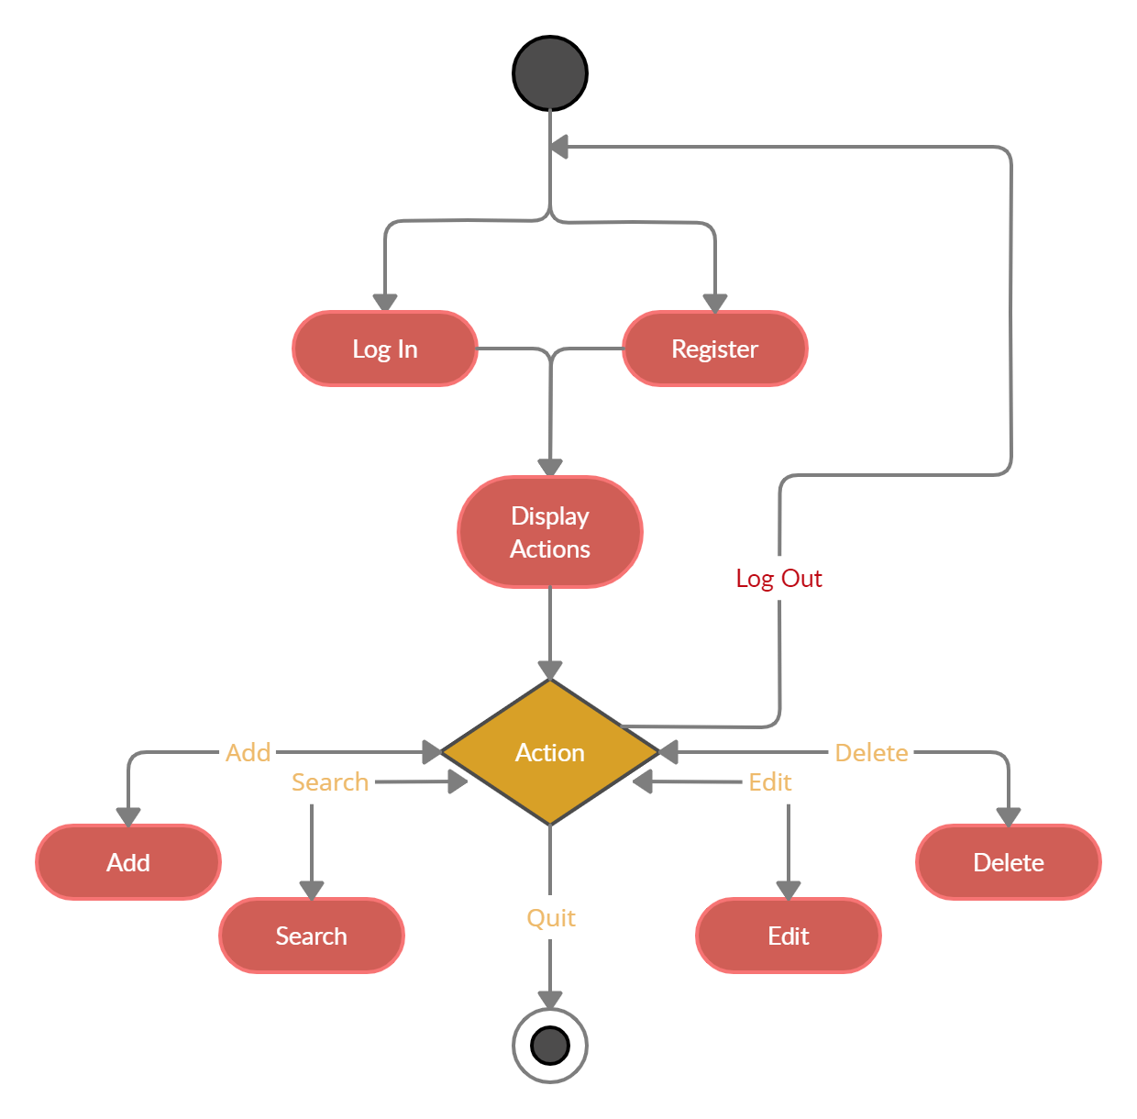
Entity Relationship Diagram (ERD)

Slide 8
APi
Login
register
Input: login, password
Output: user ID, first name, last name
Input: first name, last name, email, phone number, login, password
Output: user ID
Add contact
Delete contact
Input: first name, last name, email, phone number, user ID
Output: print statement
Input: user ID, contact ID
Output: print statement

Slide 9
api
Read contact
Edit contact
Input: user ID, contact ID
Output: first name, last name, email, phone number
Input: first name, last name, email, phone number, user ID, contact ID
Output: print statement
Search contact
Input: search keywords, user ID
Output: first name and contact ID of matches

Slide 10
Swaggerhub demo
Demonstration of the Register API
Swaggerhub Link!

Slide 11
Website demonstration
Website Link!

Slide 12
Questions?

