Slide 1
Video_Game_Sales
File created on: 3/13/2023 2:33:32 AM

Slide 2
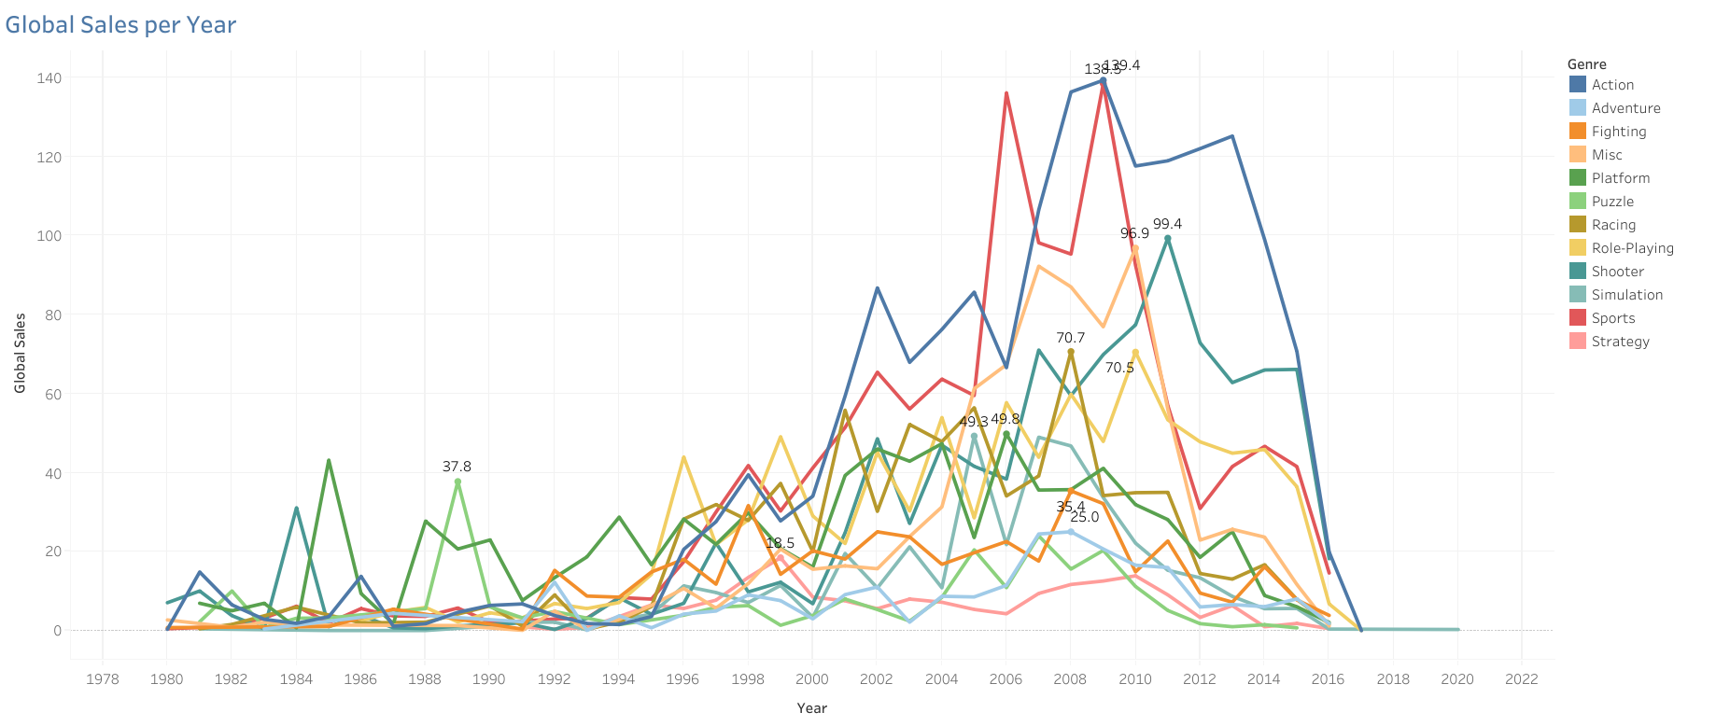

Slide 3
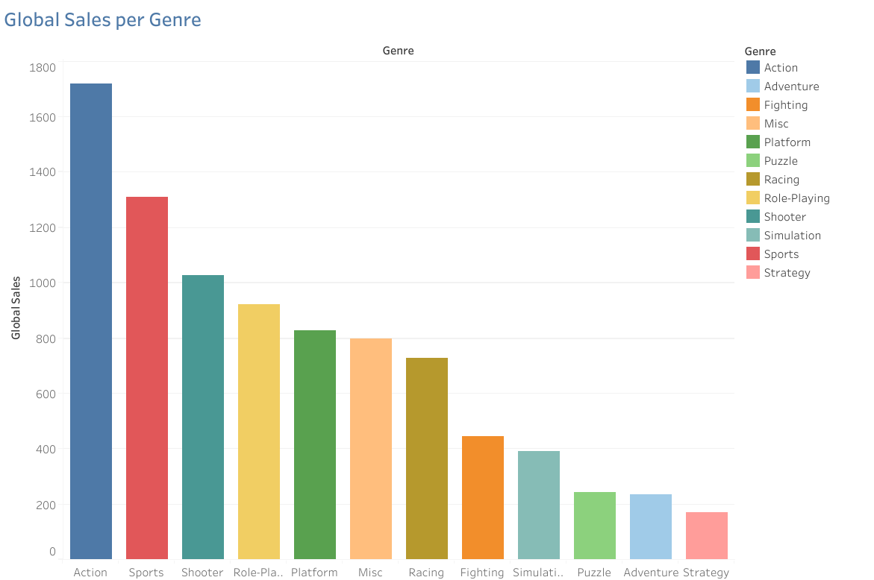

Slide 4
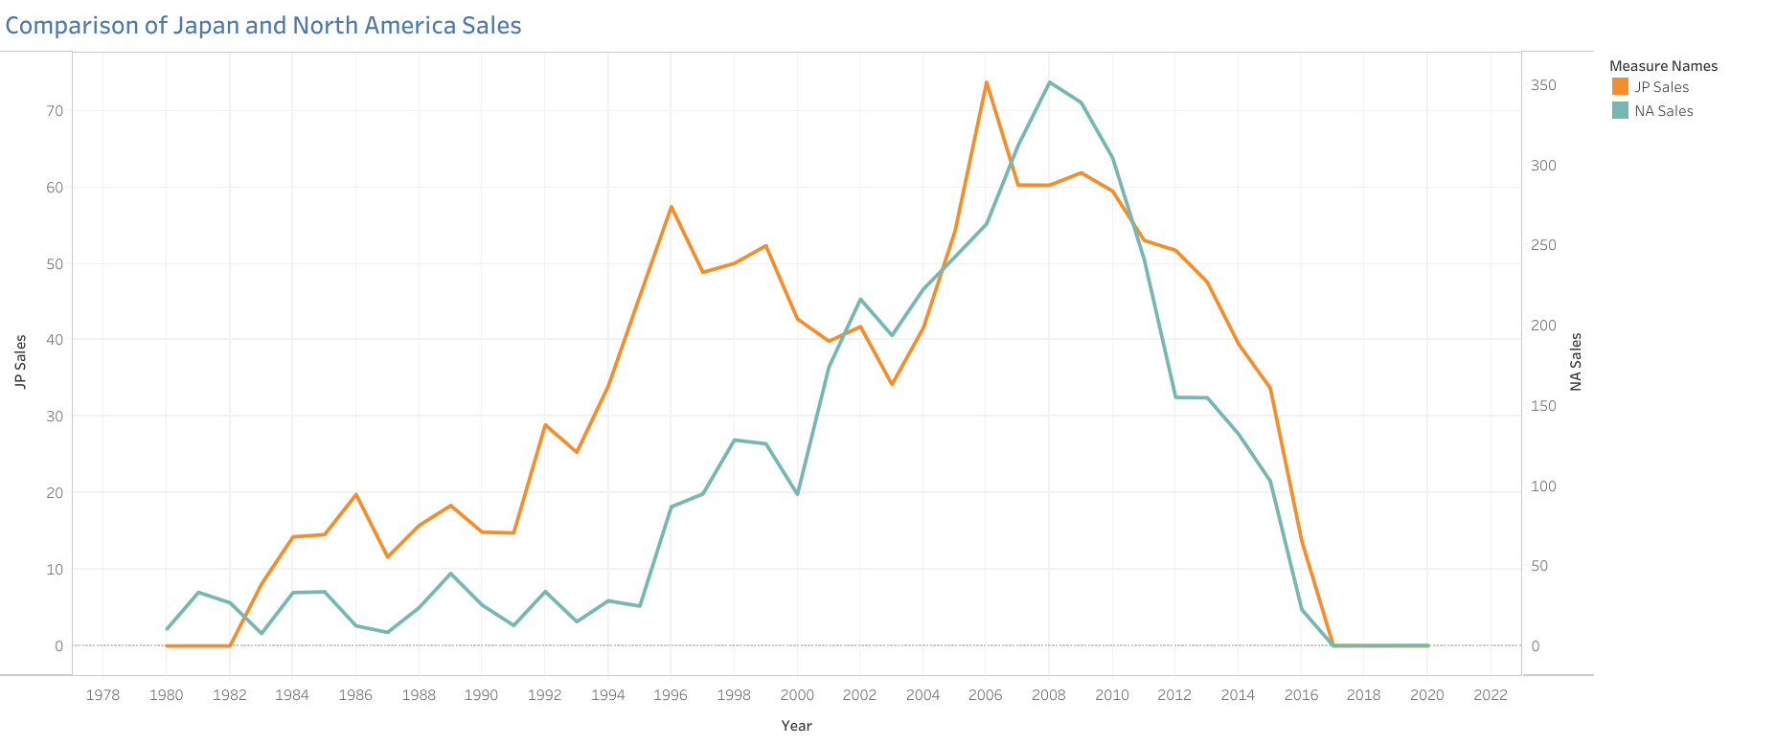

Slide 5
