Slide 1
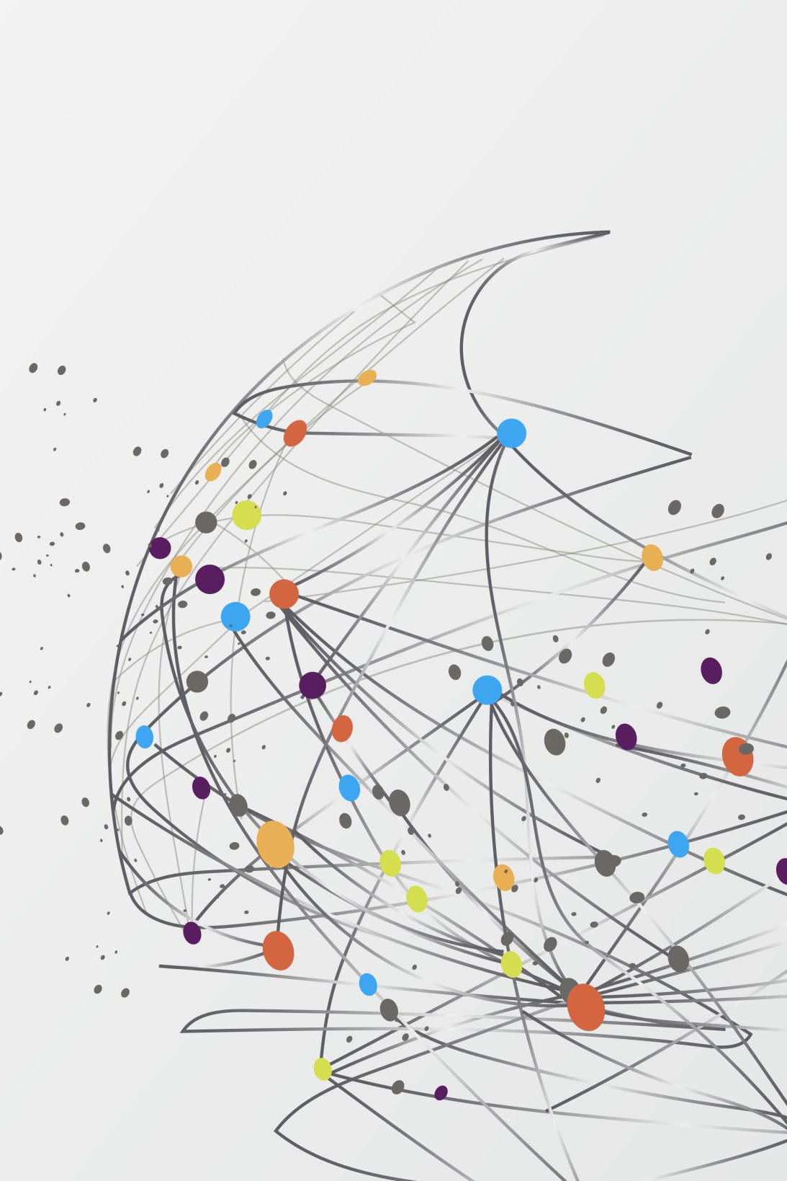
Travel Guide
- Smart Travel Companion
Team members:
Satya Nandan Thota – st83254n Sri Ramgopal Tandra - st57907n
Vijay Kumar Chelluboyana – vc86728n
Bharath babu – Bb97934n

Slide 2
Introduction & Problem Statement
Problem: Travelers struggle with finding personalized recommendations; local businesses lack visibility.
Objective: Provide real-time, location-based recommendations for tourists and integrate local businesses.
Importance: Enhances user travel experience and supports local tourism.

Slide 3


System Design & Architecture
Technologies Used:
Architecture:
Frontend: React Native (Expo)
Backend: Firebase (Firestore for database, Authentication for user management)
APIs: Ticketmaster API for events, GeoAPIFY.
-Mobile app interacts with Firebase backend.
-Data is fetched in real-time from external APIs and displayed to users.

Slide 4
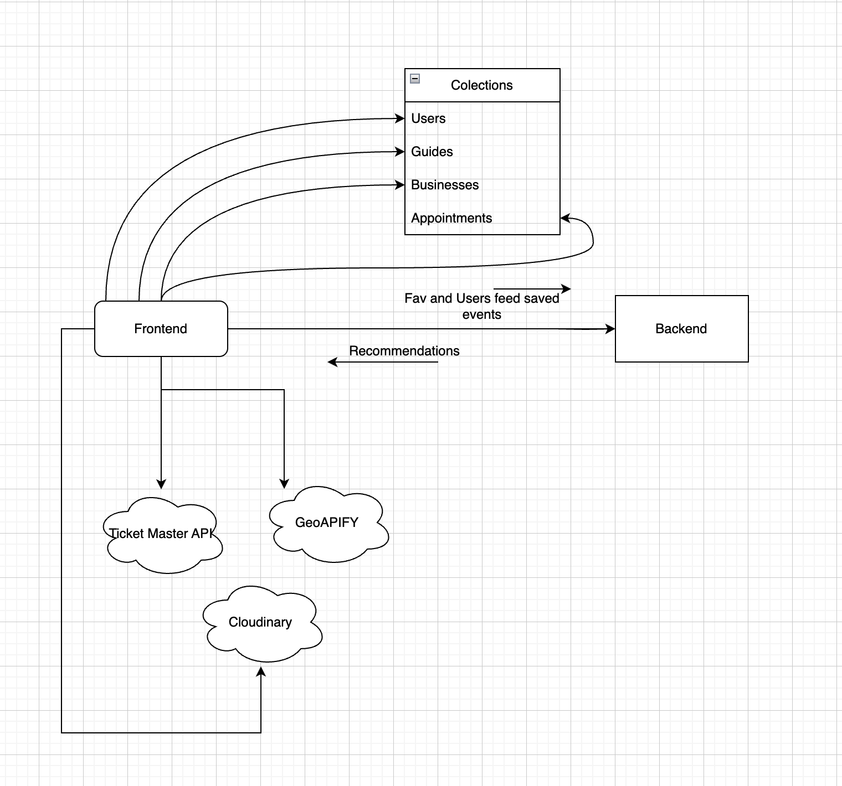







Project FLow

Slide 5



System Workflow & Data Flow
User Interaction:
Data Retrieval:
Personalized Recommendations:
Users enter a location or browse recommendations.
Firebase fetches stored preferences.
External APIs provide live data for events, hotels, and attractions.
Based on user interests and search history.

Slide 6
Features Implemented
Favorites & Saved places:
Users can save their favorite places and events.
Home Screen:
Display of recommended places, events, and accommodations.
User Profile & Authentication:
Sign up, login, and data storage using Firebase.
Search & Suggestions:
Search bar with real-time location and event suggestions.

Slide 7
Recommendation Algorithm & Machine Learning
Type:
Content-Based Filtering (a Machine Learning approach for recommendations).
Algorithm Used:
Cosine Similarity to measure event similarity.
Process:
Events are one-hot encoded based on category, venue, city, and state.
Cosine similarity is applied between favorite events and fetched events.
The top 5 most similar events are recommended to the user.
Comparison with Advanced ML Approaches:
Current method: Uses event attributes.
Future improvements: Implement collaborative filtering, deep learning, and graph-based recommendations.

Slide 8

Challenges & Solutions
Challenges:
Integrating multiple APIs for real-time data.
Managing user authentication and data privacy.
Ensuring smooth navigation and UI performance.
Designing a Recommendations System.
Solutions:
Optimized API calls and caching.
Firebase security rules for data protection.
Implementing efficient navigation and state management.

Slide 9
Next Steps & Future Improvements
-Advanced filtering options for places and events.
-Enhanced UI/UX for better usability.
-More integrations with open-source travel databases.
Upcoming Features:
Live Tracking & Updates:
Provide live updates and tracking to users.
User-Generated Events:
Allow users to create and share events they are conducting or interested in.
Appointment Booking:
Enable users to book appointments with travel guides in our network.
Admin Pages:
Provide business owners and guides with admin dashboards to manage their tourists and events.

Slide 10


Conclusion & Q&A
Summary:
Questions & Feedback
Developed core features and integrated Firebase.
Successfully fetching real-time travel data.
Future work focuses on improving recommendations and UI.

