Slide 1



asssinment2
View in Power BI
Last data refresh:
2/28/2024 7:00:11 AM UTC
Downloaded at:
2/29/2024 9:41:06 AM UTC

Slide 2
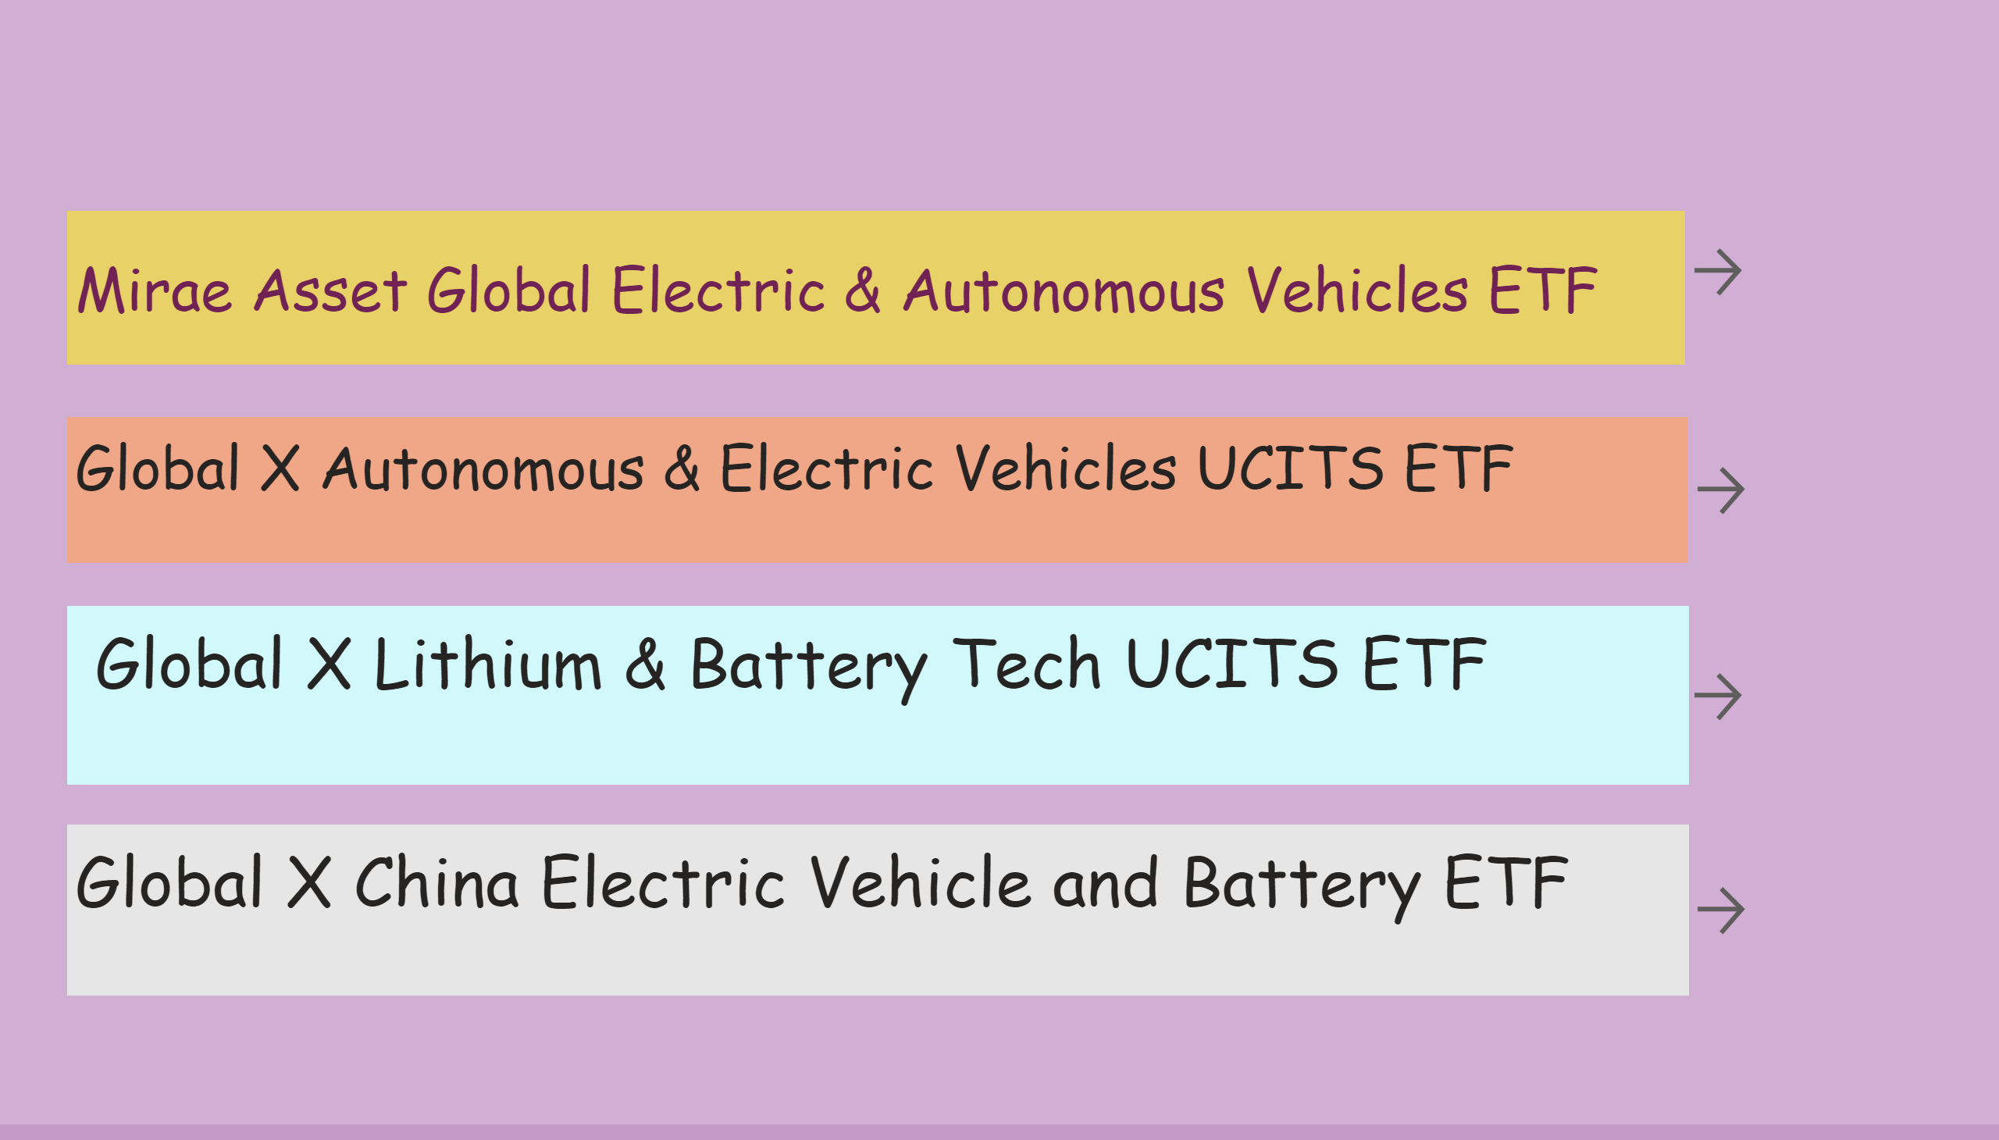
first
Notes:
actionButton
No alt text provided
actionButton
No alt text provided
actionButton
No alt text provided
actionButton
No alt text provided
textbox
No alt text provided
textbox
No alt text provided
textbox
No alt text provided
textbox
No alt text provided

Slide 3
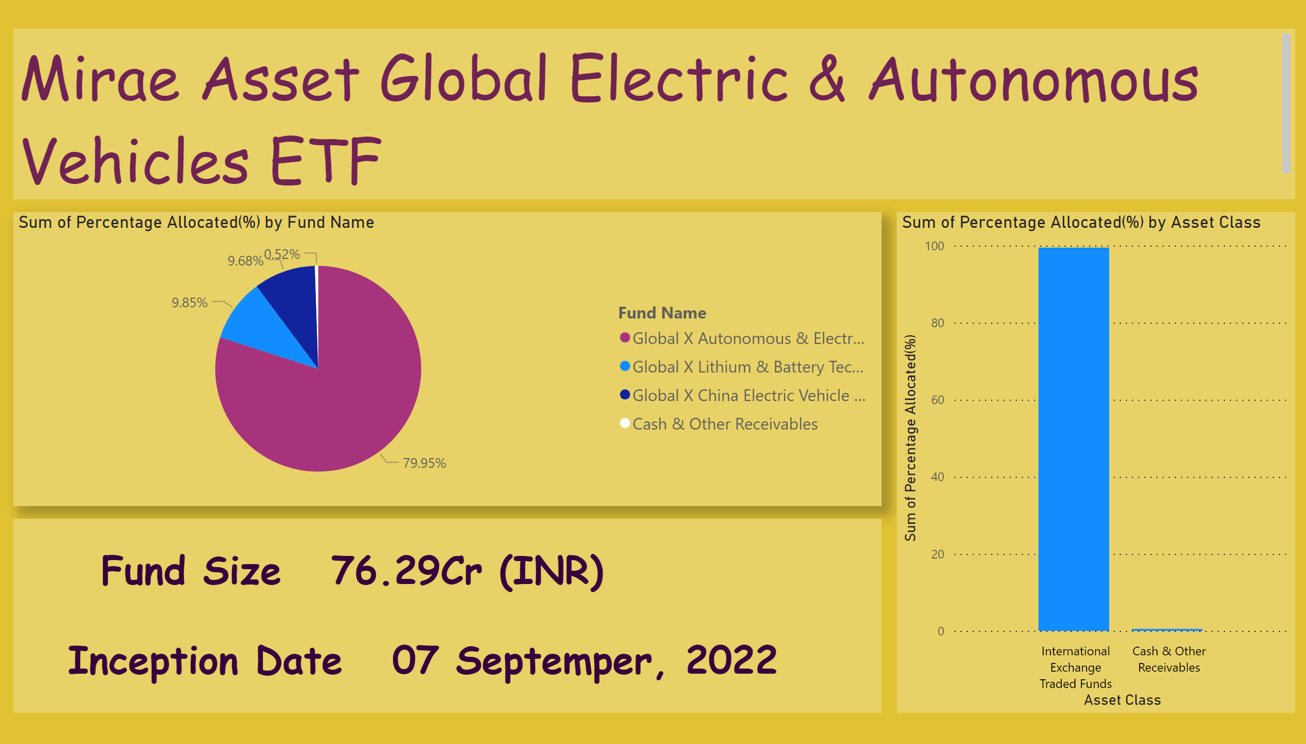
Page 1
Notes:
pieChart
No alt text provided
textbox
No alt text provided
textbox
No alt text provided
columnChart
No alt text provided

Slide 4
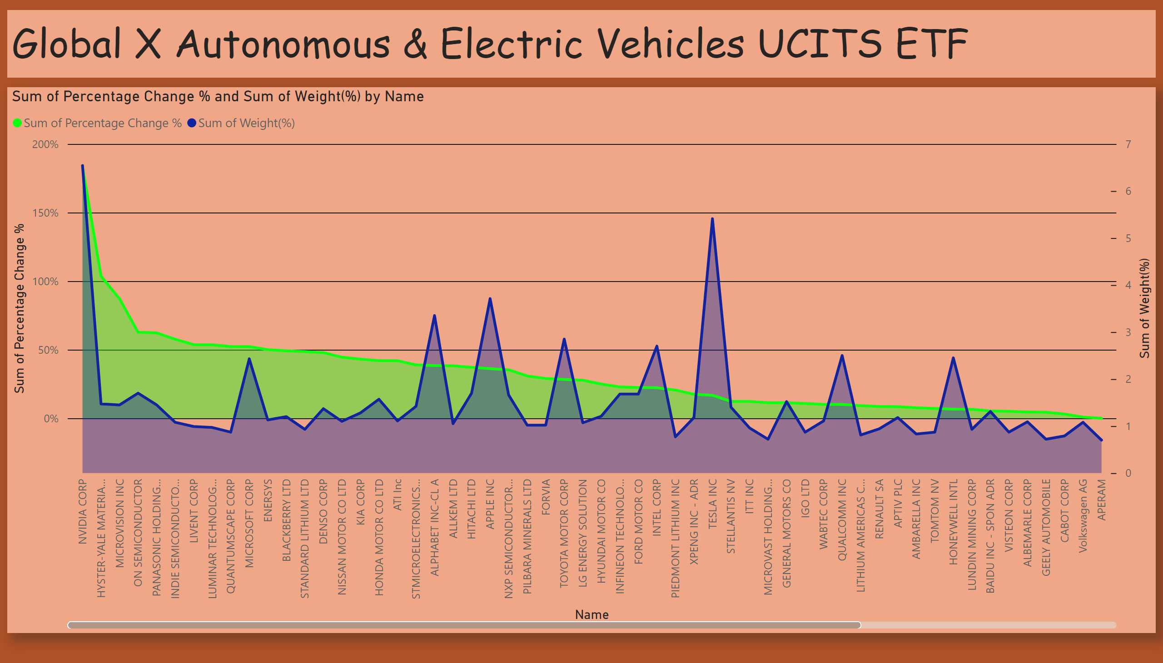
Page 2
Notes:
textbox
No alt text provided
areaChart
No alt text provided

Slide 5
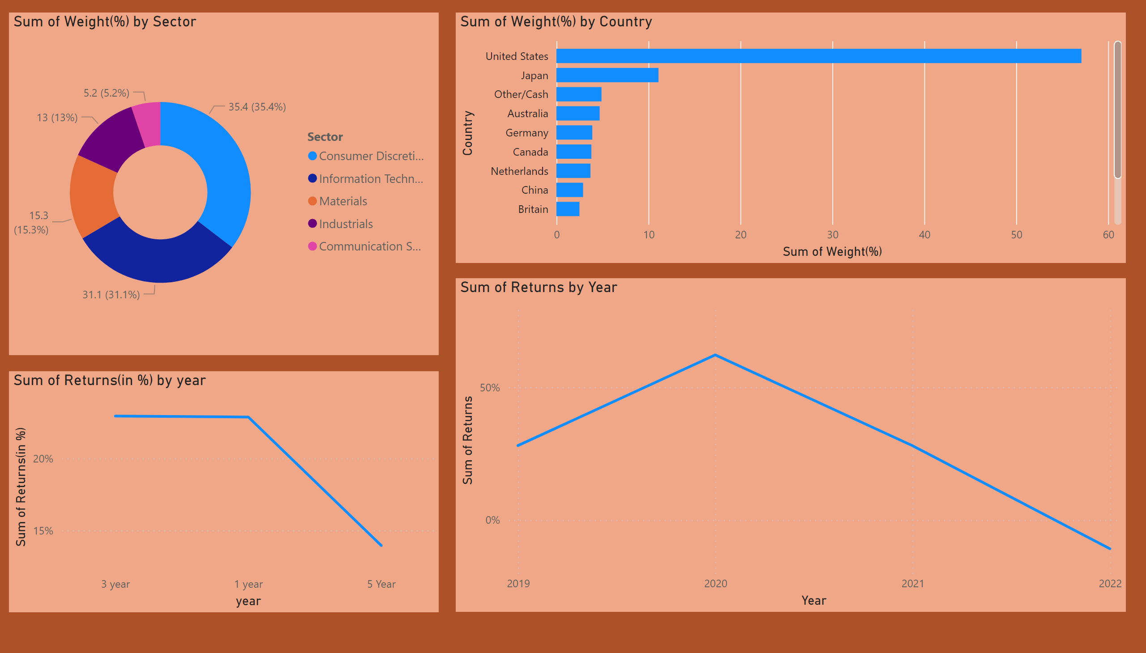
Page 3
Notes:
lineChart
No alt text provided
lineChart
No alt text provided
clusteredBarChart
No alt text provided
donutChart
No alt text provided

Slide 6
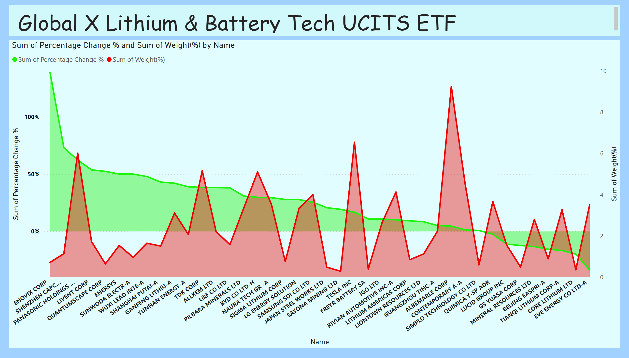
Page 4
Notes:
textbox
No alt text provided
areaChart
No alt text provided

Slide 7
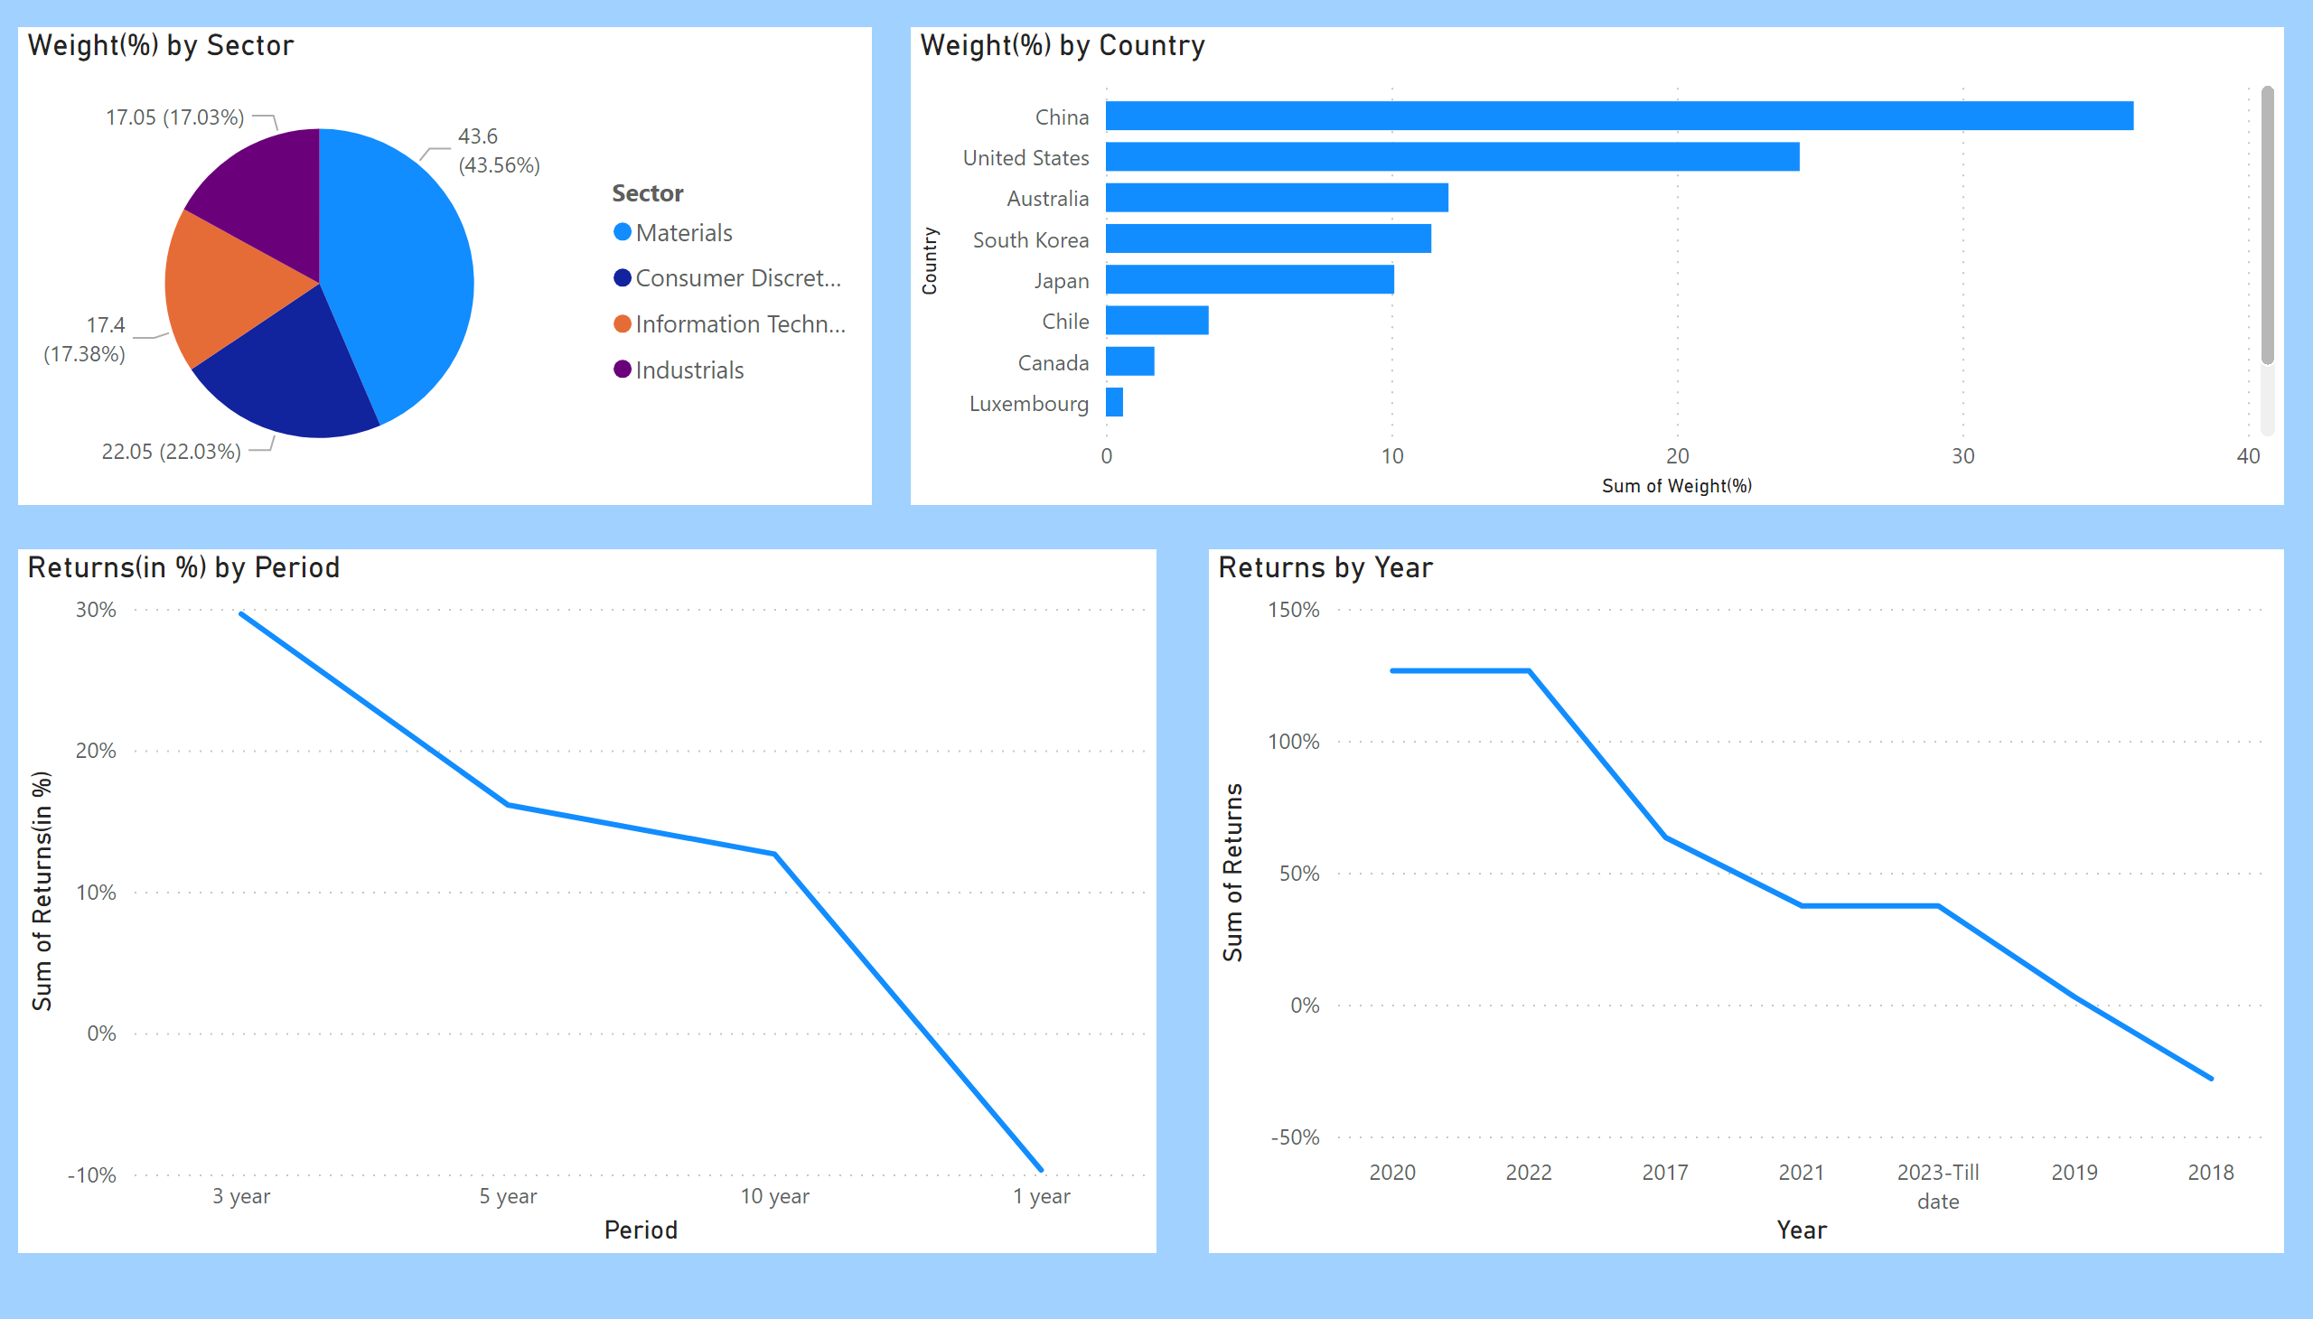
Page 5
Notes:
Returns(in %) by Period
No alt text provided
Returns by Year
No alt text provided
Weight(%) by Country
No alt text provided
Weight(%) by Sector
No alt text provided

Slide 8
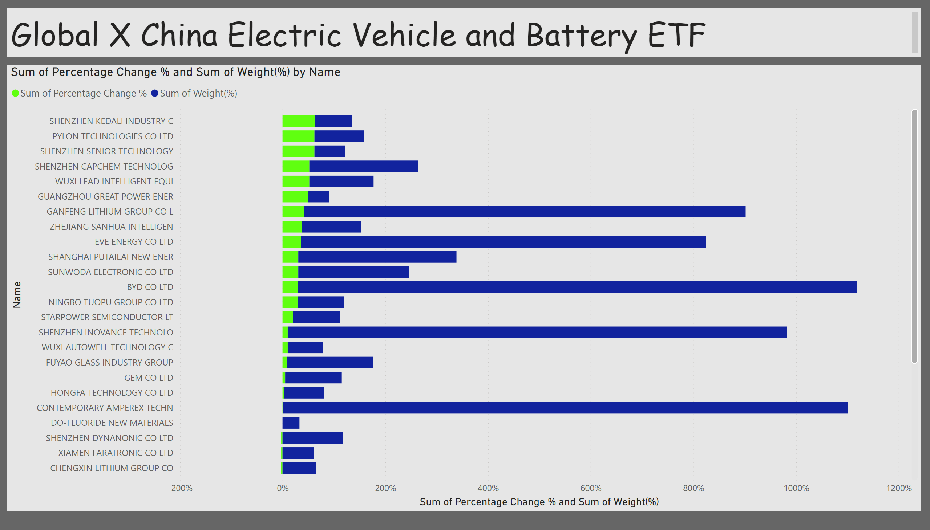
Page 6
Notes:
textbox
No alt text provided
barChart
No alt text provided

Slide 9
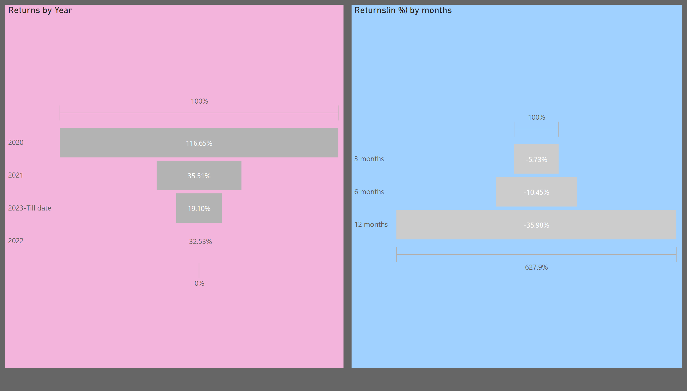
Page 7
Notes:
Returns(in %) by months
No alt text provided
Returns by Year
No alt text provided

Slide 10
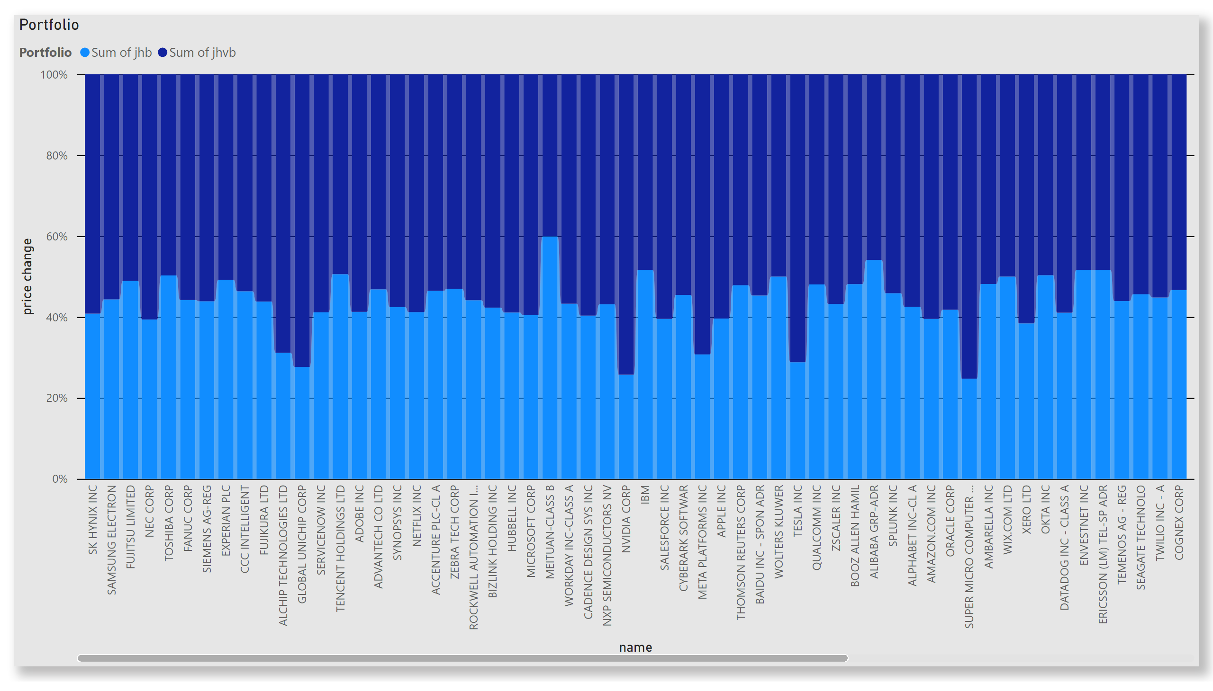
Page 8
Notes:
Portfolio
No alt text provided

Slide 11

Page 9
Notes:
actionButton
No alt text provided
textbox
No alt text provided

