Slide 1

MSDS-6306 Case Study 02 Employee Attrition
Kalen ASberry

Slide 2
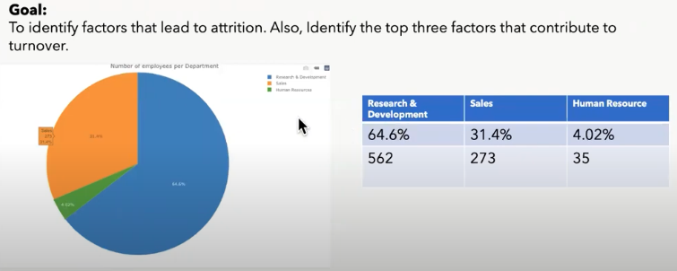
Distribution of Employee

Slide 3
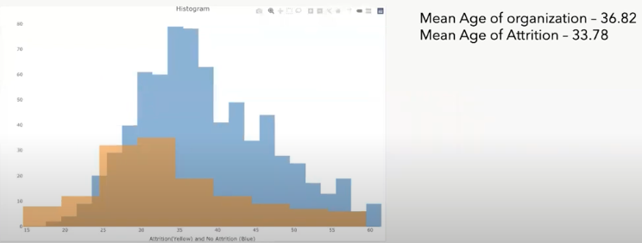
Attrition

Slide 4
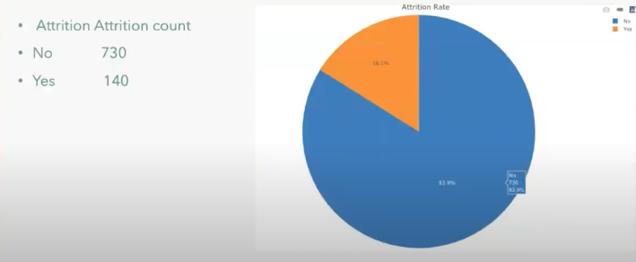
Attrition

Slide 5
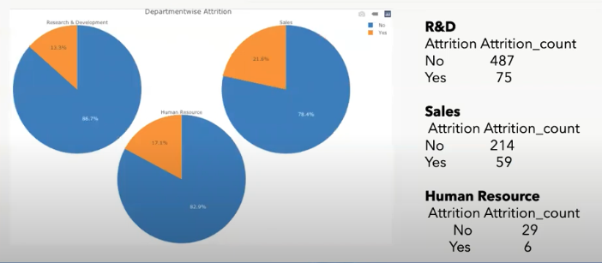
Attrition by Department

Slide 6
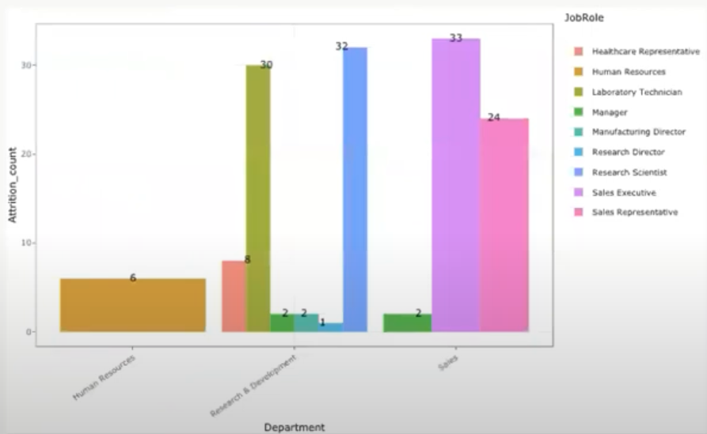
Roles

Slide 7
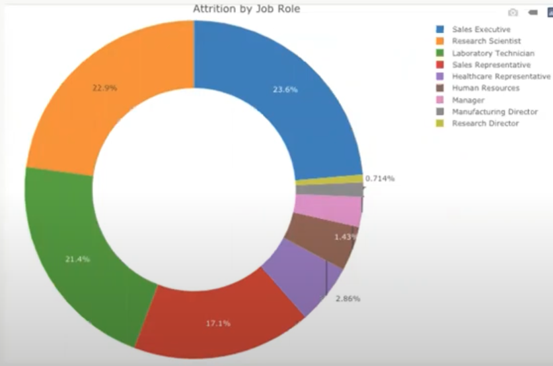
Attrition by job role

Slide 8
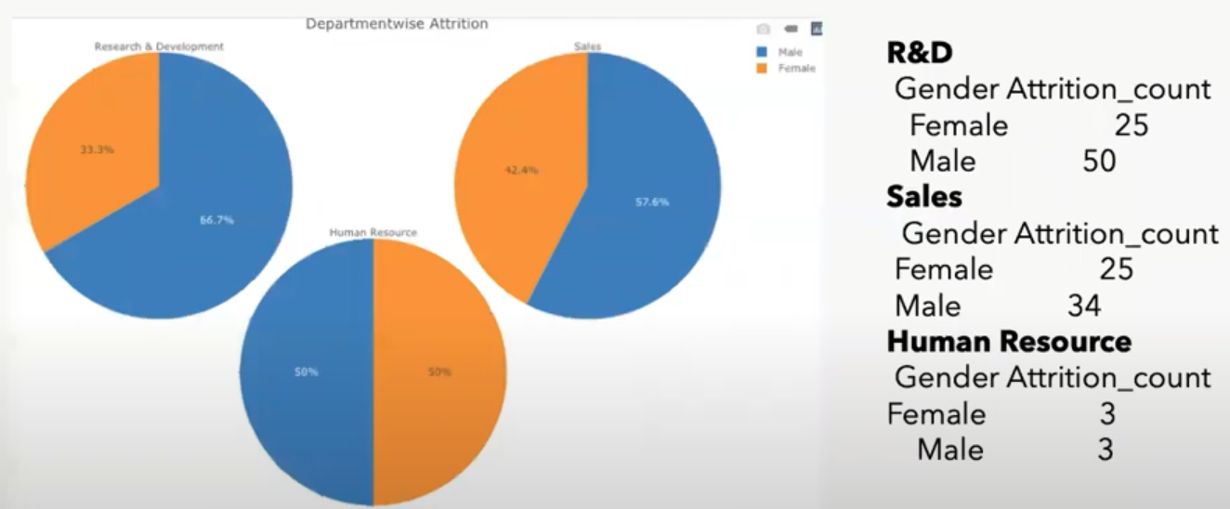
Males Vs Females

Slide 9
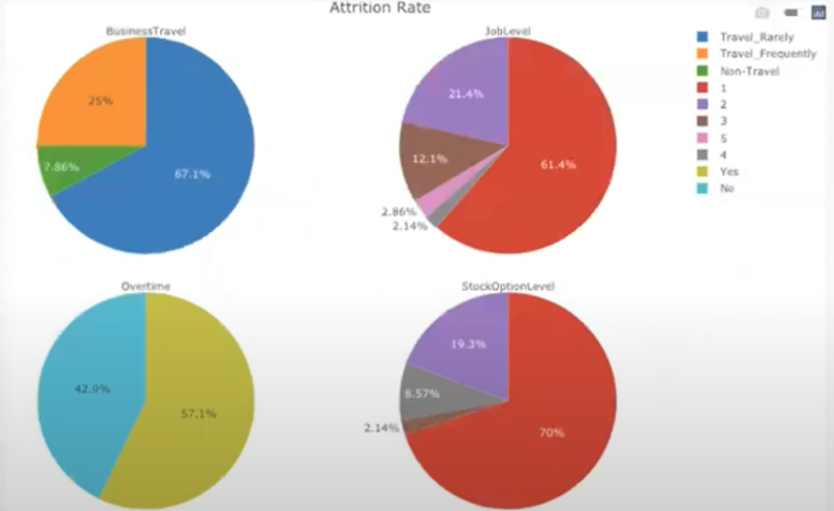
Top 3 Identifiers

Slide 10
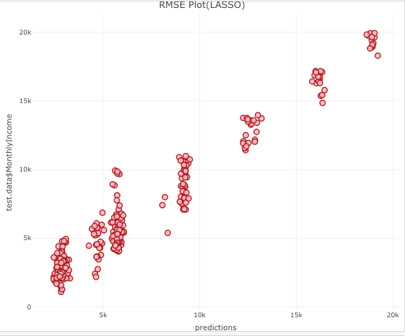
Prediction

Slide 11
Accuracy of Data

