Slide 1
Mid-Project_IRONHACK
PREDICTION OF OFFER ACCEPTANCE
Kalenga Mbonyinshuti

Slide 2
OUTLINE
Introduction to the customer’s objective
Dataset issues
Correlation
Step by step process/results presentation
Conclusion

Slide 3
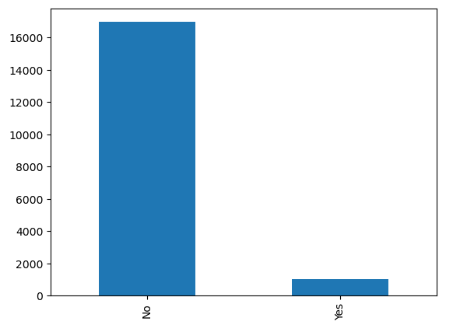
Introduction to the customer’s objective
CURRENT SITUATION
OBJECTIVE
Credit Card Marketing Team
To offer different customer’s their card
Data were mixed and not sure if the offer will be accepted.

Slide 4
Dataset issues
Nan values
Irrelevant information about customers(sort)
Vague/ungrouped customers
Relationship about data to be able to predict was not clear

Slide 5
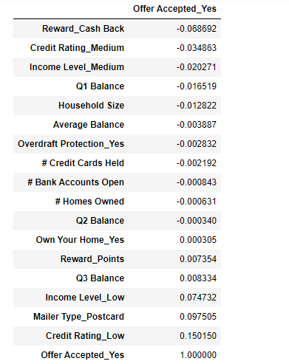
Correlation
Note: It is important to mention that were no significant correlation between our y value with other columns.
In the light of the above, we decided to use all of them.

Slide 6
Step by step process
Clean Nan values and drop unnecessary columns
Grouping columns to be able to know the numbers based on district groups.
Sort columns based on
Credit rating medium or high
Credit cards held 2 or less
Owns their own home
Household size 3 or more
Customers who accepted offer
Checked balance of difference customers credit rating

Slide 7
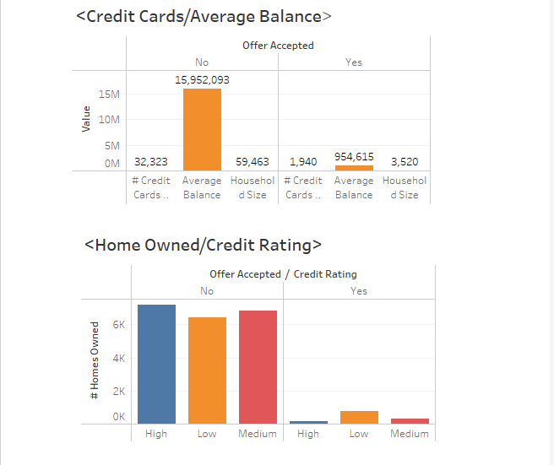
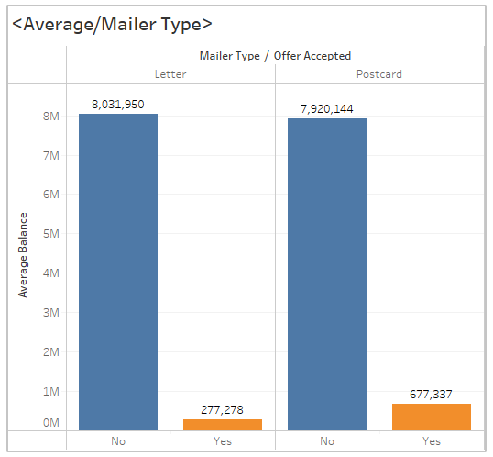
Step by step process (cont…)

Slide 8
Step by step process(Cont..)
Prediction:
Transform categorical into numerical
Use scaler on numerical
Join them back
Split the x, y
Minmax scaler for numerical
Fit the model(logistic regression)
Predict
Evaluate the model using accuracy and kappa

Slide 9
Conclusion
Evaluation; in regards to evaluation ,I was able to get 94% of accuracy, however, kappa gave me 0.0 mainly due to the imbalance data.
Through resampling I was able to get the below data.
Accuracy: 0.6511111111111111
Precision: 0.1099476439790576
Recall: 0.6901408450704225
F1 Score: 0.1896774193548387
Kappa Score: 0.09756392554902393

Slide 10
End.
QUESTIONS/RECOMMENDATIONS

