Slide 1
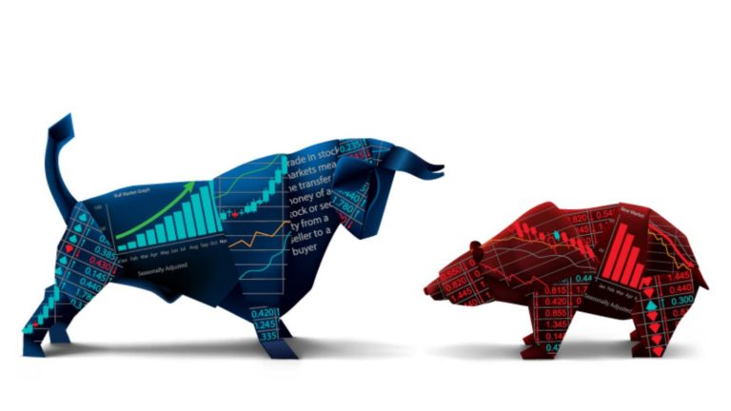
Stock ANALYSIS
Submitted By: Diksha Kaler
(10722016218)
Yasha Sharma
(10722016169)

Slide 2


Introduction
A market where shares are publicly issued and traded is known as a share a market.
Implementing the concept of algorithmic trading ,which uses automated ,pre-programmed trading strategies to predict stock prices.
Time series forecasting(Predicting future values based on historical values) applies well to stock forecasting .

Slide 3
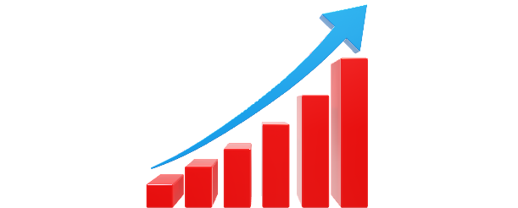
FUTURE WORK
Machine learning and Data science is a game changer in this domain so there is lot of data to find in for predicting with high degree of accuracy.
In future we’ll try to predict the values based on multiple factors such as politics, global economic conditions ,unexpected events like covid, companies financial performance and so on .
We are going to implement multiple types of algorithms because different types of data requires different types of techniques.
Decided to implement a simple user interface to operate this whole process to users so ti make people engage in stock market.

Slide 4
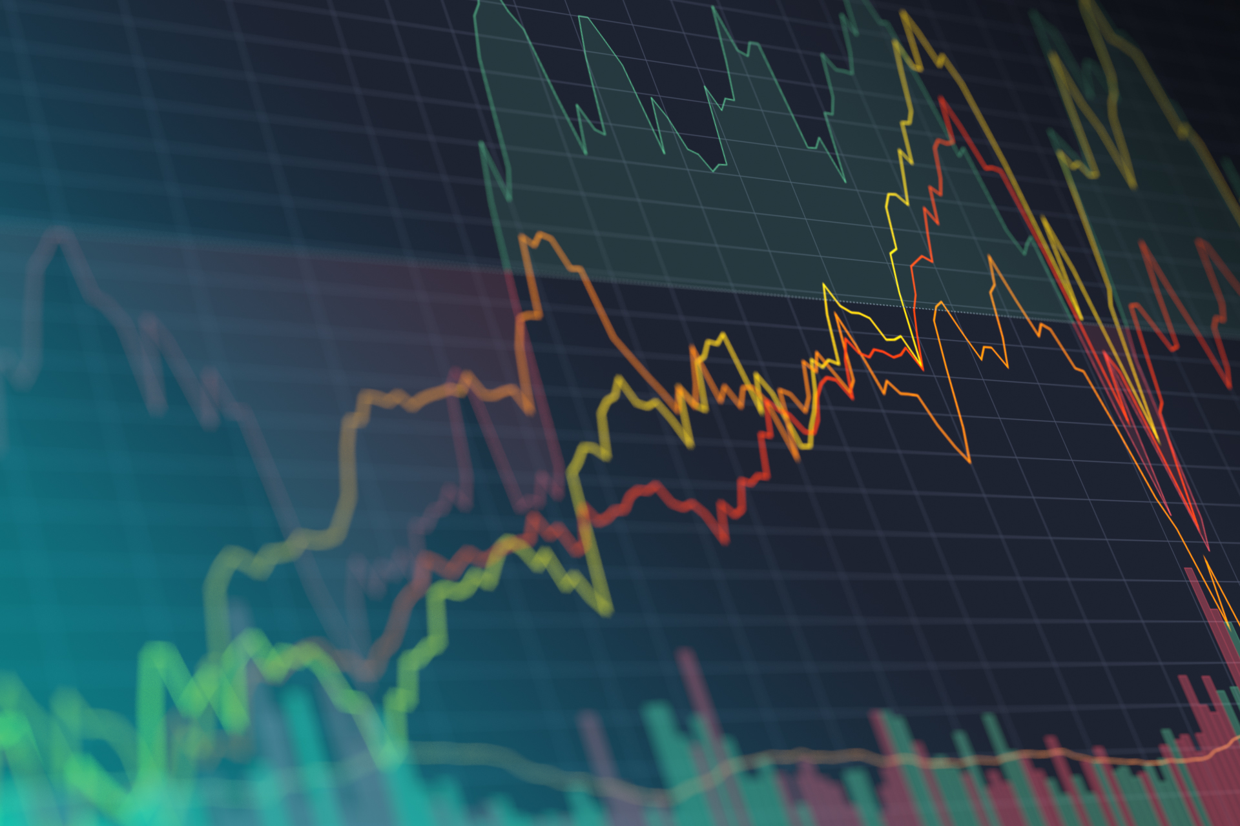
STEPS PERFORMED
Importing and Cleaning data
Split the Data into Training/test sets
Creating and Training the Model
Making Predictions
Evaluating and Improving Predictions

Slide 5
NEED OF PROJECT
The stock market is known for being volatile, dynamic & nonlinear.
Accurate stock price prediction is extremely challenging because
of multiple factors.
But, all of this also means that there’s a lot of data to find patterns in .
So, we keep exploring analytics techniques to detect stock market trends.
So, they can keep analyzed as a sequence of discrete-time data.
Despite the volatility, stock prices aren’t just randomly generated
numbers.

Slide 6
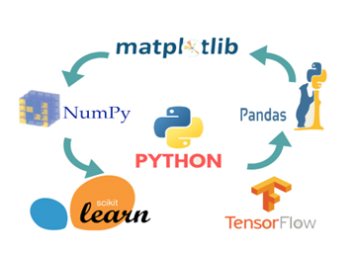



METHOLOGY
Libraries
Pandas, NumPy, Sklearn, TensorFlow ,etc
Python Language
Python is a rich language for Data Science and AI
Algorithm
Long Short Term Memory
(LSTM)
Streamlit UI
Provided User Interface using Streamlit

Slide 7
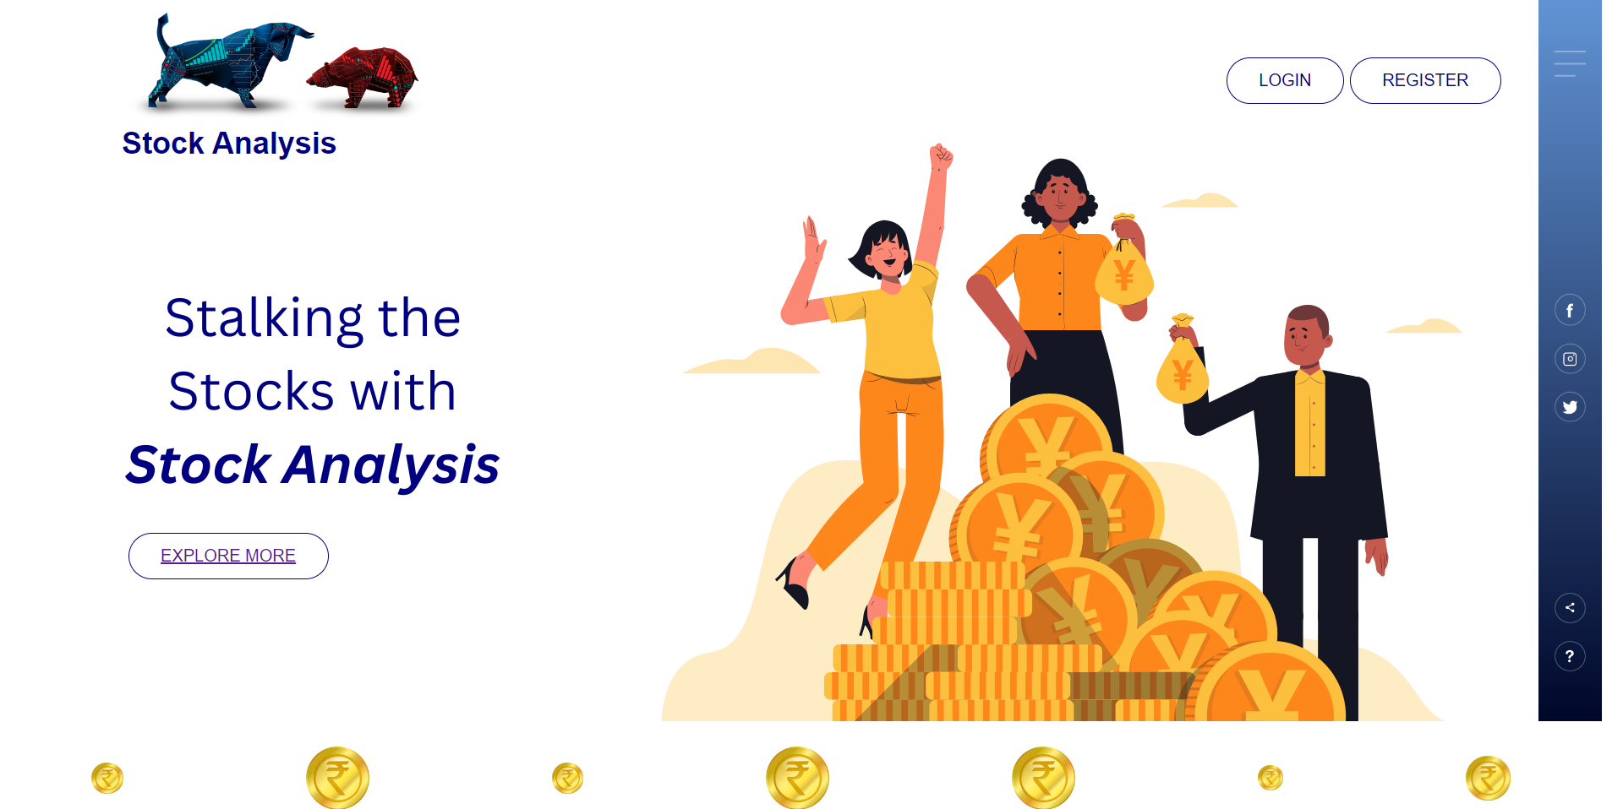
Preview:

Slide 8
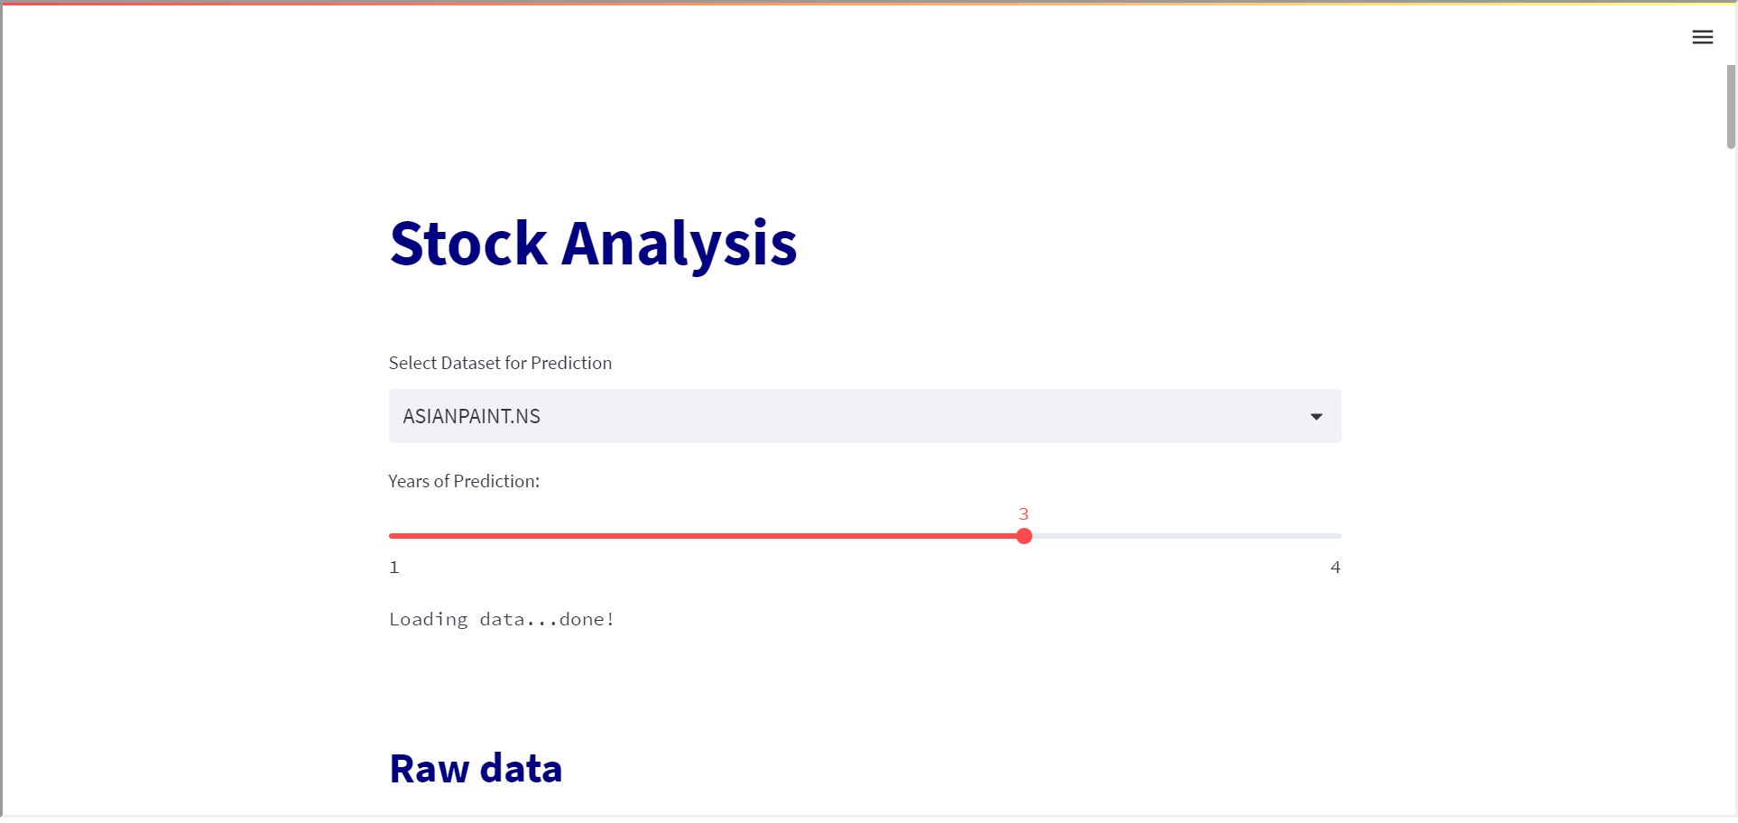
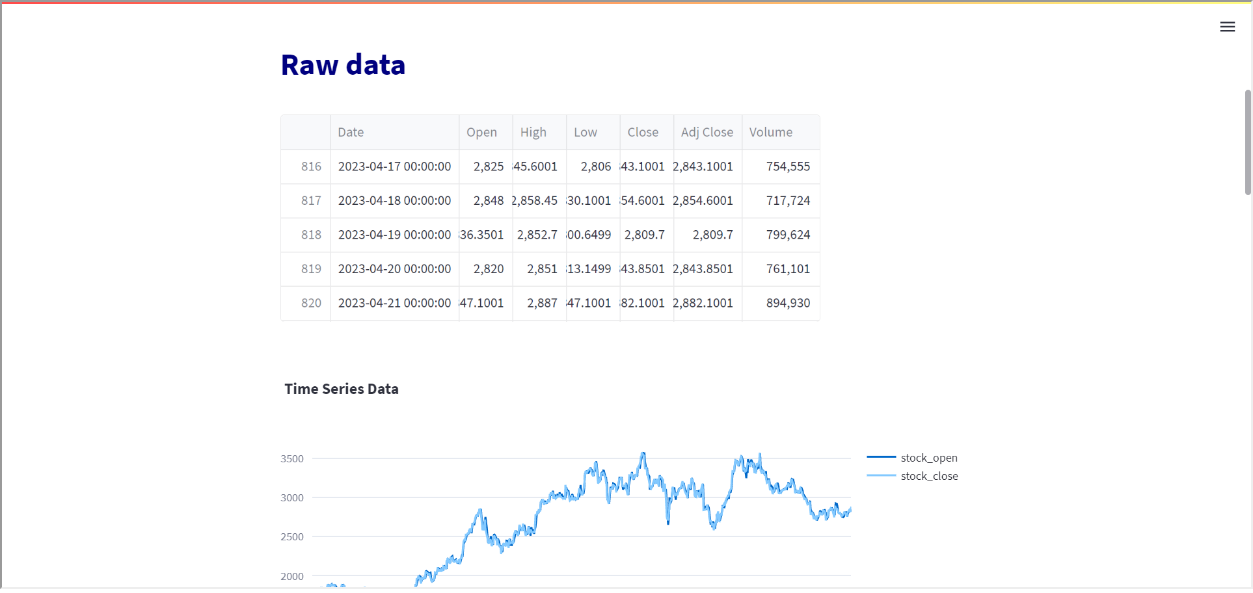

Slide 9
