Slide 1
PLIVO POC

Slide 2
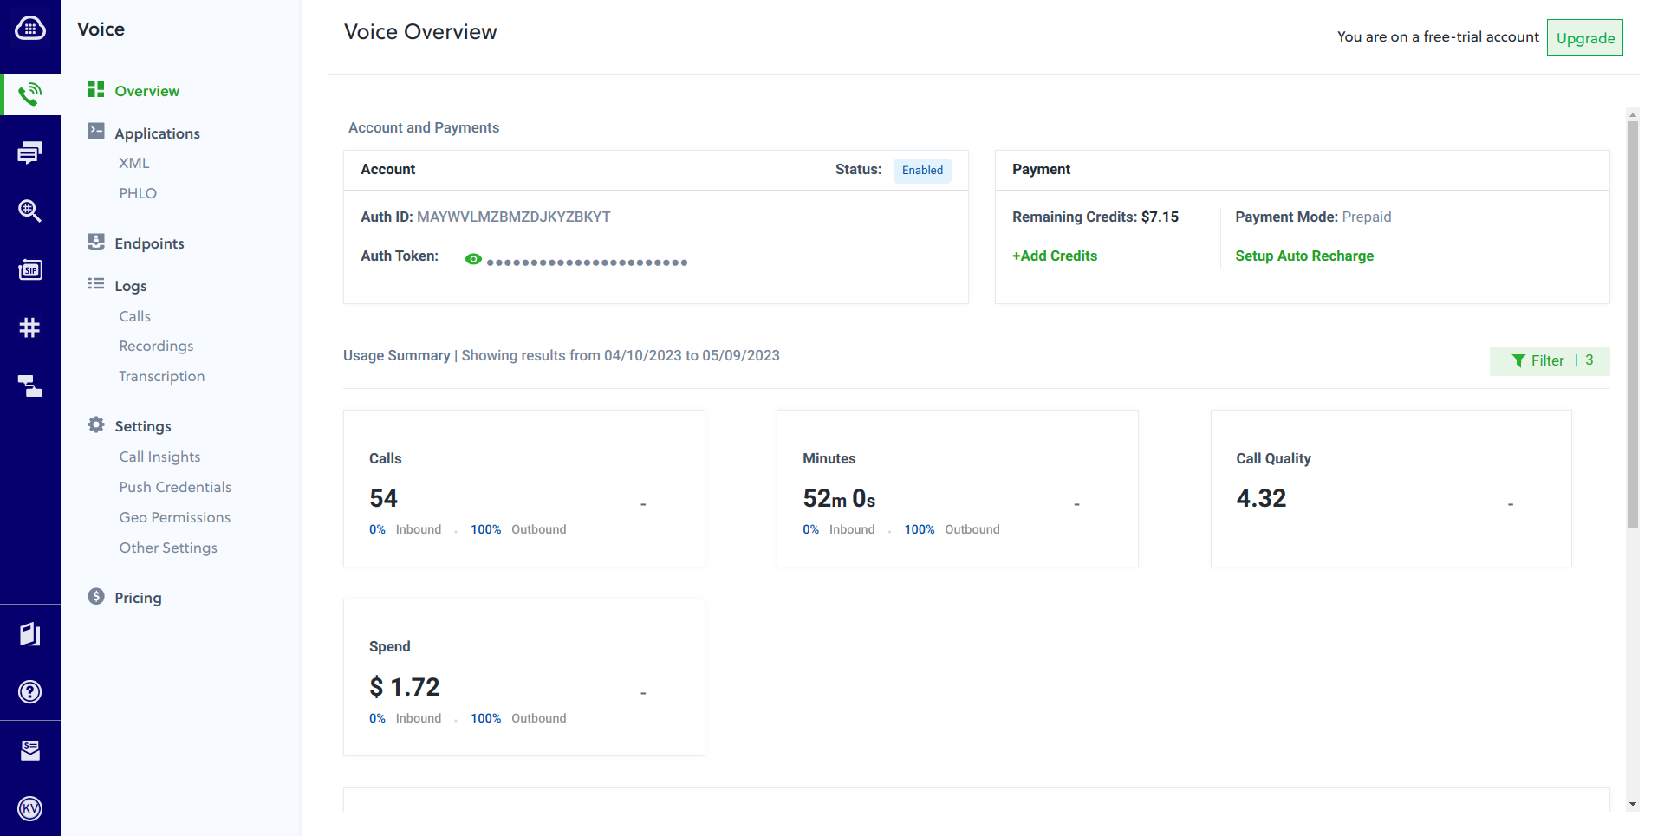
Plivo Overview

Slide 3
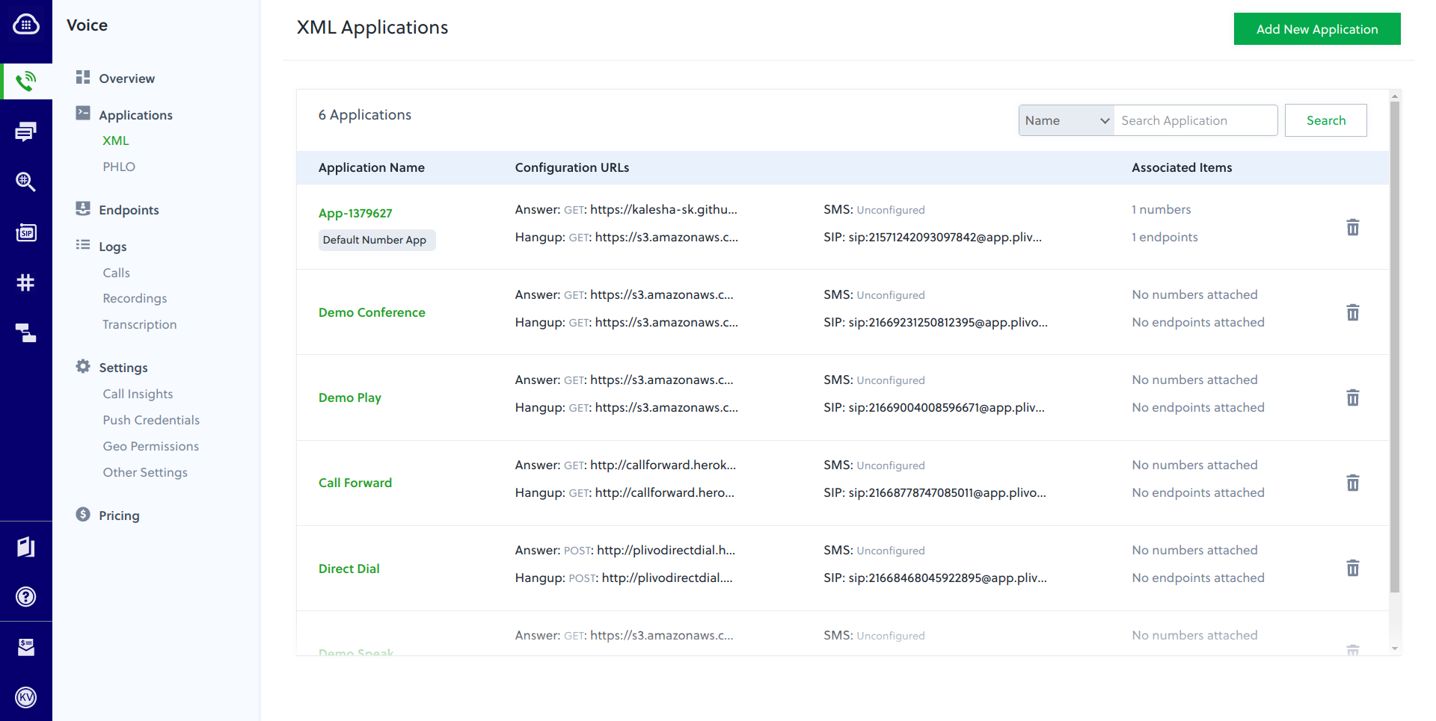
Applications - XML

Slide 4
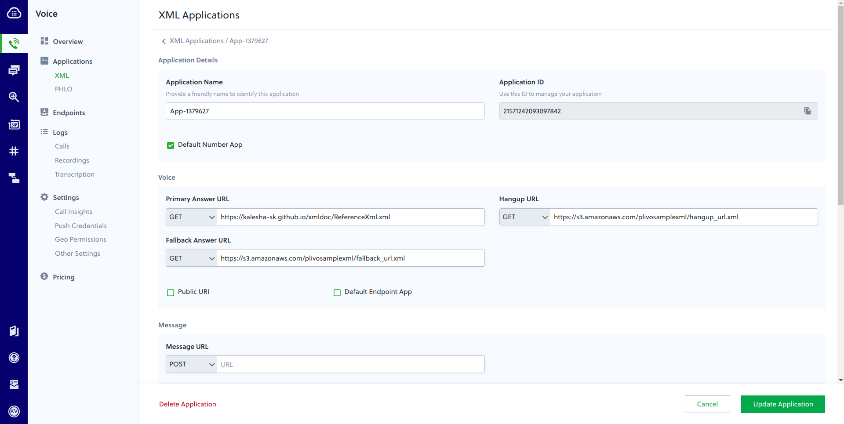
Applications - XML

Slide 5
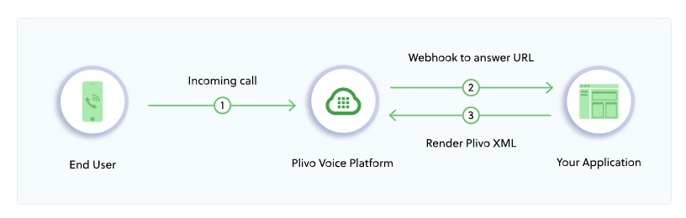
How it works:

Slide 6
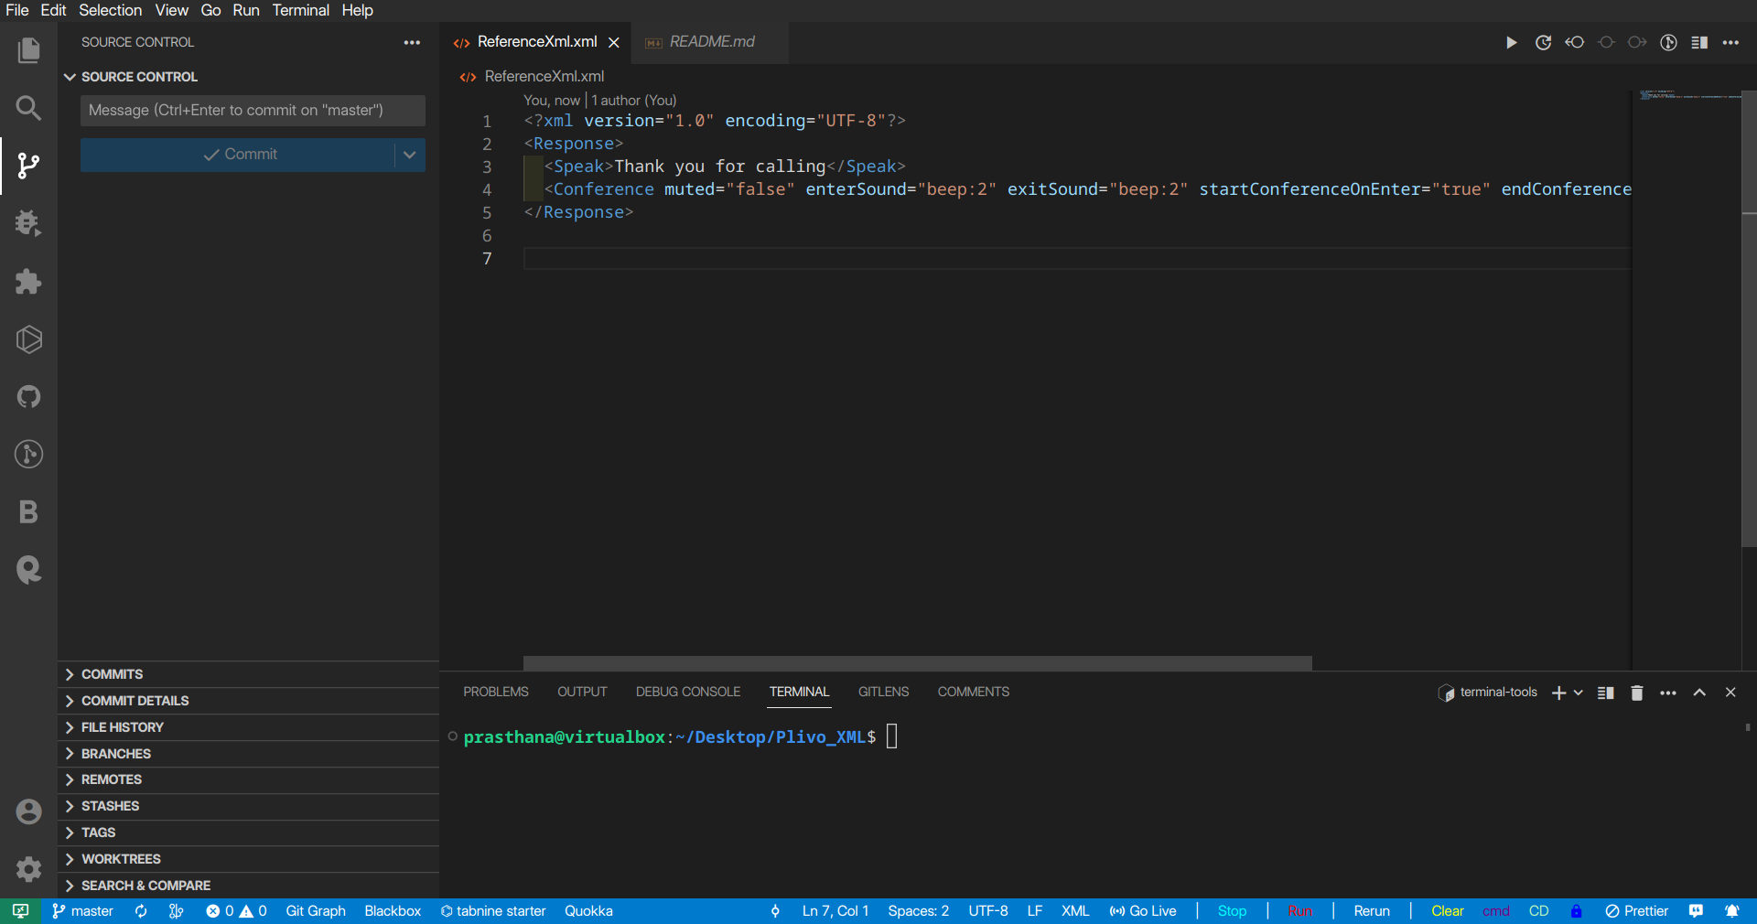
Conference XML element

Slide 7
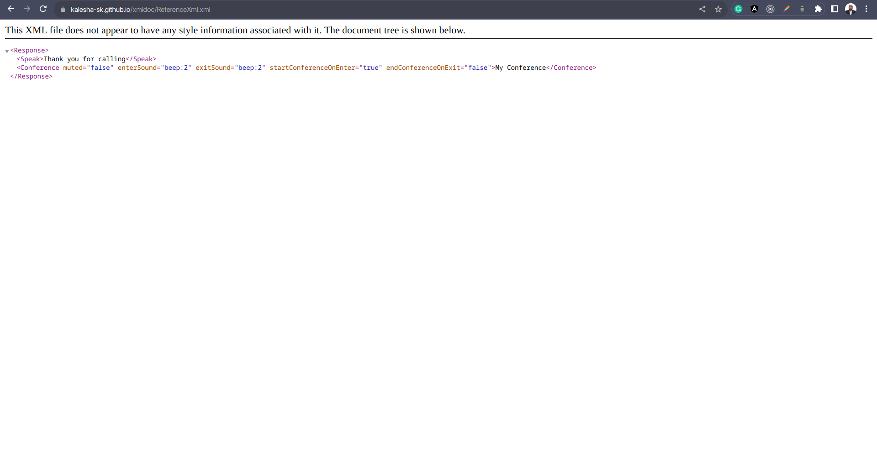
Conference XML element

Slide 8
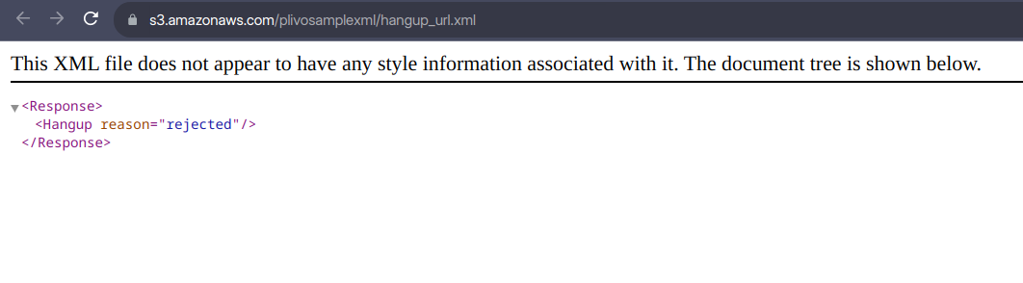
Hangup XML element

Slide 9
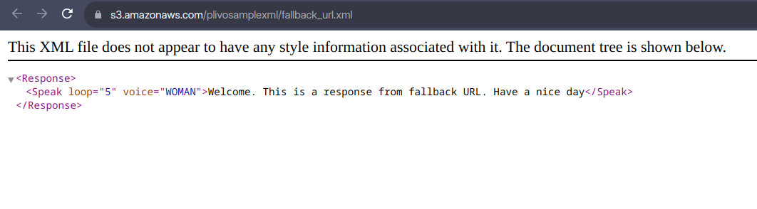
Fallback XML element

Slide 10
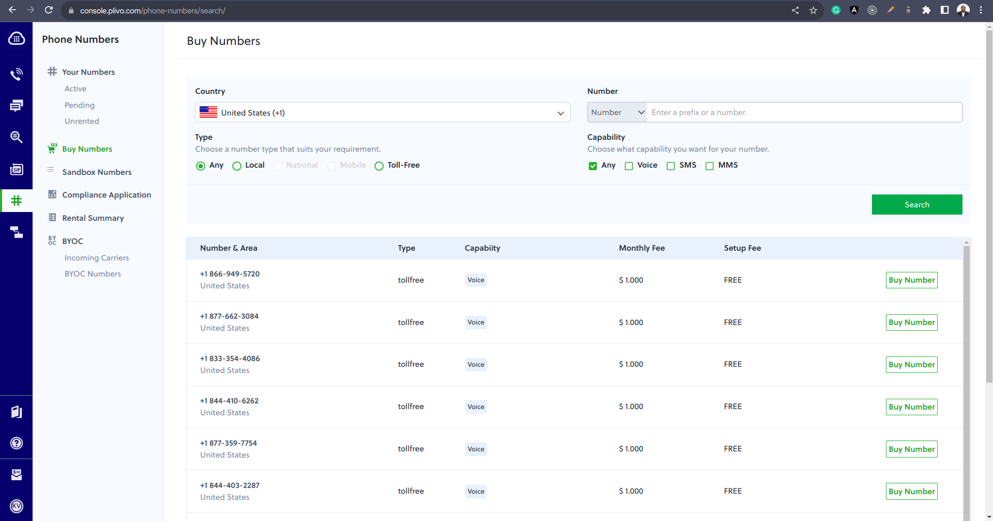
Bought +1 417-212-8972
Blue Eye, Missouri

Slide 11
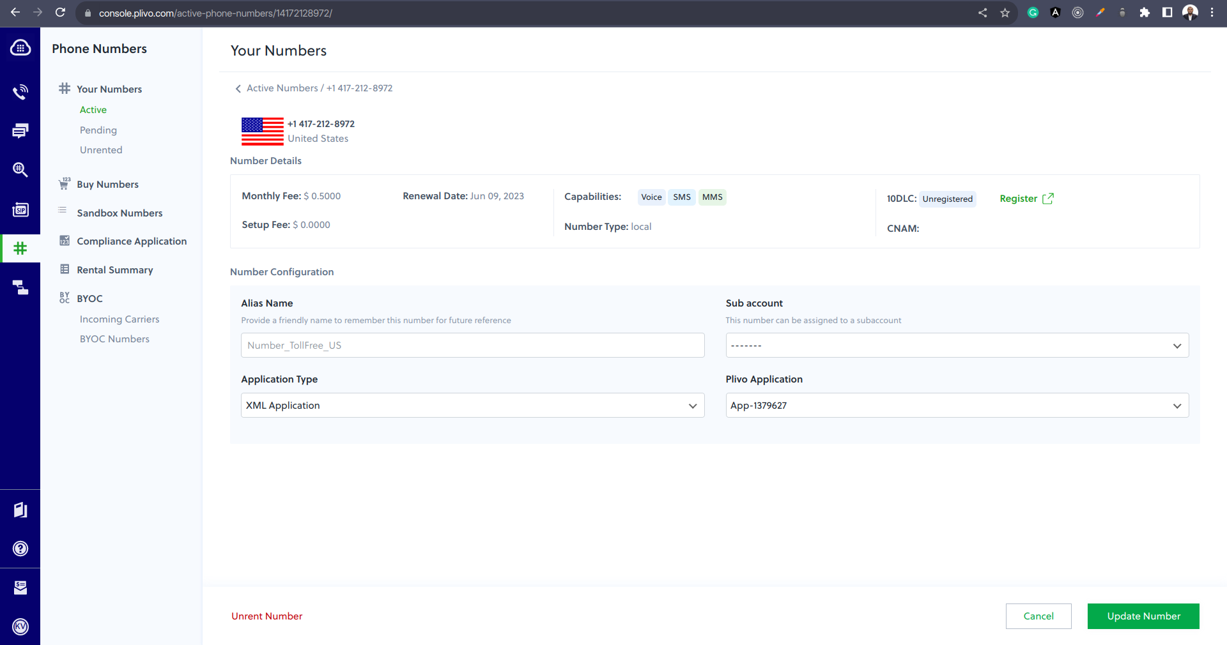
Number configuration to XML application

Slide 12
Application – XML
Outboud Call
Requesting GET XML
Received response from XML
Starting execution of Speak XML element
Executing Speak XML element
Speak XML: Element execution complete
Executing Conference XML element
Conference max count set to 20
Starting execution of Conference XML element
Conference XML: Element execution complete.
Call has hung up
Call has ended
Received response from hangup
Requesting GET hangup

Slide 13
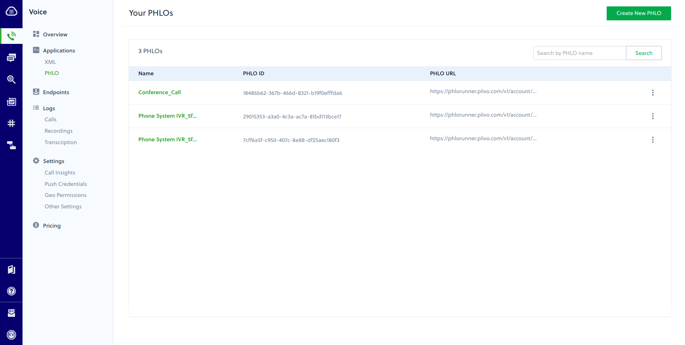
Application - PHLO

Slide 14
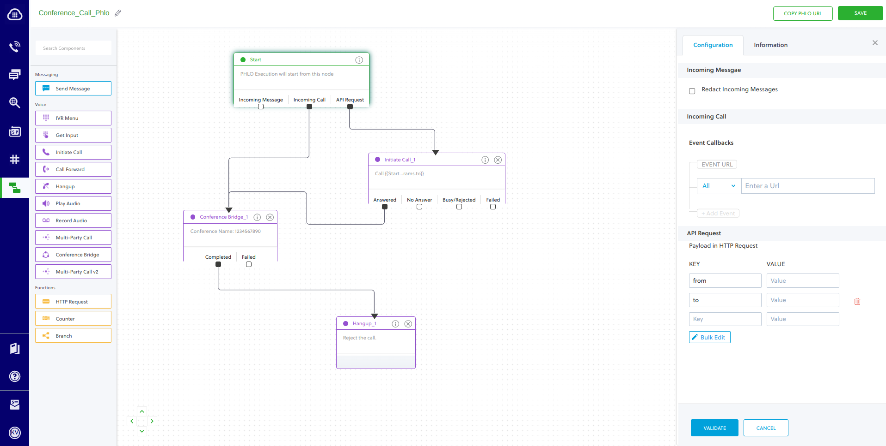
Application - PHLO

Slide 15
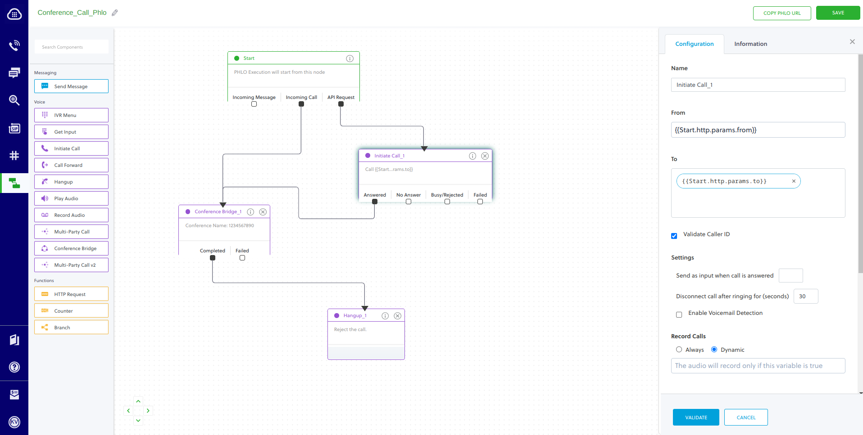
Application - PHLO

Slide 16
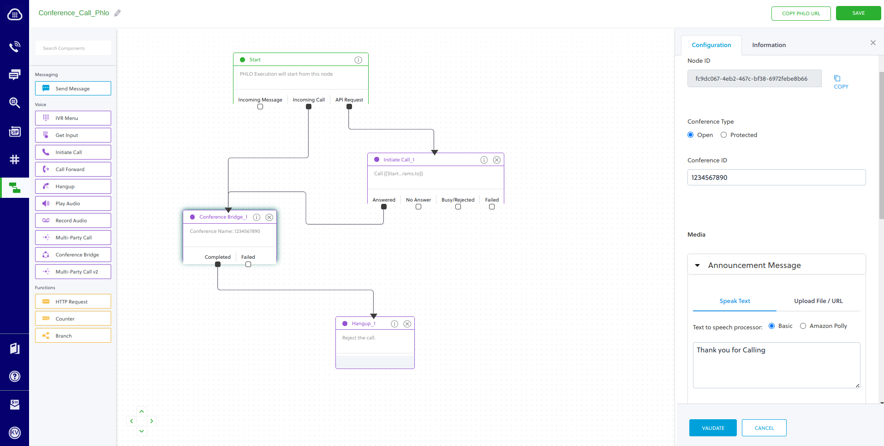
Application - PHLO

Slide 17
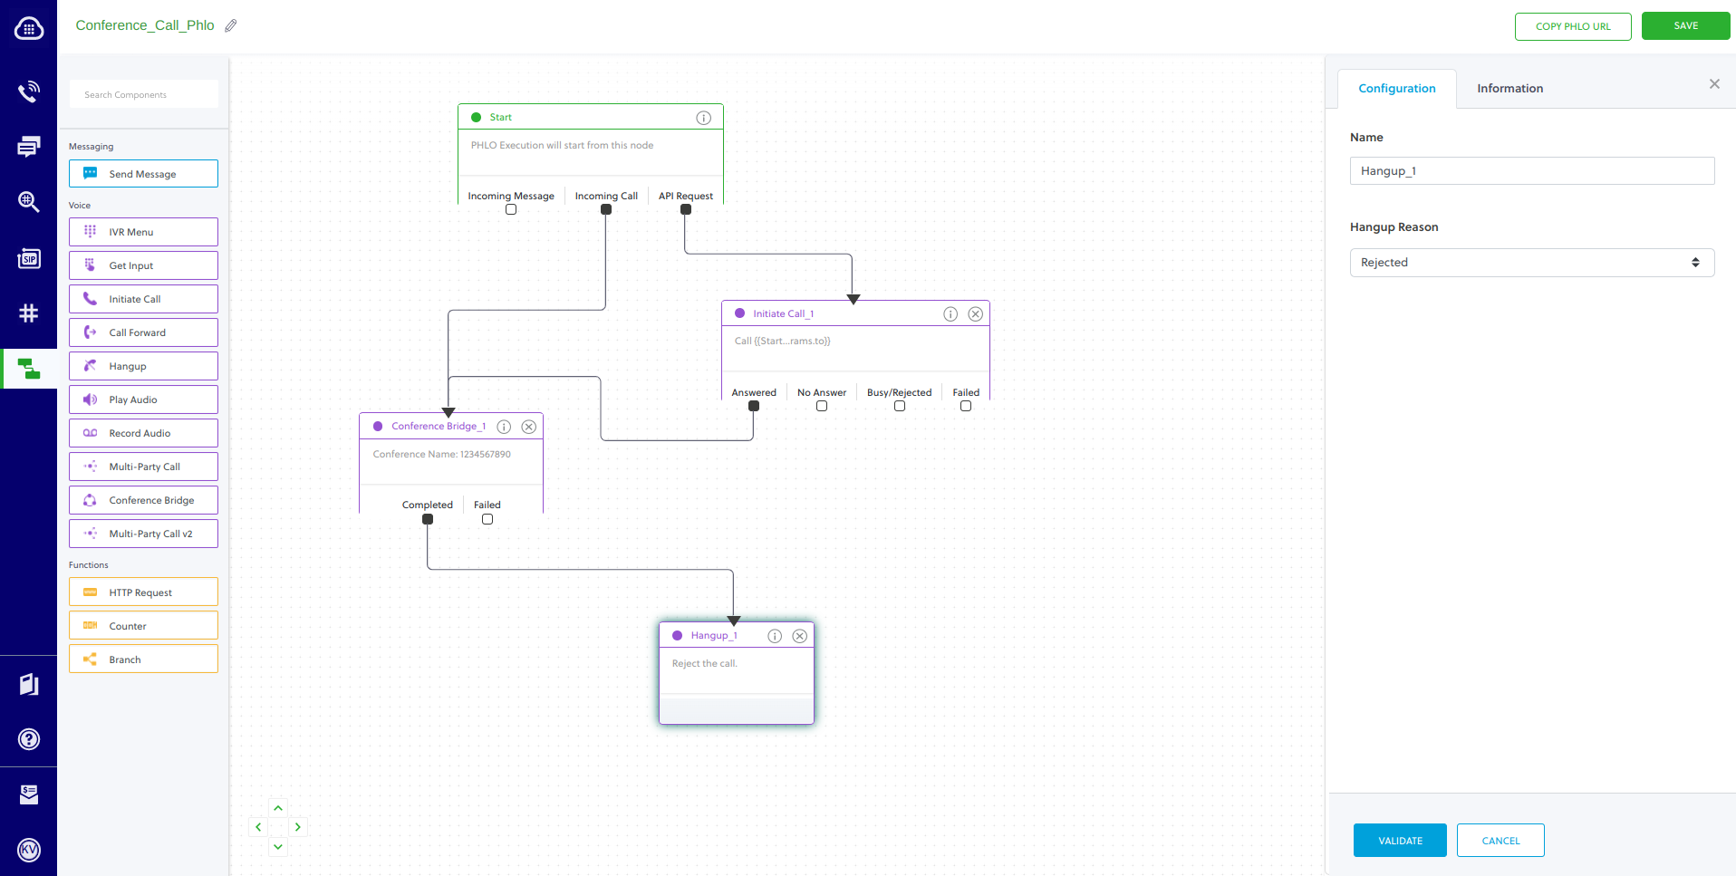
Application - PHLO

Slide 18

PLIVO - POC

