Slide 1
TRƯỜNG ĐIỆN – ĐIỆN TỬ

Slide 2
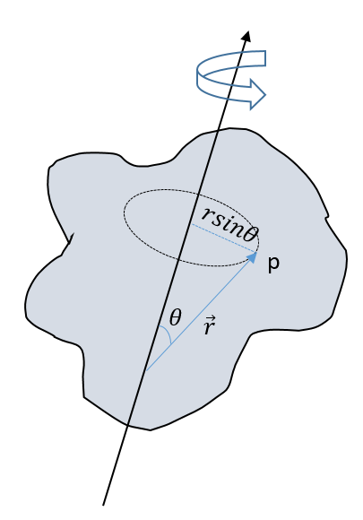
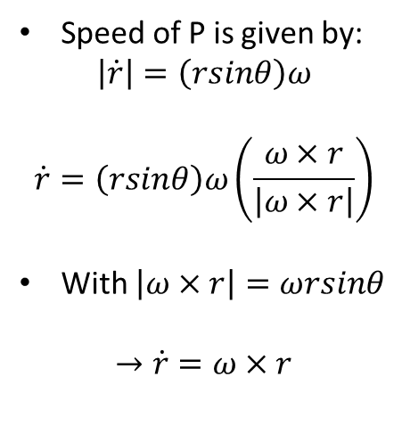
Angular velocity
Speed of P is given by:
$$\left|\dot{r}\right|=\left(rsinθ\right)ω$$
$$\dot{r}=\left(rsinθ\right)ω\left(\frac{ω×r}{\left|ω×r\right|}\right)$$
With $\left|ω×r\right|=ωrsinθ$
$$→\dot{r}=ω×r$$

Slide 3
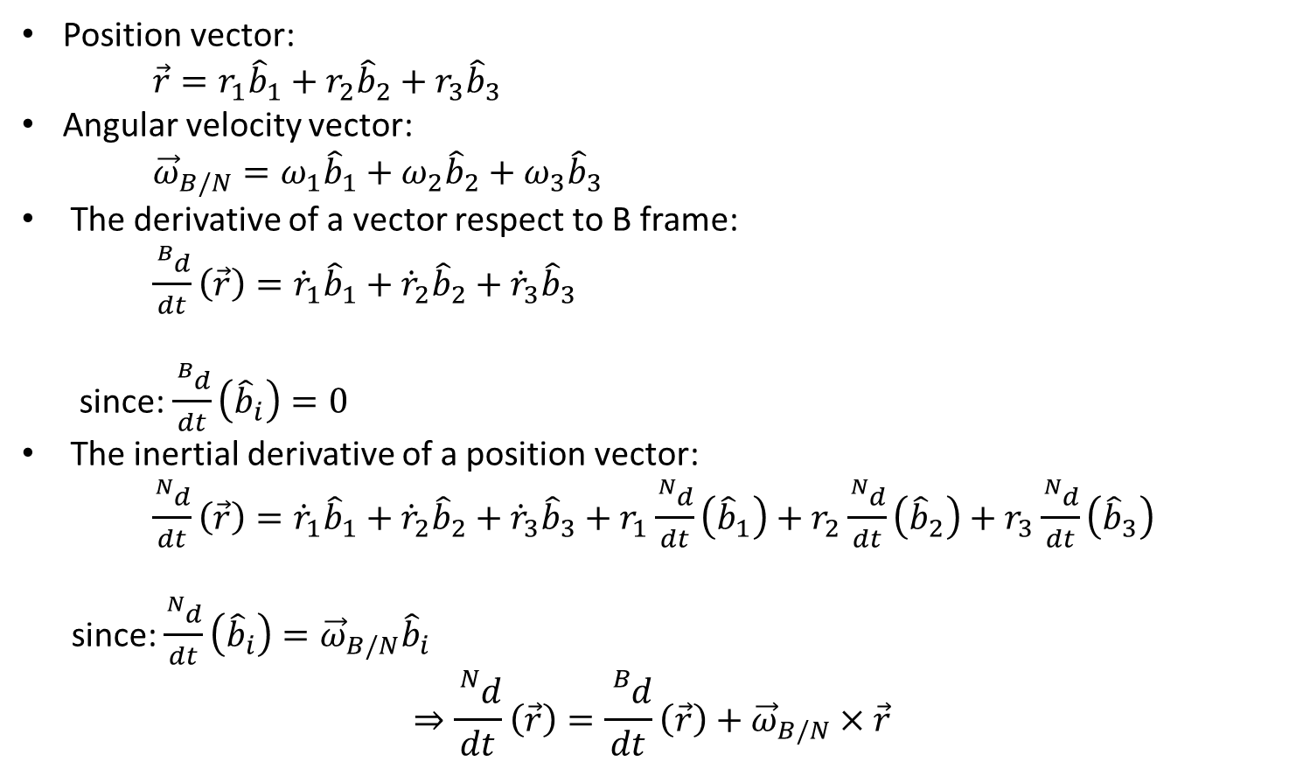
The inertia derivative of the position vector
Position vector:
$\vec{r}=r_{1}{\hat{b}}_{1}+r_{2}{\hat{b}}_{2}+r_{3}{\hat{b}}_{3}$
Angular velocity vector:
${\vec{ω}}_{B/N}=ω_{1}{\hat{b}}_{1}+ω_{2}{\hat{b}}_{2}+ω_{3}{\hat{b}}_{3}$
The derivative of a vector respect to B frame:
$\frac{{}_{}^{B}d}{dt}\left(\vec{r}\right)={\dot{r}}_{1}{\hat{b}}_{1}+{\dot{r}}_{2}{\hat{b}}_{2}+{\dot{r}}_{3}{\hat{b}}_{3}$
since: $\frac{{}_{}^{B}d}{dt}\left({\hat{b}}_{i}\right)=0$
The inertial derivative of a position vector:
$\frac{{}_{}^{N}d}{dt}\left(\vec{r}\right)={\dot{r}}_{1}{\hat{b}}_{1}+{\dot{r}}_{2}{\hat{b}}_{2}+{\dot{r}}_{3}{\hat{b}}_{3}+r_{1}\frac{{}_{}^{N}d}{dt}\left({\hat{b}}_{1}\right)+r_{2}\frac{{}_{}^{N}d}{dt}\left({\hat{b}}_{2}\right)+r_{3}\frac{{}_{}^{N}d}{dt}\left({\hat{b}}_{3}\right)$
since: $\frac{{}_{}^{N}d}{dt}\left({\hat{b}}_{i}\right)={\vec{ω}}_{B/N}{\hat{b}}_{i}$
$$⇒\frac{{}_{}^{N}d}{dt}\left(\vec{r}\right)=\frac{{}_{}^{B}d}{dt}\left(\vec{r}\right)+{\vec{ω}}_{B/N}×\vec{r}$$

Slide 4
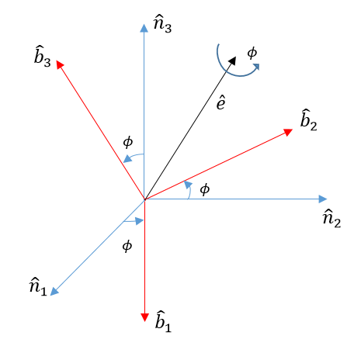
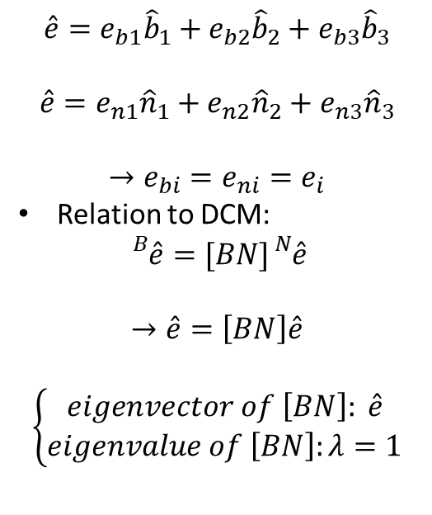
Principal Rotation Vector (PRV)
$$\hat{e}=e_{b1}{\hat{b}}_{1}+e_{b2}{\hat{b}}_{2}+e_{b3}{\hat{b}}_{3}$$
$$\hat{e}=e_{n1}{\hat{n}}_{1}+e_{n2}{\hat{n}}_{2}+e_{n3}{\hat{n}}_{3}$$
$$→e_{bi}=e_{ni}=e_{i}$$
Relation to DCM:
$${}_{}^{B}{\hat{e}=[BN]{}_{}^{N}{\hat{e}}}$$
$$→\hat{e}=\left[BN\right]\hat{e}$$
$$\left\{\begin{aligned}eigenvector of \left[BN\right]: \hat{e} \\ eigenvalue of \left[BN\right]:λ=1\end{aligned}\right.$$

Slide 5
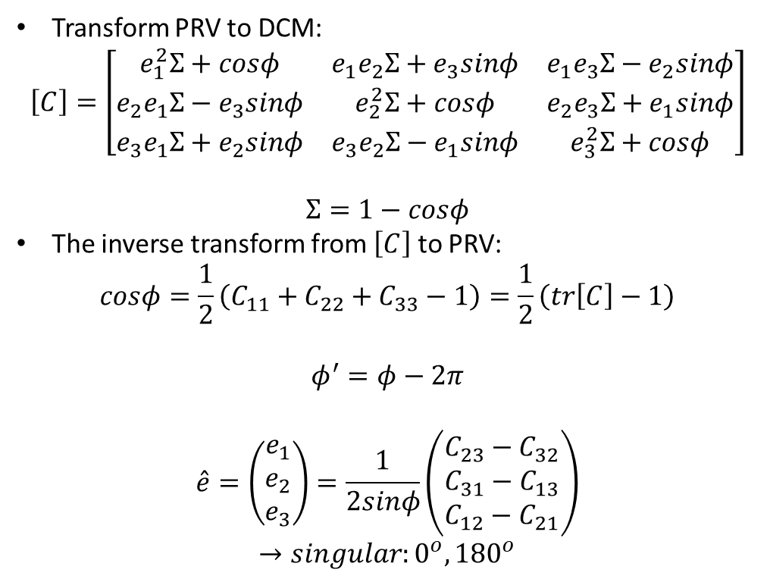
Principal Rotation Vector (PRV)
Transform PRV to DCM:
$$\left[C\right]=\left[\begin{matrix}e_{1}^{2}Σ+cosφ & e_{1}e_{2}Σ+e_{3}sinφ & e_{1}e_{3}Σ−e_{2}sinφ \\ e_{2}e_{1}Σ−e_{3}sinφ & e_{2}^{2}Σ+cosφ & e_{2}e_{3}Σ+e_{1}sinφ \\ e_{3}e_{1}Σ+e_{2}sinφ & e_{3}e_{2}Σ−e_{1}sinφ & e_{3}^{2}Σ+cosφ\end{matrix}\right]$$
$$Σ=1−cosφ$$
The inverse transform from $\left[C\right]$ to PRV:
$$cosφ=\frac{1}{2}\left(C_{11}+C_{22}+C_{33}−1\right)=\frac{1}{2}\left(tr\left[C\right]−1\right)$$
$$φ^{′}=φ−2π$$
$$\hat{e}=\left(\begin{matrix}e_{1} \\ e_{2} \\ e_{3}\end{matrix}\right)=\frac{1}{2sinφ}\left(\begin{matrix}C_{23}−C_{32} \\ C_{31}−C_{13} \\ C_{12}−C_{21}\end{matrix}\right)$$
$$→singular:0^{o}, {180}^{o}$$

Slide 6
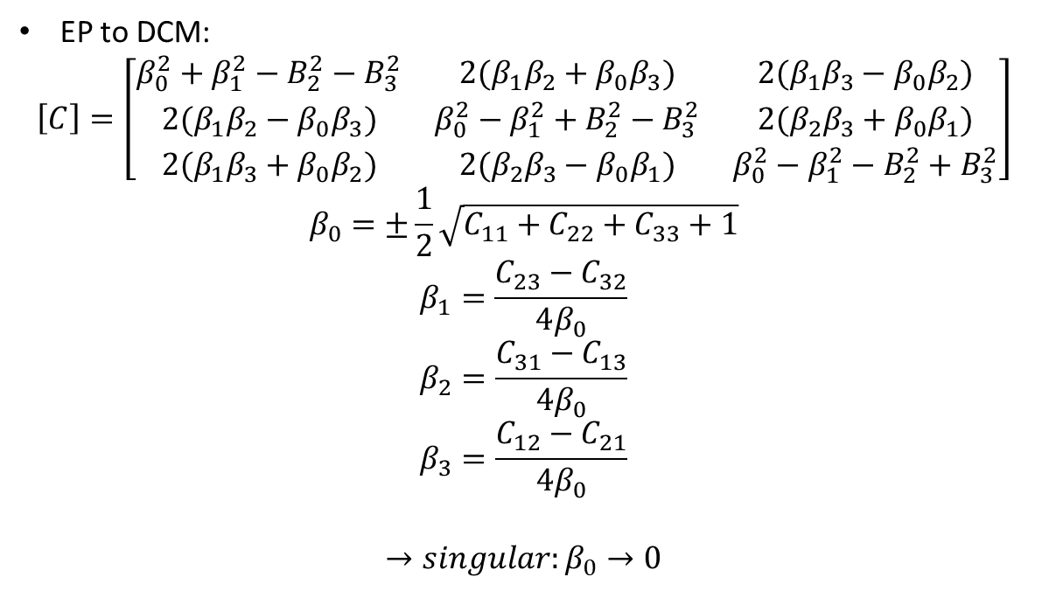
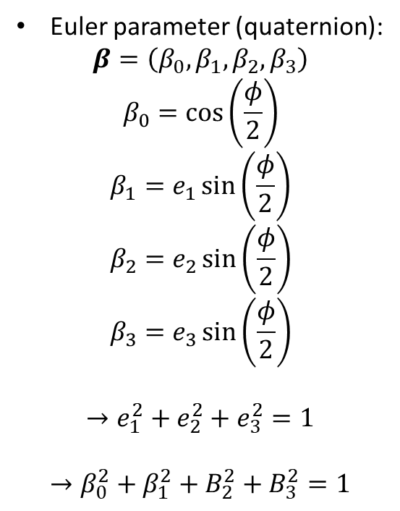
Euler parameters (quaternion)
Euler parameter (quaternion):
$$β=\left(β_{0},β_{1},β_{2},β_{3}\right)$$
$$β_{0}=\cos\left(\frac{φ}{2}\right)$$
$$β_{1}=e_{1}\sin\left(\frac{φ}{2}\right)$$
$$β_{2}=e_{2}\sin\left(\frac{φ}{2}\right)$$
$$β_{3}=e_{3}\sin\left(\frac{φ}{2}\right)$$
$$→e_{1}^{2}+e_{2}^{2}+e_{3}^{2}=1$$
$$→β_{0}^{2}+β_{1}^{2}+B_{2}^{2}+B_{3}^{2}=1$$
EP to DCM:
$$\left[C\right]=\left[\begin{matrix}β_{0}^{2}+β_{1}^{2}−B_{2}^{2}−B_{3}^{2} & 2(β_{1}β_{2}+β_{0}β_{3}) & 2(β_{1}β_{3}−β_{0}β_{2}) \\ 2(β_{1}β_{2}−β_{0}β_{3}) & β_{0}^{2}−β_{1}^{2}+B_{2}^{2}−B_{3}^{2} & 2(β_{2}β_{3}+β_{0}β_{1}) \\ 2(β_{1}β_{3}+β_{0}β_{2}) & 2(β_{2}β_{3}−β_{0}β_{1}) & β_{0}^{2}−β_{1}^{2}−B_{2}^{2}+B_{3}^{2}\end{matrix}\right]$$
$$β_{0}=±\frac{1}{2}\sqrt{C_{11}+C_{22}+C_{33}+1}$$
$$β_{1}=\frac{C_{23}−C_{32}}{4β_{0}}$$
$$β_{2}=\frac{C_{31}−C_{13}}{4β_{0}}$$
$$β_{3}=\frac{C_{12}−C_{21}}{4β_{0}}$$
$$→singular:β_{0}→0$$

Slide 7
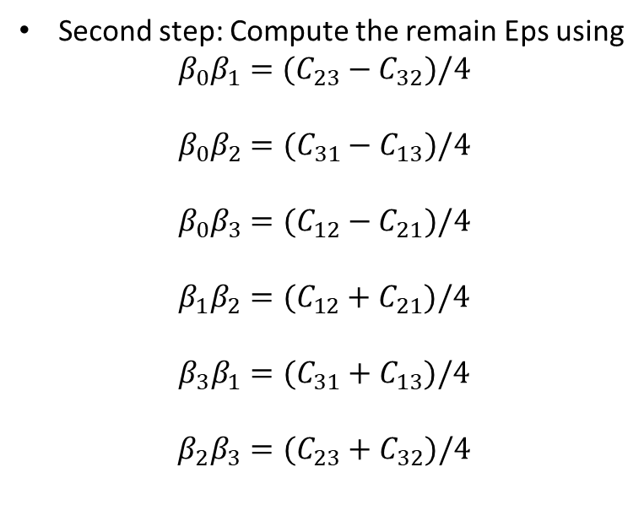
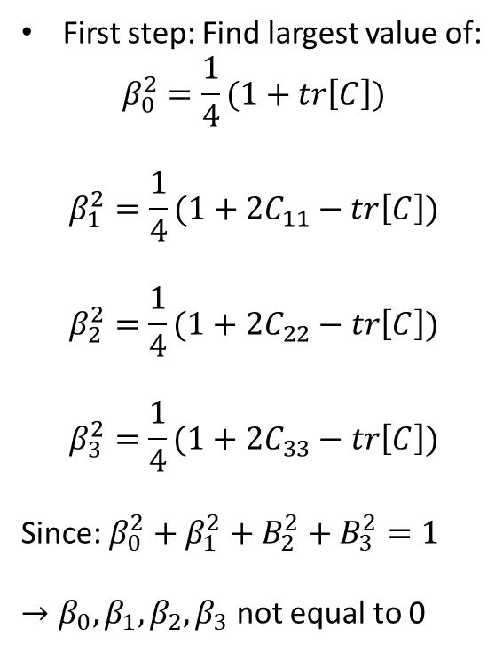
Sheppard’s method
First step: Find largest value of:
$$β_{0}^{2}=\frac{1}{4}(1+tr\left[C\right])$$
$$β_{1}^{2}=\frac{1}{4}(1+2C_{11}−tr\left[C\right])$$
$$β_{2}^{2}=\frac{1}{4}(1+2C_{22}−tr\left[C\right])$$
$$β_{3}^{2}=\frac{1}{4}(1+2C_{33}−tr\left[C\right])$$
Since: $β_{0}^{2}+β_{1}^{2}+B_{2}^{2}+B_{3}^{2}=1$
$→β_{0}, β_{1}, β_{2},β_{3}$ not equal to 0
Second step: Compute the remain Eps using
$$β_{0}β_{1}=(C_{23}−C_{32})/4$$
$$β_{0}β_{2}=(C_{31}−C_{13})/4$$
$$β_{0}β_{3}=(C_{12}−C_{21})/4$$
$$β_{1}β_{2}=(C_{12}+C_{21})/4$$
$$β_{3}β_{1}=(C_{31}+C_{13})/4$$
$$β_{2}β_{3}=(C_{23}+C_{32})/4$$

Slide 8
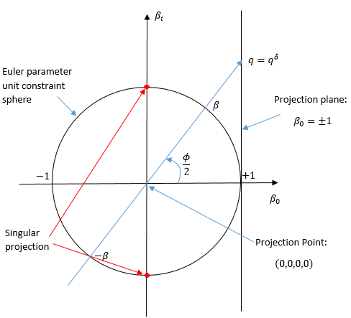
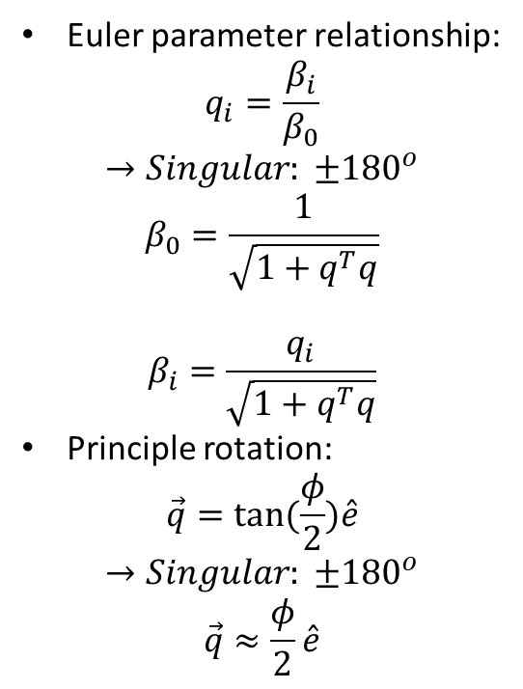
Classical Rodrigues Parameters (CRP)
Euler parameter relationship:
$$q_{i}=\frac{β_{i}}{β_{0}}$$
$$→Singular: ±{180}^{o}$$
$$β_{0}=\frac{1}{\sqrt{1+q^{T}q}}$$
$$β_{i}=\frac{q_{i}}{\sqrt{1+q^{T}q}}$$
Principle rotation:
$$\vec{q}=tan⁡(\frac{φ}{2})\hat{e}$$
$$→Singular: ±{180}^{o}$$
$$\vec{q}≈\frac{φ}{2}\hat{e}$$
CRP Stereographic Projection:

Slide 9
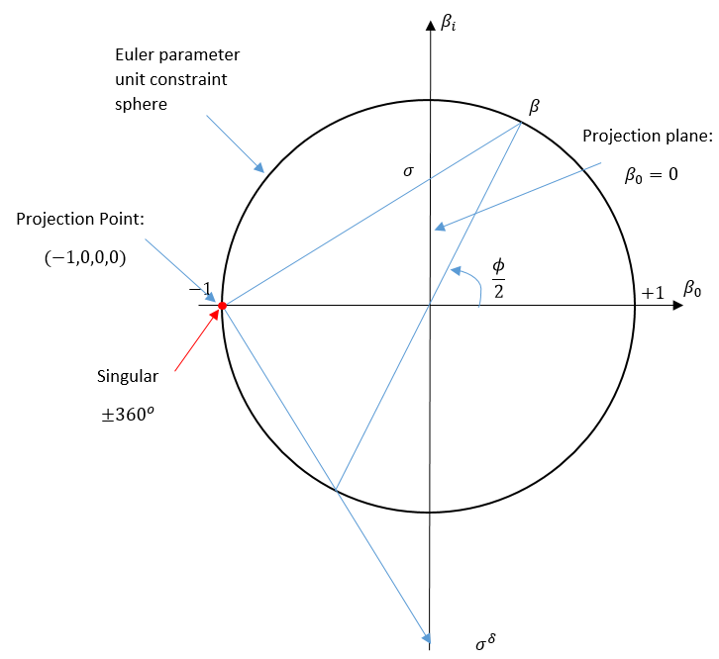
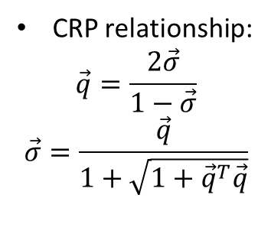
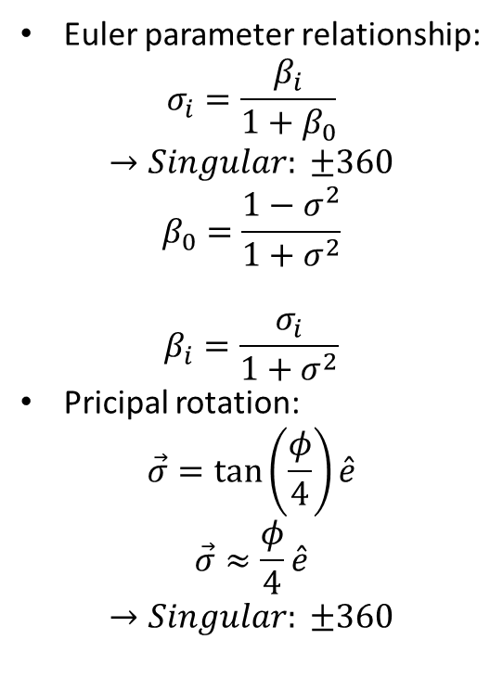
Modified Rodrigues parameters (MRPs)
Euler parameter relationship:
$$σ_{i}=\frac{β_{i}}{1+β_{0}}$$
$$→Singular: ±360$$
$$β_{0}=\frac{1−σ^{2}}{1+σ^{2}}$$
$$β_{i}=\frac{σ_{i}}{1+σ^{2}}$$
Pricipal rotation:
$$\vec{σ}=\tan\left(\frac{φ}{4}\right)\hat{e}$$
$$\vec{σ}≈\frac{φ}{4}\hat{e}$$
$$→Singular: ±360$$
CRP relationship:
$$\vec{q}=\frac{2\vec{σ}}{1−\vec{σ}}$$
$$\vec{σ}=\frac{\vec{q}}{1+\sqrt{1+{\vec{q}}^{T}\vec{q}}}$$

Slide 10
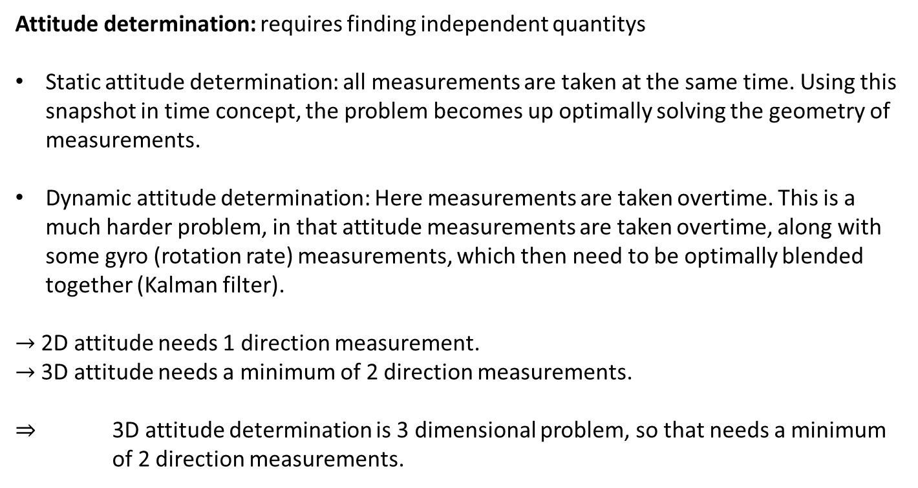
Attitude Determination
Attitude determination: requires finding independent quantitys
Static attitude determination: all measurements are taken at the same time. Using this snapshot in time concept, the problem becomes up optimally solving the geometry of measurements.
Dynamic attitude determination: Here measurements are taken overtime. This is a much harder problem, in that attitude measurements are taken overtime, along with some gyro (rotation rate) measurements, which then need to be optimally blended together (Kalman filter).
$→$2D attitude needs 1 direction measurement.
$→$3D attitude needs a minimum of 2 direction measurements.
$⇒$ 3D attitude determination is 3 dimensional problem, so that needs a minimum of 2 direction measurements.

Slide 11
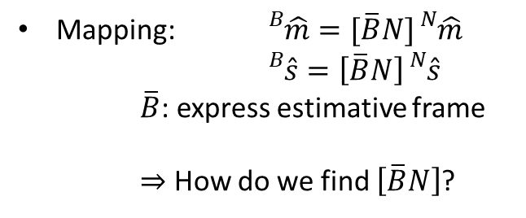
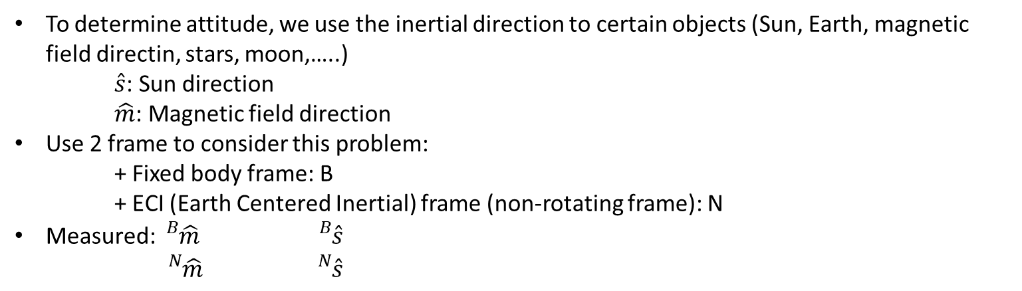
Attitude Determination
To determine attitude, we use the inertial direction to certain objects (Sun, Earth, magnetic field directin, stars, moon,…..)
$\hat{s}$: Sun direction
$\hat{m}$: Magnetic field direction
Use 2 frame to consider this problem:
+ Fixed body frame: B
+ ECI (Earth Centered Inertial) frame (non-rotating frame): N
Measured: ${}_{}^{B}{\hat{m}}$ ${}_{}^{B}{\hat{s}}$
${}_{}^{N}{\hat{m}}$ ${}_{}^{N}{\hat{s}}$
Mapping: ${}_{}^{B}{\hat{m}}=[\overline{B}N]{}_{}^{N}{\hat{m}}$
${}_{}^{B}{\hat{s}}=\left[\overline{B}N\right]{}_{}^{N}{\hat{s}}$
$\overline{B}$: express estimative frame
$⇒$ How do we find $\left[\overline{B}N\right]$?

Slide 12
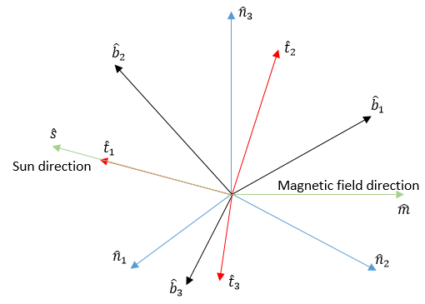
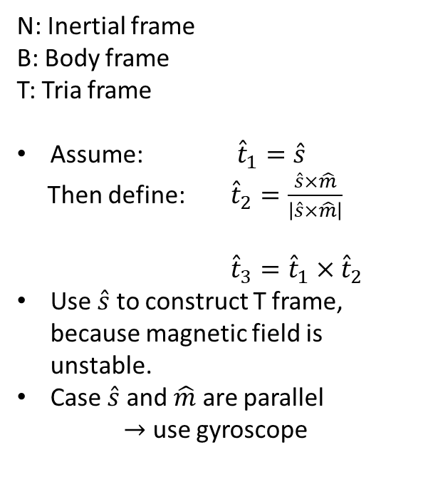
TRIAD Method
N: Inertial frame
B: Body frame
T: Tria frame
Assume: ${\hat{t}}_{1}=\hat{s}$
Then define: ${\hat{t}}_{2}=\frac{\hat{s}×\hat{m}}{\left|\hat{s}×\hat{m}\right|}$
${\hat{t}}_{3}={\hat{t}}_{1}×{\hat{t}}_{2}$
Use $\hat{s}$ to construct T frame, because magnetic field is unstable.
Case $\hat{s}$ and $\hat{m}$ are parallel
$→$ use gyroscope

Slide 13
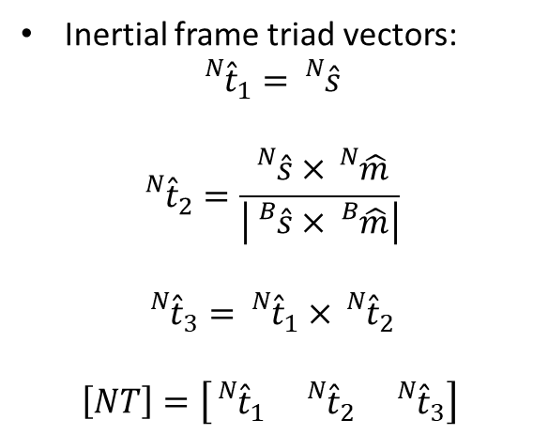
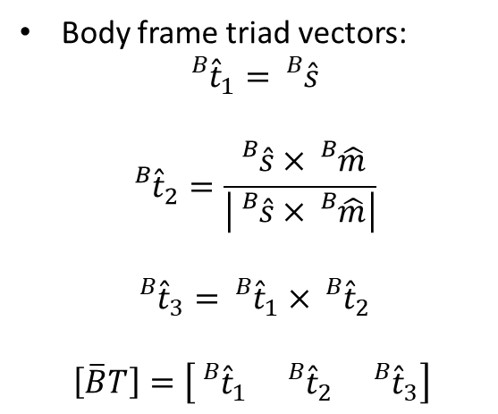
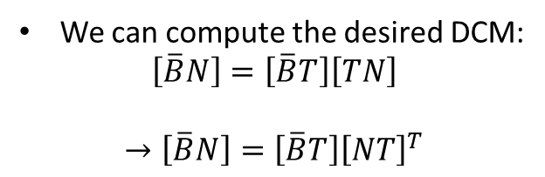
TRIAD Method
Body frame triad vectors:
$${}_{}^{B}{{\hat{t}}_{1}={}_{}^{B}{\hat{s}}}$$
$${}_{}^{B}{{\hat{t}}_{2}=\frac{{}_{}^{B}{\hat{s}×{}_{}^{B}{\hat{m}}}}{\left|{}_{}^{B}{\hat{s}×{}_{}^{B}{\hat{m}}}\right|}}$$
$${}_{}^{B}{{\hat{t}}_{3}}={}_{}^{B}{{\hat{t}}_{1}×{{}_{}^{B}{\hat{t}}}_{2}}$$
$$\left[\overline{B}T\right]=\left[\begin{matrix}{}_{}^{B}{{\hat{t}}_{1}} & {}_{}^{B}{{\hat{t}}_{2}} & {}_{}^{B}{{\hat{t}}_{3}}\end{matrix}\right]$$
Inertial frame triad vectors:
$${}_{}^{N}{{\hat{t}}_{1}={}_{}^{N}{\hat{s}}}$$
$${}_{}^{N}{{\hat{t}}_{2}=\frac{{}_{}^{N}{\hat{s}×{}_{}^{N}{\hat{m}}}}{\left|{}_{}^{B}{\hat{s}×{}_{}^{B}{\hat{m}}}\right|}}$$
$${}_{}^{N}{{\hat{t}}_{3}}={}_{}^{N}{{\hat{t}}_{1}×{{}_{}^{N}{\hat{t}}}_{2}}$$
$$\left[NT\right]=\left[\begin{matrix}{}_{}^{N}{{\hat{t}}_{1}} & {}_{}^{N}{{\hat{t}}_{2}} & {}_{}^{N}{{\hat{t}}_{3}}\end{matrix}\right]$$
We can compute the desired DCM:
$$\left[\overline{B}N\right]=\left[\overline{B}T\right]\left[TN\right]$$
$$→\left[\overline{B}N\right]=\left[\overline{B}T\right]{\left[NT\right]}^{T}$$

Slide 14
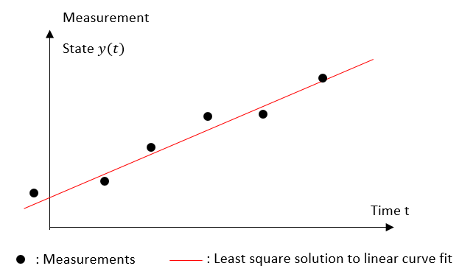
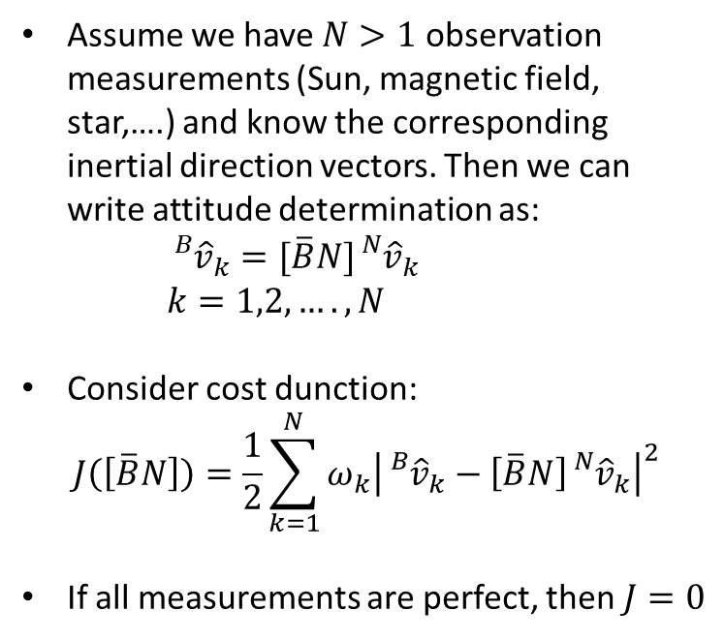
Wahba’s Problem
Assume we have $N>1$ observation measurements (Sun, magnetic field, star,….) and know the corresponding inertial direction vectors. Then we can write attitude determination as:
${}_{}^{B}{{\hat{v}}_{k}=[\overline{B}N]{}_{}^{N}{{\hat{v}}_{k}}}$
$k=1,2,….,N$
Consider cost dunction:
$$J\left(\left[\overline{B}N\right]\right)=\frac{1}{2}\sum_{k=1}^{N}{ω_{k}{\left|{}_{}^{B}{{\hat{v}}_{k}−\left[\overline{B}N\right]{}_{}^{N}{{\hat{v}}_{k}}}\right|}^{2}}$$
If all measurements are perfect, then $J=0$

Slide 15
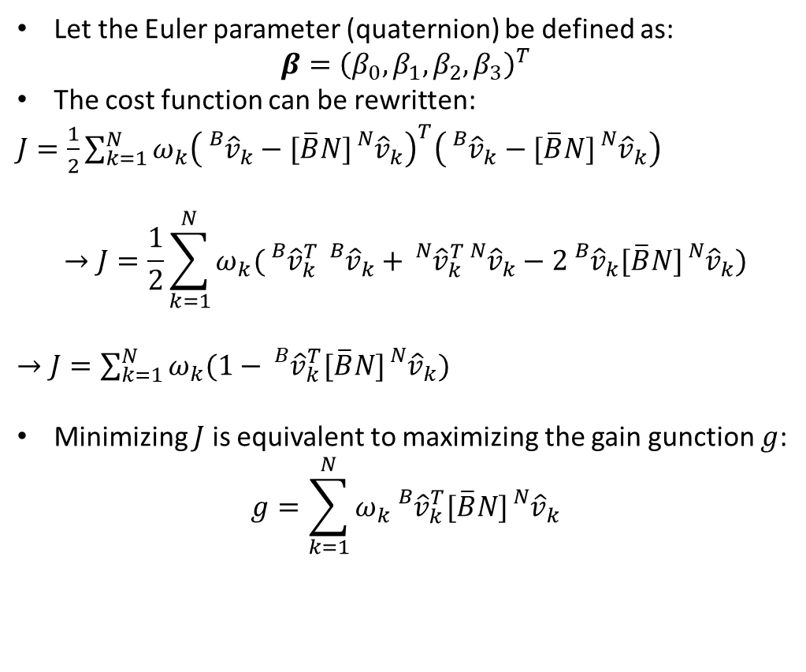
Devenport’s q-method
Let the Euler parameter (quaternion) be defined as:
$$β={\left(β_{0},β_{1},β_{2},β_{3}\right)}^{T}$$
The cost function can be rewritten:
$J=\frac{1}{2}\sum_{k=1}^{N}{ω_{k}{\left({}_{}^{B}{{\hat{v}}_{k}−[\overline{B}N]{}_{}^{N}{{\hat{v}}_{k}}}\right)}^{T}{\left({}_{}^{B}{{\hat{v}}_{k}−[\overline{B}N]{}_{}^{N}{{\hat{v}}_{k}}}\right)}^{}}$
$$→J=\frac{1}{2}\sum_{k=1}^{N}{ω_{k}({}_{}^{B}{{\hat{v}}_{k}^{T}}}{}_{}^{B}{{\hat{v}}_{k}+{}_{}^{N}{{\hat{v}}_{k}^{T}{}_{}^{N}{{\hat{v}}_{k}−2{}_{}^{B}{{\hat{v}}_{k}[\overline{B}N]{}_{}^{N}{{\hat{v}}_{k})}}}}}$$
$→J=\sum_{k=1}^{N}{ω_{k}(1−{}_{}^{B}{{\hat{v}}_{k}^{T}[\overline{B}N]{}_{}^{N}{{\hat{v}}_{k})}}}$
Minimizing $J$ is equivalent to maximizing the gain gunction $g$:
$$g=\sum_{k=1}^{N}{ω_{k}{}_{}^{B}{{\hat{v}}_{k}^{T}[\overline{B}N]{}_{}^{N}{{\hat{v}}_{k}}}}$$

Slide 16
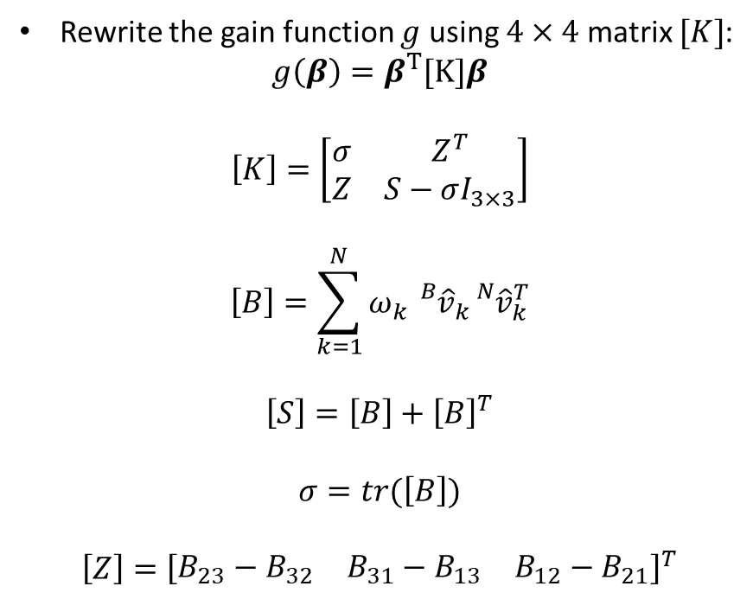
Devenport’s q-method
Rewrite the gain function $g$ using $4×4$ matrix $[K]$:
$$g\left(β\right)=β^{T}[K]β$$
$$\left[K\right]=\left[\begin{matrix}σ & Z^{T} \\ Z & S−σI_{3×3}\end{matrix}\right]$$
$$\left[B\right]=\sum_{k=1}^{N}{ω_{k}}{}_{}^{B}{{\hat{v}}_{k}{}_{}^{N}{{\hat{v}}_{k}^{T}}}$$
$$\left[S\right]=\left[B\right]+{\left[B\right]}^{T}$$
$$σ=tr(\left[B\right])$$
$$\left[Z\right]={\left[\begin{matrix}B_{23}−B_{32} & B_{31}−B_{13} & B_{12}−B_{21}\end{matrix}\right]}^{T}$$

Slide 17
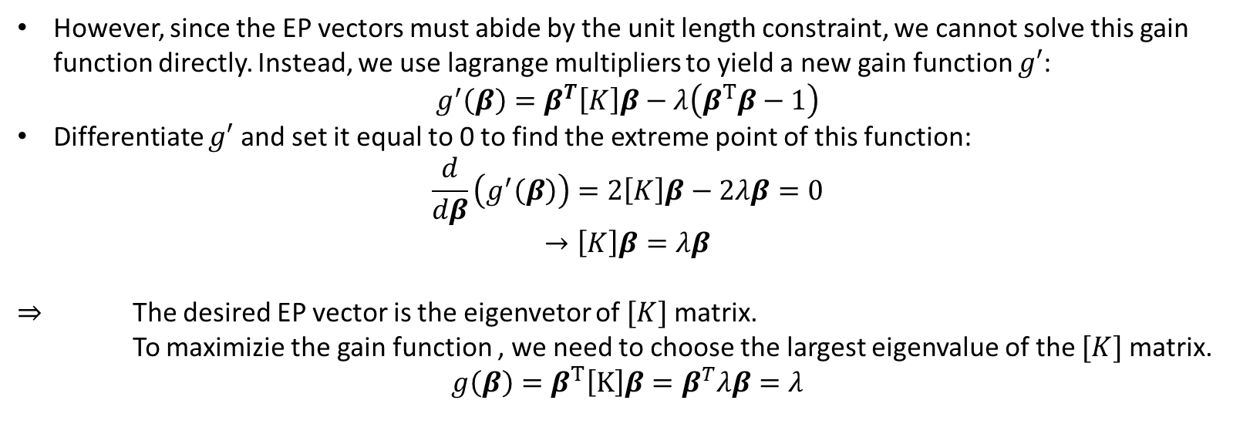
Devenport’s q-method
However, since the EP vectors must abide by the unit length constraint, we cannot solve this gain function directly. Instead, we use lagrange multipliers to yield a new gain function $g′$:
$$g^{′}\left(β\right)=β^{T}\left[K\right]β−λ\left(β^{T}β−1\right)$$
Differentiate $g′$ and set it equal to 0 to find the extreme point of this function:
$$\frac{d}{dβ}\left(g^{′}\left(β\right)\right)=2\left[K\right]β−2λβ=0$$
$$→\left[K\right]β=λβ$$
$⇒$ The desired EP vector is the eigenvetor of $[K]$ matrix.
To maximizie the gain function , we need to choose the largest eigenvalue of the $[K]$ matrix.
$$g\left(β\right)=β^{T}\left[K\right]β=β^{T}λβ=λ$$

Slide 18
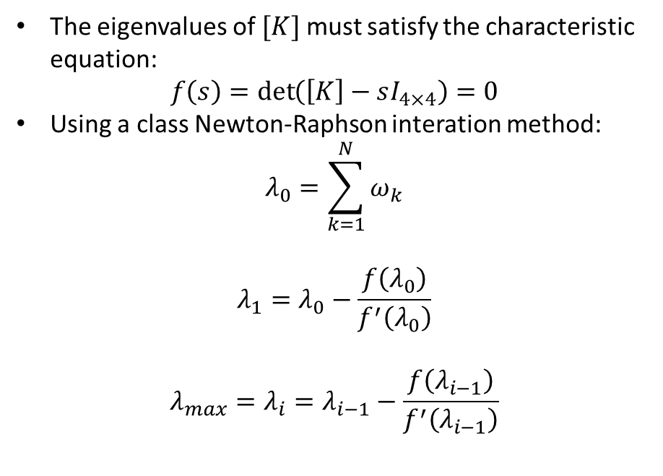
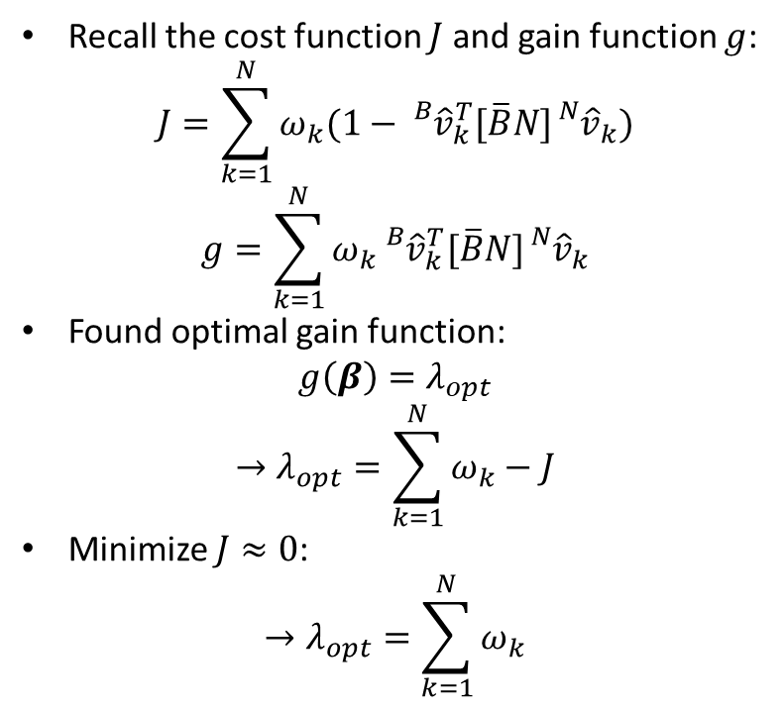
QUEST Method
Recall the cost function $J$ and gain function $g$:
$$J=\sum_{k=1}^{N}{ω_{k}(1−{}_{}^{B}{{\hat{v}}_{k}^{T}[\overline{B}N]{}_{}^{N}{{\hat{v}}_{k})}}}$$
$$g=\sum_{k=1}^{N}{ω_{k}{}_{}^{B}{{\hat{v}}_{k}^{T}[\overline{B}N]{}_{}^{N}{{\hat{v}}_{k}}}}$$
Found optimal gain function:
$$g\left(β\right)=λ_{opt}$$
$$→λ_{opt}=\sum_{k=1}^{N}{ω_{k}}−J$$
Minimize $J≈0$:
$$→λ_{opt}=\sum_{k=1}^{N}{ω_{k}}$$
The eigenvalues of $[K]$ must satisfy the characteristic equation:
$$f\left(s\right)=\det\left(\left[K\right]−sI_{4×4}\right)=0$$
Using a class Newton-Raphson interation method:
$$λ_{0}=\sum_{k=1}^{N}{ω_{k}}$$
$$λ_{1}=λ_{0}−\frac{f\left(λ_{0}\right)}{f^{′}\left(λ_{0}\right)}$$
$$λ_{max}=λ_{i}=λ_{i−1}−\frac{f\left(λ_{i−1}\right)}{f^{′}\left(λ_{i−1}\right)}$$

Slide 19
THANKS FOR YOUR WATCHING!

