Slide 1

Cyclistic data analysis
Case study 01

Slide 2
Business Task
Analyze the data and try find answer to following questions
How do annual members and casual riders use Cyclistic bikes differently?
Why would casual riders buy Cyclistic annual memberships?
How can Cyclistic use digital media to influence casual riders to become members?

Slide 3
A description of all data sources used
Used entire year of cyclistic trip data provided for the task
Source : https://divvy-tripdata.s3.amazonaws.com/index.html

Slide 4
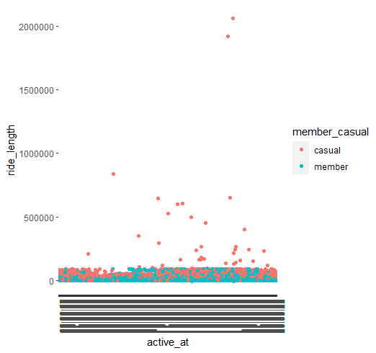
Documentation of any cleaning or manipulation of data
Observed there are “NA” values present in some data files.
Removed “NA” values as well as repetitions
Calculated ride length and checked for outliers
Removed them using filter function
Outliers

Slide 5
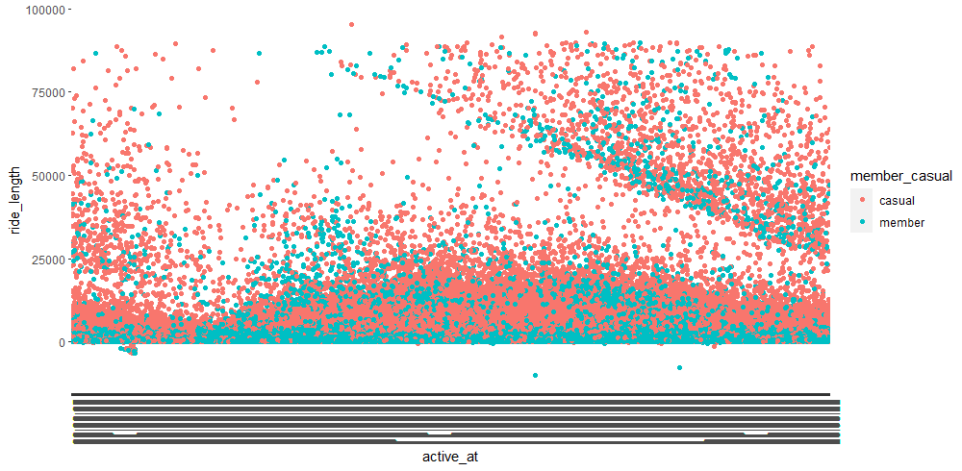
Documentation of any cleaning or manipulation of data. contd
Filter out the data which ride_length is more than 100000s

Slide 6
Plan
understand the data set by developing some primary graphs on members and casual users
Check their count
Check their distribution during weekdays, months
Check whether users at any specific area prefer specific user type
Check in which time, these casual users mostly rides
To convert casual users to members, I wanted to check is there any difference in their usage of bicycles
Calculate average ride length for casual and member categories and check whether they have any difference to prefer each membership type
to check if any seasonal parameter affects the membership preference

Slide 7
A summary of your analysis
Install following packages and calling them in to the analysis
hms
data.table
Tidyverse
lubridate
dplyr
Import the monthly data for 12 different data frames
eg: mar_df <- read_csv("202203-divvy-tripdata.csv")

Slide 8
A summary of your analysis. contd
Compile a whole year data frame named as “cyclistic_df” using rbind
cyclistic_df <- rbind(mar_df,apr_df,may_df,jun_df,jul_df,aug_df,sep_df,oct_df,nov_df,dec_df,jan_df,feb_df)
Clean the data
Analyze the data
Compose a column for ride_length
Compose separate columns for day and month

Slide 9
A summary of your analysis. contd
Calculate average ride length for casual and member riders compile it in a separate column
Combine both average values to one column name it as “average”
Next part of the analysis is included in the visualization
Total analysis : https://rpubs.com/Kalhara/case_study_1_google_data_analysis_certificate_course

Slide 10
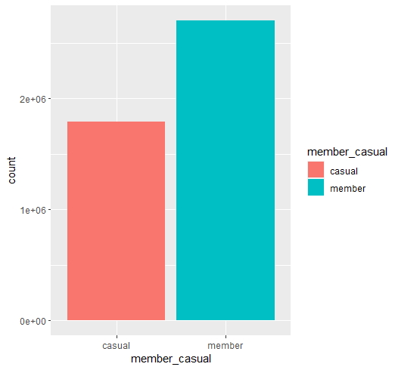
Supporting visualizations and key findings
We have nearly 2 million riders as casual members, this is surely a considerable amount to try to convert in to annual members

Slide 11
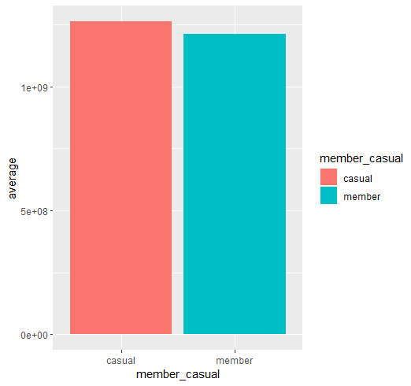
Supporting visualizations and key findings contd.
Casual riders use the cyclistic bikes higher than the members

Slide 12
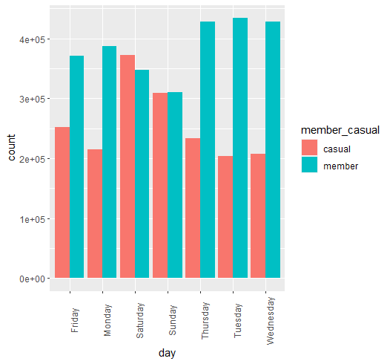
Supporting visualizations and key findings contd.
During Saturdays and Sundays, we got the maximum casual users
This might be more casual users are ride bicycles as a leisure activity during weekend

Slide 13
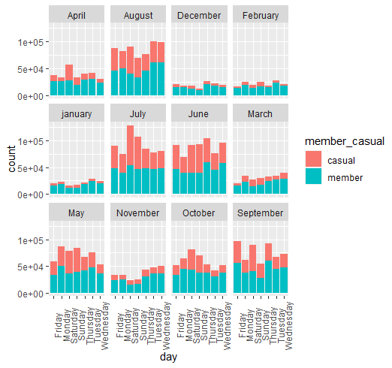
Supporting visualizations and key findings contd.
Casual riders are highly active during specific months. Those are…,
May
June
July
August
September

Slide 14
Your top three recommendations based on your analysis
Even though the casual riders are less than member riders, casual users rides more than the members. This shows that they use cycles more often. That can be used to approach casual riders and offer to convert to member subscription with more benefits
Since casual users are higher in weekdays we can introduce new member scheme for weekends to concert casual users to members
Target seasonal offers for casual users to try member subscription during following months
May
June
July
August
September

