Slide 1


Slide 2


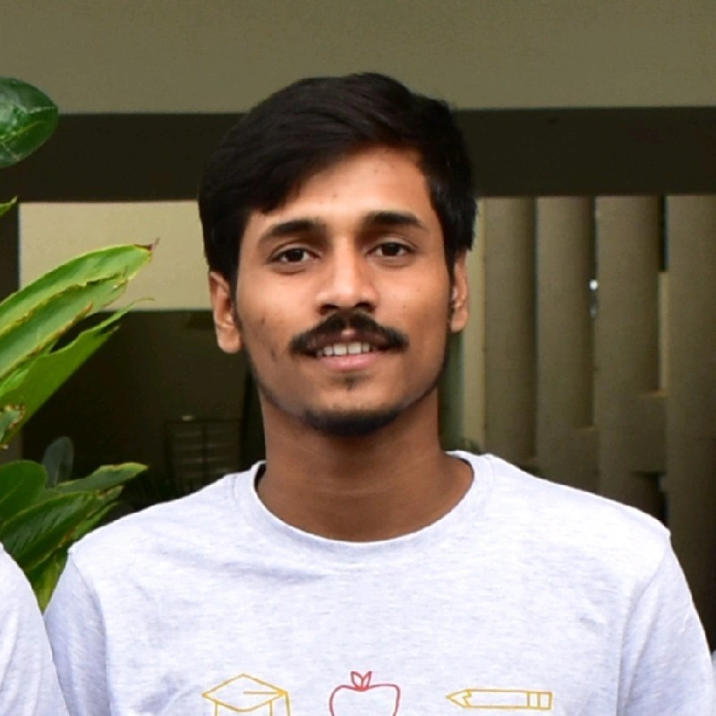

Team details
NEERAJ CHOUBISA
RAKESH ROUSHAN
College : IIIT Dharwad
Stream : ECE
Year of graduation : 2024
College : IIIT Dharwad
Stream : ECE
Year of graduation : 2024
HARSHIT MISHRA
College : IIIT Dharwad
Stream : ECE
Year of graduation : 2024
All fields are mandatory

Slide 3
Describe the problem statement (200 words)
In a world where energy is stuck in slow-moving, centralized systems, fossil fuels still dominate, and our planet's health is at risk, we face a big problem. Our issue can be summed up like this: We're stuck with old-fashioned energy grids that block progress and innovation. These grids rely on fossil fuels, which pollute the air and warm our planet. Plus, they're like old giants that often break down and cause power outages.
This causes several problems:
High energy costs: Centralized energy providers often have high overhead costs, which are passed on to consumers.
Environmental damage: Fossil fuels are a major source of greenhouse gas emissions, which contribute to climate change.
Energy insecurity: Centralized energy grids are vulnerable to disruptions, such as extreme weather events and cyberattacks.
Lack of Transparency: Consumers often have limited visibility into the source of their electricity and the environmental impact of their energy consumption.

Slide 4
Proposed solution / your big Idea (200 words)
Solving the problems of centralized energy systems through the transition to a decentralized model using energy trading marketplace involves the strategic use of cutting-edge technologies:
1. Complete Decentralization: In this transition, local communities and individuals leverage technologies such as solar panels, wind turbines, and battery storage to become self-reliant energy producers. Smart grid systems, integrated with blockchain technology, enable decentralized energy distribution and management.
2. Peer-to-Peer Energy Trading: This empowers every energy producer to share efficient surplus energy using energy trading marketplace, through blockchain and smart contract technologies fostering community-driven sustainability and reducing dependence on centralized grids. These innovations facilitate direct energy exchange between substations, power stations, and users based on their needs.
3. Transparency and Accountability: To ensure trust and traceability, blockchain technology is applied. Every energy transaction is securely recorded on an immutable blockchain ledger, providing transparency and accountability.
4. Optimal Energy Use and Sustainability: Machine learning algorithms continually analyze energy data, predicting demand patterns and optimizing the use of renewable sources.
Technologies Used
Ethereum + Metamask + Solidity + Ethers-js + Truffle + Polygon Mumbai Testnet +
Reactjs + Tailwind-css + Oppenzepplin + VeriDoc Api (invoice verification)
Nodejs + Machine Learning( supervised models )

Slide 5
How does your innovation accelerate change with the power of Technology?
(200 words)
Our innovation leverages technology to accelerate a profound shift in the energy landscape. Here's how:
1. Blockchain Assurance: Blockchain guarantees secure and transparent energy transactions, eliminating intermediaries and enhancing trust among users.
2. Decentralized Energy Generation: Utilizing solar panels, wind turbines, and battery storage, technology empowers individuals and communities to produce renewable energy locally. Smart grids, enabled by blockchain and smart contracts, ensure efficient distribution, reducing dependence on centralized grids.
3. Smart Contract Automation: Smart contracts automate energy transactions, ensuring seamless and secure peer-to-peer trading, enhancing marketplace efficiency, and minimizing disputes.
4. Data-Driven Efficiency: Machine learning analyzes energy data, predicting demand and optimizing renewable energy utilization. This data-driven approach lowers costs, promotes sustainability, and reduces reliance on fossil fuels.
5. Transparency and Accountability: Blockchain records transactions immutably, offering transparency and accountability.
By harnessing these technologies, our innovation fast-tracks the transition to a decentralized, renewable energy ecosystem, fostering sustainability, cutting emissions, and creating a cleaner, more resilient energy future.

Slide 6
How is your solution different/unique from other solutions in market (150 words)
Our solution excels in the market with a multi-faceted approach:
1. Complete Decentralization:
Empowers Local Energy Producers: Communities and individuals produce and sell energy locally.
Two-Way Energy Flow: Users both consume and sell surplus power back to substations.
Outage Resilience: Energy services reroute during substation outages, ensuring uninterrupted supply.
2. Cutting-edge Technology Integration:
Blockchain and Smart Contracts Efficiency: Ensures secure, automated, and transparent transactions.
Data-Driven Optimization: Predicts demand patterns, optimizing renewable energy use through ML.
3. Community-Centric Sustainability:
Local Empowerment: Fosters local ownership of energy production and consumption.
Promotes Renewable Energy: Encourages adoption, reduces emissions.
Enhances Energy Security: Reduces reliance on centralized grids, ensuring resilience.
PATENT FILED: No
Do you have a working model/prototype: No
If not, will you be able to show working prototype during finale. Yes

Slide 7
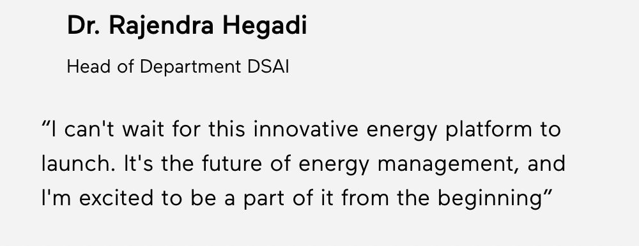
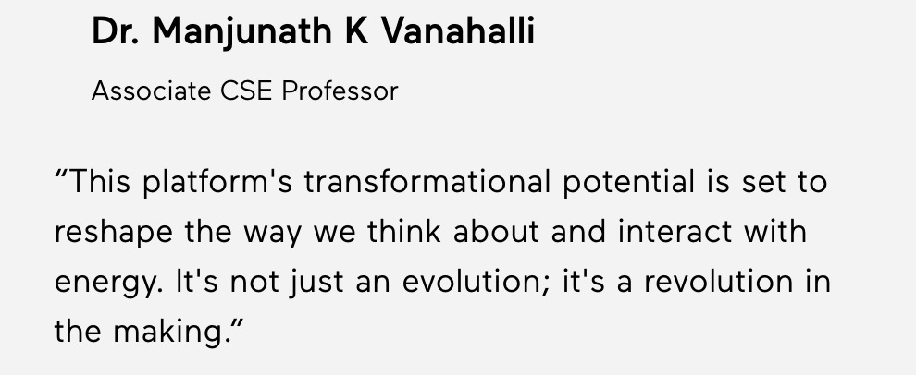
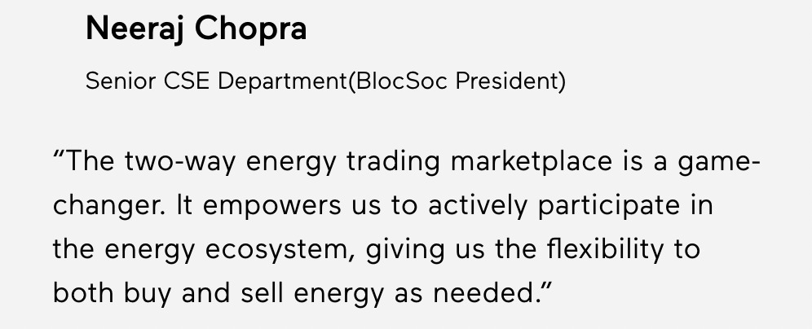
Any testimonials received?

Slide 8


Thank you!

