Slide 1

Enlighten Network
Professional social network
A way to excellence in your career

Slide 2
STUDENT DETAILS:
Particulars | Details
Name | Kalikrishna Prasanna Yalamati
Skills Build Email ID | krishnaprasanna2003@gmail.com
College Name | Rishi M.S. institute of engineering and technology for women
College Location | Hyderabad, Telangana - 500085
Domain of Internship | Front End Development
Duration of Internship | 6 weeks (7 June 2023 – 23 July 2023)

Slide 3
Enlighten network
PROBLEM STATEMENT:
In the modern landscape of education and career development, there exists a significant gap in providing students with a dedicated and effective platform to cultivate their professional networks. Current social networks primarily cater to personal connections and lack the focused features required to foster meaningful connections and opportunities within the professional realm for students. This gap impedes students' ability to build essential connections, gain insights into potential career paths, access mentorship, and stay updated with industry trends.
As a result, there is a pressing need for a specialized professional social network tailored exclusively for students. This platform should facilitate seamless networking, knowledge sharing, and mentorship opportunities among students, peers, alumni, industry professionals, and recruiters. It should empower students to actively engage in career development activities, such as seeking advice, exploring internships, participating in relevant discussions, and accessing resources that enhance their employability.

Slide 4

The way to get started is to quit talking and begin doing.

Slide 5



AGENDA
Overview
End users
Solution and its proposition
Uniqueness of the project
Modelling
Outcomes
Results
Links

Slide 6




INTRODUCTION
“Welcome to Enlighten Network, the premier professional social platform designed exclusively for students who are eager to build meaningful connections, explore career opportunities, and cultivate a powerful network that will shape your future. This platform is dedicated to empowering students on their journey towards success, offering a seamless space where they can showcase there achievements, collaborate with like-minded peers, and engage with industry experts. This website helps to unlock a world of possibilities as they embark on a path of growth, knowledge, and endless potential.”

Slide 7

PROJECT OVERVIEW
Purpose:
The purpose of a professional social network for students is to provide a dedicated platform that facilitates and enhances their career development and networking opportunities during their academic journey. This type of social network serves several important purposes:
Targeted Networking
Mentorship and Guidance
Career Exploration
Industry Insights
Skill Development
Personal Branding
Transition to Professional Life
Knowledge Sharing
Job and Internship Opportunities

Slide 8
PROJECT OVERVIEW
Scope:
The scope of a professional social network for students is comprehensive and multifaceted, encompassing a wide range of features and functionalities to cater to the diverse needs of students pursuing their academic and career goals. The scope of such a platform includes:
User Profiles and Networking
Mentorship and Guidance
Career Exploration and Resources
Industry Insights and News
Skill Development and Learning
Job and Internship Opportunities
Professional Development
Knowledge Sharing and Collaboration
Events and Networking
Privacy and Security
Gamification and Engagement
Analytics and Insights
Community Building and Support

Slide 9
PROJECT OVERVIEW
Objectives:
The objective is to develop a professional social network exclusively for students that addresses the aforementioned challenges. The platform should provide a user-friendly interface that facilitates targeted networking, mentorship connections, career exploration, industry insights, and employability enhancement. By creating an environment where students can seamlessly connect with peers, mentors, industry professionals, and recruiters, this platform aims to empower students with the tools and knowledge needed to make informed career decisions and thrive in their chosen fields.
Ultimately, the goal of this specialized professional social network is to bridge the gap between education and the professional world, ensuring that students are equipped with the resources and connections necessary to succeed in their future careers.

Slide 10
END USERS OF THE ENLIGHTEN NETWORK
Category 1 | Category II | Category III
Students | Industry Associations | Researchers and Scholars
Educational Institutions | Recruiters and Employers | Mentors and Industry Professionals
Parents and Guardians | Entrepreneurs and Startups | Industry Experts
Career Services | Non-Profit Organizations | Freelancers and Consultants

Slide 11
CHARACTERISTICS OF END USERS
Diverse Academic Backgrounds
Varied Educational Levels
Career Aspirations
Skill Development Goals
Networking Objectives
Mentorship Preferences
Digital Proficiency
Motivation for Engagement
Time Constraints
Personal Branding Goals
Privacy Concerns
Accessibility Needs
Collaboration Styles

Slide 12
NEEDS OF END USERS
Networking Opportunities
Mentorship and Guidance
Career Exploration
Skill Development
Industry Insights
Job and Internship Opportunities
Professional Development
Knowledge Sharing and Learning
Community and Support
Transition to Professional Life
Flexibility and Accessibility
Privacy and Security
Engagement & Gamification and Cultural Sensitivity
Continued Learning & Development and Integration with Education

Slide 13
BENEFITS OF END USERS BY USING ENLIGHTEN NETWORK
Expanded Professional Network
Personal Branding
Mentorship and Guidance
Career Exploration
Knowledge Sharing and Collaboration
Skill Development
Industry Insights
Job and Internship Opportunities
Continuous Learning
Professional Development
Networking for Job Search
Confidence Building
Transition to Professional Life
Access to Experts
Supportive Community
Students can derive numerous benefits from using a professional social network specifically designed for their career development and networking needs. Such a platform provides valuable opportunities and resources that contribute to their personal growth, professional success, and overall preparation for the job market. Here are some ways in which students can benefit from using a professional social network for students:

Slide 14
ENLIGHTEN NETWORK & ITS VALUE PROPOSITION
They need an network which acts like an bridge between the educational life and the professional life. Here is the Enlighten Network for the students to connect with the professional life and enhance your career with this network.
Enlighten network provides all the needs of the students for there career development in a right way
See the posts of the courses, events, opportunities and etc. in the home page.
Connect with the others like students, professionals, educational institutes, companies, online learning platforms and etc. which are the connections section.
Learn new courses to develop your career with new technologies which are in the courses section.
Clarify your doubts by using chats at any instant of time.
Play I-K (Improve-Knowledge)games to improve your learning skills.
Get the latest updates with the notifications.
You can also post your achievements in the network
Update your learning skills.
And many other features include in the Enlighten Network which satisfies the needs of the students.

Slide 15
UNIQUENESS OF ENLIGHTEN NETWORK
Describe about yourself similar to a portfolio website
Courses menu
Connections menu
Trend menu
I-K games menu
Others like educational details, skills details and etc.
As this features are already present in different multiple applications, but in all this features are included in one application (Enlighten Network) and this are related to the career development of students before they entry into an professional world.

Slide 16
MODELLING OF ENLIGHTEN NETWORK
The main techniques used for Enlighten network are:
HTML
CSS
JavaScript
Frameworks
HTML | CSS
Document Structure | Internal CSS
Text Elements | External CSS
Lists | Selectors and Declarations
Images | Colours
Links | Layout
Forms | Background
Tables | Box Model
Divisions and Spans | Positioning

Slide 17
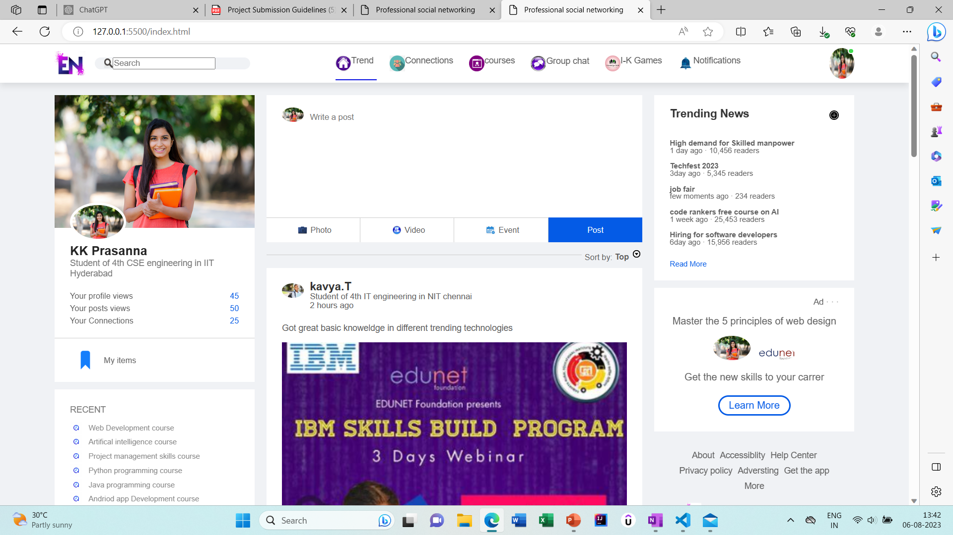
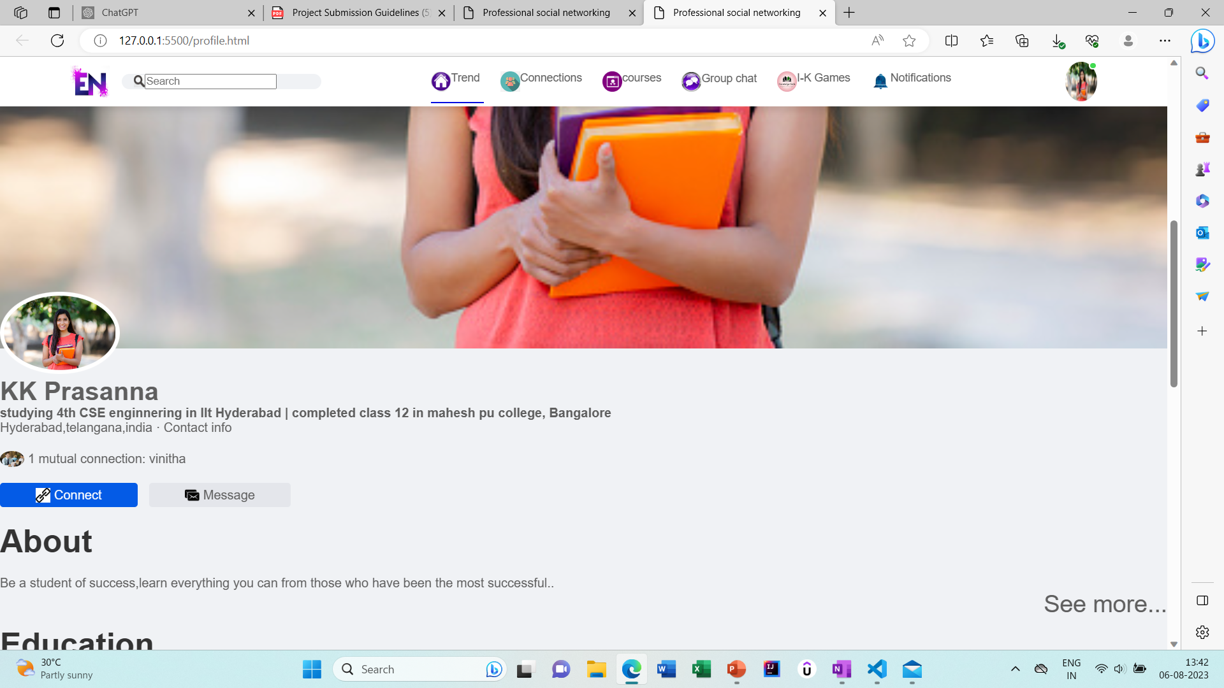
OUTCOME OF ENLIGHTEN NETWORK
Main page View
Profile page View

Slide 18
LINKS
Enlighten Network website link: C:\Users\Kalik\Downloads\Enlight network\index.html

Slide 19


Thank You
Best regards,
Kalikrishna Prasanna Yalamati

