Slide 1




HardnBot : Server Hardening Automation Software
Proposal Presentation

Slide 2


Research Crew
IT16054400 -R.M Budditha Rathnayake
IT16022416-G.G.L Anjula
IT16167742-W.M.K.M.W Wijekoon
IT16099746-Aruna Shan H.G.R

Slide 3
Introduction
Here fully automated free open source hardening platform is developed with the capability to detect poor or non-compliant configurations in a system (OS/DB/Application) and applying industry recommended fixes/configurations and secure systems by reducing its surface of vulnerabilities.
This research composes a great business value as it can cover 90% of an Information Systems Audit and hardening process.
By helping the organization understand and control risks and identifying opportunities/industry best practices to embrace.
This software also will allow internal audit to position themselves as trusted advisors.

Slide 4

Research Problem
Manual Server auditing and hardening is a process that server custodian will manually audit the server for any compliance failures and correct them manually.
There is no fully automated hardening platform implemented yet. Even the network administrators plan to do the Hardening processes manually, it might take more than 6 hours for the complete harden processes to complete.

Slide 5
Research Gap
Design formatted configuration libraries/Design Solution structures/libraries.
Design OS commands/Queries.
Implement scans to detect non-compliant parameters in OS/DB components.
Implement backup functions.
Implement methods to apply fixes.
Implement follow up sheets to track audit progress.
Track performance of applied fixes and logging.

Slide 6
Solution Proposed
Fully automated operations.
Automatically detect OS/Database/Application components.
Perform registry scans to identify registry errors.
Comprehensive scans on group policies.
Automatically execute quarries to detect configurations (OS/DB).
Compare output with pre-defined configuration libraries.
Generate detailed reports on detected vulnerabilities.
Apply fixes upon user confirmation.
Brings industry best practices into your system configurations.
Provide audit checklists/questionnaires covering all functions of a comprehensive audit.
Maintain follow up sheets to track audit progress.
Backup system configurations before applying any fixes.

Slide 7
Product Comparison
Features | Lynis | YoLinux | Open Audit | Pentana Software | NetWrix | SolarWinds | Audit Prodigy
No need to Expert knowledge for doing the audit | * | * | * | * | * | * | *
Generate detailed reports | * |  | * |  | *
Risk Assessment |  |  |  | * |  |  | *
Monitoring Network Devices |  | * | * |  |  | *
Backup Functions for all the settings
Compare with previous reports
Mobile Access |  |  |  |  |  |  | *
Vulnerability detection | * | *

Slide 8
Tools and Techniques
Tools
Microsoft Visual Studio IDE
VMware Workstation
PuTTY
Techniques
C#
Ansible
Python
Perl
Shell Script

Slide 9
Task Distribution
Member | Task
IT16054400 R.M Budditha Rathnayake | Design the main dashboard and integrate the system. Setup SSH connection to servers through dashboard. Implement scans to detect OS/DB/Application components/versions. Design OS commands/Query Ansible installation and its configurations Manage node requirements to communicate through SSH Create Ansible configuration files by CIS benchmarks for separate OS/DB/Application versions.
IT16022416 G.G.L Anjula | Design formatted external configuration files. Manage privileges. Implement customizable configuration files. (Install updates, patches and additional software’s/OS services /Special purpose services) Create Ansible configuration files by CIS benchmarks for separate OS/DB/Application versions. Design interface for backup and Implement backup functions. Setup secure VPN tunnel.

Slide 10
Task Distribution
Member | Task
IT16167742 W.M.K.M.W Wijekoon | Implement audit checklist. Create Ansible configuration files by CIS benchmarks for separate OS/DB/Application versions. Implement follow up sheets to track audit progress. Implement customizable configuration files. (Network configuration and Firewalls / Logging and Auditing / System Access and Environment) Generate detailed reports and implement export functions for reports. Perform Dry-Run and make a report for every hardening. Design interface for reporting.
IT16099746 Aruna Shan H.G.R | Create Ansible configuration files by CIS benchmarks for separate OS/DB/Application versions. Implement customizable configuration files. (Warning Banners / System maintenance) Implement scan function using Ansible audits. Track performance of Applied fixes and logging. Design interface for scanning.

Slide 11
Setup connection and perform hardening
Eliminate potential attacks by attack vectors and minimize the system's attack surface.
Remote access is more commonly accomplished using a secure software solution like a VPN software, by connecting hosts through a hard-wired network interface or Wi-Fi network interface or by connecting via the internet
After identifying the system type hardening is carried out by Ansible scripts according to industry best practices or CIS benchmark's best practices

Slide 12
Implementation of backup functions
The good way of hardening is hardening the backup image of the system.
This backup server is responsible for restoring files, folders, databases in order to prevent the loss of data in the event of a hardening failure, user error, disaster or accident.
This backup server should have or Create/Use a local account with administrative access which has suitable privileges to perform hardening.
As an example backup should be stored in a cloud storage, hard drive or a network share folder.

Slide 13
Implementation of Audit and Reporting
Before the hardening process starts, the software needs to audit the server to find any failed compliances which is generally called as “server compliance audit”, and then if any failed compliances exist, the software needs to launch fixes against them.
Also, these repots must be consists with all the applied fixes when carrying out the hardening process so that later the company’s information security team can use for their monthly and yearly general and board meetings
addition to report generation this software will track the audit progress using follow-up lists.

Slide 14
Implementation of scan function using Ansible audits
Main and basic task of our tool is to scan a unix based server and find any information security related issues, such as poor policy configurations, security banner issues, etc..
. This task is performed using the operating system vendor’s guidelines (CIS Benchmarks) or configured guidelines according to the company’s information security policy.
This tool needs to perform an audit scan using ansible audits.
Also, by applying correction countermeasures by automated hardening process (which is the main task of or tool) the tool also needs to track the performance of these applied fixes (countermeasures) and automatically generate a log file.

Slide 15
System Diagram

Slide 16
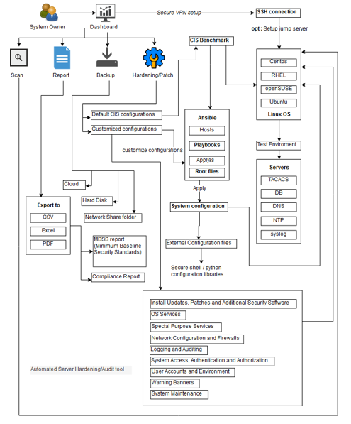

Slide 17
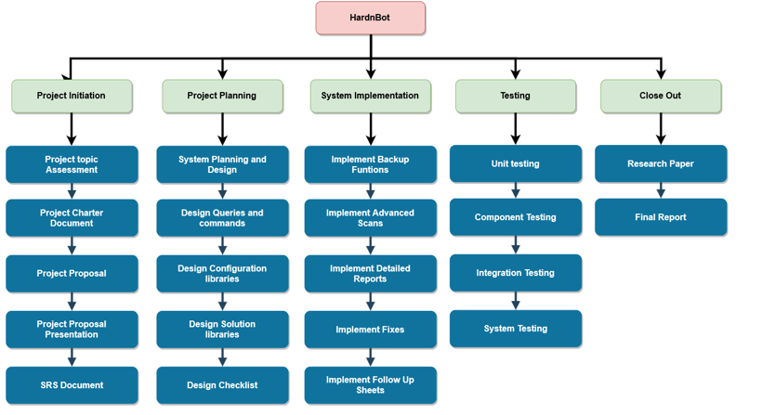
Work Breakdown

Slide 18
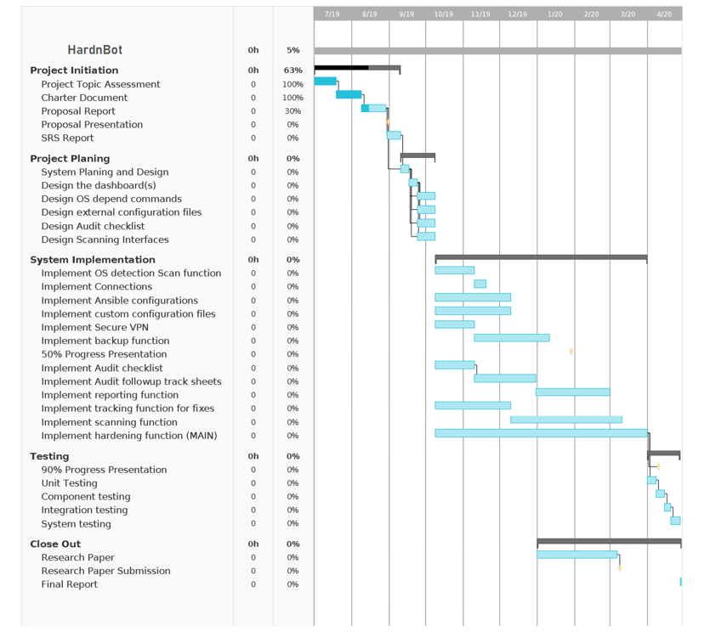
Evaluation Plan

Slide 19
Thank You
Notes:
You can use this slide as your opening or closing slide. Should you choose to use it as a closing, make sure you review the main points of your presentation. One creative way to do that is by adding animations to the various graphics on a slide. This slide has 4 different graphics, and, when you view the slideshow, you will see that you can click to reveal the next graphic. Similarly, as you review the main topics in your presentation, you may want each point to show up when you are addressing that topic.
Add animation to images and graphics:
Select your image or graphic.
Click on the Animations tab.
Choose from the options. The animation for this slide is “Split”. The drop-down menu in the Animation section gives even more animations you can use.
If you have multiple graphics or images, you will see a number appear next to it that notes the order of the animations.
Note: You will want to choose the animations carefully. You do not want to make your audience dizzy from your presentation.

