Slide 1




Introduction and rationale:
Resilience quantification approaches in general
and residual-based methods in particular
Raffael Kalisch
Leibniz Institute for Resilience Research (LIR), Mainz
Neuroimaging Center (NIC), Focus Program Translational Neuroscience (FTN), Johannes Gutenberg University Medical Center Mainz
International Resilience Alliance (intresa.org)

Slide 2





Funding
State of Rhineland-Palatinate

Slide 3
Thanks
Group members:
Kenneth SL Yuen
Benjamin Meyer
Elena Andres
Maximilian Lückel
Papoula Petri-Romão
Matthias Zerban
Lara Puhlmann
Frédérique Maas
Collaborators:
Mainz:
Marianne Müller
Sarah Ayash
Oliver Tüscher
Til Ole Bergmann
Alexandra Sebastian
Bianca Kollmann
Albrecht Stroh
Michèle Wessa
Klaus Lieb
Beat Lutz
Susann Schweiger
Amsterdam:
Marit Sijbrandij
Ilya Veer
Barcelona:
Josep Maria Haro
Mireia Félez Nóbrega
Berlin:
Zala Reppmann
Antje Riepenhausen
Caroline Wackerhagen
Henrik Walter
Esslingen:
Andrea Chmitorz
Frankfurt:
Ximena Salinas-Her-
nández
Sevil Duvarci
Kira Ahrens
Charlotte Schenk
Michael Plichta
Andreas Reif
Christian Fiebach
Rebecca Neumann
Freiburg:
Harald Binder
Göran Köber
Shakoor Pooseh
Jens Timmer
Landau:
Ulrike Basten
Leiden:
Anne-Laura van Harmelen
Leuven:
Inez Myin-Germeys
Jeroen Weermeijer
Mannheim:
Anita Schick
Madrid:
Roberto Mediavilla
Joseluis Ayuso
Nanjing:
Chuan-Peng Hu
New York:
Katharina Schultebraucks
Nijmegen:
Sophie Bögemann
Erno Hermans
Guillén Fernández
Karin Roelofs
Christian Beckmann
Emma Sprooten
Oslo:
Haakon Engen
Riga:
Signe Mezinska
Mara Neikena
Rotterdam:
Marta Marciniak
Neeltje van Haren
Ryan Mützel
Tel Aviv:
Talma Hendler
Netali Mor
Sapir Bar
Warsaw:
Dorota Kobylinska
Julek Mituniewicz
Zurich:
Birgit Kleim
Sebastian Hachenberg
Flurin Cathomas

Slide 4
What is resilience?
“Except for the main idea of facing challenges, it is somewhat difficult to guess that all of those definitions concern the same subject.”
(M. Pecillo, 2016)

Slide 5
A (very) brief history of resilience research
Trait
Hardiness (Kobasa, 1979)
Ego resiliency (Block and Block, 1980)

Slide 6
A (very) brief history of resilience research
Trait
Hardiness (Kobasa, 1979)
Ego resiliency (Block and Block, 1980)
Multiple factors
Various traits, skills, behaviors, beliefs, …
(Masten & Garmezy, 1985; Werner & Smith, 1989)

Slide 7
A (very) brief history of resilience research
Trait
Hardiness (Kobasa, 1979)
Ego resiliency (Block and Block, 1980)
Multiple factors
Various traits, skills, behaviors, beliefs, …
(Masten & Garmezy, 1985; Werner & Smith, 1989)
Processes
Coping efforts, person-environment transactions (“resilience mechanisms“)
(Luthar et al., 2000; a.m.o.)
- Lasting individual change
Outcome
Masten & Garmezy, 1985

Slide 8
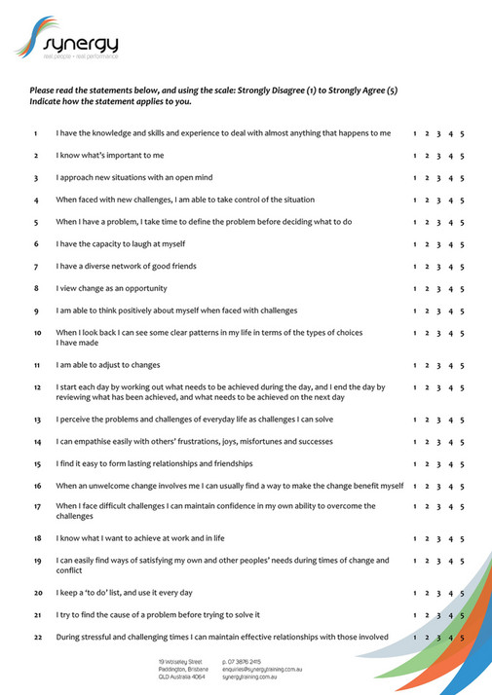
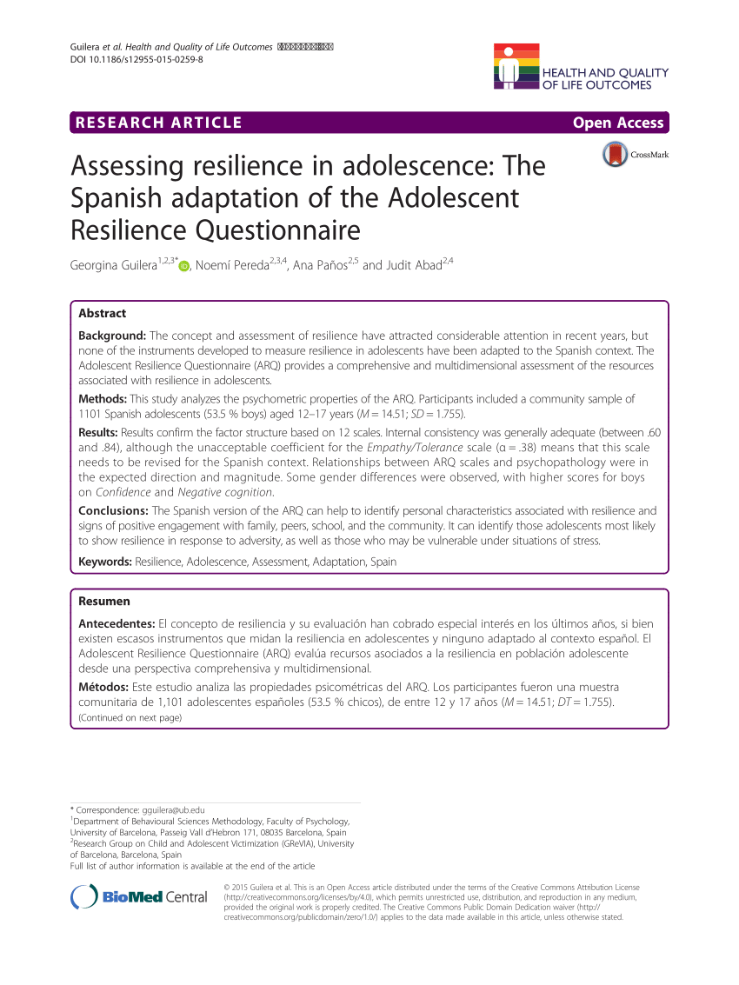
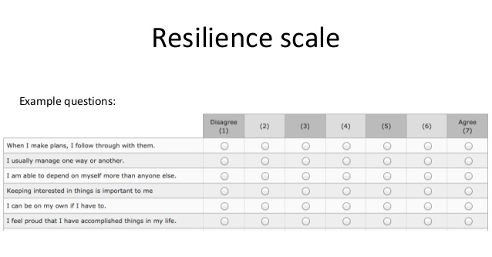
The reality of resilience research
Notes:
All good, isn‘t it?
One new thing: we have to do neurobio now
Second: there is a more profound problem with lists

Slide 9
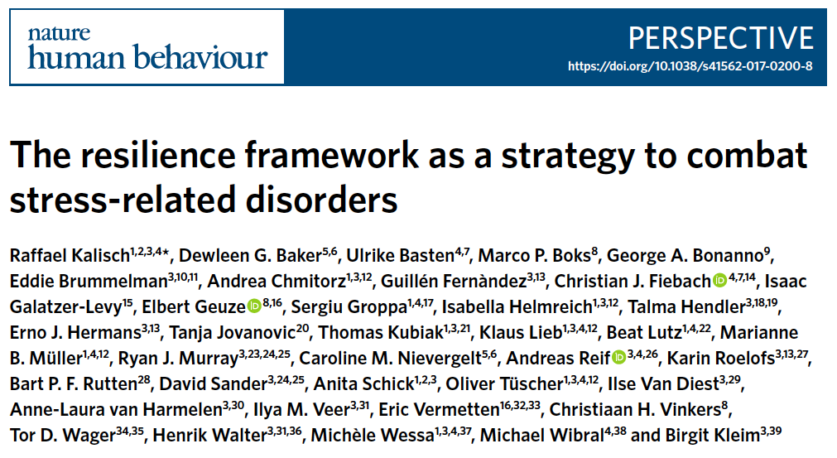
If resilience is not a trait, what then?
Notes:
Purely operational and purely pragmatic
No word about what the processes or resileince mechanisms or baseline predictors are
i.e., atheoretical → does not exclude any theoretical school
Great possibilty:
Now we can focus on the processes that lead to the outcome
And also on possible baseline predictors
Ex: emotion regulation skill as factor, process: use of it, perhaps inspired, training/improvement → not stable

Slide 10
If resilience is not a trait, what then?
Resilience is the maintenance or quick recovery of mental health during and after periods of adversity
(good long-term mental health outcome despite adversity*)
*traumatizing events, challenging life circumstances or transitions, physical illness...
Notes:
Purely operational and purely pragmatic
No word about what the processes or resileince mechanisms or baseline predictors are
i.e., atheoretical → does not exclude any theoretical school
Great possibilty:
Now we can focus on the processes that lead to the outcome
And also on possible baseline predictors
Ex: emotion regulation skill as factor, process: use of it, perhaps inspired, training/improvement → not stable

Slide 11
If resilience is not a trait, what then?
Resilience is the maintenance or quick recovery of mental health during and after periods of adversity
(good long-term mental health outcome despite adversity*)
*traumatizing events, challenging life circumstances or transitions, physical illness...
Resilience is NOT …
… any baseline predictor or biomarkers (“resilience factors“, RFs)
… just the opposite of risk, or vulnerability
Notes:
Purely operational and purely pragmatic
No word about what the processes or resileince mechanisms or baseline predictors are
i.e., atheoretical → does not exclude any theoretical school
Great possibilty:
Now we can focus on the processes that lead to the outcome
And also on possible baseline predictors
Ex: emotion regulation skill as factor, process: use of it, perhaps inspired, training/improvement → not stable

Slide 12
If resilience is not a trait, what then?
Resilience is the maintenance or quick recovery of mental health during and after periods of adversity
(good long-term mental health outcome despite adversity*)
*traumatizing events, challenging life circumstances or transitions, physical illness...
Resilience is NOT …
… any baseline predictor or biomarkers (“resilience factors“, RFs)
… just the opposite of risk, or vulnerability
… any specific process or mechanism leading to the outcome (“resilience processes“, RPs)
Notes:
Purely operational and purely pragmatic
No word about what the processes or resileince mechanisms or baseline predictors are
i.e., atheoretical → does not exclude any theoretical school
Great possibilty:
Now we can focus on the processes that lead to the outcome
And also on possible baseline predictors
Ex: emotion regulation skill as factor, process: use of it, perhaps inspired, training/improvement → not stable

Slide 13
If resilience is not a trait, what then?
Resilience is the maintenance or quick recovery of mental health during and after periods of adversity
(good long-term mental health outcome despite adversity*)
*traumatizing events, challenging life circumstances or transitions, physical illness...
Resilience is NOT …
… any baseline predictor or biomarkers (“resilience factors“, RFs)
… just the opposite of risk, or vulnerability
… any specific process or mechanism leading to the outcome (“resilience processes“, RPs)
BUT:
You can ask which RFs predict the outcome or which RPs lead to the outcome
Notes:
Purely operational and purely pragmatic
No word about what the processes or resileince mechanisms or baseline predictors are
i.e., atheoretical → does not exclude any theoretical school
Great possibilty:
Now we can focus on the processes that lead to the outcome
And also on possible baseline predictors
Ex: emotion regulation skill as factor, process: use of it, perhaps inspired, training/improvement → not stable

Slide 14
If resilience is not a trait, what then?
Resilience is the maintenance or quick recovery of mental health during and after periods of adversity
(good long-term mental health outcome despite adversity*)
*traumatizing events, challenging life circumstances or transitions, physical illness...
→ Outcome-based definition is purely operational and atheoretical
Notes:
Purely operational and purely pragmatic
No word about what the processes or resileince mechanisms or baseline predictors are
i.e., atheoretical → does not exclude any theoretical school
Great possibilty:
Now we can focus on the processes that lead to the outcome
And also on possible baseline predictors
Ex: emotion regulation skill as factor, process: use of it, perhaps inspired, training/improvement → not stable

Slide 15
If resilience is not a trait, what then?
Resilience is the maintenance or quick recovery of mental health during and after periods of adversity
(good long-term mental health outcome despite adversity*)
*traumatizing events, challenging life circumstances or transitions, physical illness...
→ Outcome-based definition is purely operational and atheoretical
→ Requires longitudinal studies
Notes:
Purely operational and purely pragmatic
No word about what the processes or resileince mechanisms or baseline predictors are
i.e., atheoretical → does not exclude any theoretical school
Great possibilty:
Now we can focus on the processes that lead to the outcome
And also on possible baseline predictors
Ex: emotion regulation skill as factor, process: use of it, perhaps inspired, training/improvement → not stable

Slide 16
Resilience: Outcome-based operationalization
T2 outcome:
T1
T2
ΔΣP
R
(problems)
(resilience)
Σ
P
T2
Mental health
problems
Σ
Σ
P
T1
P
T2
R_{T2} = 1 / (ΔΣP / ΣS)
= ΣS / ΔΣP
P
Σ
T2
STRESSORS
Normalization to stressors!
Kalisch et al., Front Psychol 2021
Notes:
Simplified way, simple ideal situation
Hidden:
No cut-off between health and disease: dimensionality/continuous
Open: what type of D (all as in GHQ, or only specific dimension, such as anxiety or impulsivity, or symptom dimension such as PTS symptoms)
Open: what type of stressors (numbering LEs, or also looking at microstressors, daily hassles)
But not open: continuous measure

Slide 17
Resilience – outcome-based operationalization
Problem 1: unpredictability of stressors
Notes:
Simplified way, simple ideal situation
Hidden:
No cut-off between health and disease: dimensionality/continuous
Open: what type of D (all as in GHQ, or only specific dimension, such as anxiety or impulsivity, or symptom dimension such as PTS symptoms)
Open: what type of stressors (numbering LEs, or also looking at microstressors, daily hassles)
But not open: continuous measure

Slide 18
Resilience – outcome-based operationalization
T2 outcome:
T1
T2
ΔΣD
R
(dysfunctions)
(resilience)
Σ
D
T2
Mental health
problems
Σ
Σ
D
T1
D
T2
R_{T2} = 1 / (ΔΣP / ΣS)
= ΣS / ΔΣP
D
Σ
T2
STRESSORS
Normalization to stressors!
Kalisch et al., Front Psychol 2021
Kalisch et al., Nat Ment Health, in press
Notes:
Simplified way, simple ideal situation
Hidden:
No cut-off between health and disease: dimensionality/continuous
Open: what type of D (all as in GHQ, or only specific dimension, such as anxiety or impulsivity, or symptom dimension such as PTS symptoms)
Open: what type of stressors (numbering LEs, or also looking at microstressors, daily hassles)
But not open: continuous measure

Slide 19
Resilience – outcome-based operationalization
Problem 1: unpredictability of stressors
Problem 2: heterogeneity of stressors
Notes:
Simplified way, simple ideal situation
Hidden:
No cut-off between health and disease: dimensionality/continuous
Open: what type of D (all as in GHQ, or only specific dimension, such as anxiety or impulsivity, or symptom dimension such as PTS symptoms)
Open: what type of stressors (numbering LEs, or also looking at microstressors, daily hassles)
But not open: continuous measure

Slide 20
Resilience – outcome-based operationalization
Problem 1: unpredictability of stressors
Problem 2: heterogeneity of stressors
Problem 3: individuality of stressors
Notes:
Simplified way, simple ideal situation
Hidden:
No cut-off between health and disease: dimensionality/continuous
Open: what type of D (all as in GHQ, or only specific dimension, such as anxiety or impulsivity, or symptom dimension such as PTS symptoms)
Open: what type of stressors (numbering LEs, or also looking at microstressors, daily hassles)
But not open: continuous measure

Slide 21
Resilience – outcome-based operationalization
Problem 1: unpredictability of stressors
Problem 2: heterogeneity of stressors
Problem 3: individuality of stressors
Problem 4: subjectivity of stressors
Notes:
Simplified way, simple ideal situation
Hidden:
No cut-off between health and disease: dimensionality/continuous
Open: what type of D (all as in GHQ, or only specific dimension, such as anxiety or impulsivity, or symptom dimension such as PTS symptoms)
Open: what type of stressors (numbering LEs, or also looking at microstressors, daily hassles)
But not open: continuous measure

Slide 22
What is resilience?
“Except for the main idea of facing challenges, it is somewhat difficult to guess that all of those definitions concern the same subject.”
(M. Pecillo, 2016)

Slide 23
What is resilience?
“Except for the main idea of having to quantify challenges, it is somewhat difficult to guess how all of those aspects could be satisfactorily addressed.”
(R. Kalisch, 2023)

Slide 24
Resilience – outcome-based operationalization
Solution 1: take an at-risk population
Kalisch et al., Front Psychol 2021
Notes:
Simplified way, simple ideal situation
Hidden:
No cut-off between health and disease: dimensionality/continuous
Open: what type of D (all as in GHQ, or only specific dimension, such as anxiety or impulsivity, or symptom dimension such as PTS symptoms)
Open: what type of stressors (numbering LEs, or also looking at microstressors, daily hassles)
But not open: continuous measure

Slide 25

Resilience – outcome-based operationalization
Kalisch et al., Front Psychol 2021
Notes:
Extension to several time points

Slide 26
Resilience – outcome-based operationalization
Solution 1: take an at-risk population
Solution 2: frequently monitor stressors and mental health
Kalisch et al., Front Psychol 2021
Notes:
Simplified way, simple ideal situation
Hidden:
No cut-off between health and disease: dimensionality/continuous
Open: what type of D (all as in GHQ, or only specific dimension, such as anxiety or impulsivity, or symptom dimension such as PTS symptoms)
Open: what type of stressors (numbering LEs, or also looking at microstressors, daily hassles)
But not open: continuous measure

Slide 27
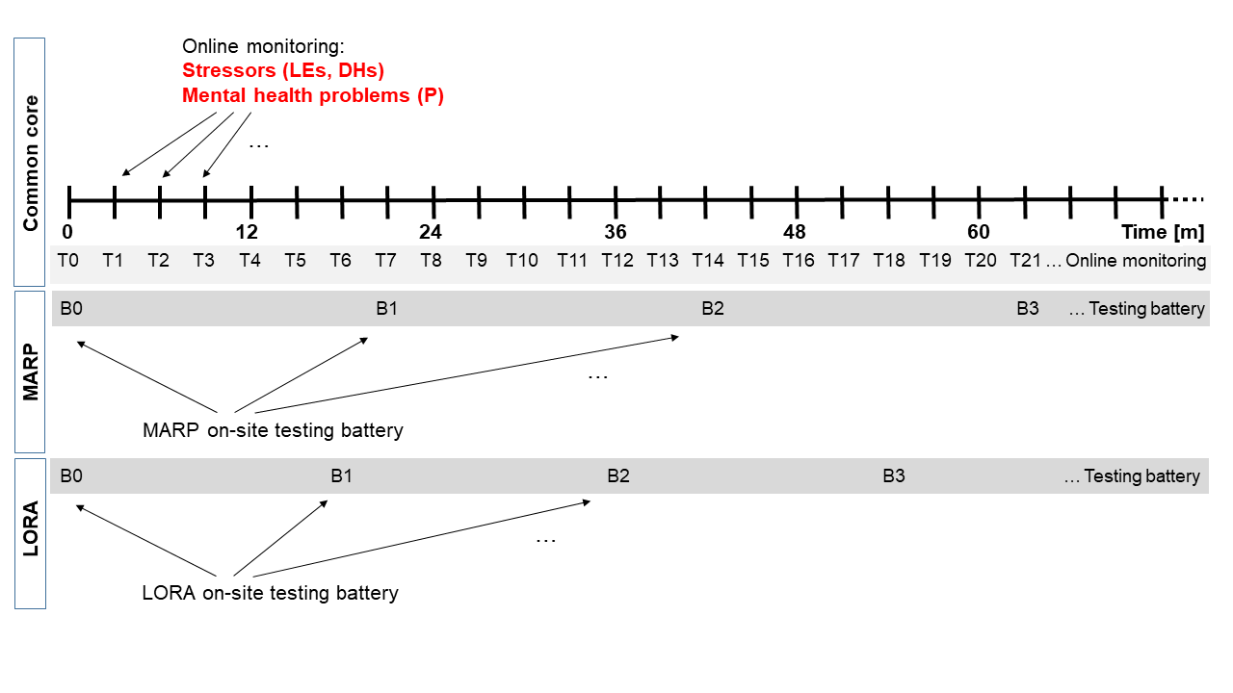
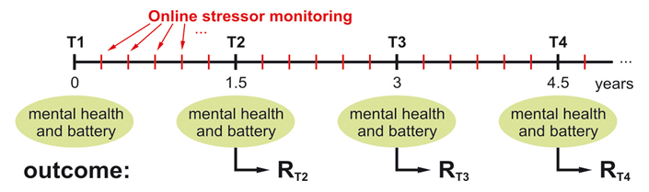
Resilience – outcome-based operationalization
Frequent Stressor and Health Monitoring paradigm (FRESHMO)
(E)
Online stressor & mental health monitoring
Battery
Battery
Battery
Battery
Kalisch et al., Front Psychol 2021
Notes:
Extension to several time points

Slide 28
Resilience – outcome-based operationalization
Frequent Stressor and Health Monitoring paradigm (FRESHMO)
(E)
Online stressor & mental health monitoring
Battery
Battery
Battery
Battery
Stressors (E): Life Events (LE) list
- 27 items
- occurrence in past 3 months?
- how many times?
- severity (appraisal)?
Kalisch et al., Front Psychol 2021
Notes:
Extension to several time points

Slide 29
Resilience – outcome-based operationalization
Frequent Stressor and Health Monitoring paradigm (FRESHMO)
(E)
Online stressor & mental health monitoring
Battery
Battery
Battery
Battery
Stressors (E): Life Events (LE) list
Daily Hassles (DH) list
- 58 items
- occurrence in past week?
- how many days?
- severity (appraisal)?
Kalisch et al., Front Psychol 2021
Notes:
Extension to several time points

Slide 30
Resilience – outcome-based operationalization
Frequent Stressor and Health Monitoring paradigm (FRESHMO)
(E)
Online stressor & mental health monitoring
Battery
Battery
Battery
Battery
Stressors (E): Life Events (LE) list
Daily Hassles (DH) list
Mental health (P): Internalizing symptoms
Kalisch et al., Front Psychol 2021
Notes:
Extension to several time points

Slide 31

Resilience – outcome-based operationalization
Average
T1…T3
Occurrence of stressors:
E_{DH} ~ E_{LE}: R=0.38, p=2e-06
(N=148)
Haakon Engen
Kalisch et al., Front Psychol 2021
Notes:
Extension to several time points

Slide 32
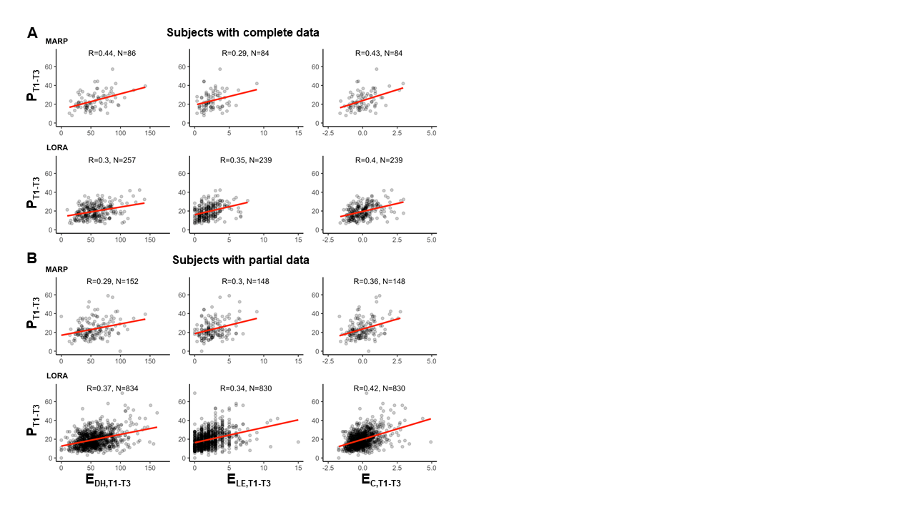
Resilience – outcome-based operationalization
Average
T1…T3
Occurrence of stressors:
E_{DH} ~ E_{LE}: R=0.38, p=2e-06
(N=148)
Haakon Engen
Kalisch et al., Front Psychol 2021
Notes:
Extension to several time points

Slide 33
Resilience – outcome-based operationalization
Solution 1: take an at-risk population
Solution 2: frequently monitor stressors and mental health
Solution 3: express mental health as a function of stressor exposure
Kalisch et al., Front Psychol 2021
Notes:
Simplified way, simple ideal situation
Hidden:
No cut-off between health and disease: dimensionality/continuous
Open: what type of D (all as in GHQ, or only specific dimension, such as anxiety or impulsivity, or symptom dimension such as PTS symptoms)
Open: what type of stressors (numbering LEs, or also looking at microstressors, daily hassles)
But not open: continuous measure

Slide 34
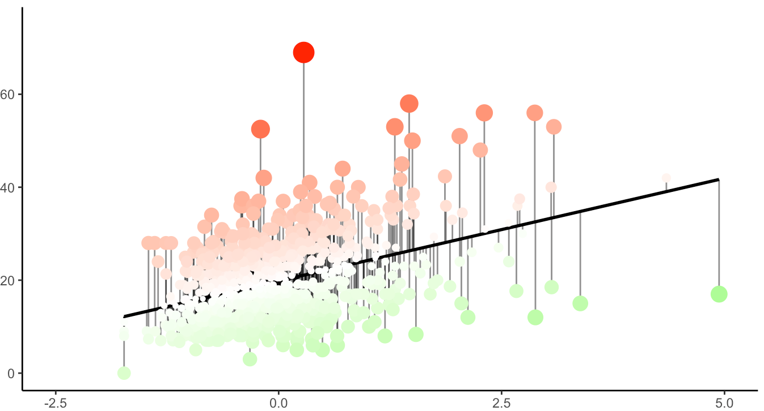
Resilience – outcome-based operationalization
Average
T1…T3
Mental health problems P_{T1-T3}
Haakon Engen
Stressor exposure E_{C,T1-T3}
Kalisch et al., Front Psychol 2021
Notes:
Extension to several time points

Slide 35
Resilience – outcome-based operationalization
Average
T1…T3
1
Mental health problems P_{T1-T3}
2
Haakon Engen
Stressor exposure E_{C,T1-T3}
Kalisch et al., Front Psychol 2021
Notes:
Extension to several time points

Slide 36
Resilience – outcome-based operationalization
Average
T1…T3
1
Mental health problems P_{T1-T3}
3
2
4
Haakon Engen
Stressor exposure E_{C,T1-T3}
Kalisch et al., Front Psychol 2021
Notes:
Extension to several time points

Slide 37
Resilience – outcome-based operationalization
Average
T1…T3
1
Mental health problems P_{T1-T3}
3
5
→ Stressor reactivity (SR) score
2
4
Haakon Engen
Stressor exposure E_{C,T1-T3}
Kalisch et al., Front Psychol 2021
Notes:
Extension to several time points

Slide 38


Identifying resilience factors
Long-term SR
Online stressor & mental health monitoring
Battery
Battery
Battery
Battery
N=132
EV=22%
N=1034
EV=13%
Battery
Variable PAS(B0)
Papoula Petri-Romão
Petri-Romão et al., Nat Commun 2025

Slide 39
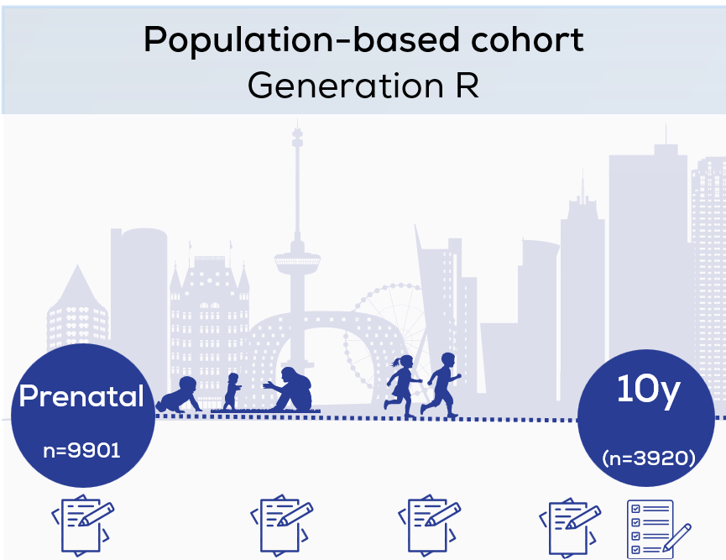
Identifying resilience factors
Koc et al., in revis.

Slide 40

Identifying resilience factors
Association with SR:
self-esteem: r = -0.31, p < .001
prosocial behavior: r = -0.27, p < .001
friendship quality: r = -0.13, p < .001
Dogukan Koc
Koc et al., in revis.

Slide 41
Identifying resilience factors
Association with SR:
self-esteem: r = -0.31, p < .001
prosocial behavior: r = -0.27, p < .001
friendship quality: r = -0.13, p < .001
IQ: r = -0.04, p = .242
Dogukan Koc
Koc et al., in revis.

Slide 42
Identifying resilience factors
Association with SR:
self-esteem: r = -0.31, p < .001
prosocial behavior: r = -0.27, p < .001
friendship quality: r = -0.13, p < .001
IQ: r = -0.04, p = .242
ALTHOUGH:
IQ ~ P: r = -0.11, p < .001
Dogukan Koc
Koc et al., in revis.

Slide 43
Identifying resilience factors
Association with SR:
self-esteem: r = -0.31, p < .001
prosocial behavior: r = -0.27, p < .001
friendship quality: r = -0.13, p < .001
IQ: r = -0.04, p = .242
ALTHOUGH:
IQ ~ P: r = -0.11, p < .001
BUT:
IQ ~ E: r = -0.25, p < .001
Dogukan Koc
Koc et al., in revis.

Slide 44
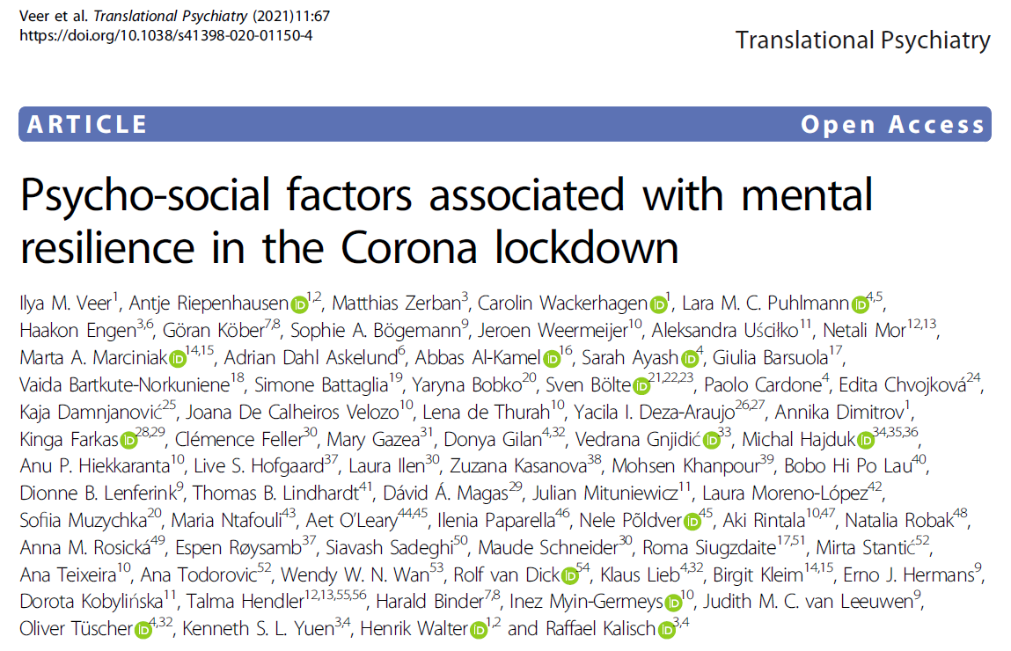
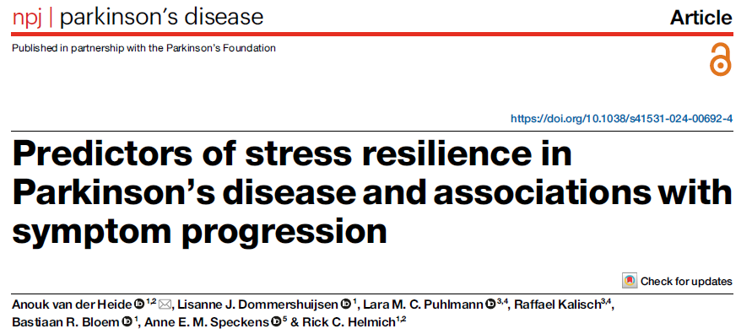
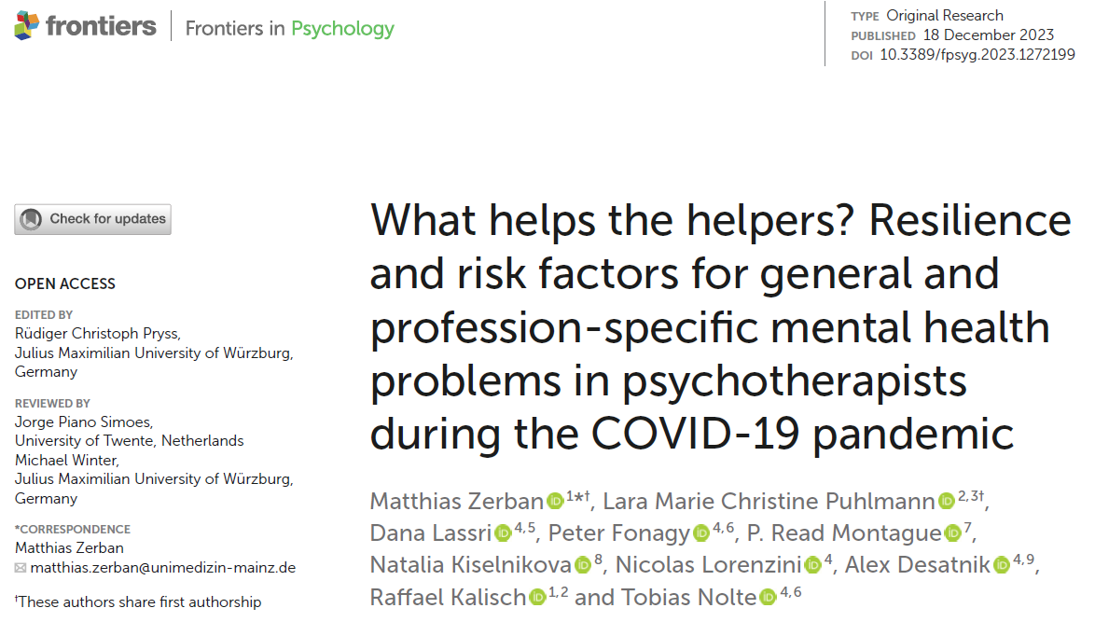
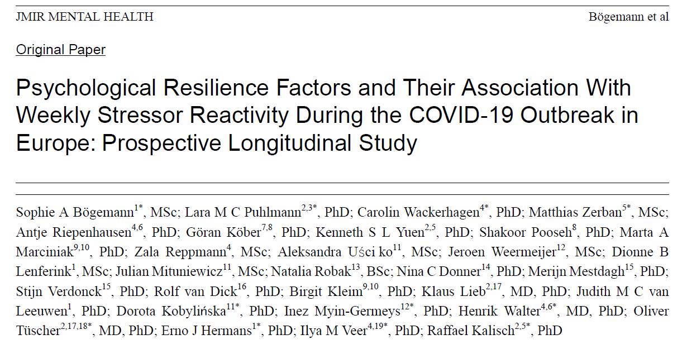
Identifying resilience factors
Association:
PAS → -SR
N=350
N=15970
N=569
N=558

Slide 45
A (very) brief history of resilience research
Trait
Hardiness (Kobasa, 1979)
Ego resiliency (Block and Block, 1980)
Multiple factors
Various traits, skills, behaviors, beliefs, …
(Masten & Garmezy, 1985; Werner & Smith, 1989)
PAS
Processes
Coping efforts, person-environment transactions (“resilience mechanisms“)
(Luthar et al., 2000; a.m.o.)
- Lasting individual change
PAS?
Outcome
Masten & Garmezy, 1985

Slide 46

Identifying resilience processes: lasting individual change
Battery
Variable PAS(B0)
Battery
Variable PAS(B1)
Battery
Variable PAS(B2)
…
SR_{B1-B2} ~ RF_{B1} + RF_{B0} + SR_{B0-B1} + Covariates
Lara
Puhlmann
→ PAS (LORA): β= -0.100, p=.008, R² = .0055
Puhlmann et al., in prep.

Slide 47

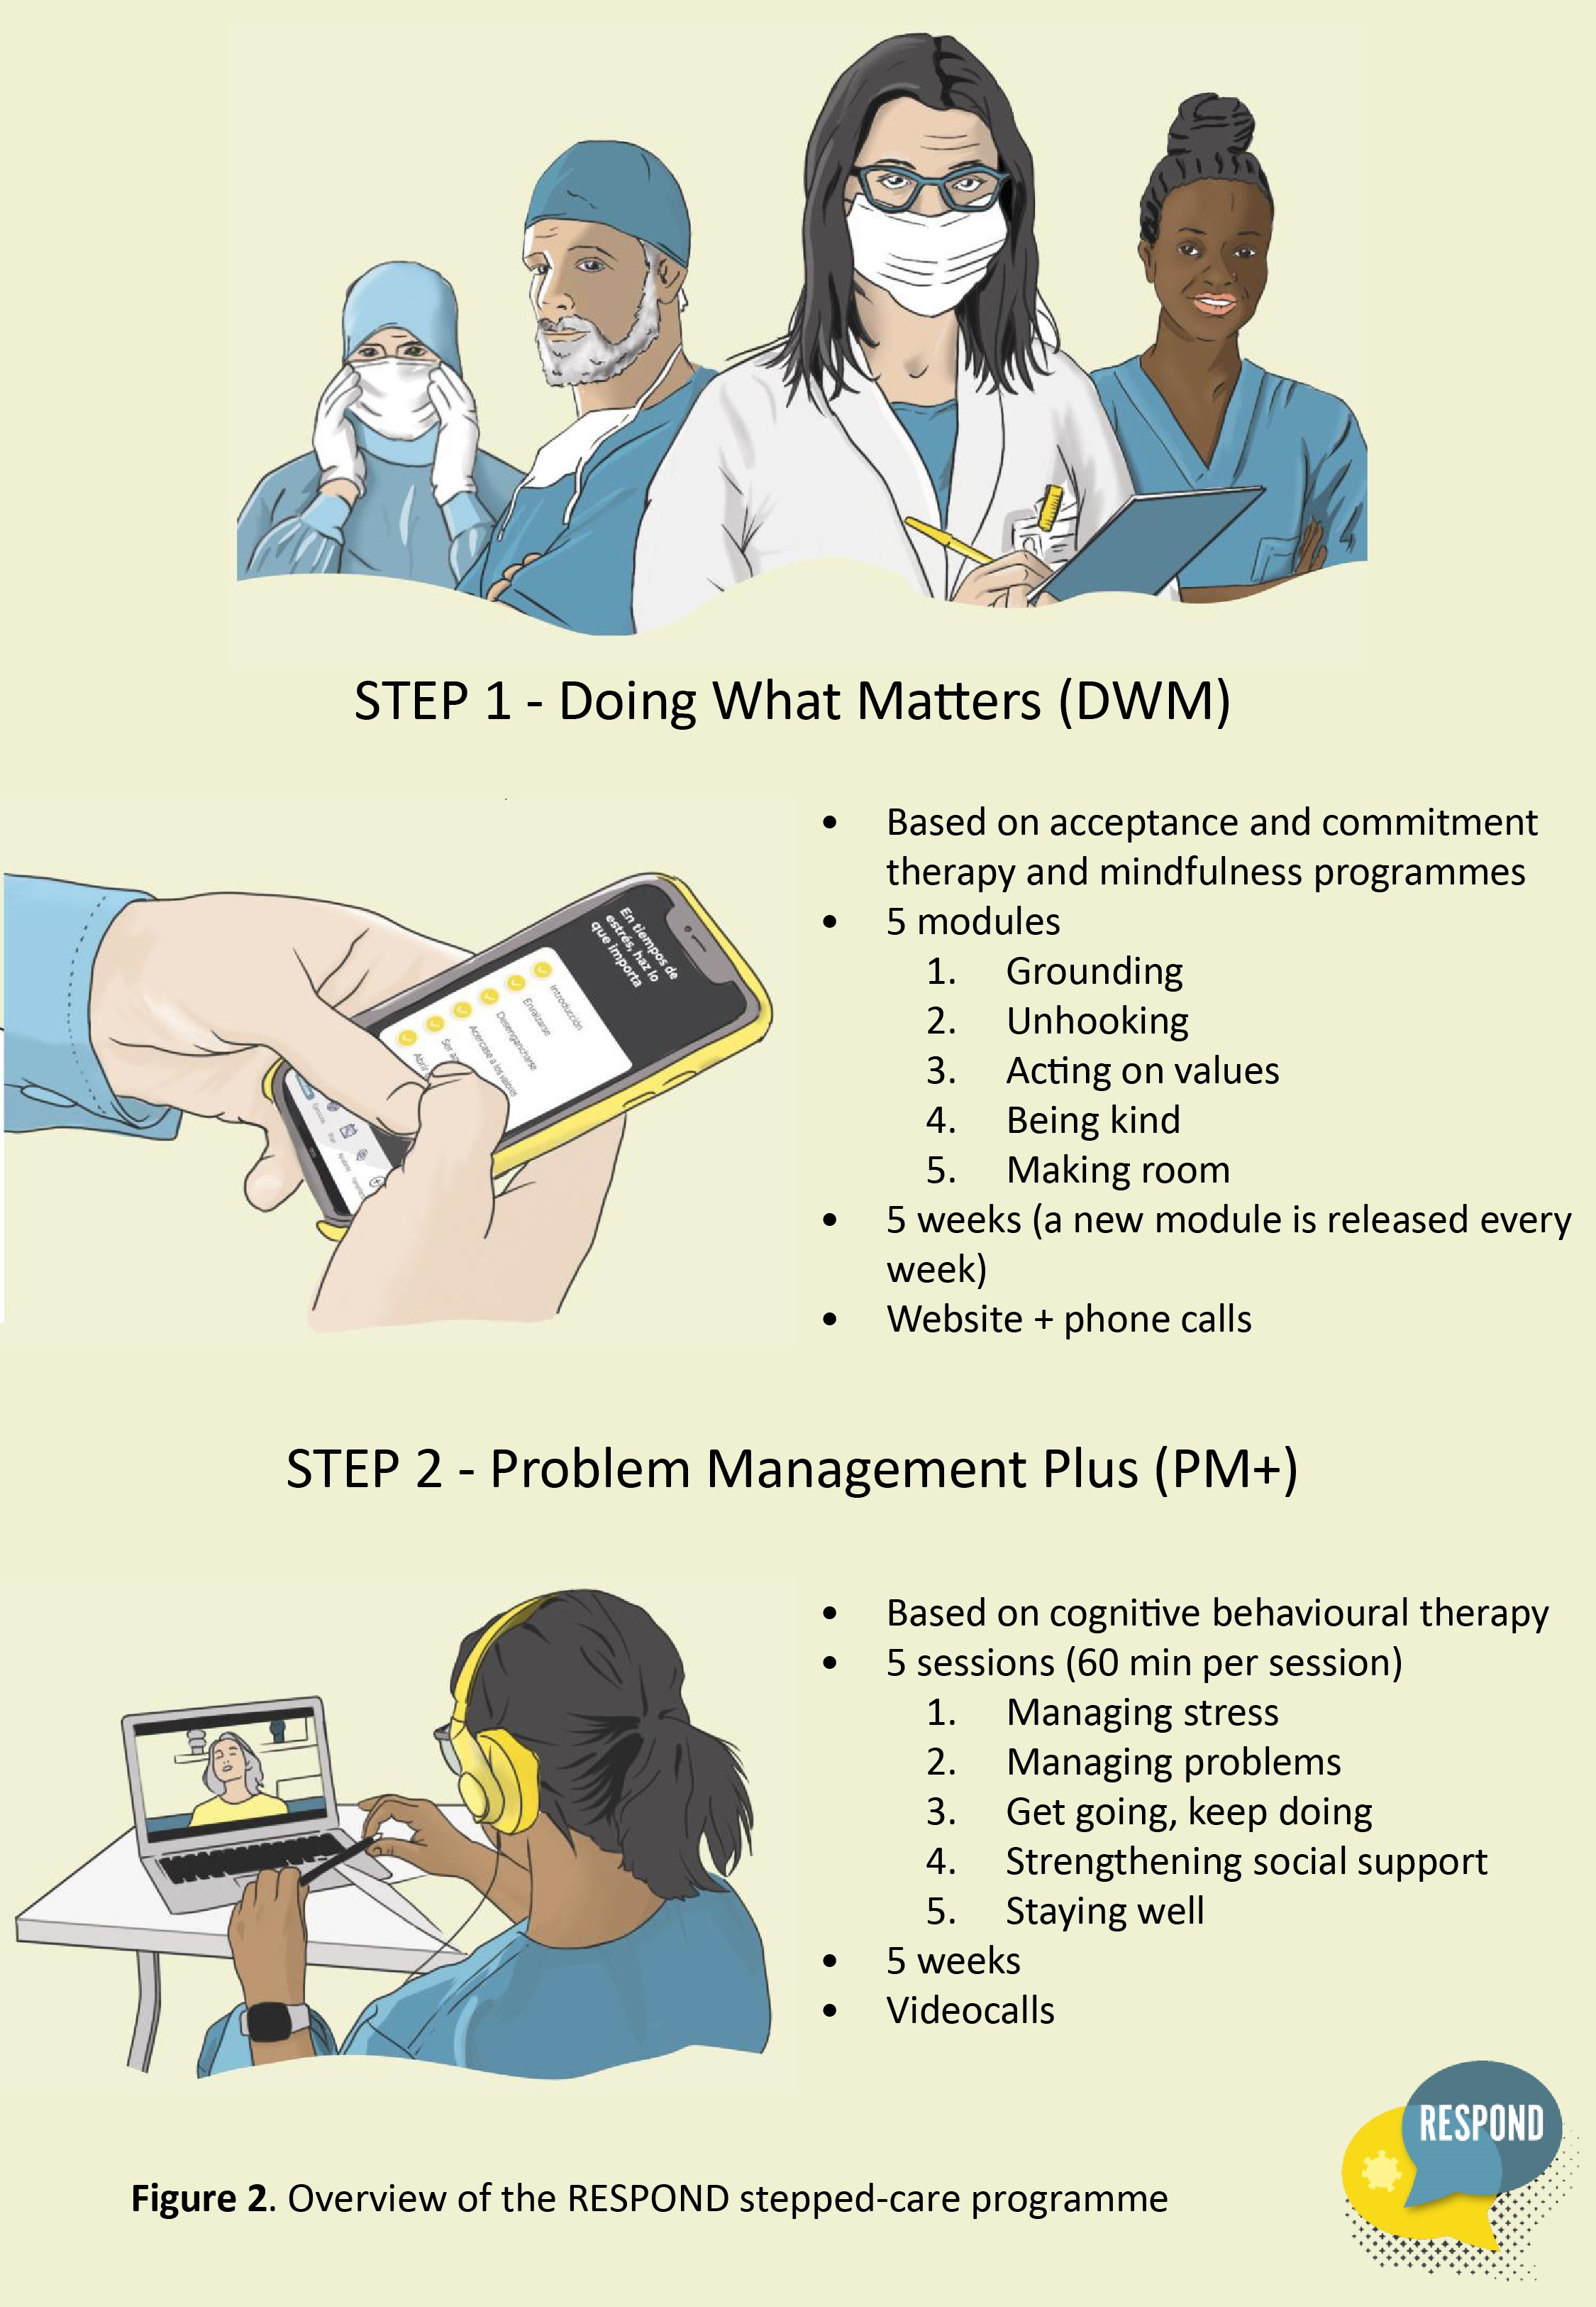
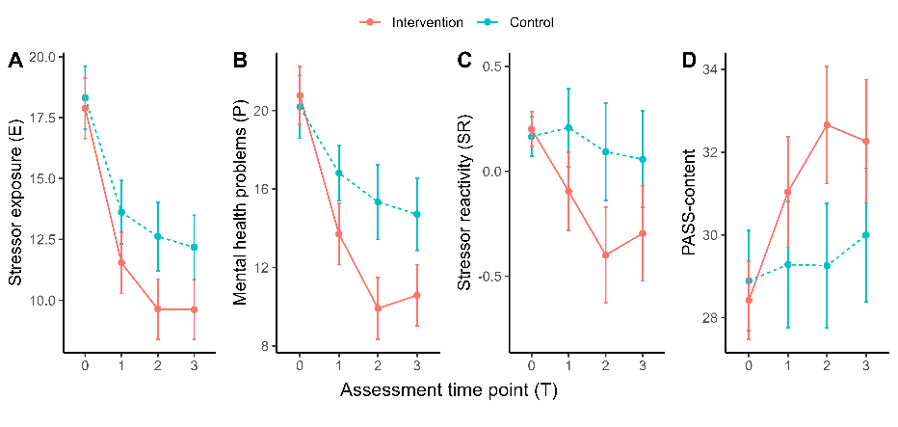
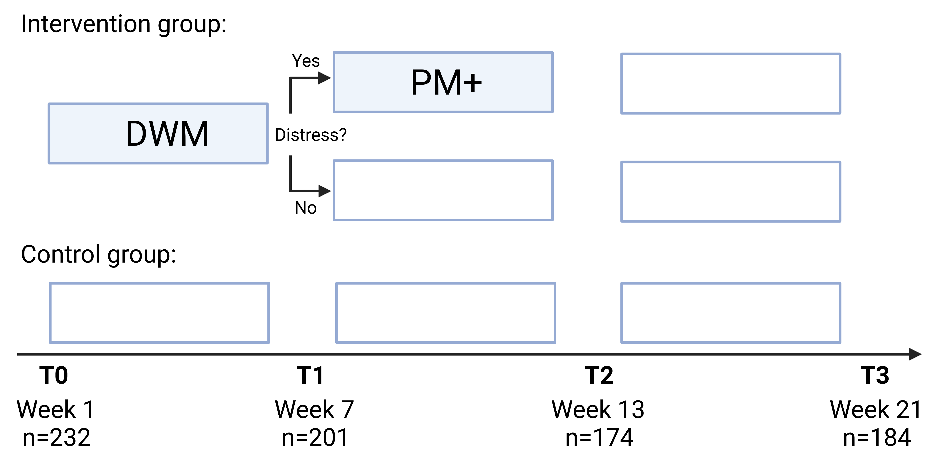
Identifying resilience processes: lasting individual change
WHO Stress management training
(stepped care, peer support, digitalized)
Intervention → PAS (T2) → -SR (T3): 47%
Reproduced in 3 more RCTs
Spanish health care workers
during COVID
Petri-Romão et al., Nat Commun 2025
Petri-Romão et al., in prep.

Slide 48
A (very) brief history of resilience research
Trait
Hardiness (Kobasa, 1979)
Ego resiliency (Block and Block, 1980)
Multiple factors
Various traits, skills, behaviors, beliefs, …
(Masten & Garmezy, 1985; Werner & Smith, 1989)
PAS
Processes
Coping efforts, person-environment transactions (“resilience mechanisms“)
(Luthar et al., 2000; a.m.o.)
- Lasting individual change
?
PAS
Outcome
Masten & Garmezy, 1985

Slide 49

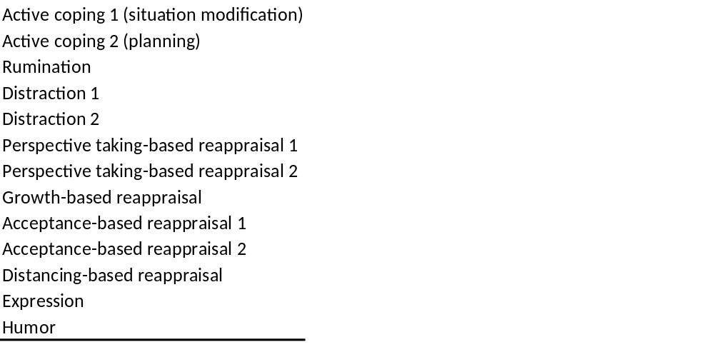
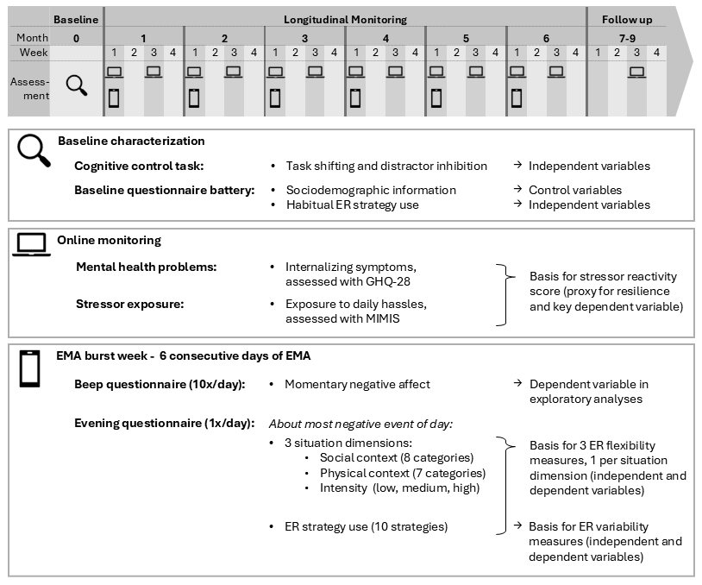

Identifying resilience processes: resilience mechanisms
DynaMORE Observational Study (DynaM-OBS)
N=239 young Western adults
Average use ~ -SR:
β = -.12, t[218] = -2.31, p = .022
MatthiasZerban
Zerban et al., in revis.

Slide 50
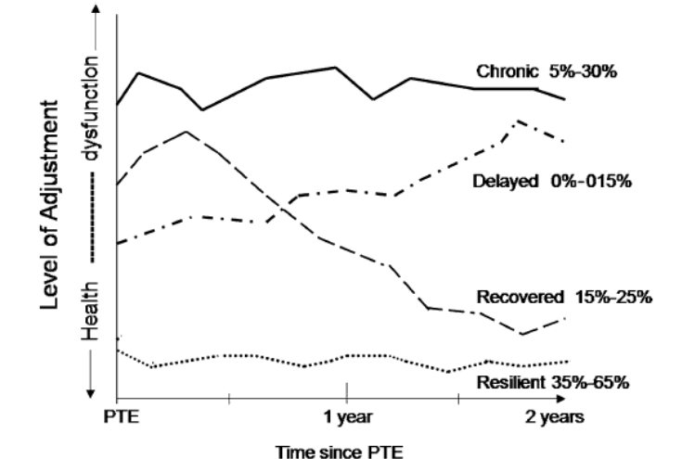
Resilience to trauma and major life events
Bonanno et al., Annu Rev Clin Psychol 2011
Notes:
Extension to several time points

Slide 51
Resilience to trauma and major life events
Bonanno et al., Annu Rev Clin Psychol 2011
Low symptoms because less adversity?
Notes:
Extension to several time points

Slide 52
Resilience to trauma and major life events
Bonanno et al., Annu Rev Clin Psychol 2011
Low symptoms because less adversity?
Major LEs often preceded & succeeded by other adversities (e.g., Norris and Uhl, 1993)
High SES predicts low symptoms (McGiffin et al., 2019)
Fewer unrelated stressors pre- & post-event predict low symptoms (Feder et al., 2016; Johannesson et al., 2015; Tao et al., 2023)
Correcting for “background“ stressors abolishes gender effects on resilience (Lowe et al., 2021)
Kalisch et al., Nat Ment Health, 2026
Notes:
Extension to several time points

Slide 53
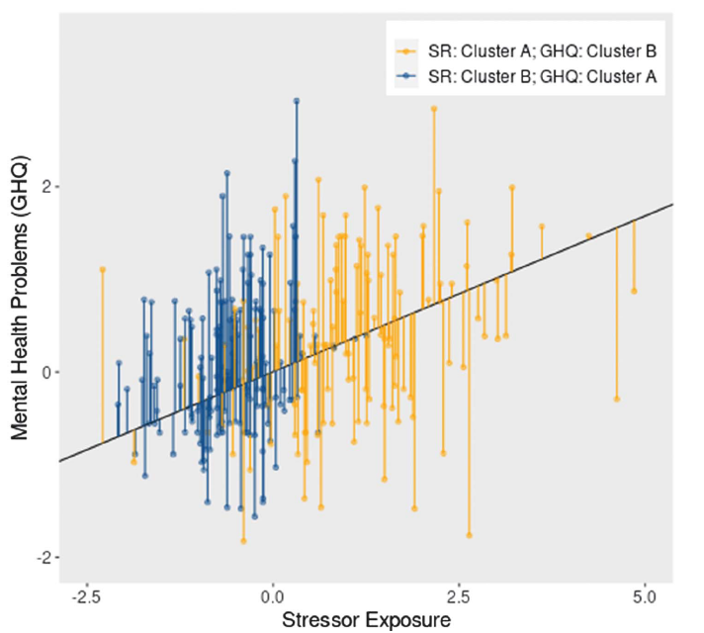
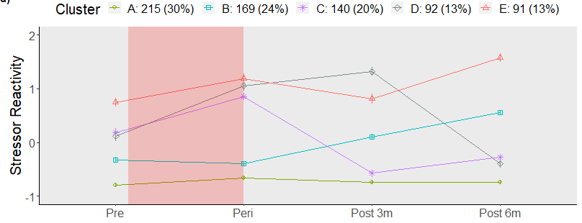
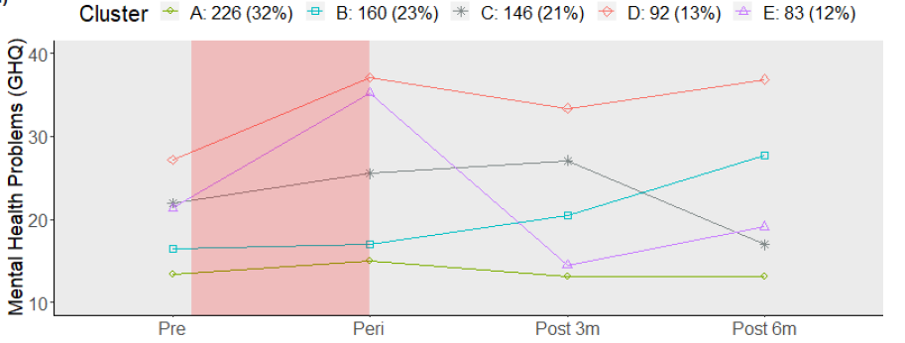

Resilience to trauma and major life events
Kira Ahrens
Ahrens et al., Am Psychol 2024
Notes:
Extension to several time points

Slide 54
Resilience to trauma and major life events
Kira Ahrens
Ahrens et al., Am Psychol 2024
Notes:
Extension to several time points

Slide 55
Resilience – outcome-based operationalization
Problem 1: unpredictability of stressors
Problem 2: heterogeneity of stressors
Problem 3: individuality of stressors
Problem 4: subjectivity of stressors
Notes:
Simplified way, simple ideal situation
Hidden:
No cut-off between health and disease: dimensionality/continuous
Open: what type of D (all as in GHQ, or only specific dimension, such as anxiety or impulsivity, or symptom dimension such as PTS symptoms)
Open: what type of stressors (numbering LEs, or also looking at microstressors, daily hassles)
But not open: continuous measure

Slide 56
Resilience – outcome-based operationalization
Solution 1: take an at-risk population
Solution 2: frequently monitor stressors and mental health
Solution 3: express mental health as a function of stressor exposure
Notes:
Simplified way, simple ideal situation
Hidden:
No cut-off between health and disease: dimensionality/continuous
Open: what type of D (all as in GHQ, or only specific dimension, such as anxiety or impulsivity, or symptom dimension such as PTS symptoms)
Open: what type of stressors (numbering LEs, or also looking at microstressors, daily hassles)
But not open: continuous measure

Slide 57
Resilience – outcome-based operationalization
Possibility 1: identify resilience factors
Possibility 2: identify resilience processes (short- and long-term)
Possibility 3: quantify intervention effects
Possibility 4: quantify resilience to trauma or life events
Always and as extensively as possible …
monitor the stressors!!!
Kalisch et al., Front Psychol 2021
Kalisch et al., Nat Ment Health, 2026
Notes:
Simplified way, simple ideal situation
Hidden:
No cut-off between health and disease: dimensionality/continuous
Open: what type of D (all as in GHQ, or only specific dimension, such as anxiety or impulsivity, or symptom dimension such as PTS symptoms)
Open: what type of stressors (numbering LEs, or also looking at microstressors, daily hassles)
But not open: continuous measure

Slide 58
Resilience – outcome-based operationalization
Studies using a residual-based operationalization of outcome resilience
Non-exhaustive list
Notebaert et al., 2026; doi: 10.1016/j.brat.2026.105150
Riske et al., 2026; doi: 10.1007/s00702-026-03218-9
Petri-Romão et al., 2025; doi: 10.1038/s41467-025-65147-7
Ruf et al., 2025; doi: 10.1037/amp0001423
Ahrens et al., 2024; doi:10.1037/amp0001315.
van der Heide et al., 2024; doi: 10(1):81. doi: 10.1038/s41531-024-00692-4
Cornwell et al., 2024; doi: 0.1093/scan/nsae006
Zerban et al., 2023; doi: 10.3389/fpsyg.2023.1272199
Bögemann et al., 2023; doi: 10:e46518. doi: 10.2196/46518
González-García et al., 2023; doi: 10.1017/S0954579423000901
Cahill et al., 2023; doi: 10.1017/S0954579423001165
Cornwell et al., 2022; doi: 10.1017/S0954579423000718
Cahill et al., 2022; doi: 10.1186/s13034-022-00449-y
Neumann et al., 2022; doi: 10.1007/s00406-021-01338-9
Veer et al., 2021; doi: 10.1038/s41398-020-01150-4
Van Harmelen et al., 2021; doi: 0.1007/s42844-020-00027-1
Sawyers et al., 2020; doi: 10.1002/da.23005
Van Harmelen et al., 2017; doi: 10.1017/S0033291717000836
Amstadter et al., 2016; doi: 10.1007/s00127-015-1163-6
Amstadter et al., 2014; doi: 10.1192/bjp.bp.113.130906
Sapouna and Wolke, 2013; doi: 0.1016/j.chiabu.2013.05.009
Miller-Lewis et al., 2013; doi: 10.1186/1753-2000-7-6
Bowes et al., 2010; doi: 10.1111/j.1469-7610.2010.02216.x
Boardman et al., 2008; doi: 10.1375/twin.11.1.12
Kim-Cohen et al., 2004; doi: 10.1111/j.1467-8624.2004.00699.x
Alternative terms (inverse residual):
‘resilient functioning‘
(van Harmelen et al., Psychol Med 2017)
‘discrepancy-based psychiatric resilience‘
(Sawyers et al., Depr Anx 2020)

